Slide 1
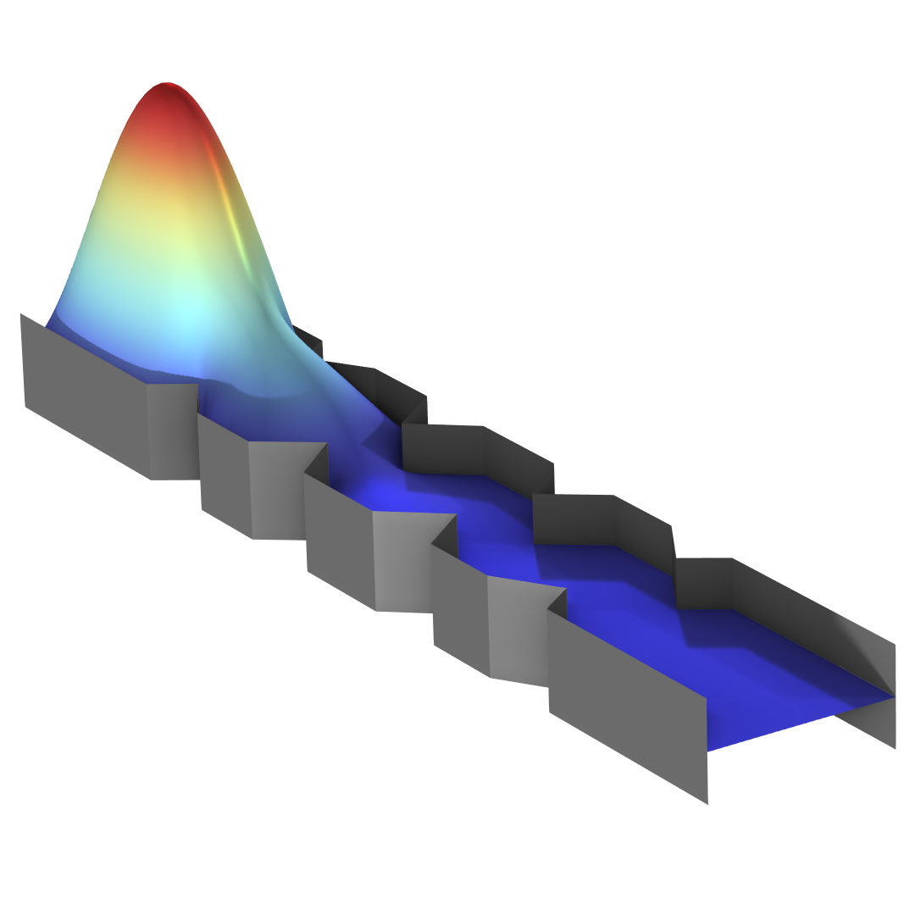
Optimization of a Waveguide Iris Bandpass Filter

Slide 2
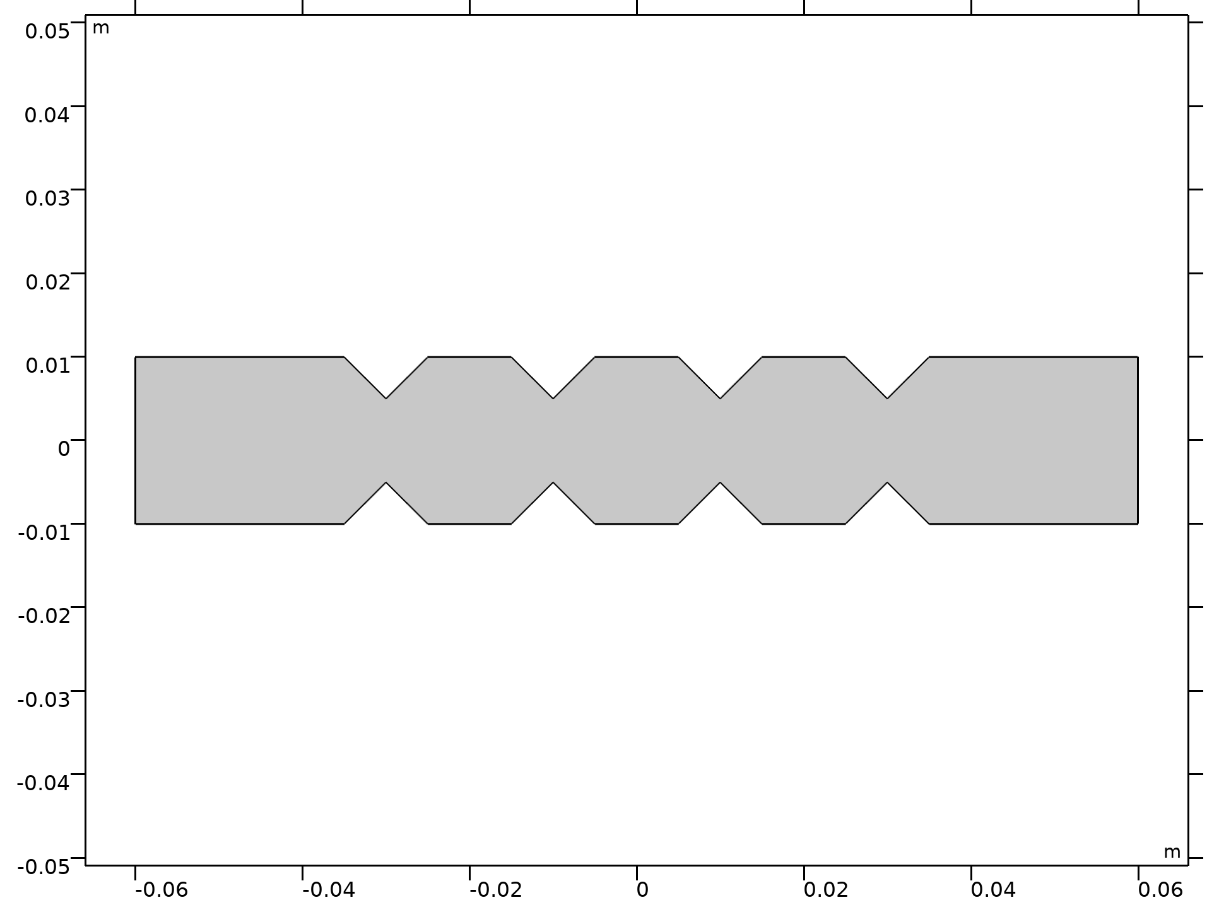
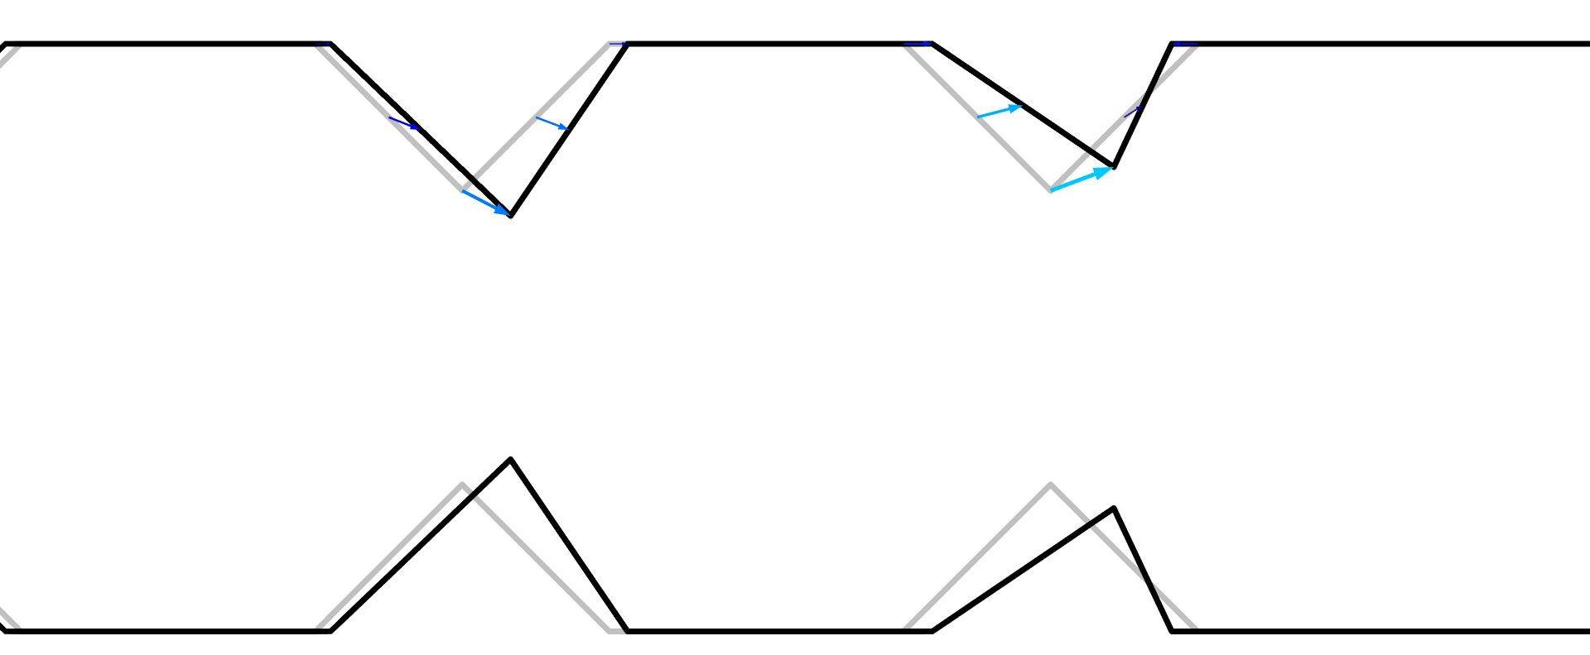
Optimization of a Waveguide Iris Bandpass Filter
Introduction
This model uses the Polynomial Boundary feature to design a Bandpass filter.
The pass band is approximated with 5 frequencies, while a single frequencies is used to ensure out-of-band rejection on either side.
A general Extrusion Operator is used to preserve two symmetry planes.
Optimization
The objective function is to maximize the bandpass response as well as the out-of-band rejection.
This achieved using a MinMax formulation.
Verification
The optimized design is transferred to a 3D component for verification.
Optimization of a Waveguide Iris Bandpass Filter — Polynomial Version

Slide 3
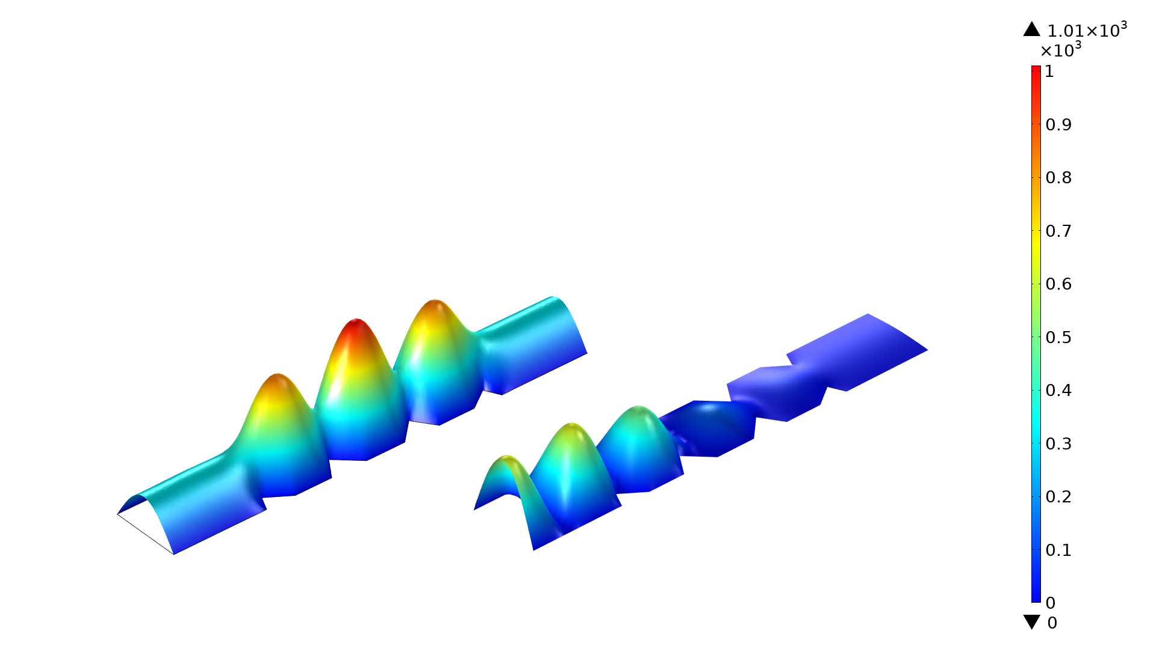
Optimization of a Waveguide Iris Bandpass Filter

Slide 4
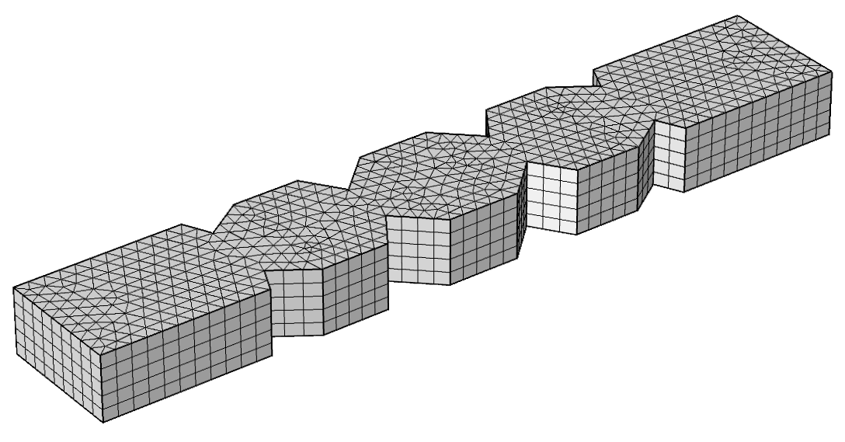
Optimization of a Waveguide Iris Bandpass Filter
Optimization of a Waveguide Iris Bandpass Filter — Polynomial Version

Slide 5
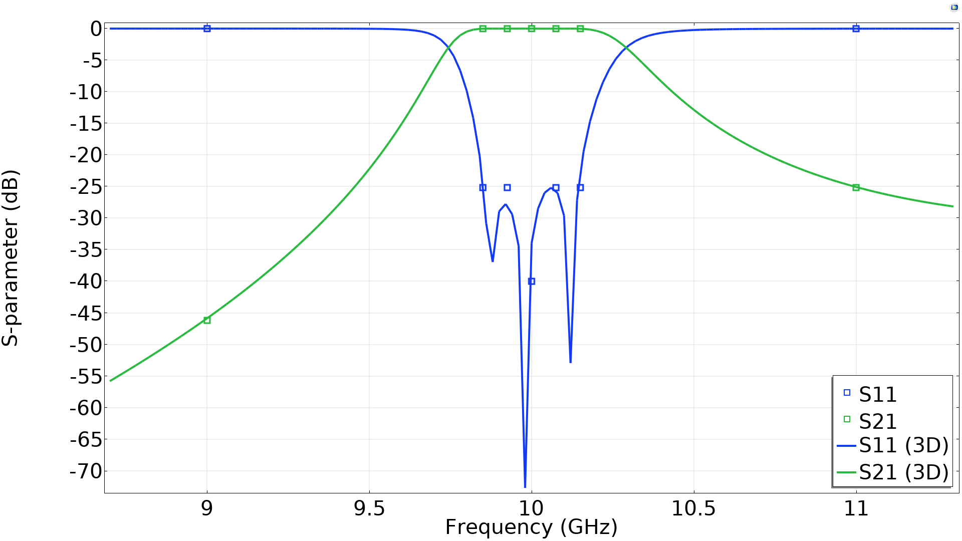
Optimization of a Waveguide Iris Bandpass Filter
Optimization of a Waveguide Iris Bandpass Filter — Polynomial Version

