Slide 1
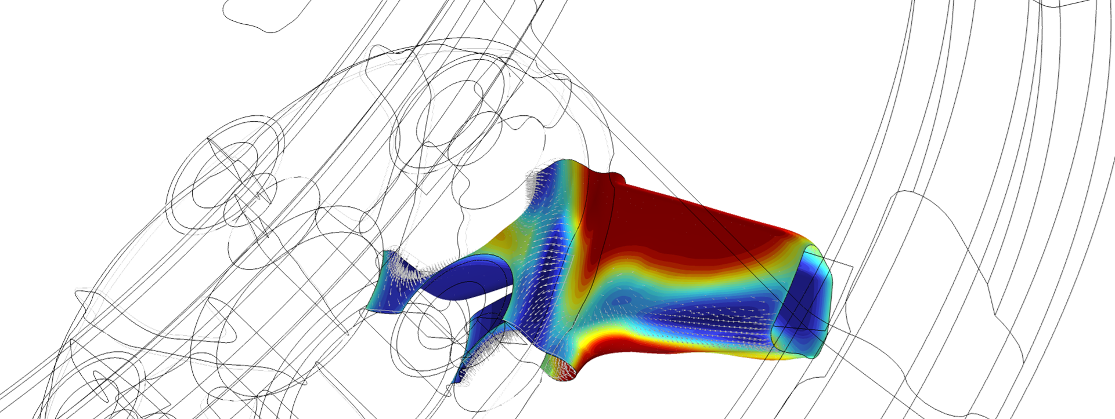
Wheel Rim — Stress Optimization with Fatigue Evaluation

Slide 2
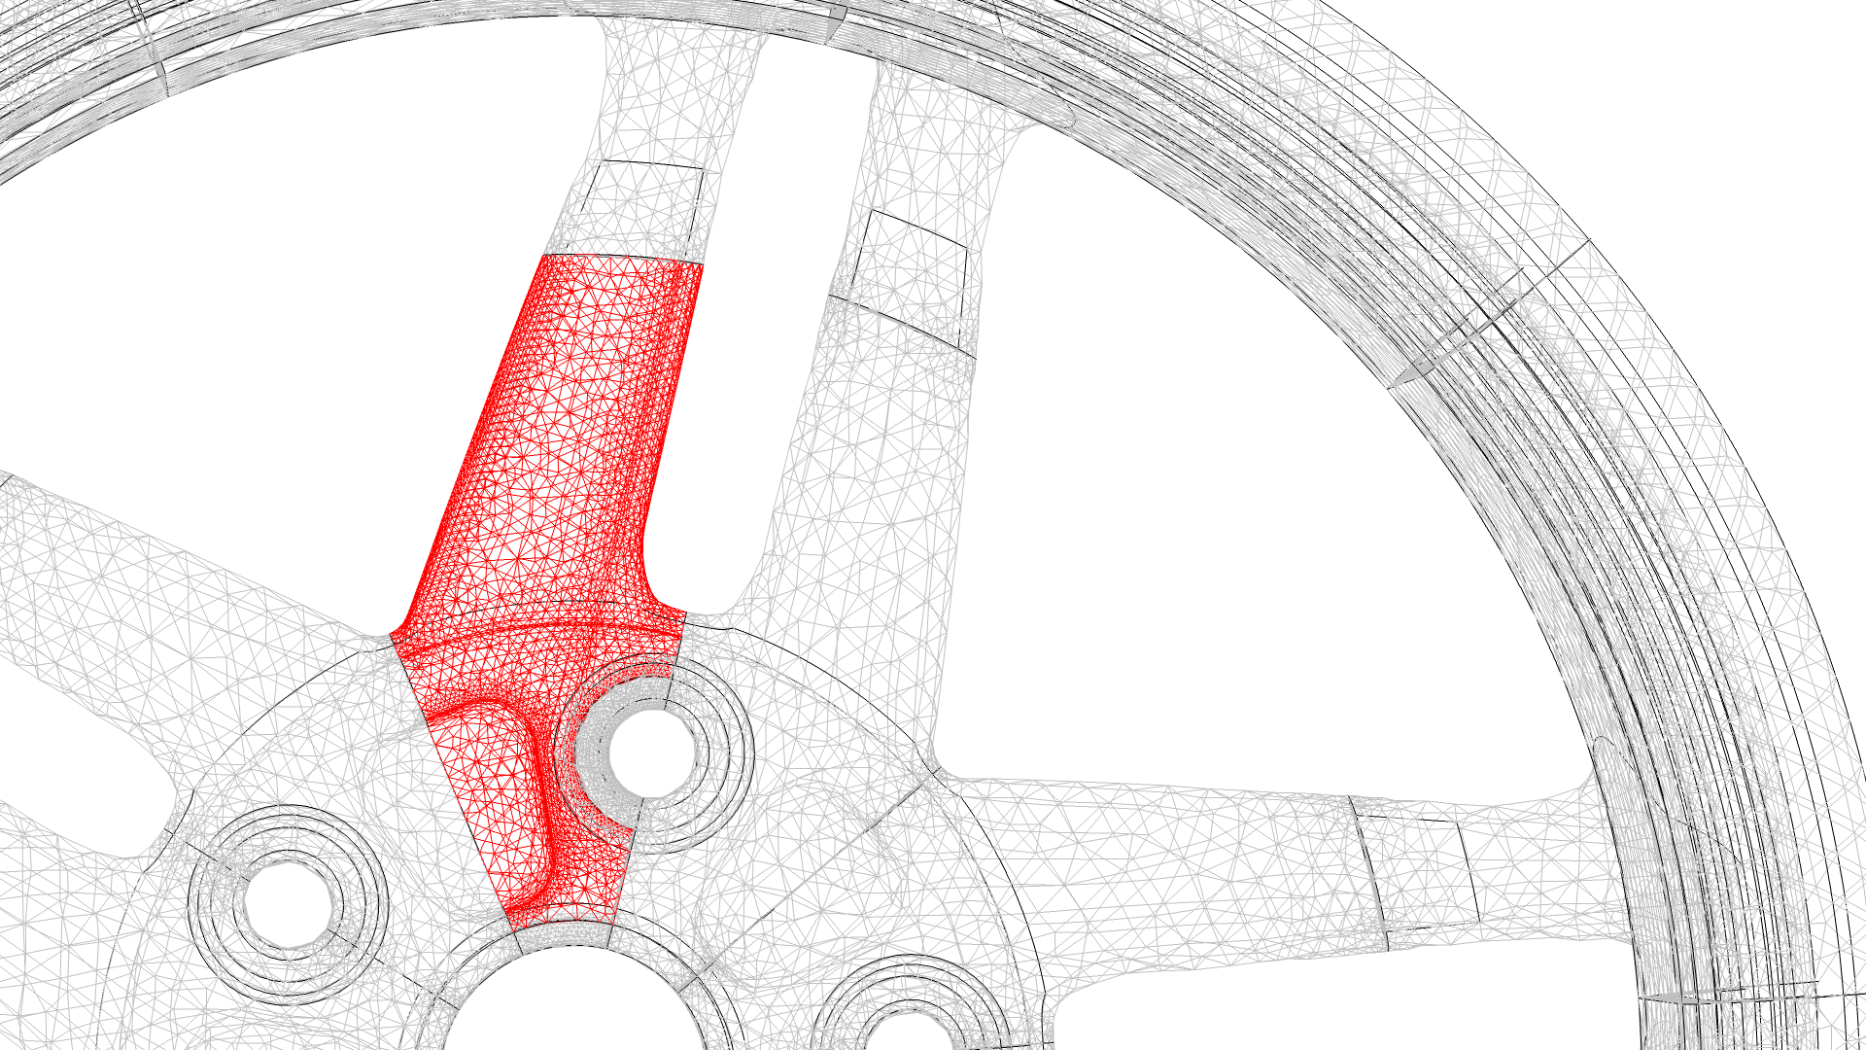
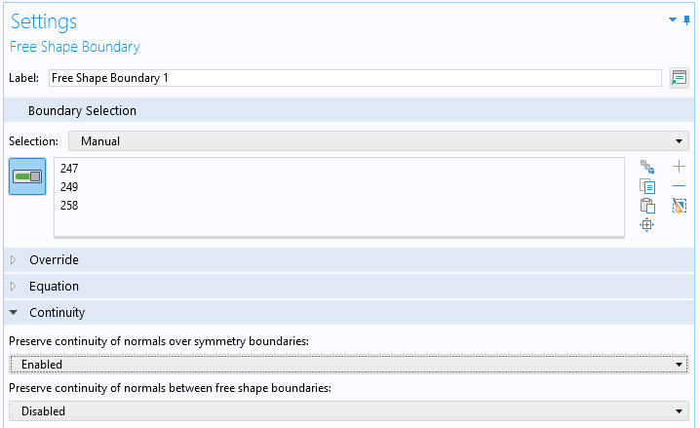
Shape Optimization
Controls
Model full wheel, but use coarse mesh for all but one spoke
Copy mesh deformation to other spokes using Sector Symmetry feature
Continuation over symmetry boundaries prevents kinks
The entire wheel is modeled, because the shape optimization can change the local stiffness characteristics. This prevents the use of a sub-modeling approach, but computational time can still be saved by only evaluating the stress on one spoke, so that a coarse mesh can be used for the other spokes
Wheel Rim — Stress Optimization with Fatigue Evaluation

Slide 3
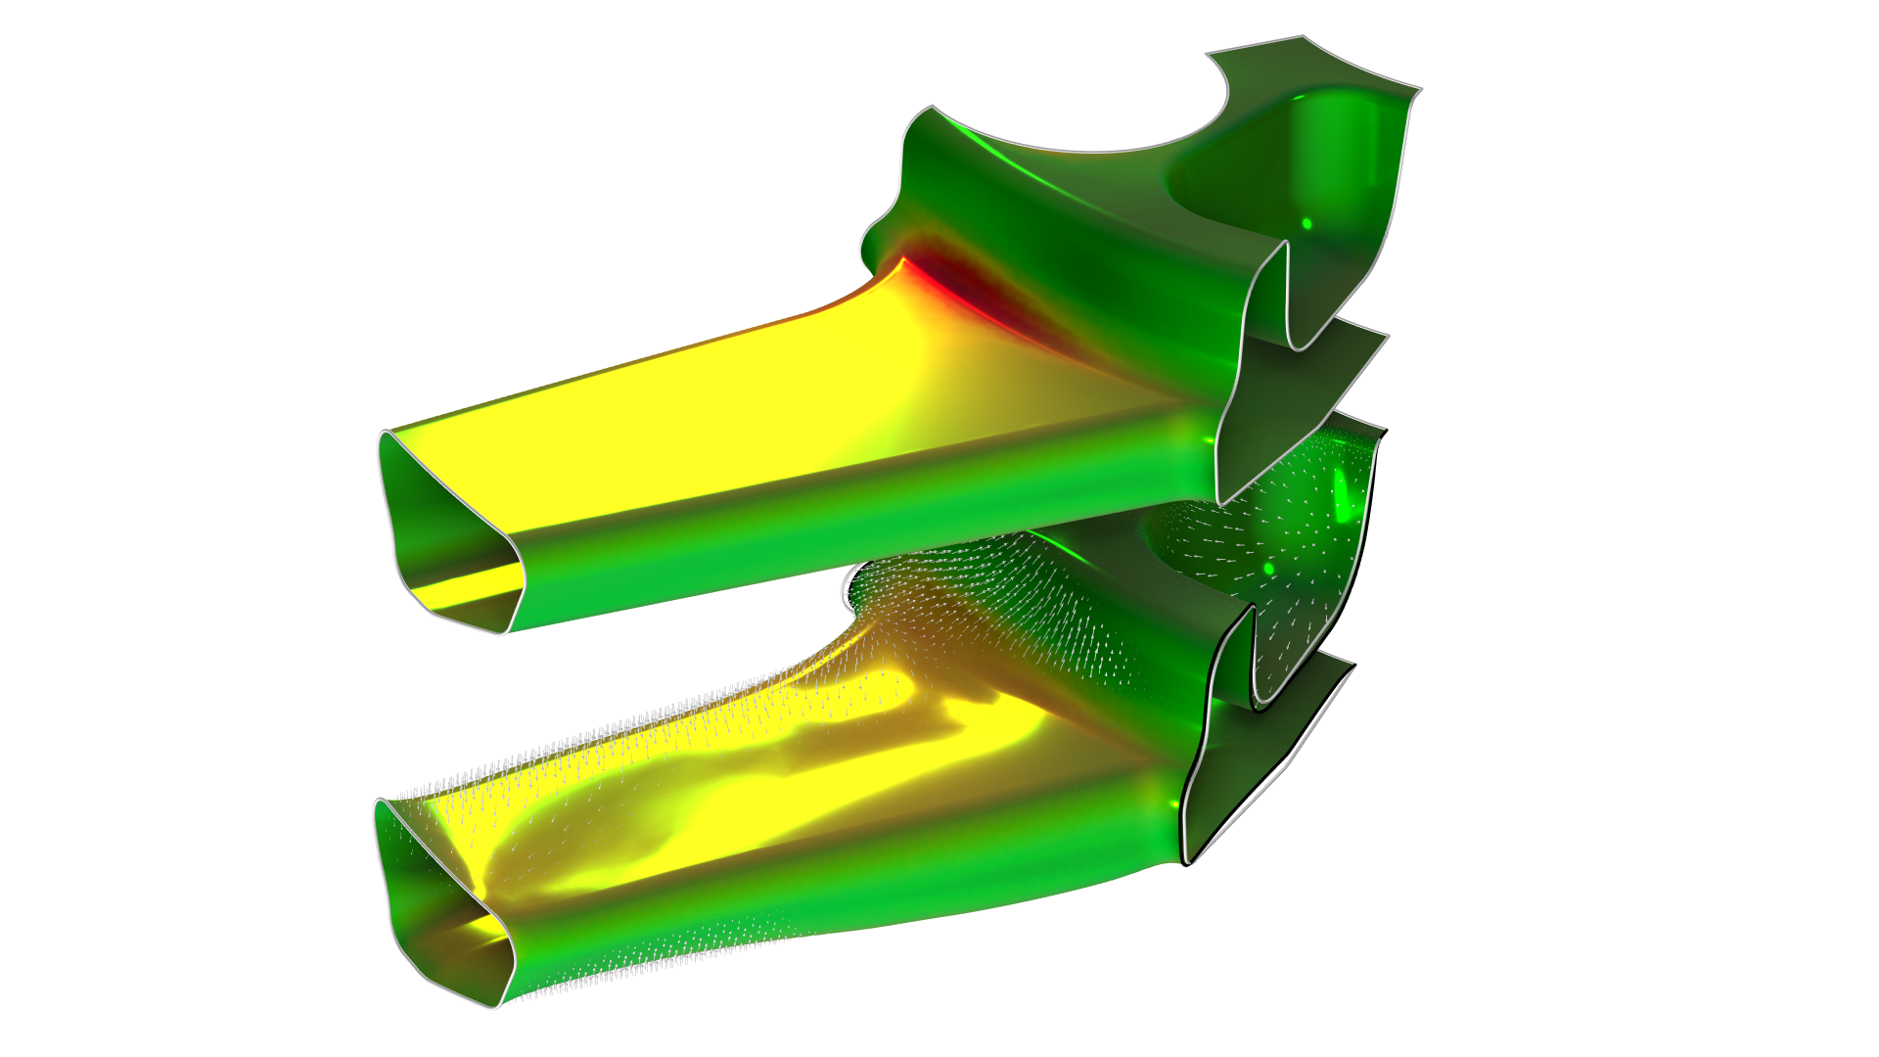
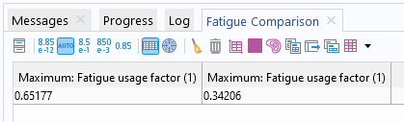
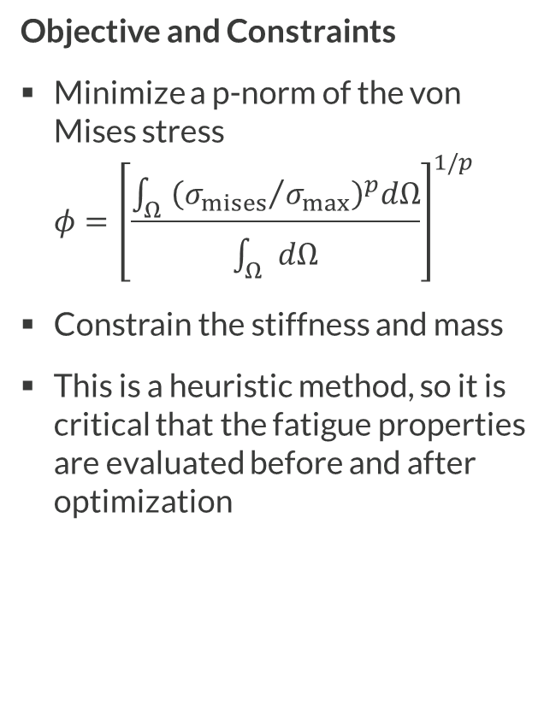
Shape Optimization
Objective and Constraints
Minimize a p-norm of the von Mises stress
$φ={\left[\frac{\int_{Ω}{{\left({σ_{mises}}/{σ_{max}}\right)}^{p}dΩ}}{\int_{Ω}{dΩ}}\right]}^{1/p}$
Constrain the stiffness and mass
This is a heuristic method, so it is critical that the fatigue properties are evaluated before and after optimization
The shape optimization increases the filter radius at the points of large stress, which improves the fatigue properties of the wheel rim. Several load cases are considered in every iteration using a MiniMax strategy.
Wheel Rim — Stress Optimization with Fatigue Evaluation

Slide 4
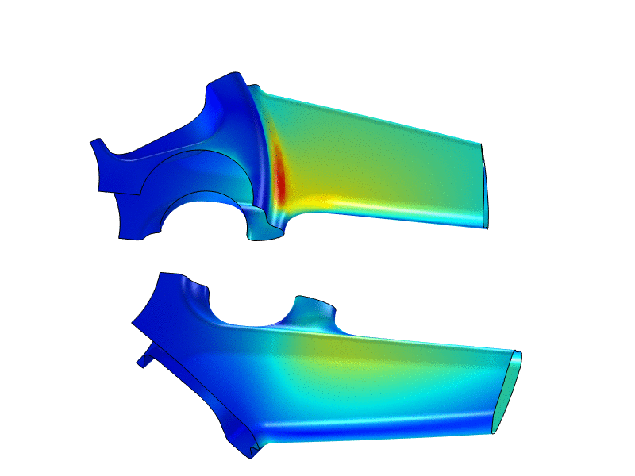
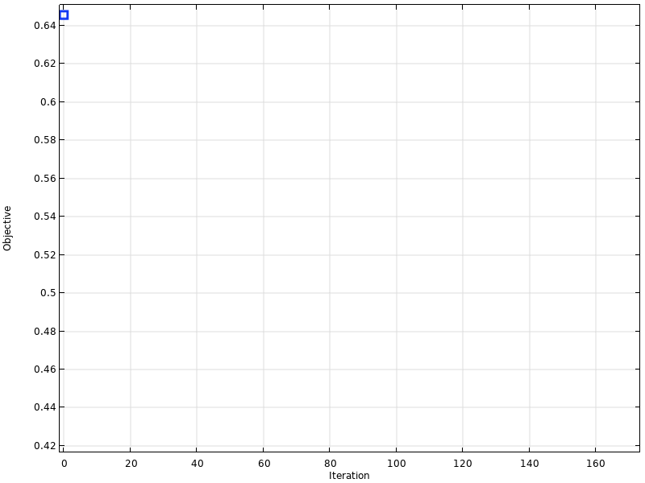
Animations
A move limit of 0.02 has been used to increase
the iteration count for visualization purposes.
Wheel Rim — Stress Optimization with Fatigue Evaluation

Slide 5
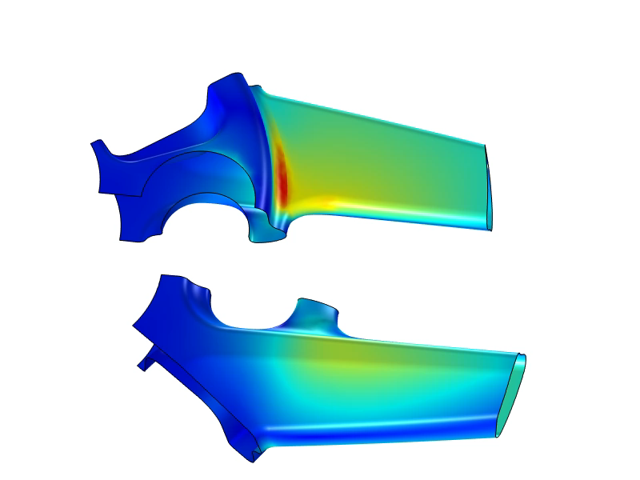

Animations (WebM)
A move limit of 0.02 has been used to increase
the iteration count for visualization purposes.
Wheel Rim — Stress Optimization with Fatigue Evaluation

