Slide 1
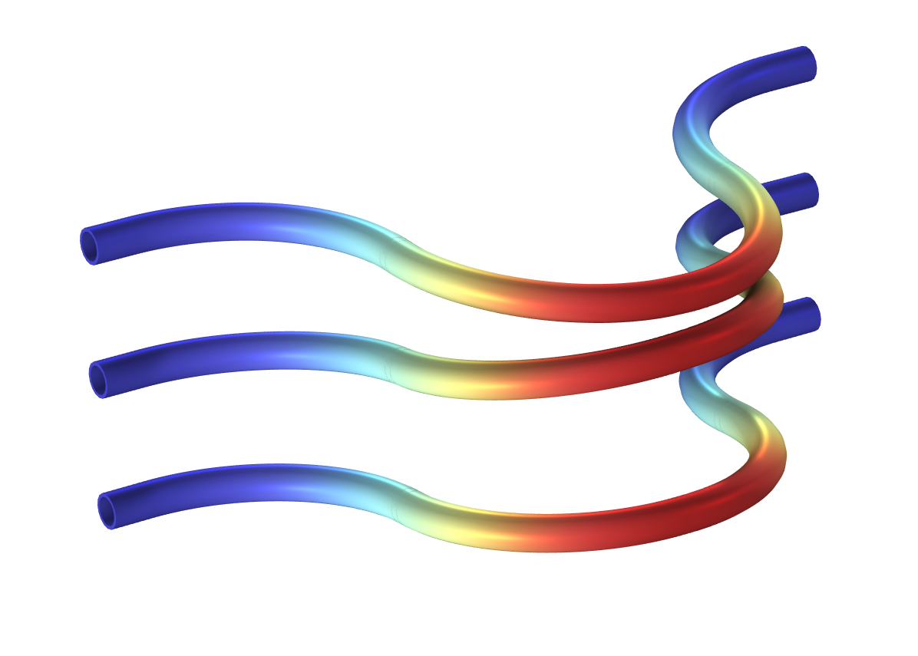
Coriolis Flowmeter

Slide 2
Background
Coriolis flowmeters, also known as mass flowmeters or inertial flowmeters, are valued for their accuracy
  Used in areas such as hydrogen storage and transportation, food and beverage, life sciences, chemical processes and production, etc.
Basic function:
  Measure the mass flow rate of a fluid traveling through it
  The density and thereby the volumetric flow rate can typically also be assessed using the device
Operating principle:
  When a fluid passes through an elastic structure (a curved duct) it interacts with the movement of the duct when vibrating
  The phase difference between the deformation of two points on the duct is caused by the Coriolis effect and can be used to evaluate the mass flow rate through the system

Slide 3
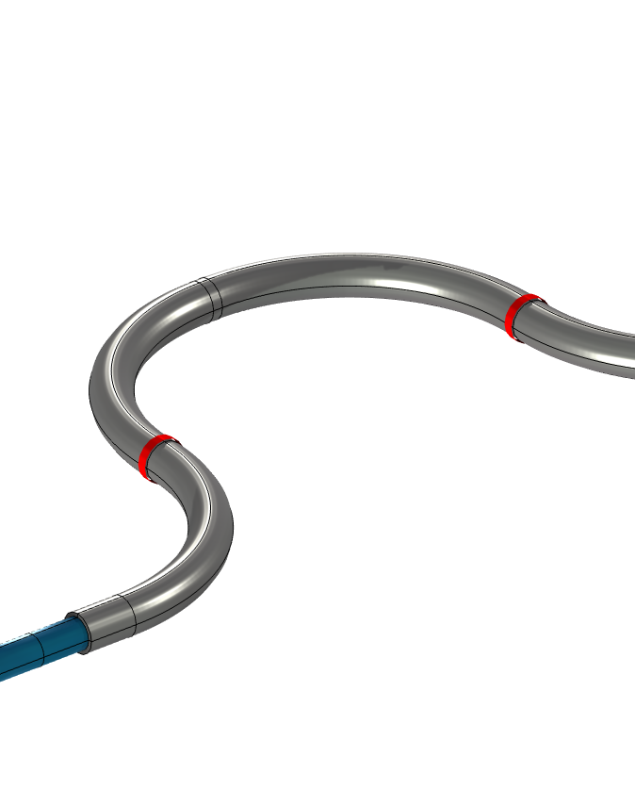
About the Model and Motivation
This example shows how to simulate a generic Coriolis flowmeter with a curved geometry using the COMSOL Multiphysics® software platform with the add-on Acoustics Module
The model is created using the Linearized Navier-Stokes, Frequency Domain interface coupled to the Solid Mechanics interface through the built-in multiphysics coupling
The background mean flow is modeled using the Turbulent Flow, SST interface
  This allows for efficient modeling of fluid–structure interaction (FSI) in the frequency domain
The Adiabatic formulation of the governing acoustic equations is used
  This is a good approximation in liquids like water, where the viscous dissipation effects dominate the thermal
The geometry and flow conditions are inspired by the reference: Stephanie Enz, "Factors Affecting Coriolis Flowmeter Accuracy, Precision, and Robustness," Ph.D. thesis, Technical University of Denmark (DTU), 2010.

Slide 4
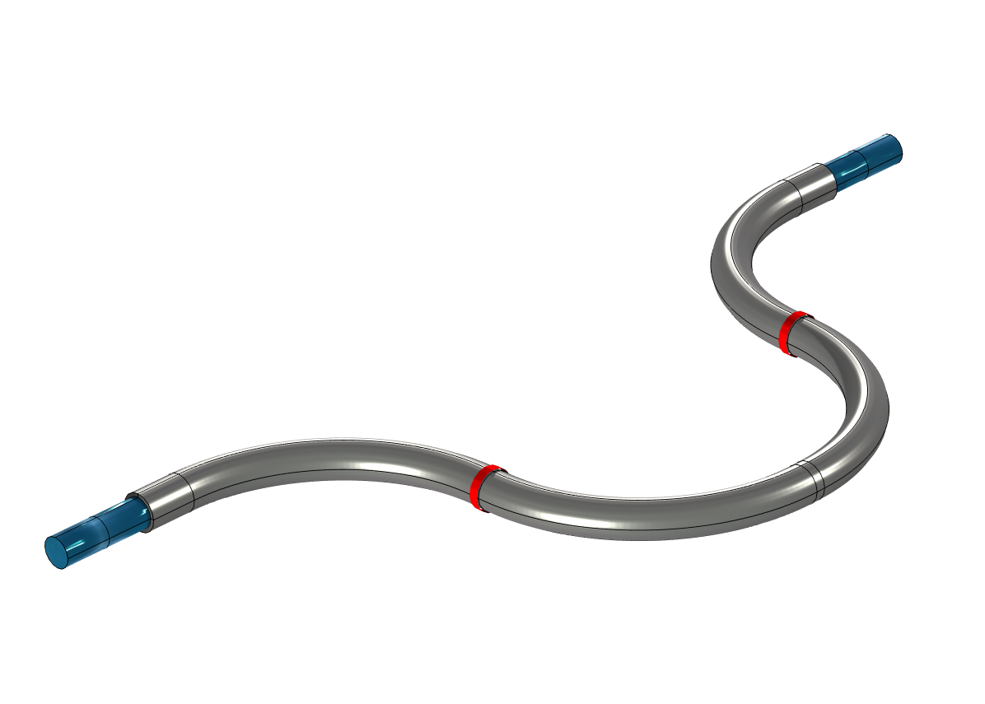
Model Setup
The system is actuated at the natural frequency f_{d} = 150.3 Hz, which is found using an eigenfrequency study.
The mass flow rate is varied from 0.2 to 2 kg/s.
Outlet
Measurement of the deformation
to extract the phase difference
Solid (steel)
Inlet for background
mean flow
Fluid (water)
Harmonic actuation

Slide 5
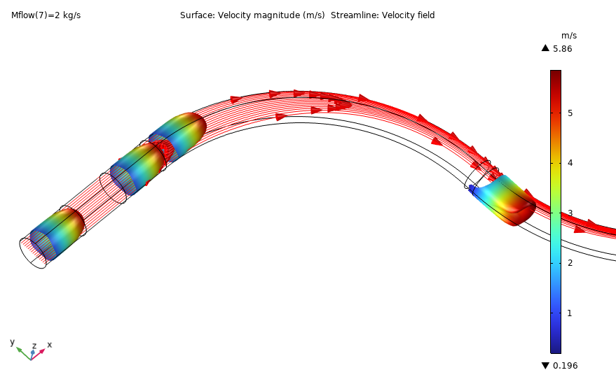
The Background Flow
The flow is calculated with the SST turbulence model for inlet mass flow rates ranging from 0.2 to 2 kg/s.
The flow and the acoustics are solved on two different computational meshes.
The background flow solution is mapped from the CFD mesh to the acoustics mesh using the Background Fluid Flow coupling multiphysics feature and the dedicated Mapping study. This is done for three reasons:
  Reduce the computational cost of running the acoustic study
  Smooth the CFD solution slightly (avoid numerical noise from the reactive terms)
  Make the CFD interface results available also in the PML domains

Slide 6
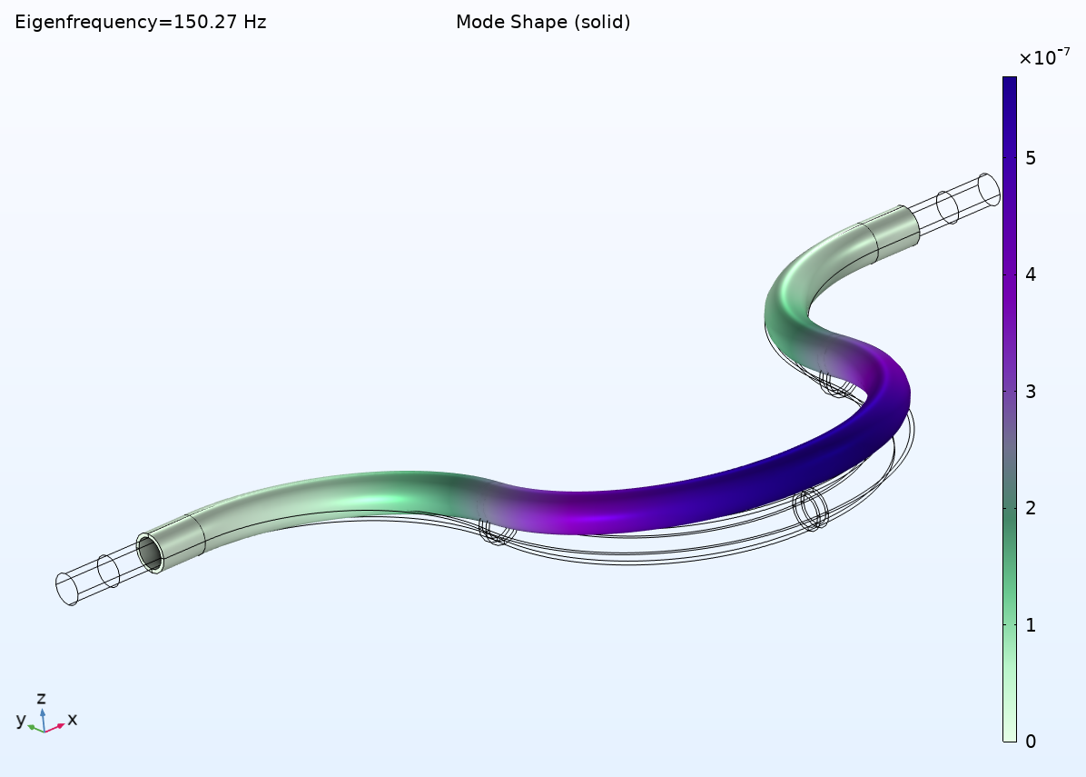
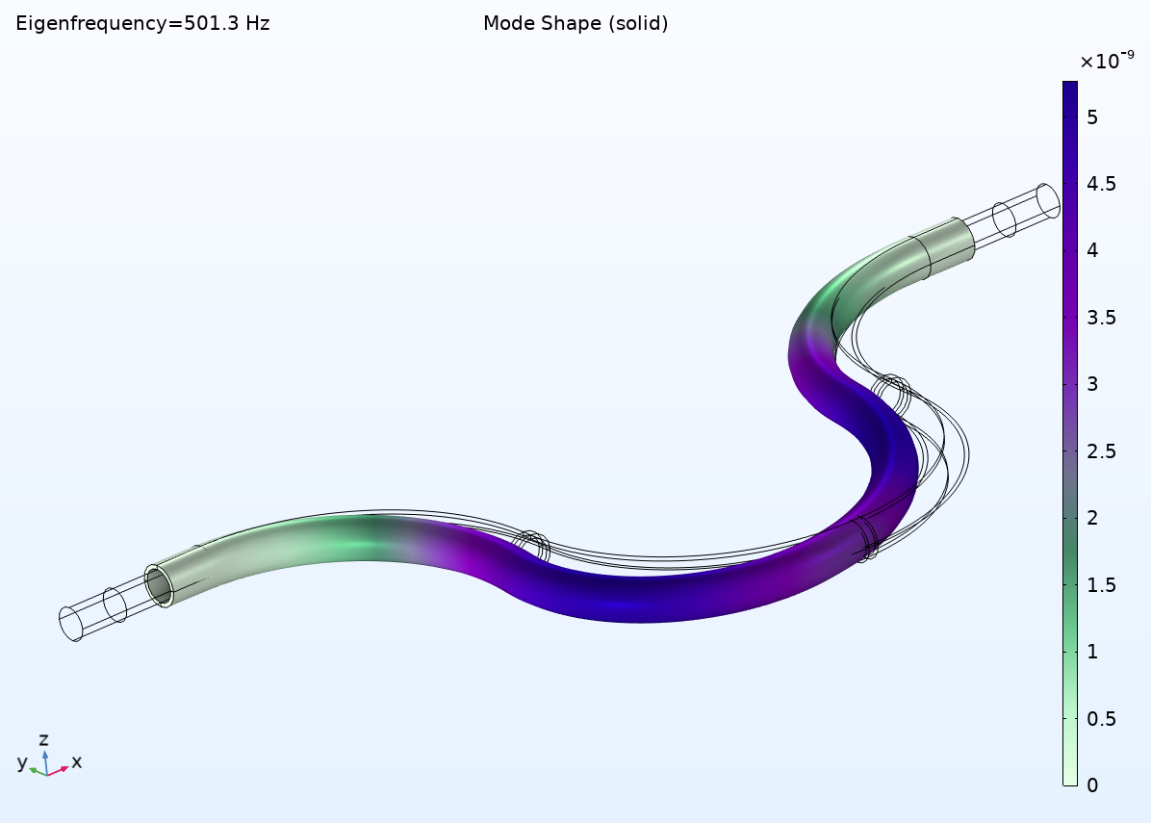
Eigenmodes of Structure with the Fluid
An eigenfrequency analysis is carried out on the structure to find its natural frequency. Pressure acoustics is included in the analysis to compute the effect of the mass of fluid in the pipe. The first mode frequency is used to excite the coupled model.

Slide 7
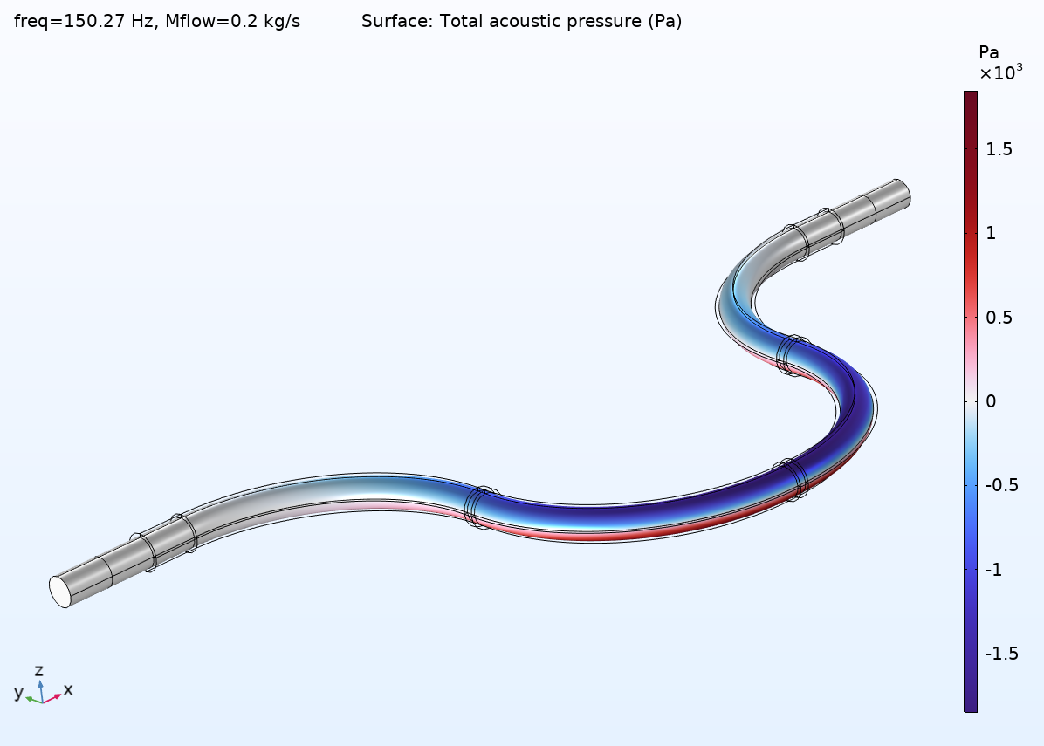
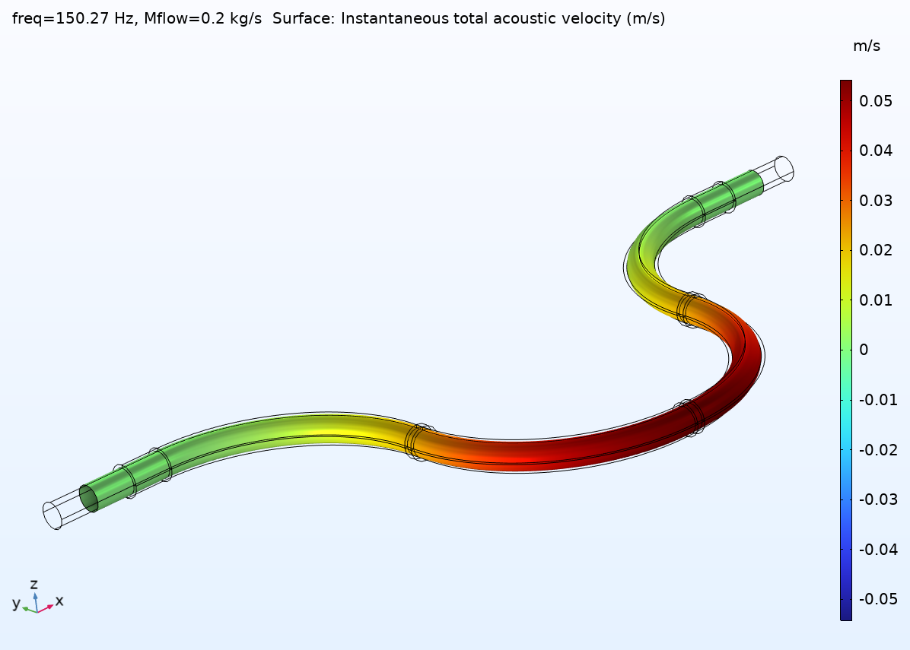
Acoustics: Linearized Navier–Stokes
The frequency response of the system including structure and background flow effects is modeled solving the linearized Navier–Stokes equations.

Slide 8
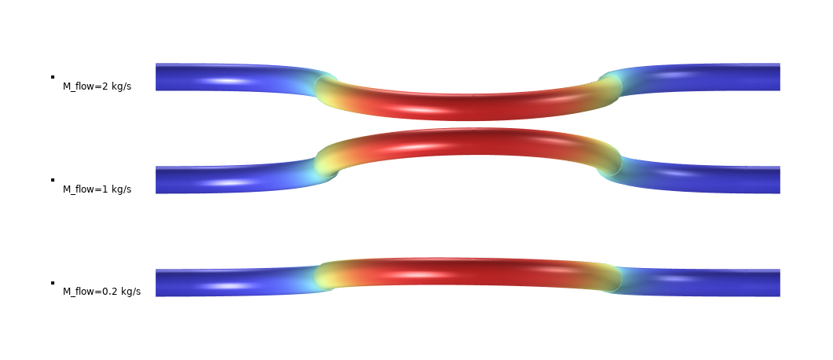
Acoustics: Linearized Navier–Stokes
Nonsymmetrical deflection of the structure to a symmetric load due to the background mean flow. The displacement amplitude and phase shift are exaggerated in the plot.

Slide 9
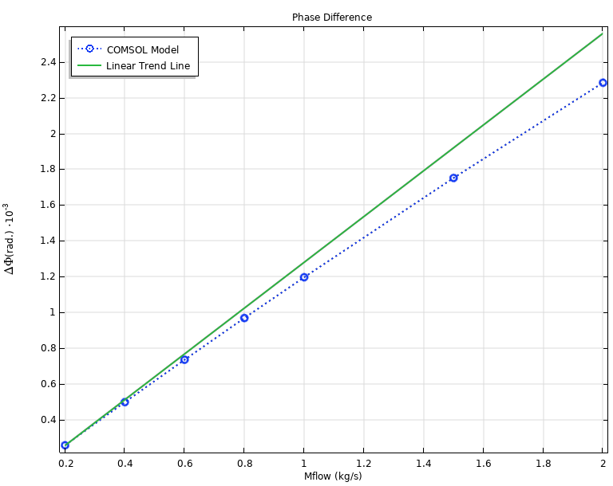
Acoustics: Linearized Navier–Stokes
Phase difference calibration curve used to predict mass flow through the Coriolis flowmeter
The phase difference is measured between the measurement locations shown in the Model Setup slide

