Slide 1
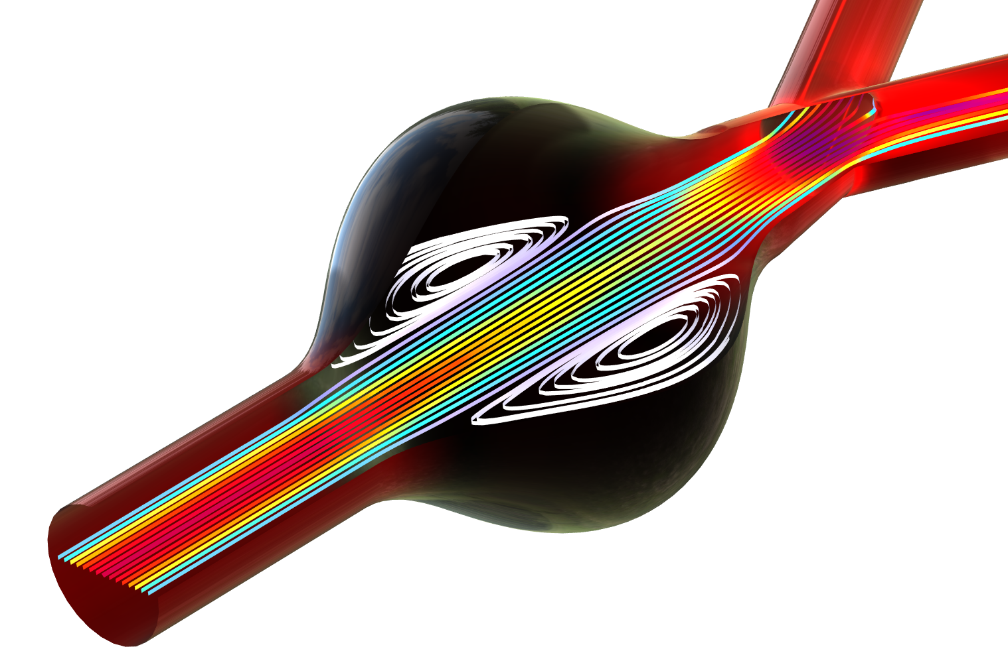
Blood Flow Through an
Abdominal Aortic Aneurysm

Slide 2
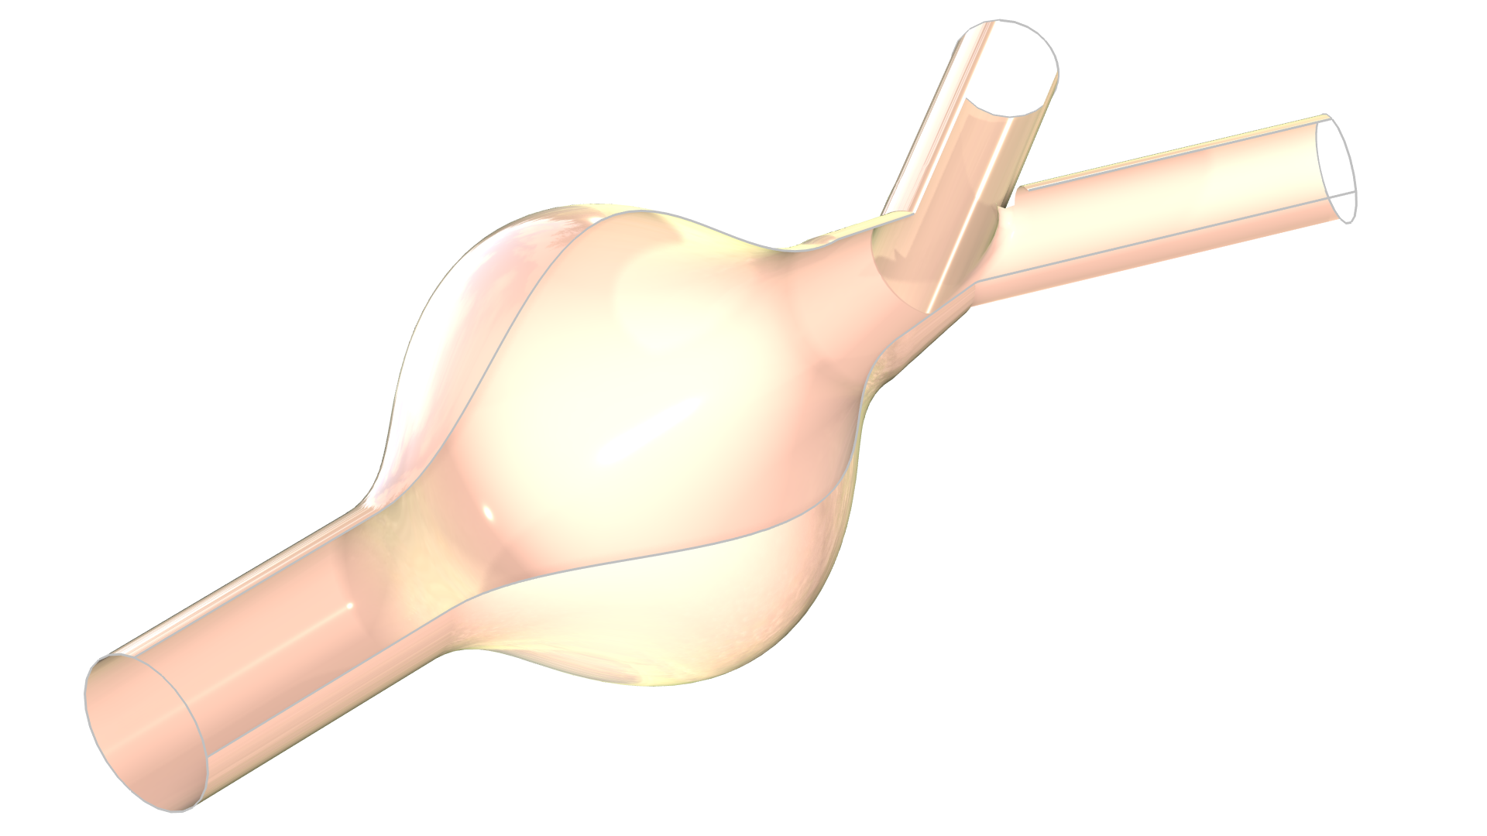
Model Definition
Outlet
Fully developed laminar flow at the inlet
Constant gauge pressure at both outlets
No-slip wall conditions at the blood vessel walls
Oldroyd-B one-branch viscoelastic
flow model
No-slip walls
Outlet
Inlet
Model geometry and boundary conditions.

Slide 3
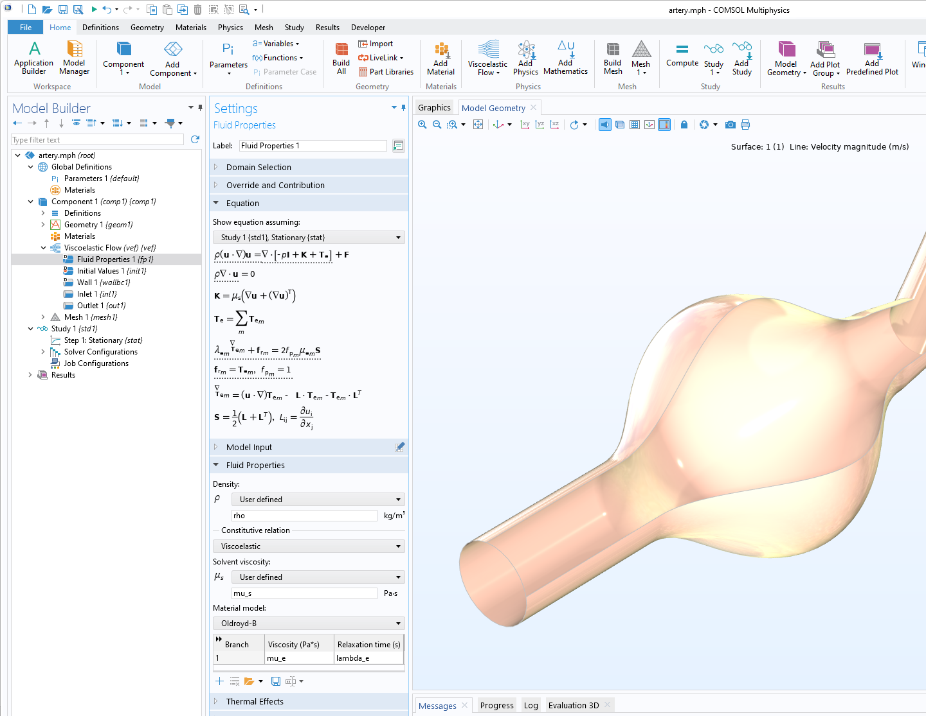
Model Setup in COMSOL Multiphysics®
The material model is selected in the Fluid Properties settings window
The branch viscosity and relaxation time are set in the Material model table

Slide 4
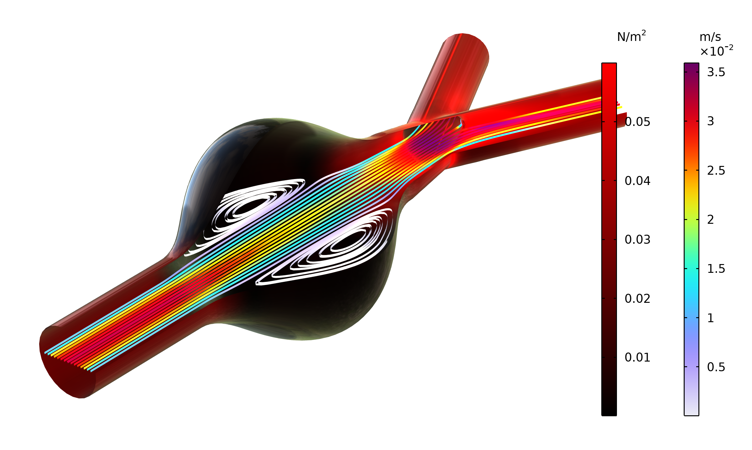
Results
A recirculation zone is formed in the aneurysm, which may increase the risk of coagulation and formation of blood clots
The viscous stresses and also the pressure losses are reduced in the aneurysm, which decreases the force that acts on the walls
Velocity streamlines and viscous stresses at the blood vessel walls.

