Slide 1
Radial Magnetic Coupler in 3D
COMSOL

Slide 2
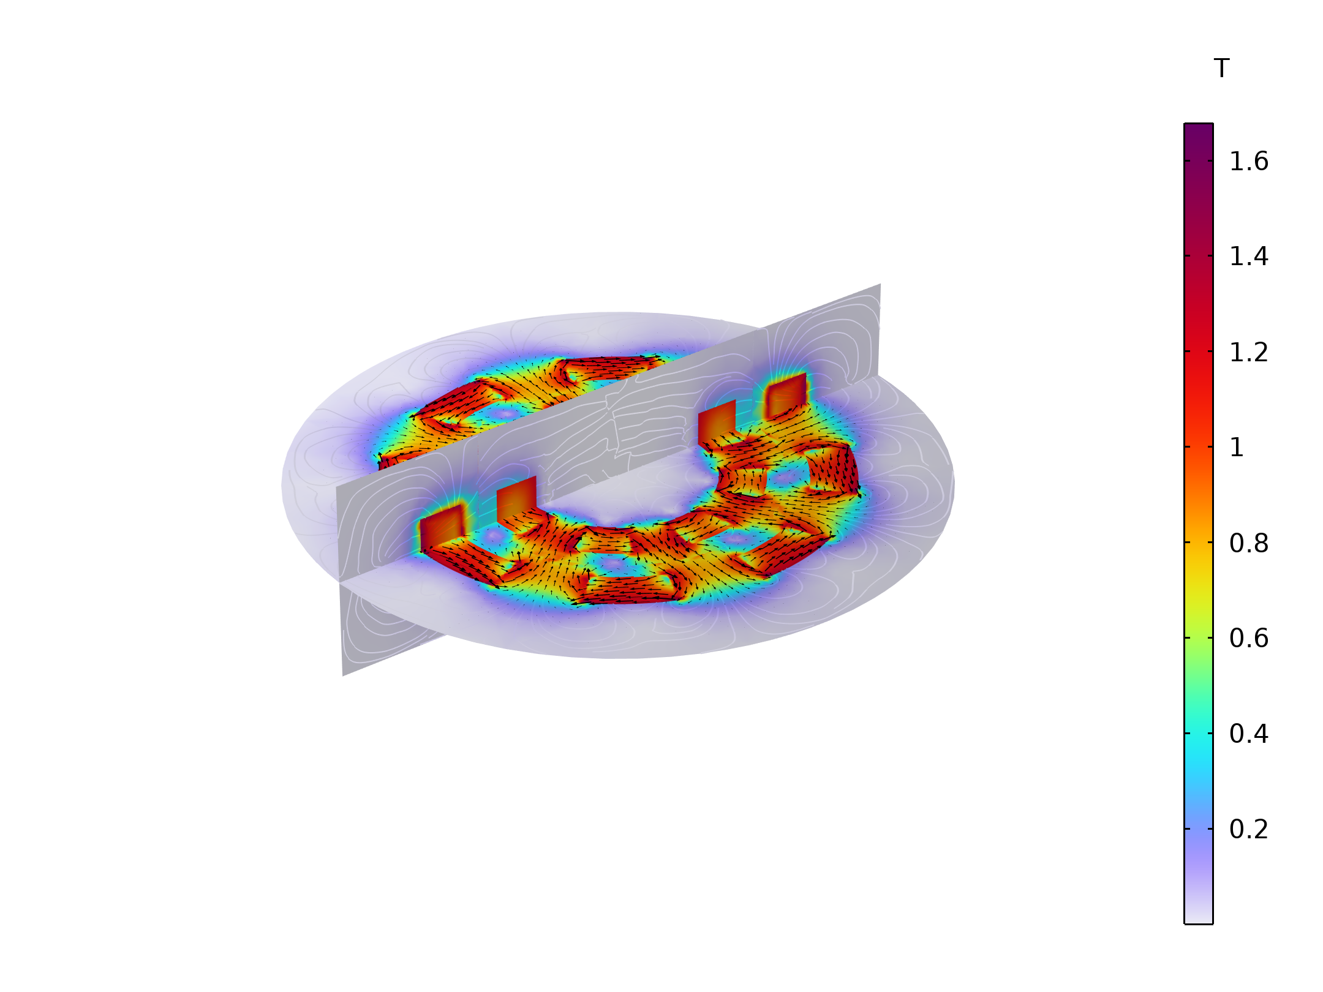
Magnetic Coupling (Radial)
The radial magnetic coupling. The arrows show the magnetization direction in the magnet pieces. The inner rotor is outward flux-focus and the outer rotor is inward flux-focus to maximize the magnetic coupling torque.
Multislice: Magnetic flux density norm (T) Arrow Volume: Magnetic flux density

Slide 3
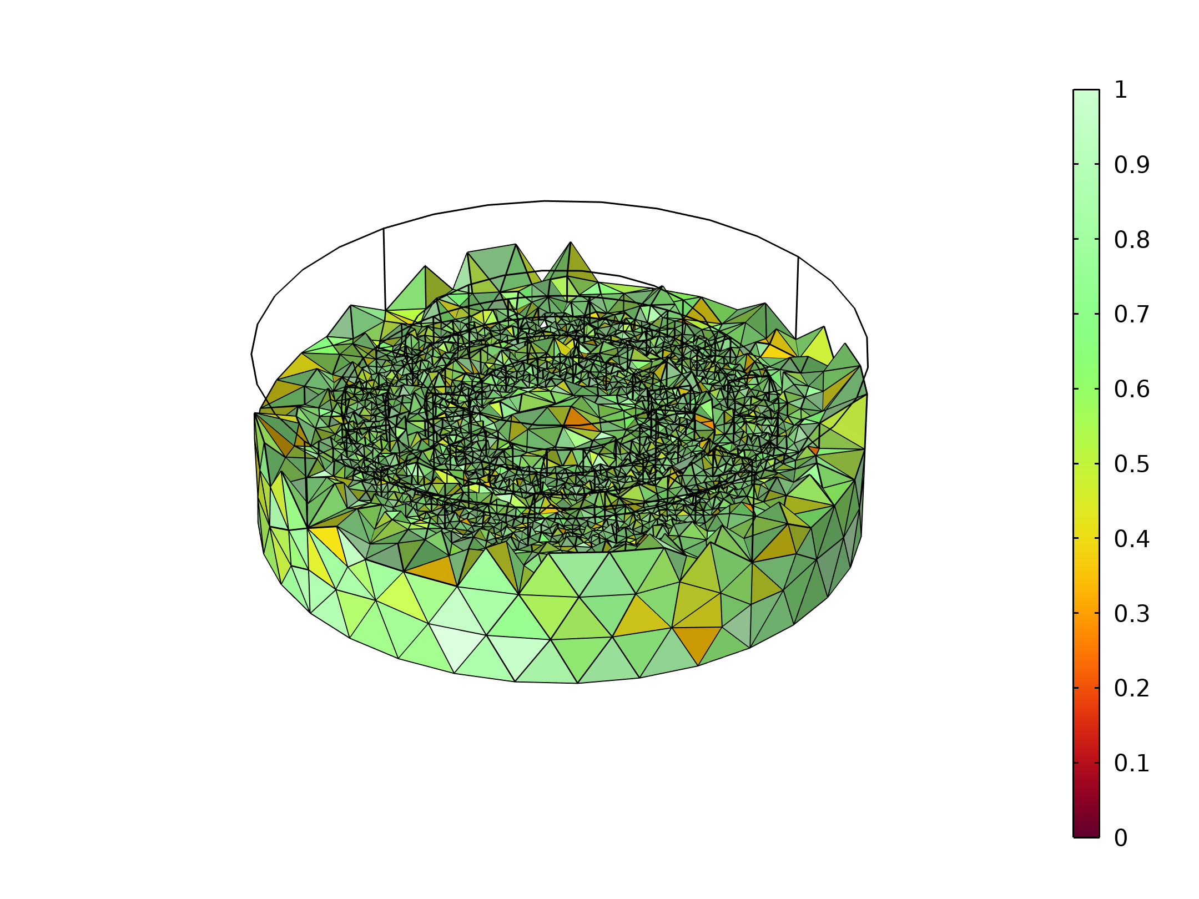
Magnetic coupling
The geometry is finalized using Form Assembly
An Identity Pair is created between the inner and outer rotors
Magnet arrays are created using specified domain directions
Zero Magnetic Scalar Potential is specified to produuce a unique solution
Force Calculation features compute force and torque
Continuity is applied at the identity pair
The rotation angle is varied in an Auxiliary sweep
A finer mesh is applied to the magnet rings.

Slide 4
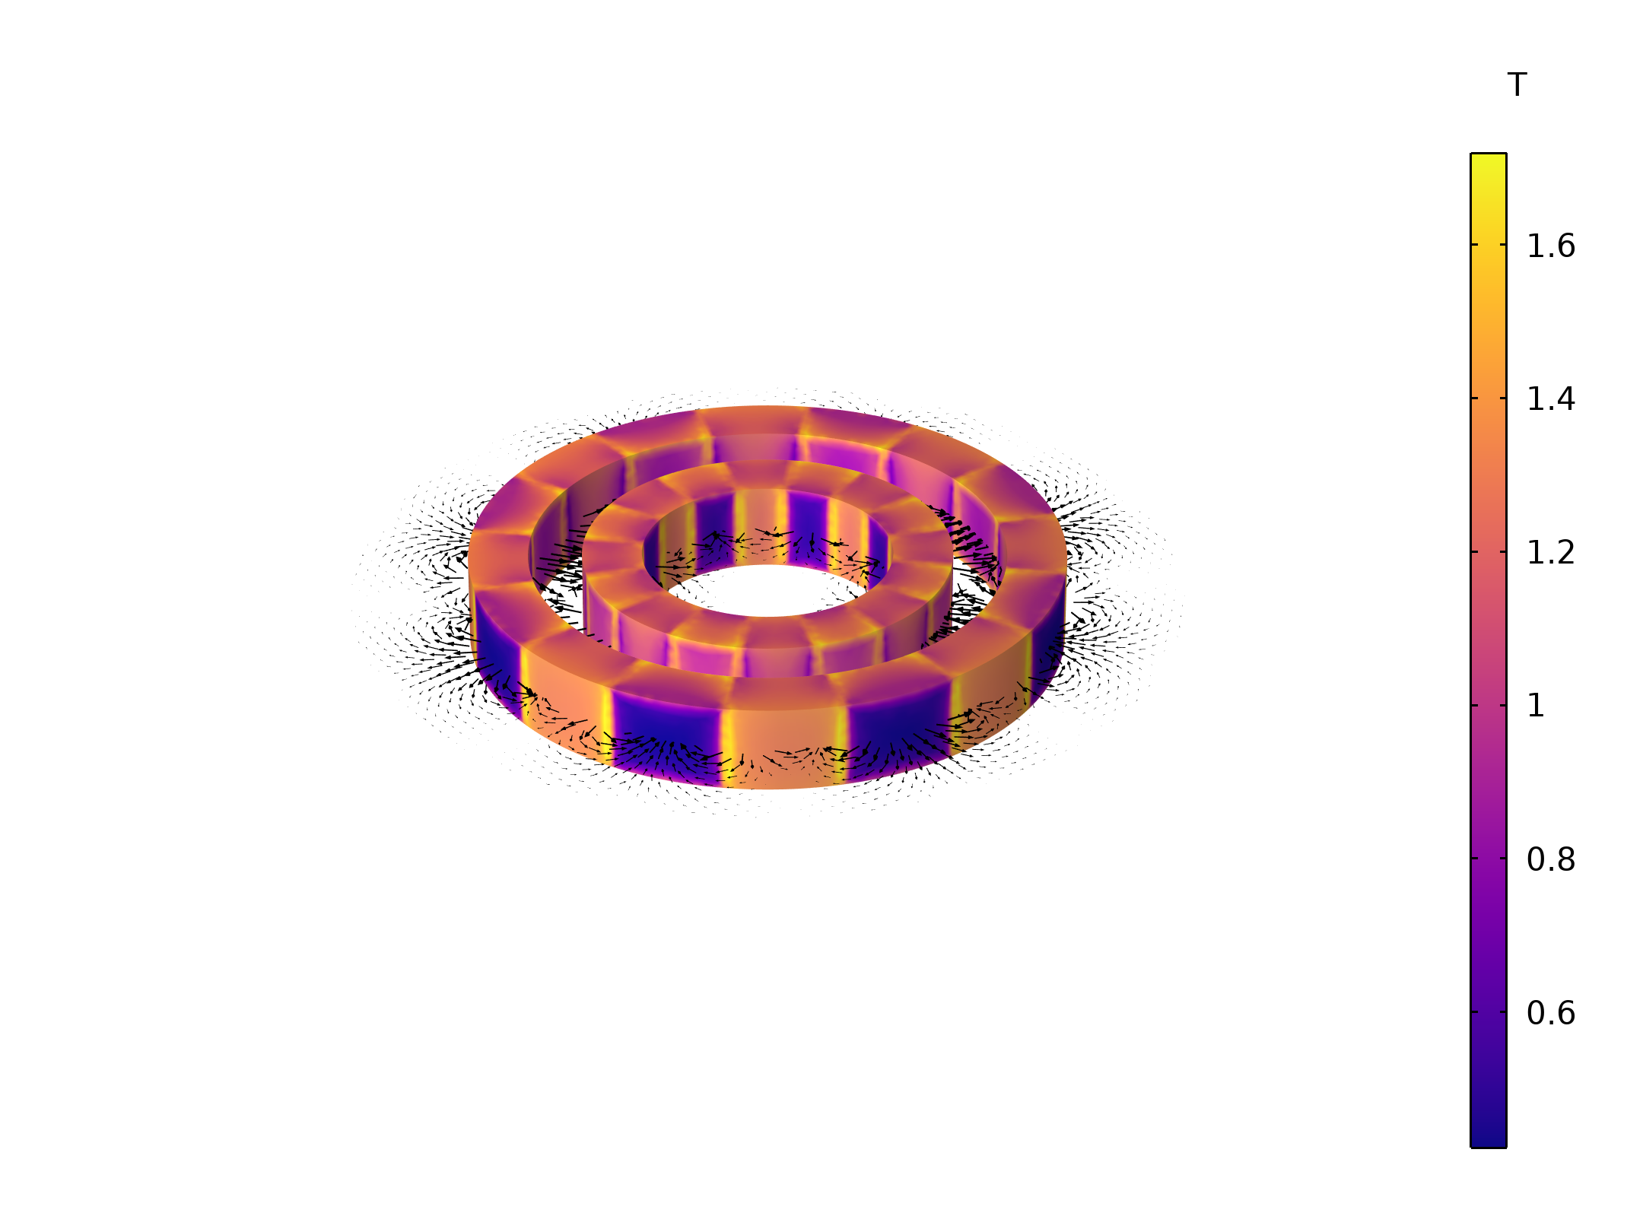
Magnetic Flux Density
A surface plot of the magnetic flux density (normB) with the arrow volume showing the x and y components of the B-field.

Slide 5
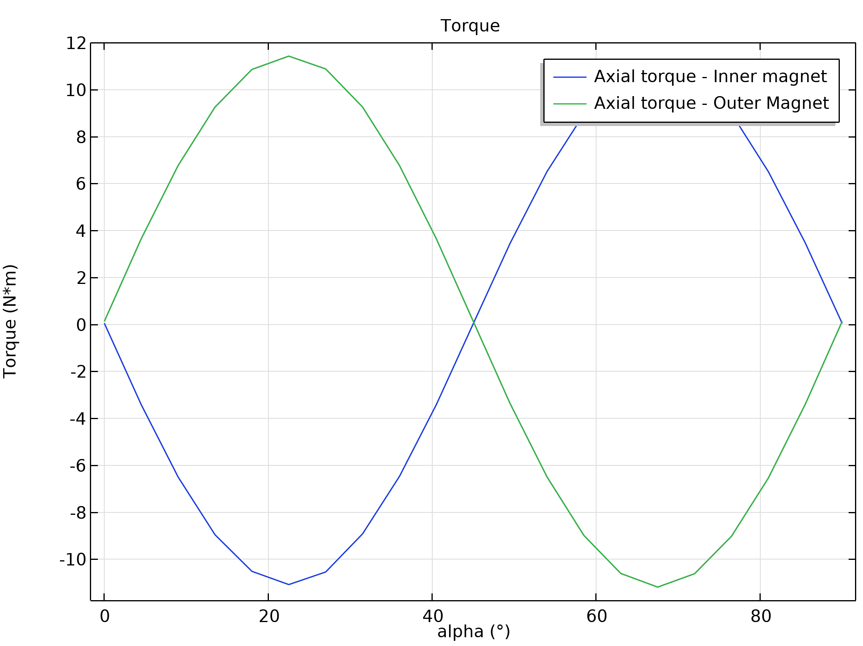
Torque vs Angle of rotation
The axial torque of both the inner and outer magnet arrays.

