Slide 1
Using the Monte Carlo Method To Estimate the Value of Pi
Venkata Krisshna
March 2024

Slide 2



Estimating the Value of Pi Using a Numerical Method
Consider a circle with a radius of 1 unit inscribed in a square with a side length of 2 units. The ratio of the area of the circle to the area of the square,
$$\frac{Area of the circle}{Area of the square}=\frac{πr^{2}}{{(2r)}^{2}}=\frac{π × {(1)}^{2} }{4 × {(1)}^{2}}=\frac{π}{4}$$
We generate randomly located points on this 2D plane. For a very large number of generated points,
$$\frac{π}{4}≈\frac{No. of points that lie within the circle}{Total no. of points}$$
$$π≈4×\frac{No. of points that lie within the circle}{Total no. of points}$$
$$r$$
$$2r$$

Slide 3
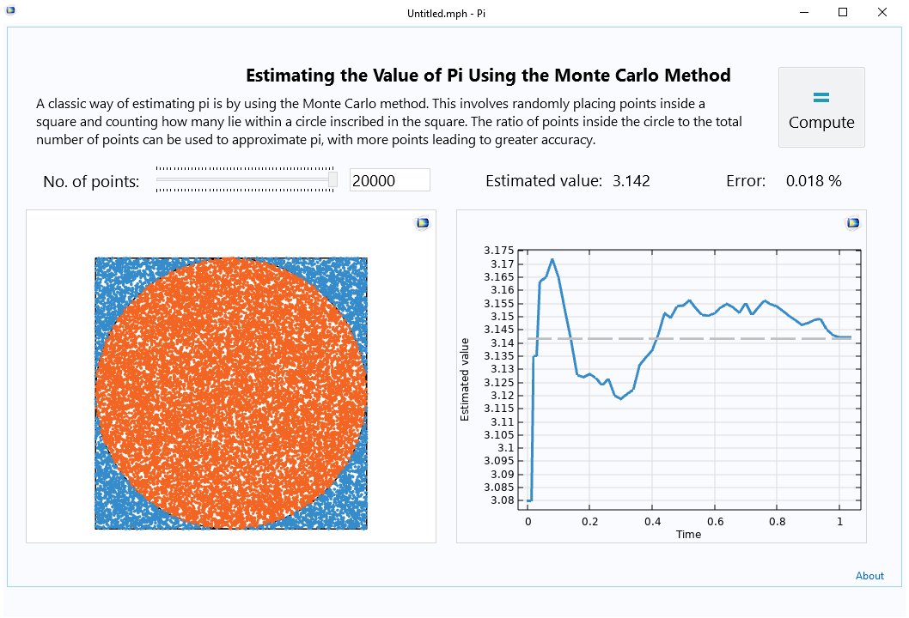
Input: user-controlled slider for number of points
Outputs: estimated value and error
Real-time plot of estimated value of pi
Real-time visualization of randomly placed points

Slide 4
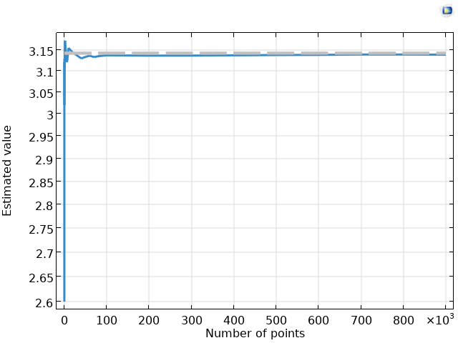
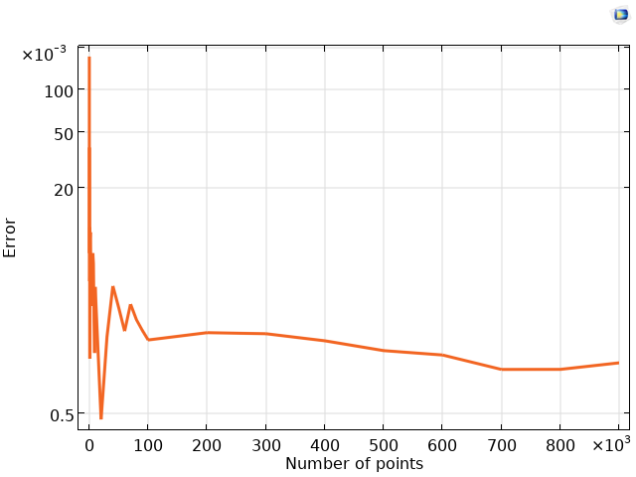
Results
Estimated value of pi
Error in the estimate
The accuracy of the estimated value of pi improves for a large number of points.
Increasing the number of points reduces the effects of random fluctuations and provides a more reliable approximation.

