Slide 1
Tonpilz Transducer Array for SONAR Systems

Slide 2
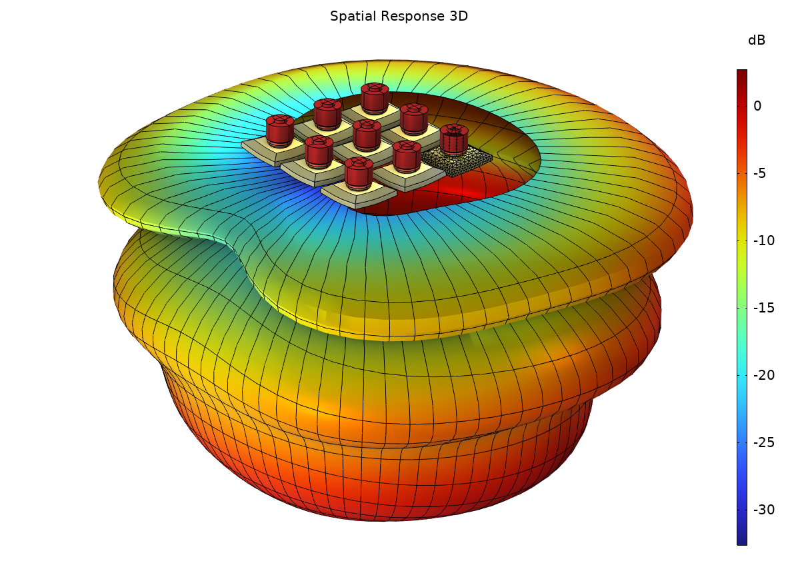
Background and Motivation
This model sets up a linear array of nine tonpilz piezoelectric transducers placed in a 3x3 grid. A voltage is applied that includes a phase change across the three rows. The transducers are located in a box below the sea surface.
The exterior acoustics are modeled using the Pressure Acoustics, Boundary Elements interface which is coupled to the vibrating structures with the Acoustic-Structure Boundary multiphysics coupling. This results in a hybrid BEM-FEM model of the full system.
The simple box geometry used here can, for example, be extended to a more realistic hull and sonar geometry.

Slide 3
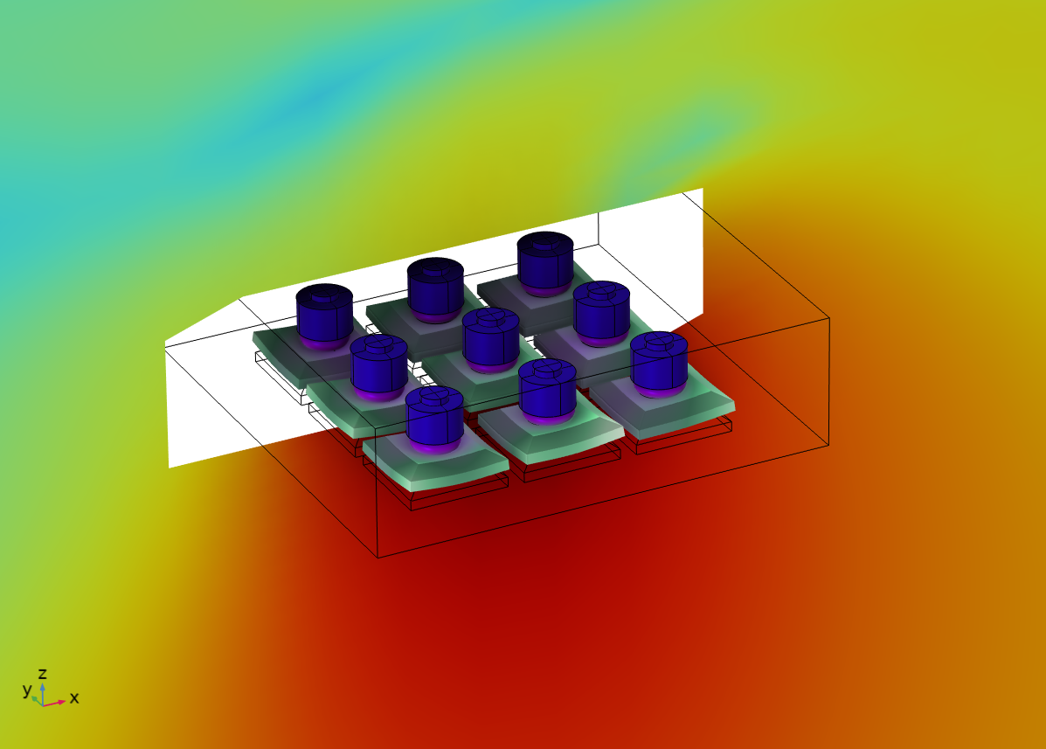
Model Setup
Piezoelectric Materials
Solid Mechanics
Pressure Acoustics,
Boundary Elements

Slide 4
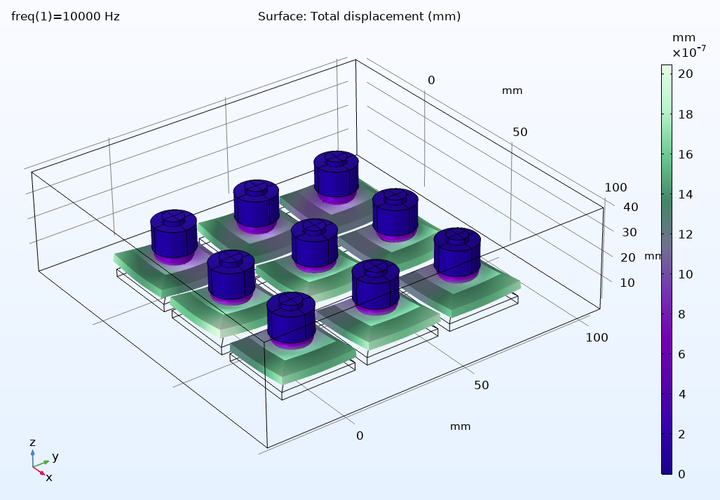
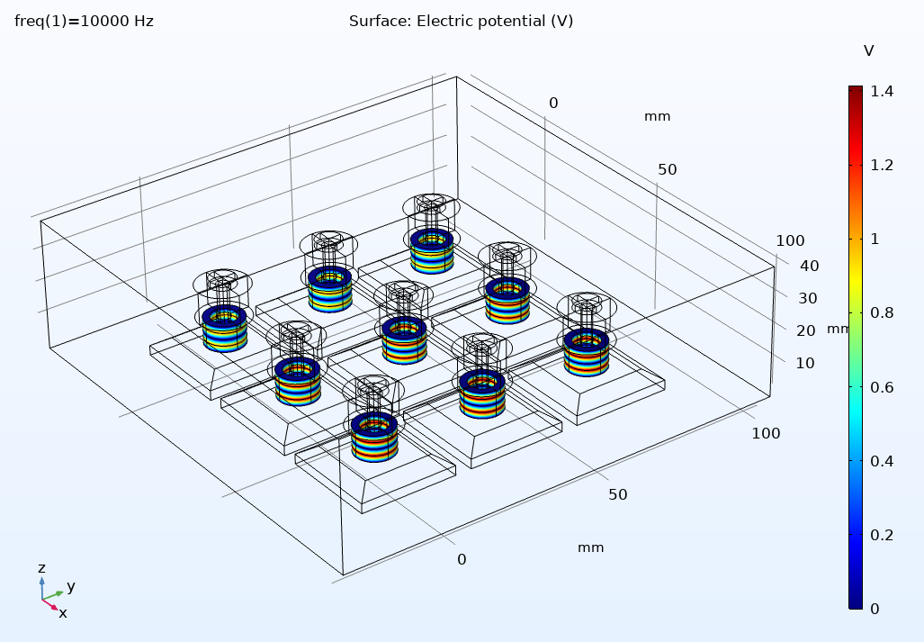
Results
Displacement of the transducers
Electric potential in the piezoelelctric discs

Slide 5
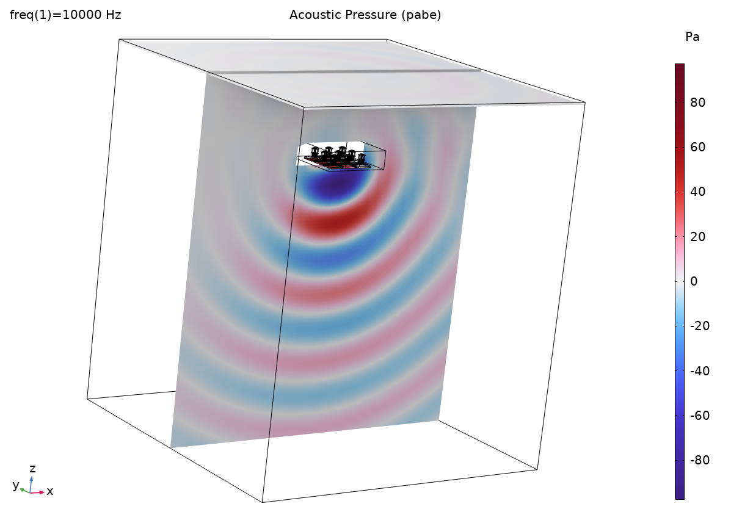
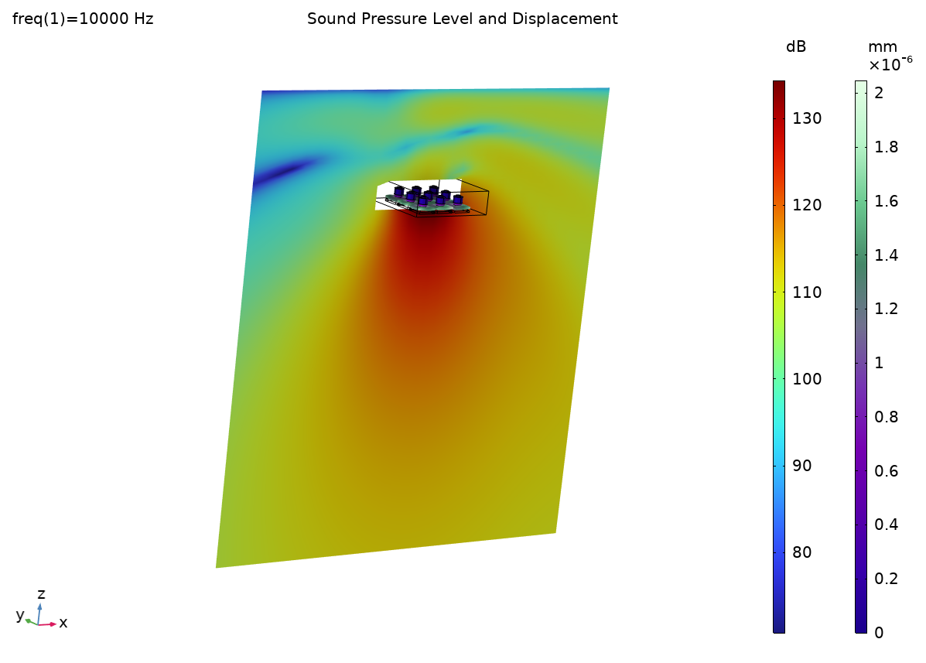
Results: Free Field
Sea surface: infinite sound soft boundary

Slide 6
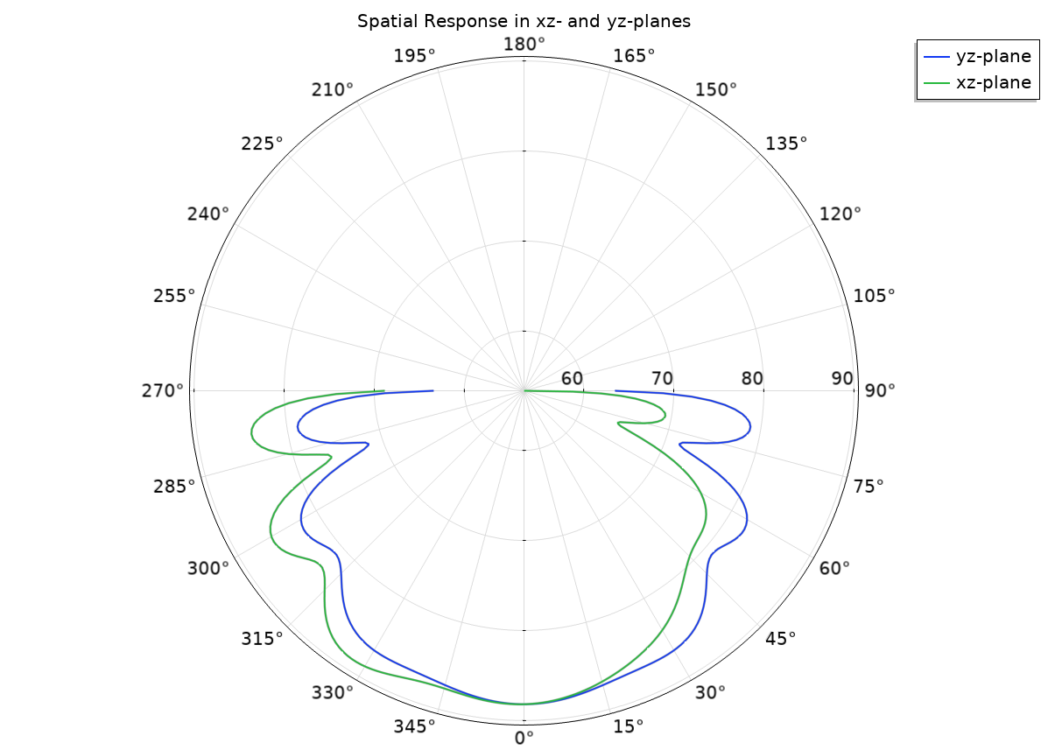
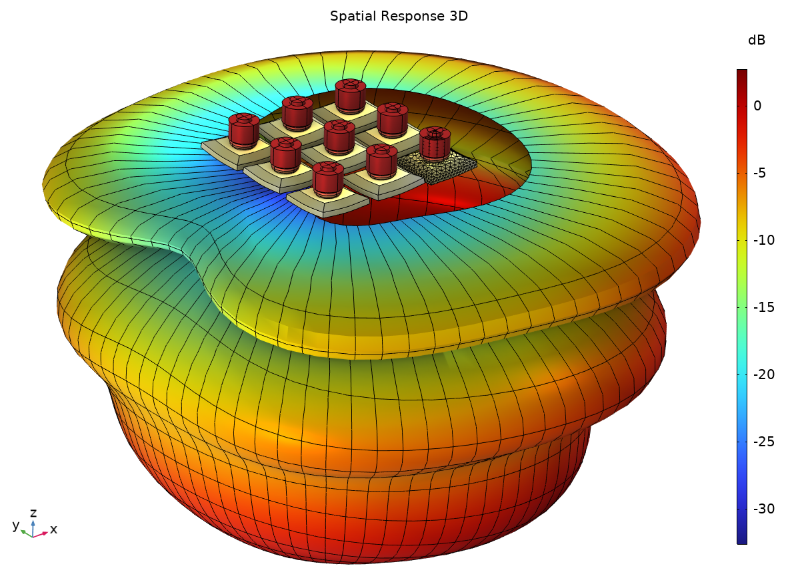
Results: Free Field

