Slide 1
Lithium Plating with Deformation Using the Phase Field Method

Slide 2
Background
This example is based on the Lithium Plating with Deformation model, available in the Battery Design Module Application Library
As an alternative to the Deformed Geometry feature, this model demonstrates how the Phase Field interface can be coupled to the Lithium-ion Battery interface to track the deformations in a cell, which allows topological changes

Slide 3
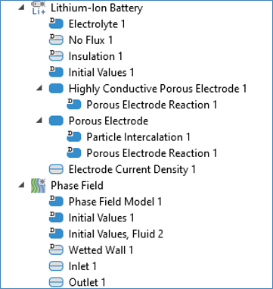
Implementation
The general setup follows the Lithium Plating with Deformation model
The Phase Field interface is used to track the deformation of the negative electrode surface during charging
The velocity field in the Phase Field Interface is calculated from the lithium-plating reaction
Highly Conductive Porous Electrode is used to model both the lithium metal electrode and the separator domain
Porous Electrode reaction sub-node is used to define the lithium plating reaction
The Phase Field variable affects the definition of electrolyte volume fraction, active specific surface area of the porous domain exposed to the deformed surface, and the effective diffusion coefficient.

Slide 4
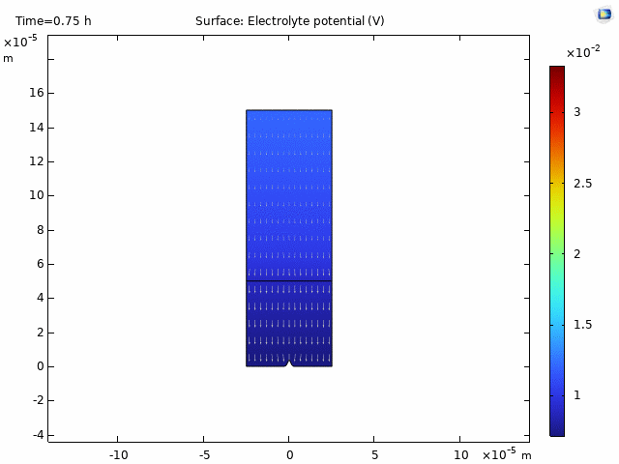

Results
Lithium gets deposited on the negative electrode surface as the cell charges over time, shown by the filtered surface plot of the phase filed variable in gray scale at the bottom
The electrolyte potential is plotted, overlaid with an arrow surface of the electrolyte current density

Slide 5
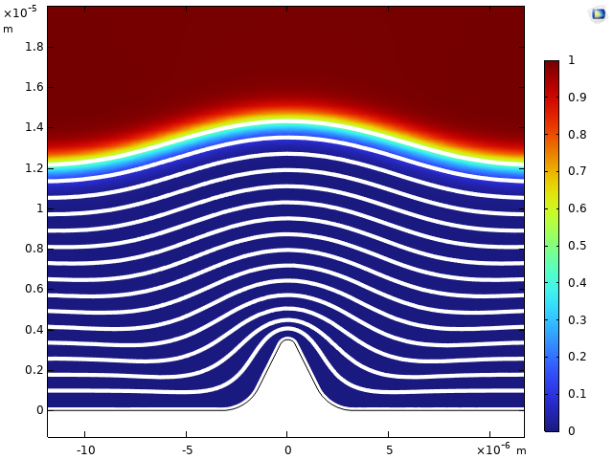
Results
The propagation of the interface between the lithium and the electrolyte in the separator can be shown by zero contours of the phase field variable
The initial protrusion on the negative electrode leads to an uneven deposition of lithium
Surface plot of volume fraction and zero contours of the phase field variable showing propagation of deposition

Slide 6
Concluding Remarks
An example of how to couple the Lithium-ion Battery interface to the Phase Field interface is presented.
The deposition of lithium on the negative electrode can be modeled by the phase field variable. The velocity field of the Phase Field interface is coupled to the kinetics of the lithium-plating reactions, and the deposited lithium alters the electrochemical performance.
The solution is in line with that in the Lithium Plating with Deformation model.

