Slide 1
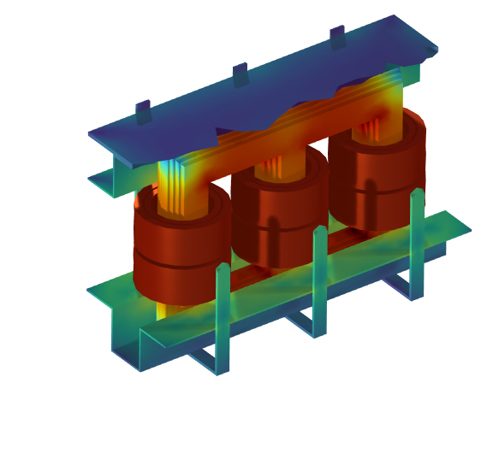
Computation of losses in a three-phase power transformer
Notes:
https://www.comsol.com/model/computation-of-losses-in-a-three-phase-power-transformer-54471

Slide 2
Aim of the model
An accurate understanding and control of losses in the different parts of a transformer is fundamental for an efficient design, which matches customers’ requirements and minimizes the costs by dimensioning of core, carpentry, and coils
The aim of this model is to present typical simulation setups for the estimation of electrical quantities in power transformers, including:
  Standard tests (i.e. short-circuit and open circuit standards)
  A discussion of the different origin of losses in different parts under different testing conditions

Slide 3
Performed analyses
Magnetic analyses in the frequency domain to extract:
  lumped electric and magnetic parameters
  losses
3D where the whole core and carpentry are modeled, while coils are homogenized
2D-axi equivalent where each coil turn is explicitly drawn
Open- and Short-circuit tests have been implemented to derive the associated quantities, see table
 | Open-circuit | Short-circuit
3D | Core losses | Carpentry losses
2D-axi |  | Coil losses Coil lumped parameters

Slide 4
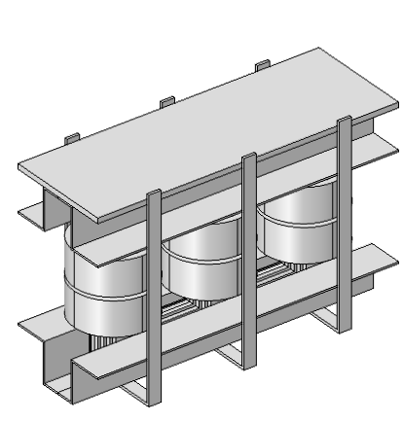
Study case
Three-phase transformer
400kVA – 15kV/400V – Yd connection
2 primary coils
  Np = 693
2 secondary coils
  Ns = 32*
*Each secondary coil is made of 4 parallel conductors
Coils (primary and secondary)
Carpentry
Core

Slide 5
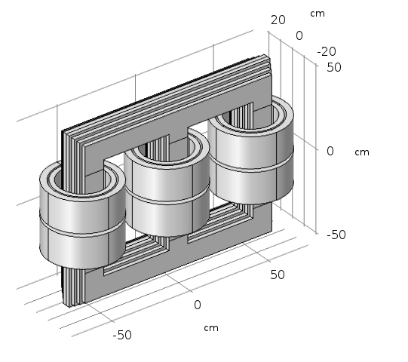
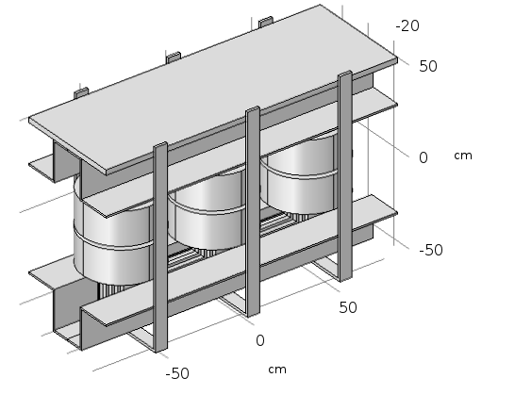
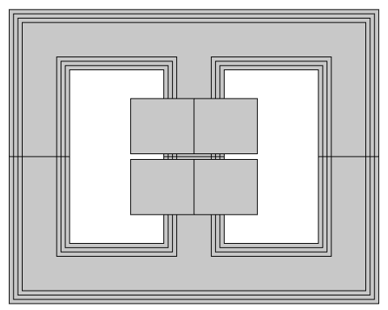
Geometry, 3D model
Carpentry
Secondary coil
Primary coil
View when
hiding carpentry
Core
Section: 330cm²
21cm
102.4cm
Core
Designed to work on the knee point of the BH curve in open circuit
Coils
Wire sections are designed for a maximum current density of 2 A/mm² with
nominal current
Front view
hiding lateral coils
and carpentry
128.48cm

Slide 6
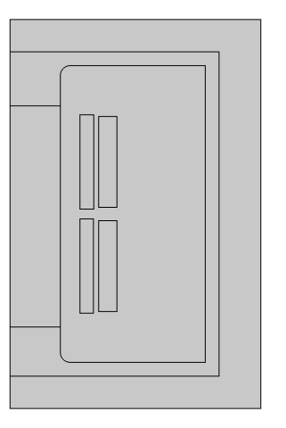
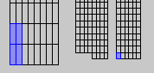
Geometry,
2D-axi model
Secondary wire section: 4x0.42 = 1.68cm2
Current density (nominal current, 50Hz)
1.98 A/mm2 RMS
In the 2D-axi simplification, a single phase is modeled
  Secondary windings are divided into smaller parallel conductors for mechanical reasons and to reduce losses. These details are easily handled in 2D-axi
The core section is adjusted to match the 3D flux
2.8cm
4 parallel conductors
(3.5x12 mm)
2.3x3.7 mm
10.5cm
(3D equivalent)
Primary wire section: 8.51mm2
Current density (nominal current, 50Hz)
1.8 A/mm2 RMS

Slide 7
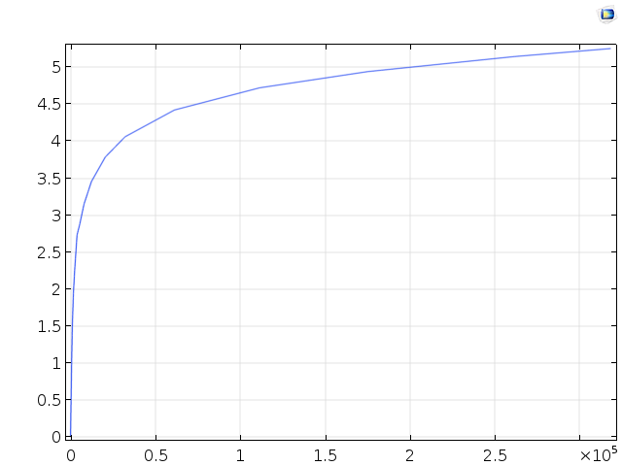
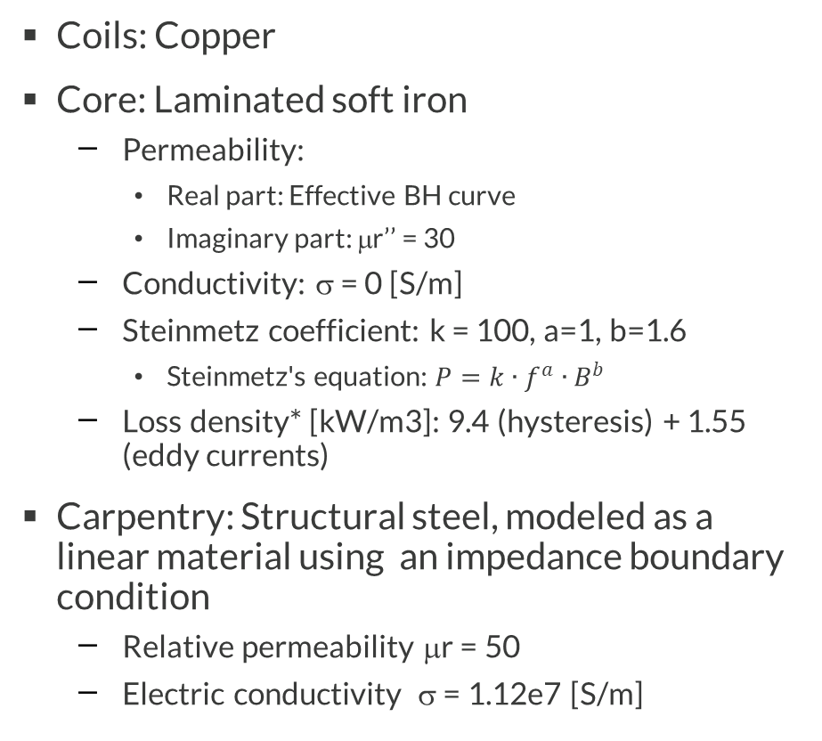
Materials
Coils: Copper
Core: Laminated soft iron
  Permeability:
    Real part: Effective BH curve
    Imaginary part: μr’’ = 30
  Conductivity: σ = 0 [S/m]
  Steinmetz coefficient: k = 100, a=1, b=1.6
    Steinmetz's equation: $P=k∙f^{a}∙B^{b}$
  Loss density* [kW/m3]: 9.4 (hysteresis) + 1.55 (eddy currents)
Carpentry: Structural steel, modeled as a linear material using an impedance boundary condition
  Relative permeability μr = 50
  Electric conductivity σ = 1.12e7 [S/m]
B [T]
H [A/m]
Effective BH Curve
* Electrical engineering manual: Daniele, Liberatore – Elettrotecnica, Monduzzi, 1996

Slide 8
Physics settings
Open-Circuit test (OC) – 3D only
Core: Effective permeability + magnetic losses
Coils: Homogenized multi-turn
Primary coils: Nominal phase voltage (VCoil=V1n_f_PP)
Secondary coils: Open circuit (ICoil=0)
Short-circuit tests (SC) – 3D and 2D-axi
Core: Relative permeability, linear iron
Primary coils: Nominal phase current
(ICoil=I1n_f_PP)
Secondary coils: Short circuit (VCoil=0)
Coils, 2D-axi: Single conductor
  Coil group to easily handle the connection between domains
  4 coils for the secondary to implement the parallel conductors
  Resistances are defined as variables to account for the parallel connection
Coils, 3D: Homogenized multi-turn
Carpentry, 3D: Impedance BC
Note: RMS are transformed to peak values (PP)

Slide 9
Study setup and solvers
3D
Open and short-circuit tests are run in different studies
  Switching between OC and SC requires changes in 12 coil inputs, see the
  job configuration in the study nodes
Linear elements + direct solver
  Complex split doubles solution time without improving accuracy and is therefore disabled
  Lossless materials’ conductivity (signum) is fixed at 0.1[S/m]. Higher values do not decrease accuracy in the core and the carpentry, but reduce the solution time. However, this results in excessively high losses in air (e.g. 200W with 1[S/m])
Error in the energy balance ~ few percent:
  With stationary gauge fixing, conductivity (signum) is set at 0[S/m], coil stabilization enabled (sigma = 0[S/m]), and complex split, the error can be decreased to 0.2% or less
2D-axi
Two different studies (Study 1 and Study2) implement a SC feed on the primary and on the secondary coil, to evaluate secondary inductance

Slide 10
Results
Losses and main electrical quantities are computed in the different scenarios:
  Core losses (3D, Open-circuit test)
  Coil currents and lumped params (2Daxi, Short-circuit test)
  Coil losses (2Daxi, Short-circuit test)
  Carpentry losses (3D, Short-circuit test)
 | Open-circuit | Short-circuit
3D | Core losses | Carpentry losses
2Daxi |  | Coil losses Coil lumped parameters

Slide 11
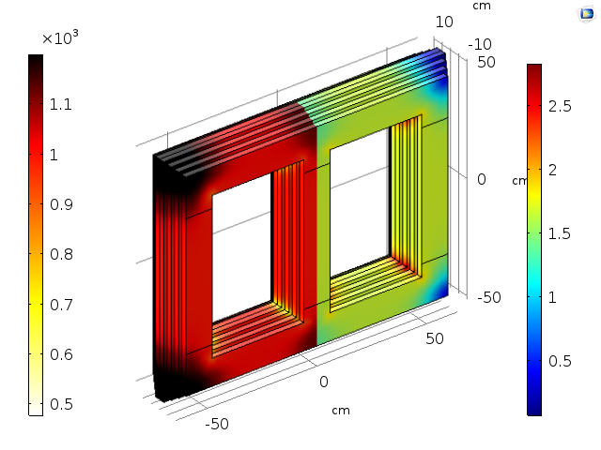
Core losses
(3D, OC test)
Core losses at 50Hz
FEM, magnetic losses formulation | 1.49 kW
Steinmetz | 1.56 kW
Empirical | 1.59 kW
Saturation (left half) and magnetic flux density (right half)
The computed losses are in good degree with empirical estimates from literature, such as given by the Steinmetz equation

Slide 12
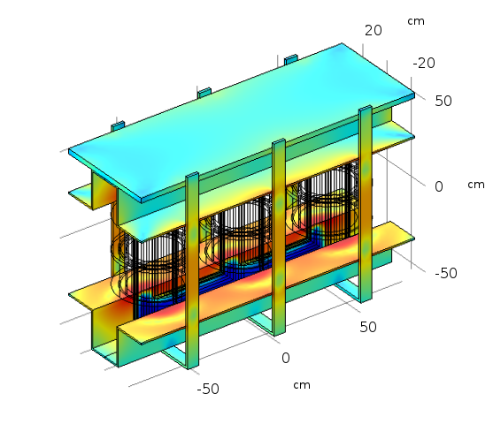
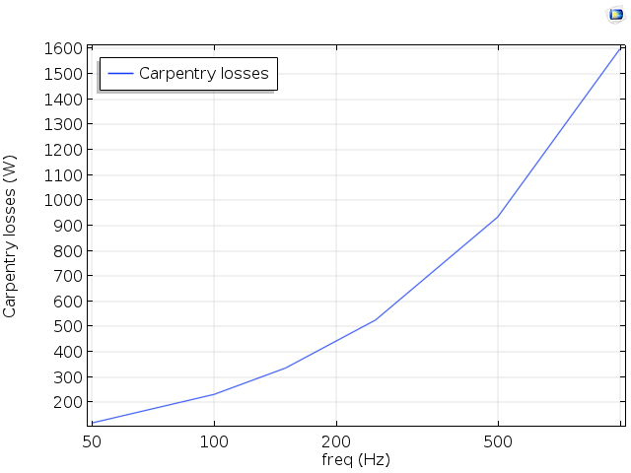
Carpentry losses (3D, SC test)
Surface current(log scale)
Losses 120W at 50Hz

Slide 13
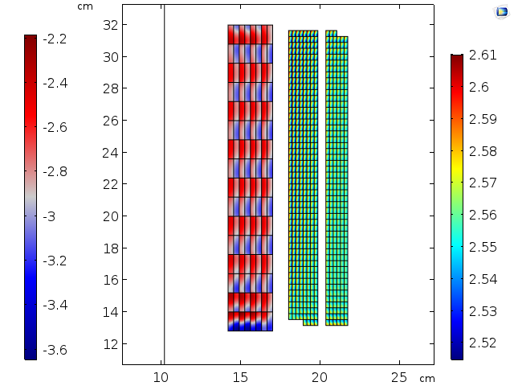

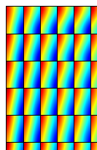
Coil current at 50Hz (2D-axi, SC test)
Secondary
Primary
4 conductors per winding
(Smoothing in geometry domains)

Slide 14
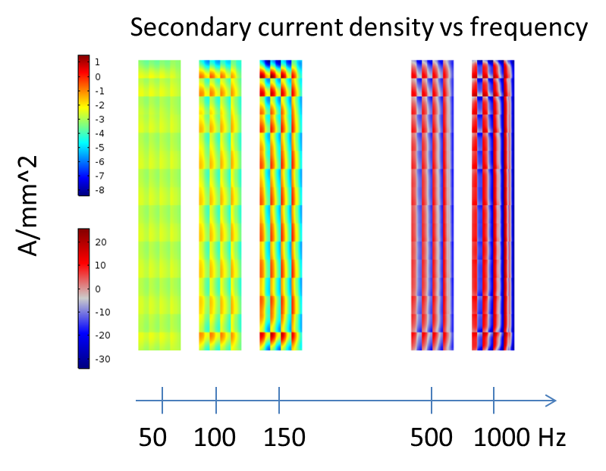
Coil current vs freq. (2D-axi, SC test)

Slide 15
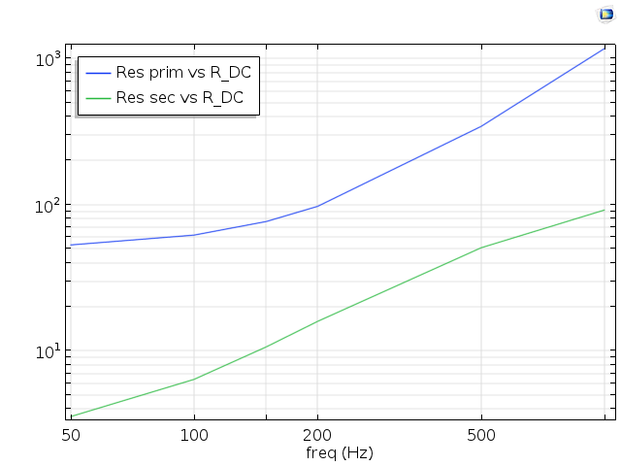
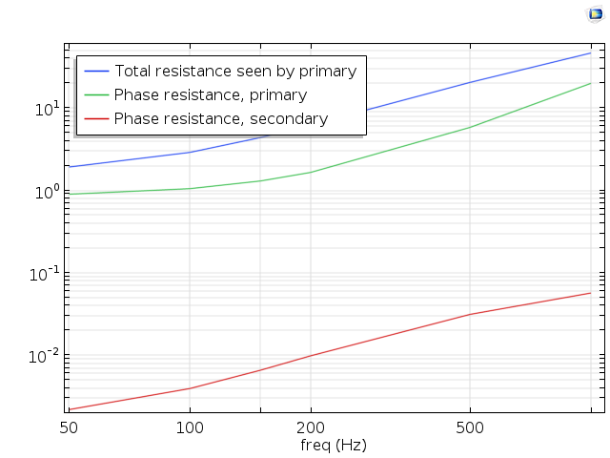
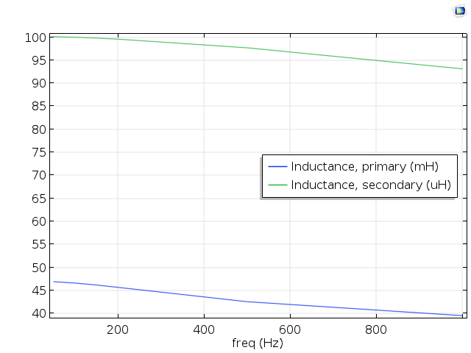
Coil impedance vs freq. (2D-axi, SC test)
 | At 50Hz
 | Resistance | Inductance
Primary | 900mΩ | 47mH
Secondary | 2.2Ω | 100μH

Slide 16
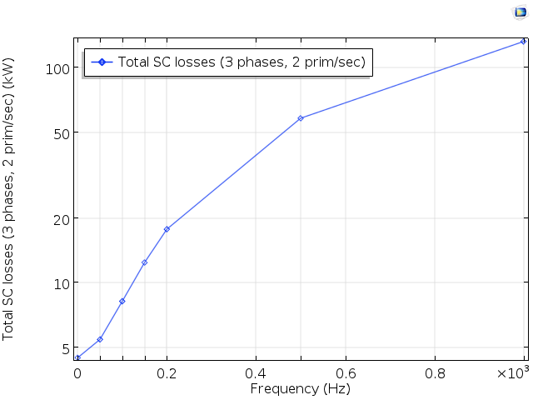
Coil losses (2D-axi, SC test)
Losses
5.5kW at 50Hz

Slide 17
Conclusions
A realistic design of a three-phase transformer has been modeled in 3D and 2D-axi
Two standard measurement setups (open and short-circuit) have been implemented
Losses and the most relevant lumped parameters have been computed

