Slide 1

The Epitaxial Growth of
SiC by the PVT Method
COMSOL

Slide 2
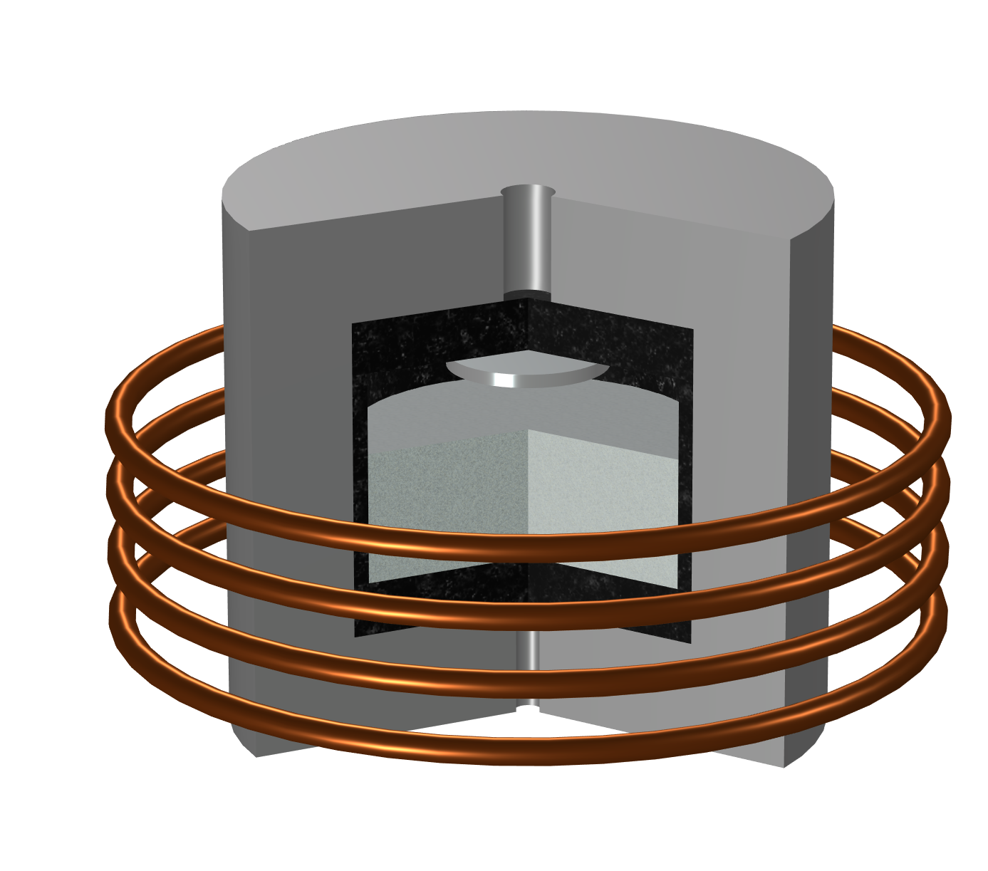
Epitaxial Furnace
Model Definition
Induction furnace
  Coil current: 1150 A
  Coil frequency: 16 kHz
Raw material powder heated to sublimation temperature
Gas phase SiC released and carried by the carrier gas
  Carrier gas: H2
  Reference pressure: 5000[Pa]
SiC deposited on the plate with seed crystals

Slide 3

Model Definition
Water cooling surface
Two-dimensional axisymmetric
Epitaxial film grows at the plate with seed crystals
The raw material powder is treated as a solid region
Water-cooling at the upper and lower surfaces
Graphite felt insulation layer outside the graphite crucible
Latent heat from phase change is neglected
Stefan flow is neglected
Air
Graphite felt
Seed crystal
Carrier gas
Induction coil
Raw material powder
Crucible
Water cooling surface

Slide 4
Material Properties
Material | Thermal capacitance [J/(kg*K)] | Density [kg/m^3] | Thermal conductivity [W/(m*K)] | Electrical conductivity [S/m] | Relative permeability Relative permittivity
SiC | 1200 | 3200 | 450 | 1000 | 1
Graphite | 710 | 1950 | 150 | 3000 | 1
Graphite felt | 200 | 120 | 0.3 | 100 | 1
Material properties used in the model are shown in the table
Properties of hydrogen, air and copper are imported from the Material Library

Slide 5
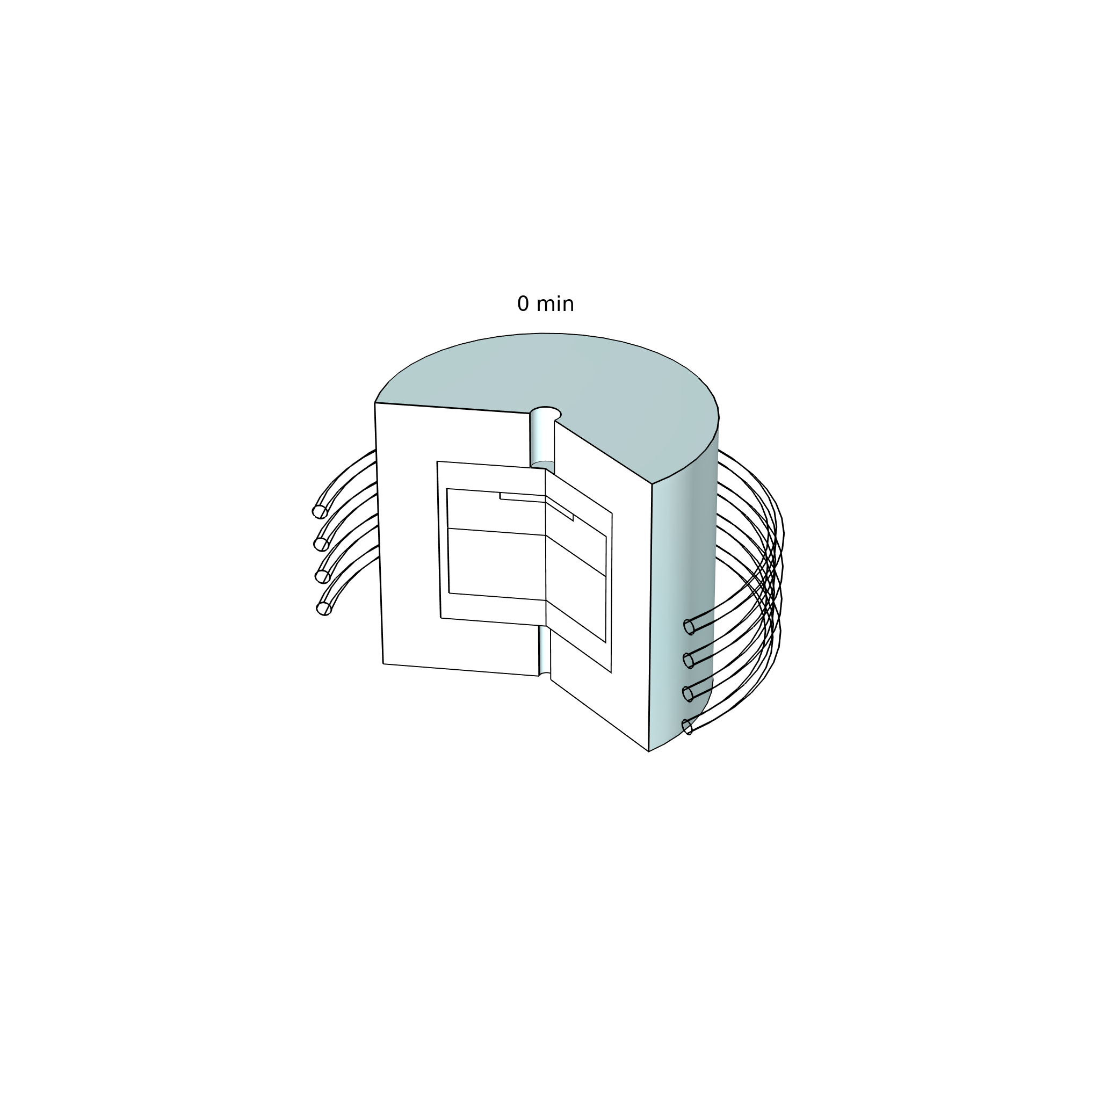
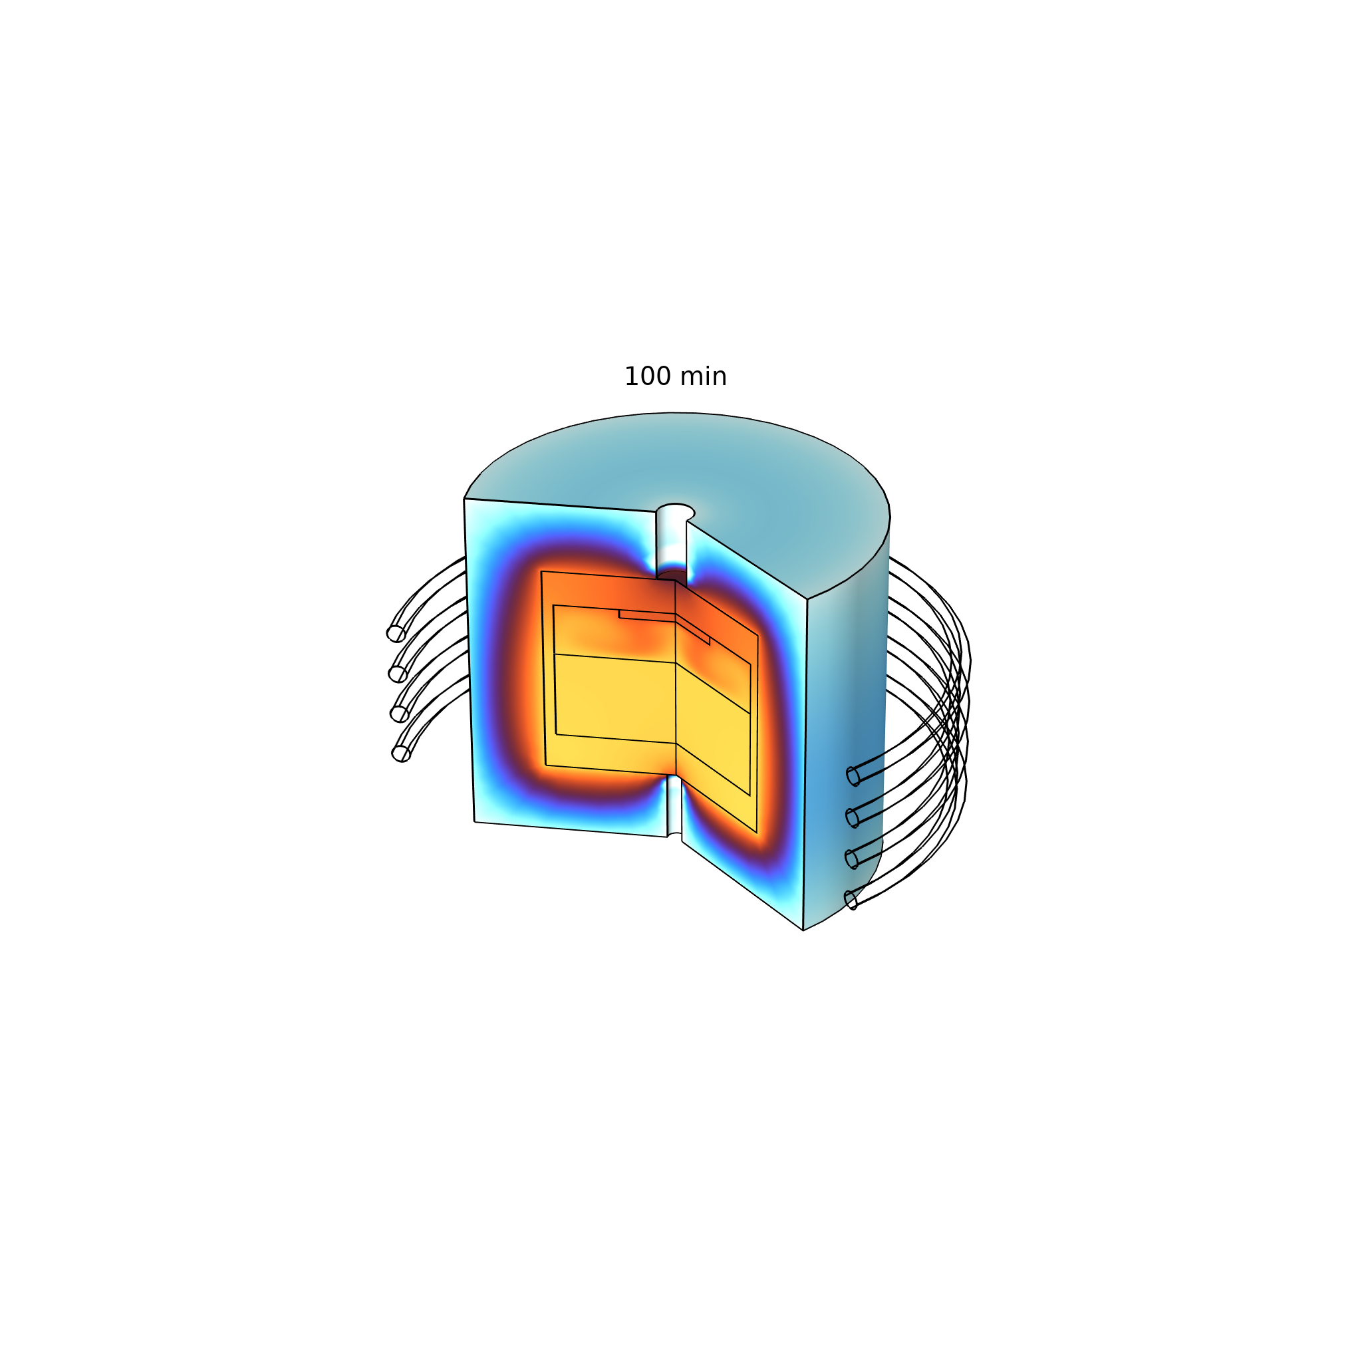
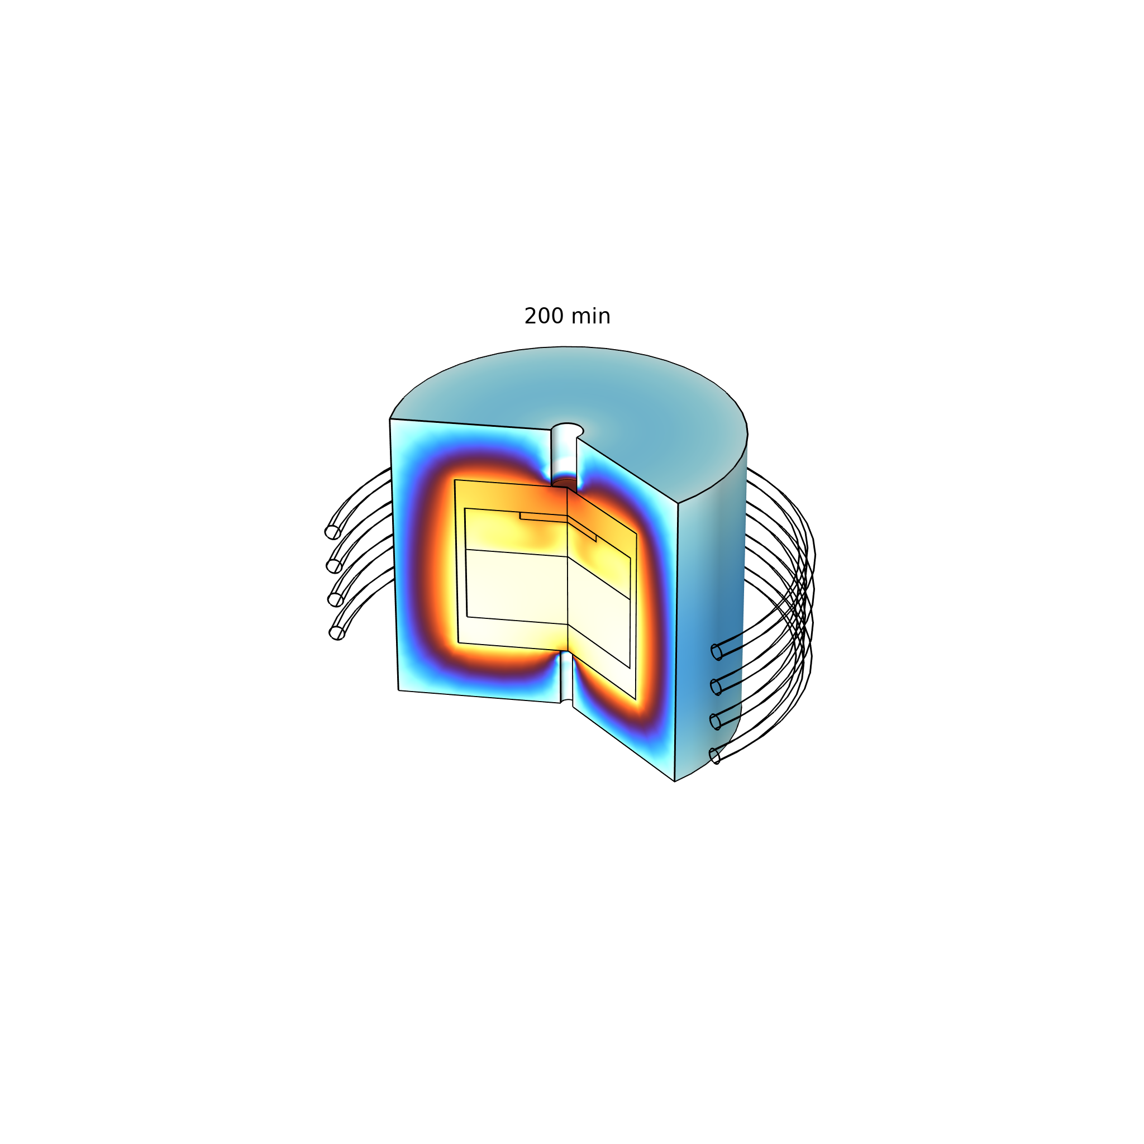
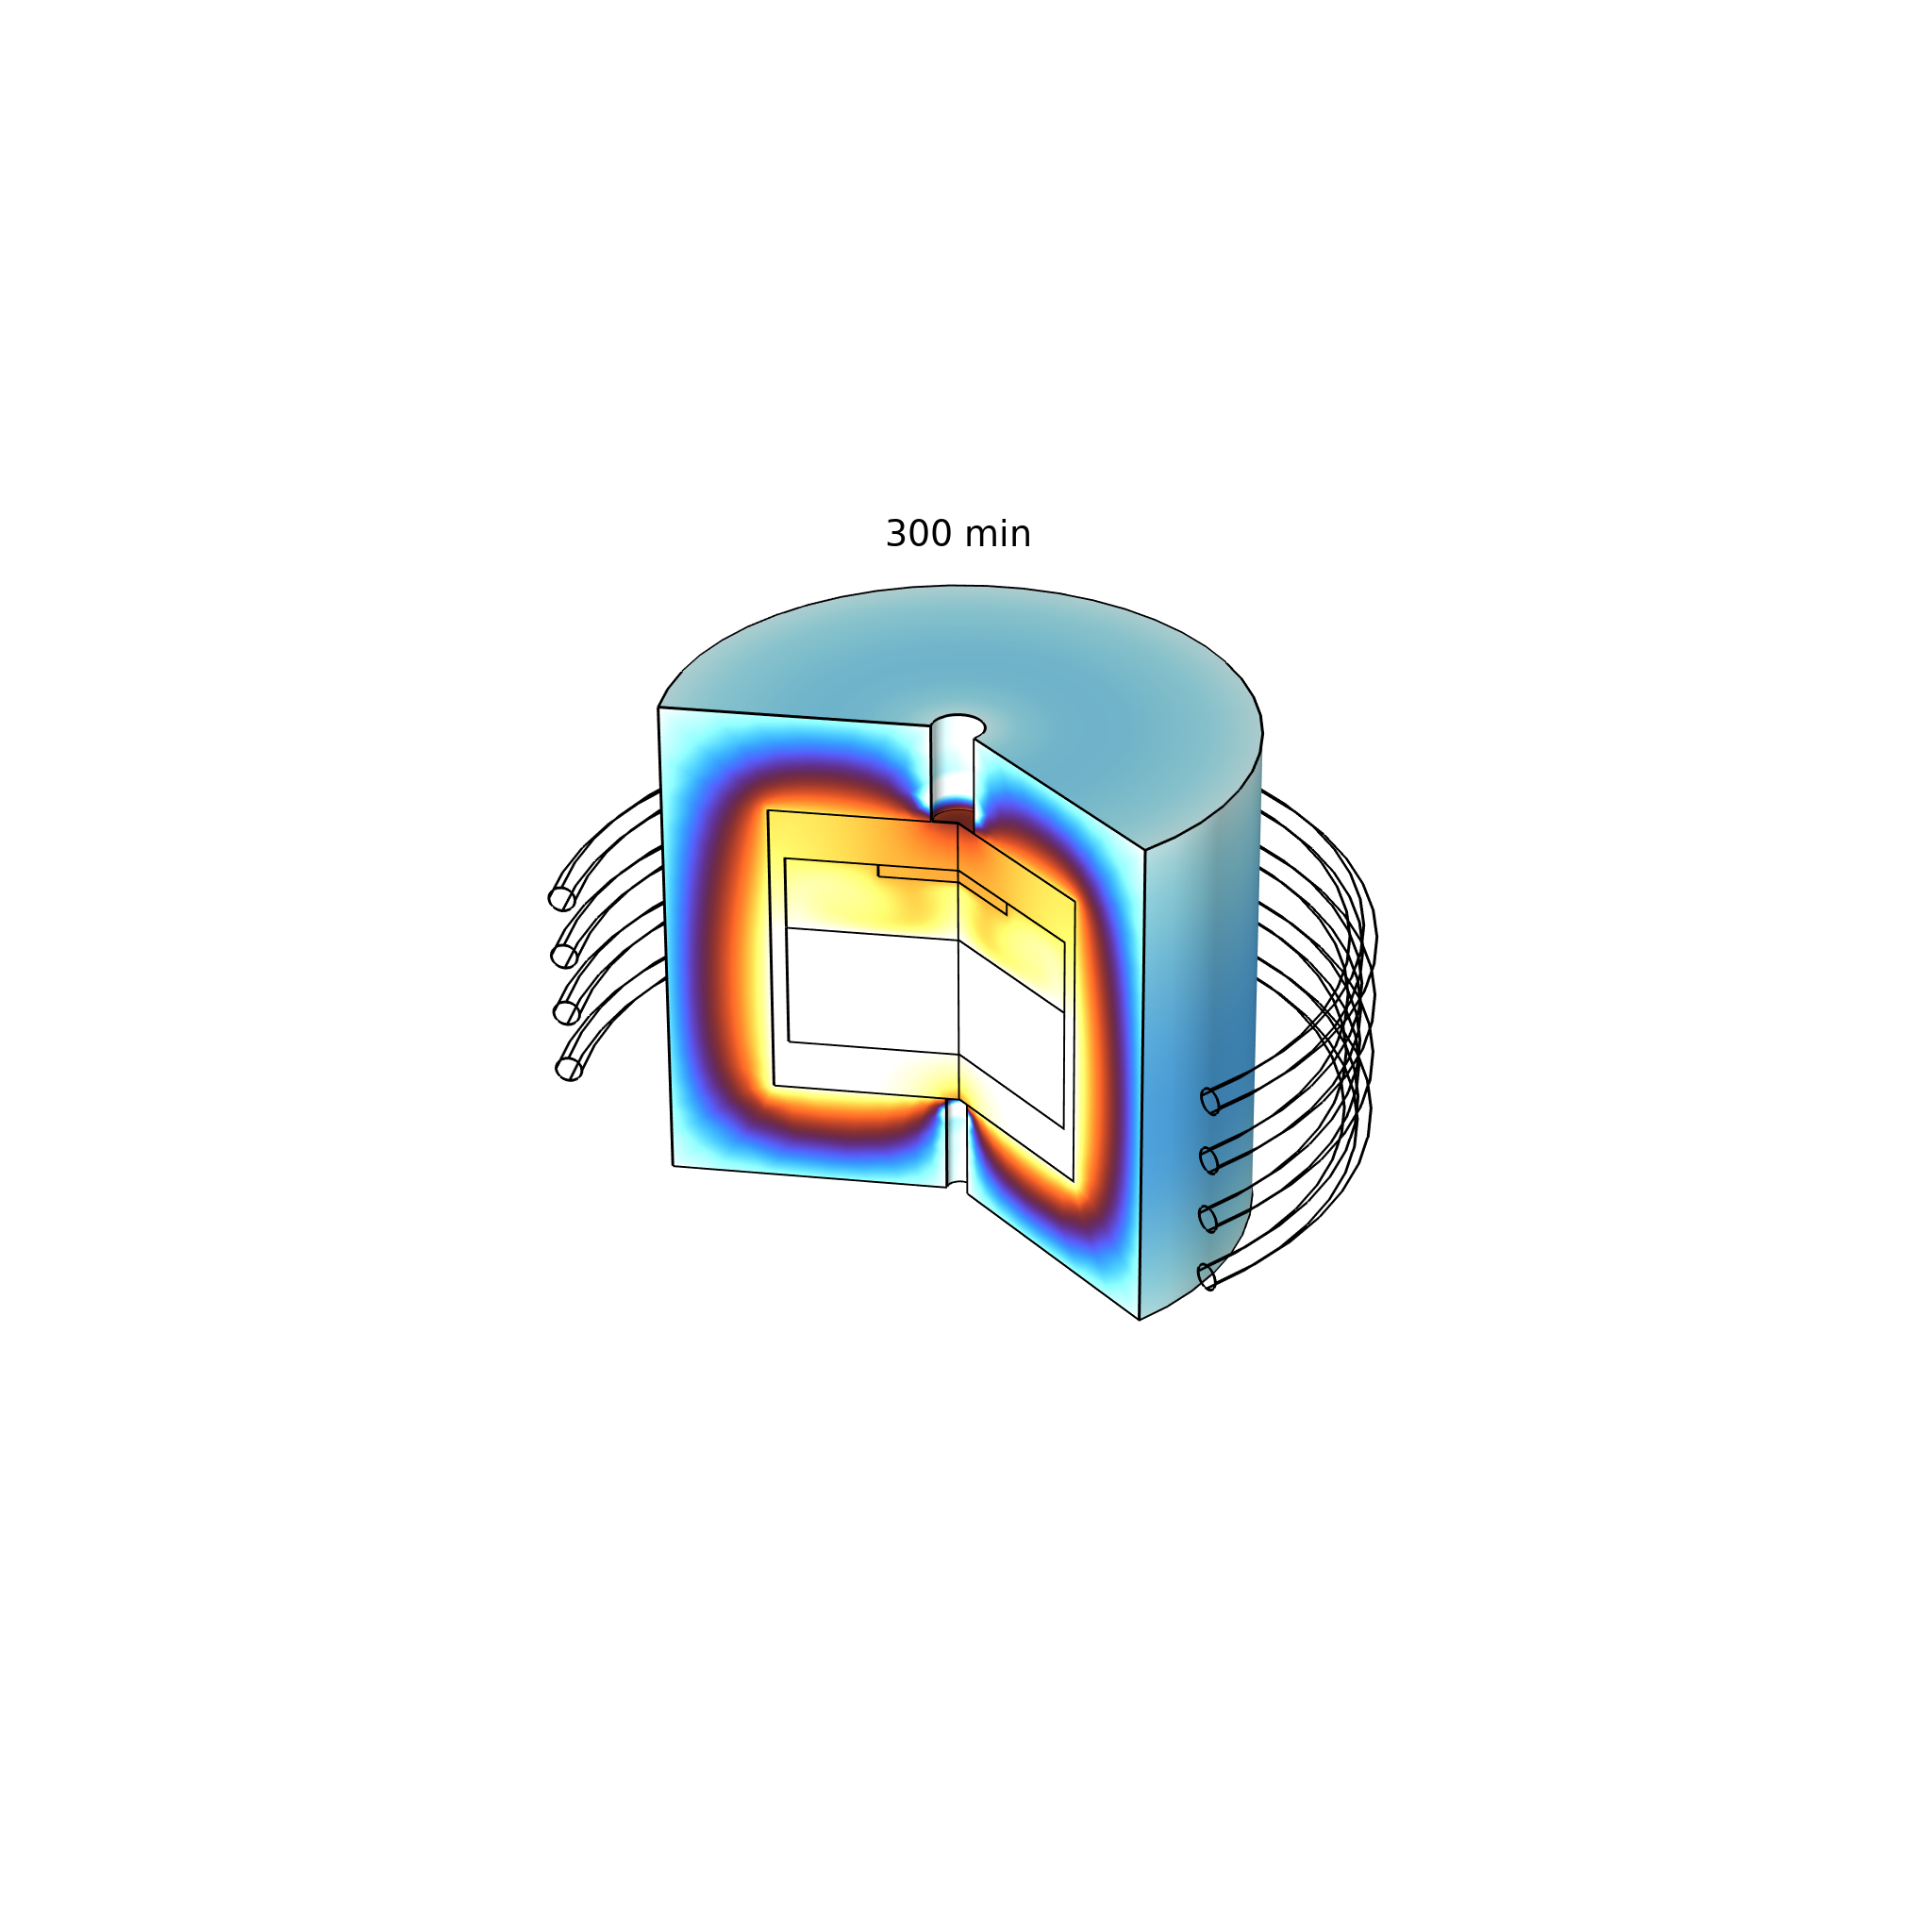
Implementation in COMSOL Multiphysics®
Magnetic Fields
Flow & Heat transfer
Mass Transfer
Magnetic Fields interface
Electromagnetic Heating multiphysics coupling
Study: Frequency Domain
Heat Transfer in Solids and Fluids
Laminar flow for natural convection of carrier gas
Surface to surface radiation
Transport of Diluted Species
Surface reaction with deposition rate defined
Sublimation flux defined on the solid-gas interface

Slide 6
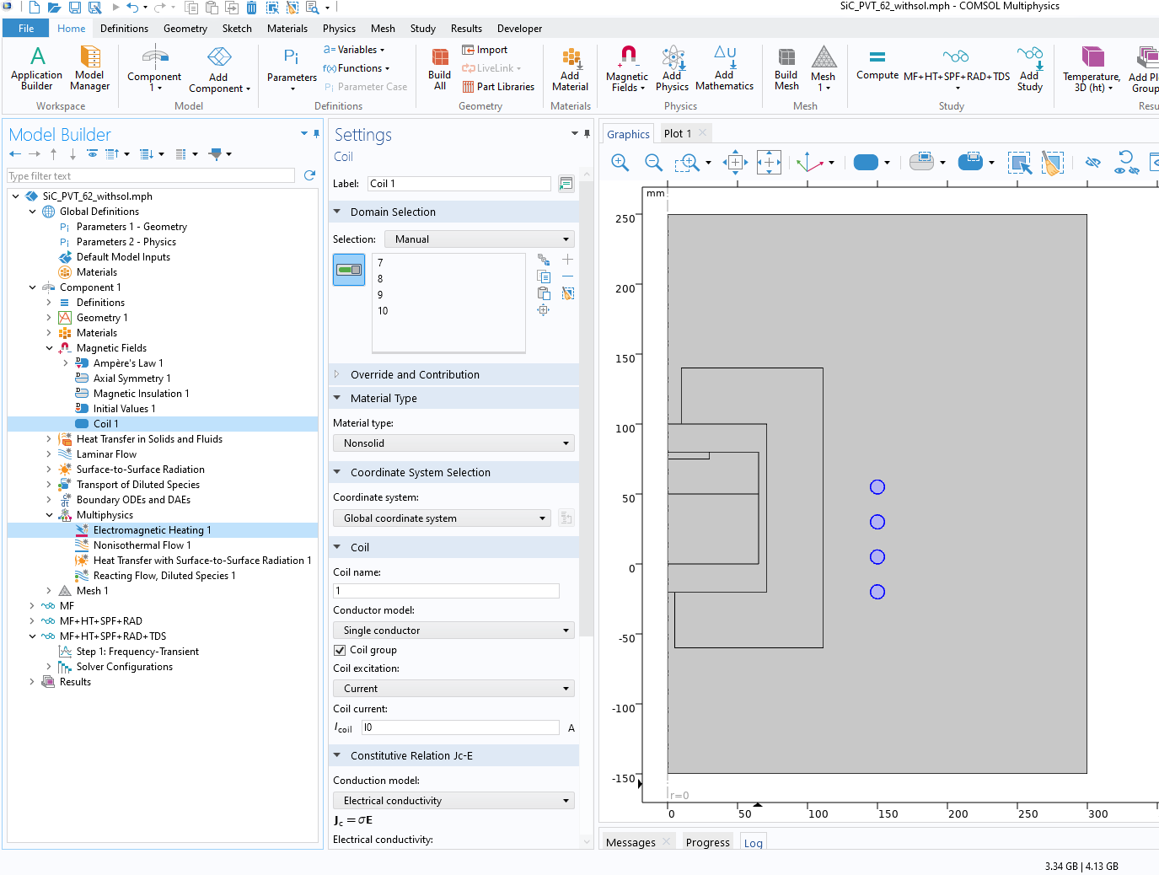
Magnetic Fields
Coil current specified
Electromagnetic Heating multiphysics coupling

Slide 7
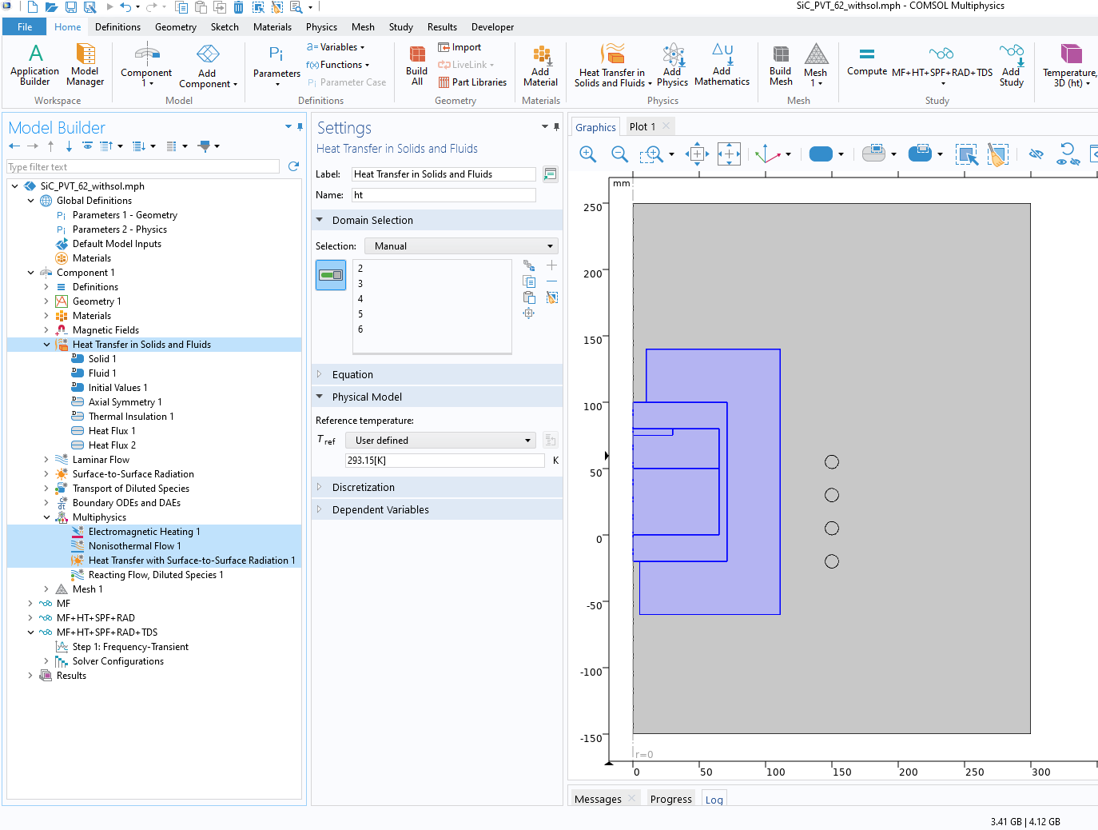
Heat Transfer
Heat transfer in the furnace is investigated
Convective heat flux specified at:
  The outer surface of the furnace
  The water cooling surfaces

Slide 8
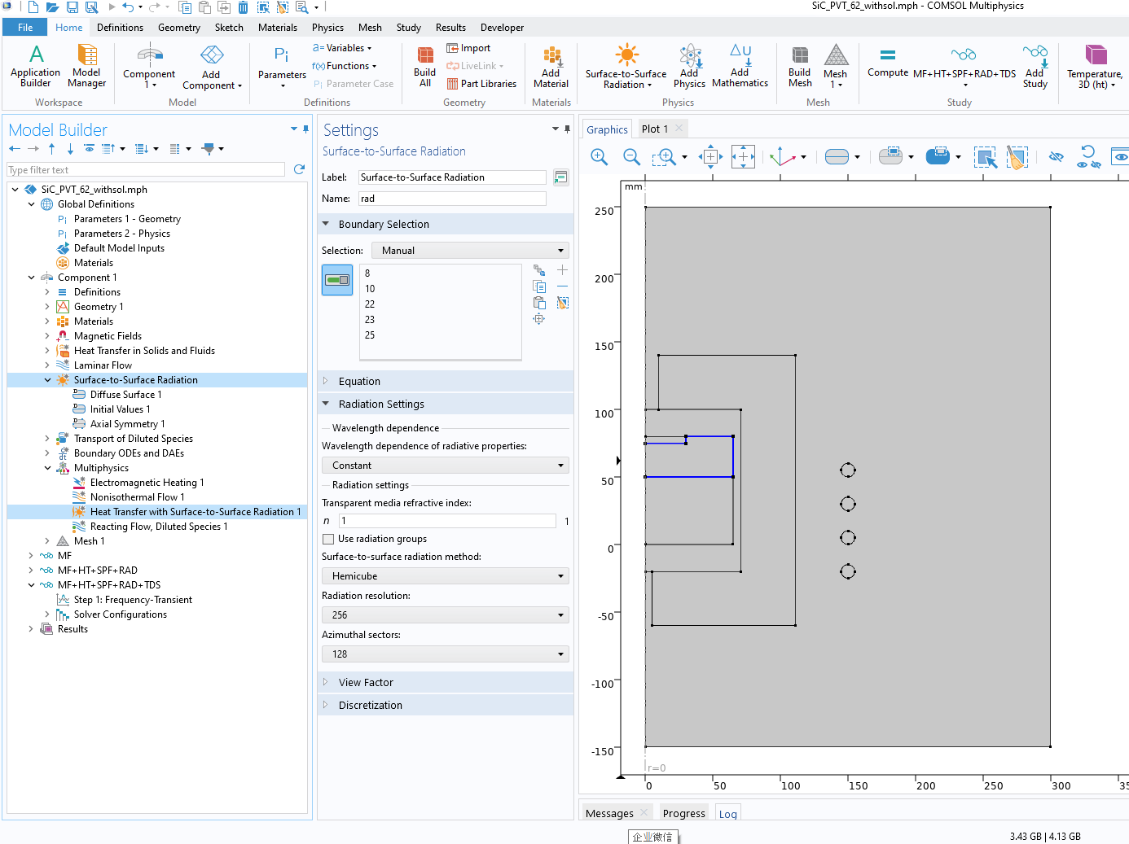
Thermal Radiation
Surface to surface radiation inside the carrier gas region.
Heat Transfer with Surface-to-Surface Radiation multiphysics coupling

Slide 9
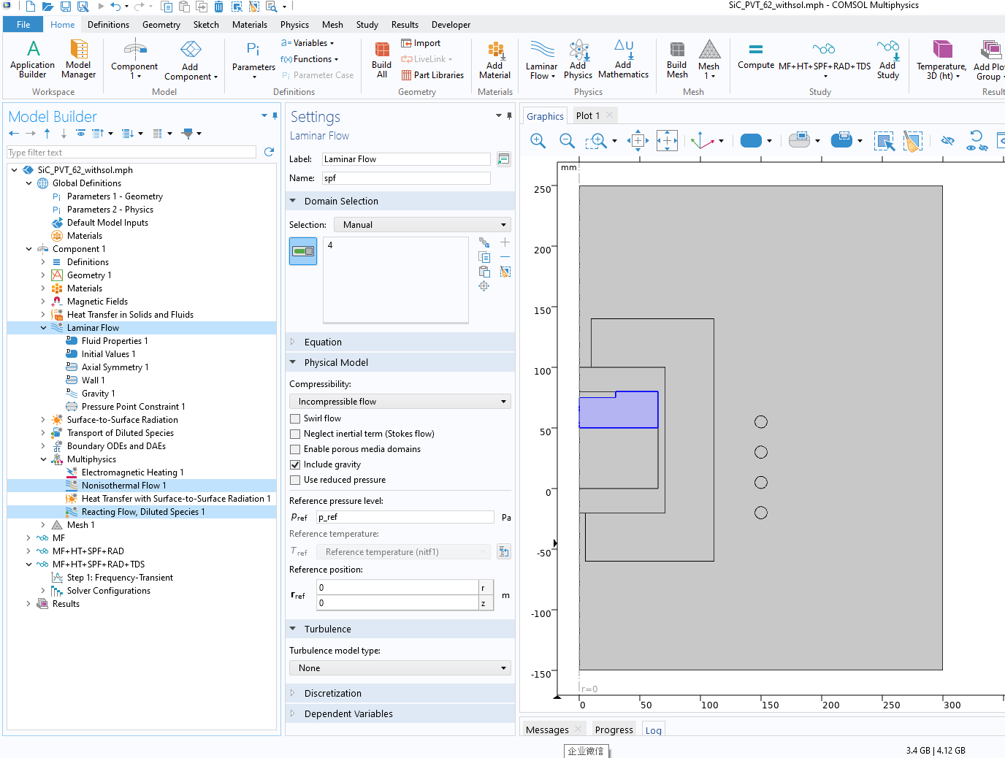
Flow Field
Laminar flow
Incompressible flow
Boussinesq approximation
Pressure point constraint: 5000 [Pa]

Slide 10
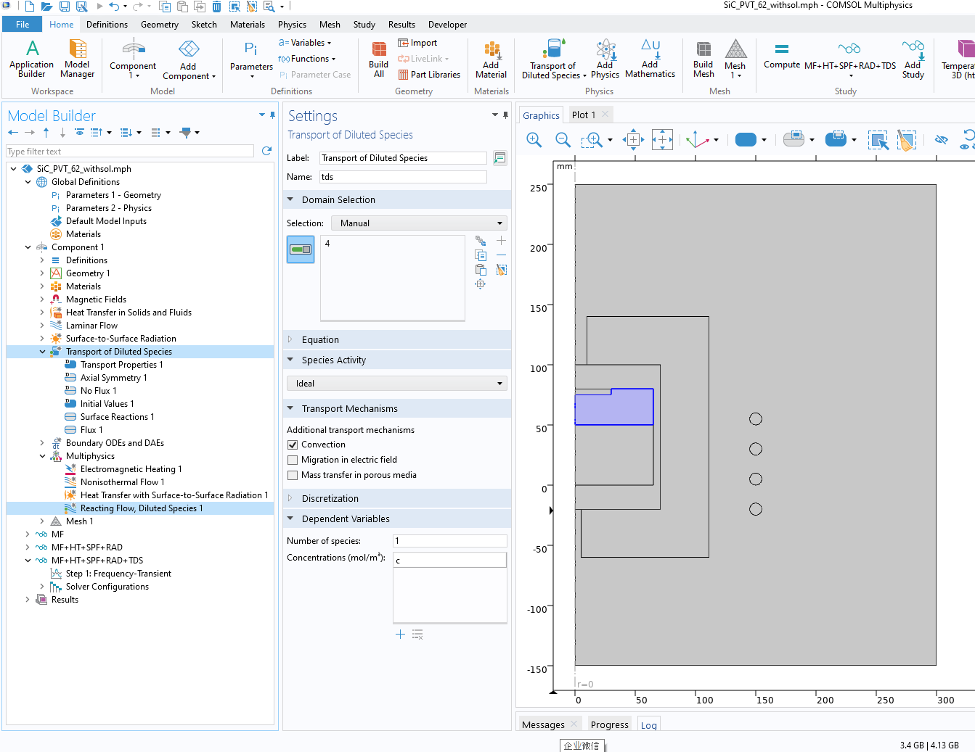
Mass Transport of SiC
Surface deposition using Surface Reaction with reaction rate defined, which is the product of the local concentration and the deposition coefficient.
Sublimation rate defined as a boundary flux.

Slide 11
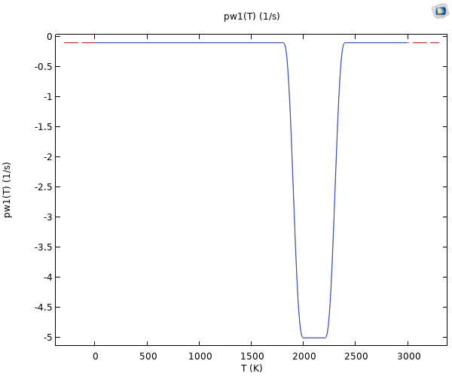
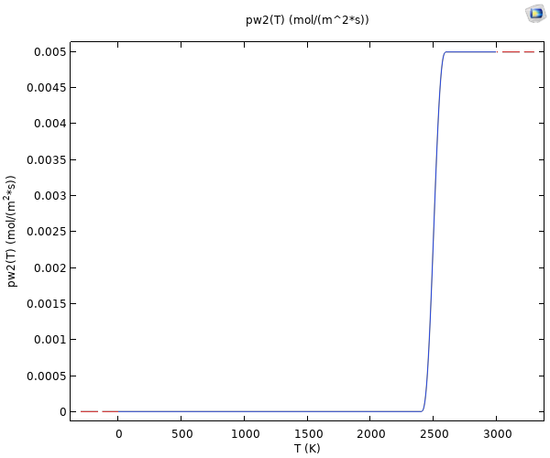
The Deposition Coefficient and the Sublimation Flux
The deposition coefficient as a function of temperature
The sublimation flux as a function of temperature

Slide 12
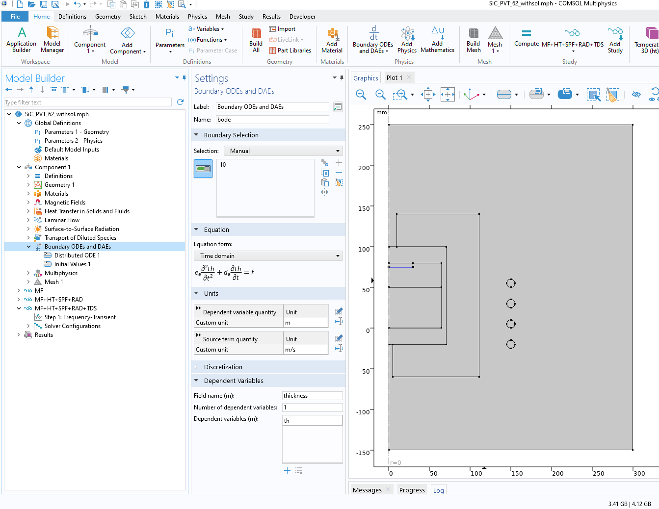
Epitaxial Layer Thickness
Boundary ODE
Source term: calculated from deposition flux, molecular mass and crystal density

Slide 13
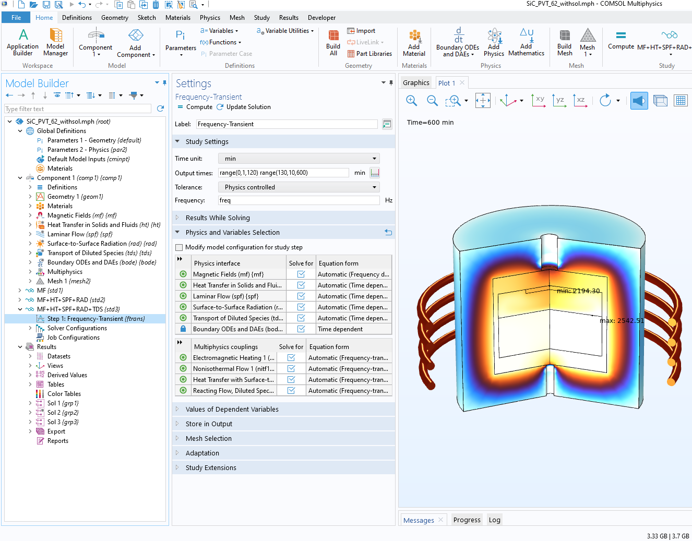
Study
Study 1: Magnetic fields, frequency-stationary
Study 2: Magnetic fields, heat transfer, flow field, radiation, frequency domain-transient
Study 3: Magnetic field, heat transfer, flow field, radiation, mass transfer, BODE, frequency domain-transient

Slide 14
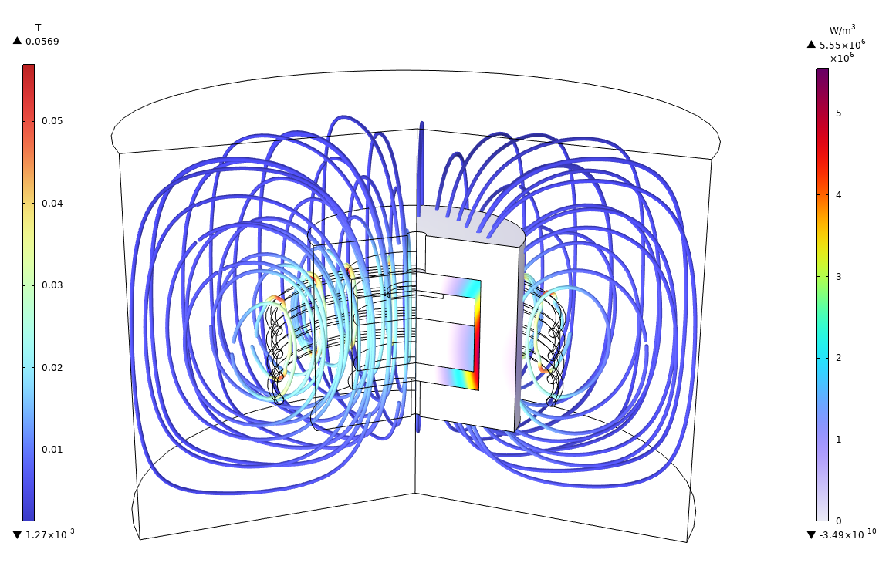
Magnetic Field Results
Electromagnetic losses
Magnetic flux and density

Slide 15
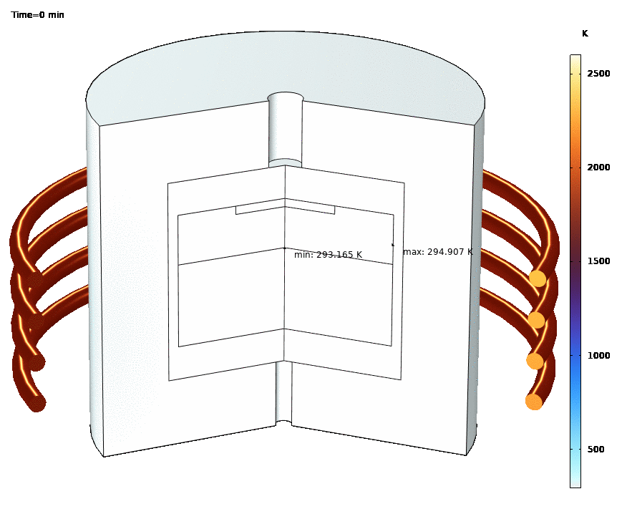
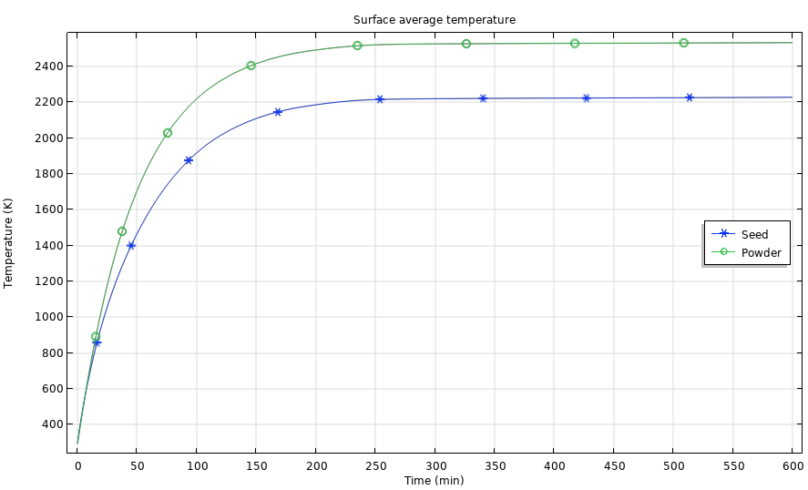
Temperature Field in the Furnace
The temperature reaches a steady state after 300 minutes.
Sublimation and deposition of SiC
  T=2533K at the raw material powder surface
  T=2227[K] at the epitaxial growth surface

Slide 16
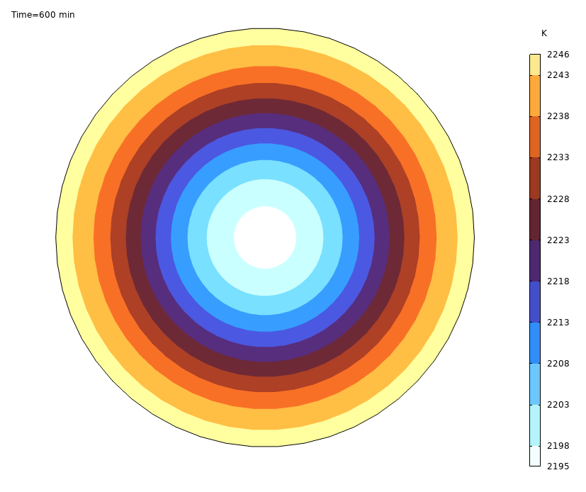
Temperature Distribution on the Epitaxial Film
Temperature gradually decreases from the edge to the center
Maximum temperature difference: 51K
Temperature directly affects deposition rate (see p11)

Slide 17
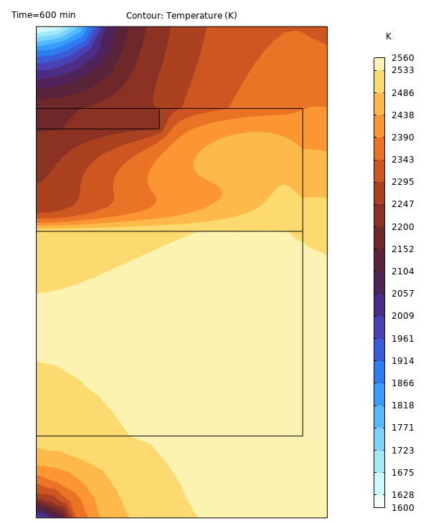
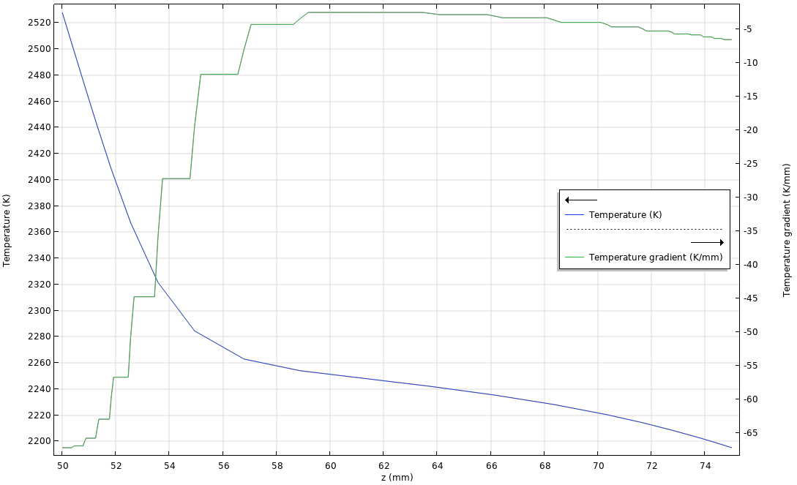
Temperature Gradient Along the Central Axis
Z=75[mm]
Carrier Gas Zone
Temperature Gradient
Z=50[mm]
In the carrier gas zone, dT/dz<0, hence natural convection
Temperature gradient at the epitaxial film surface: 5 [K/mm]
Close to the epitaxial growth surface, the temperature gradient is more stable.

Slide 18
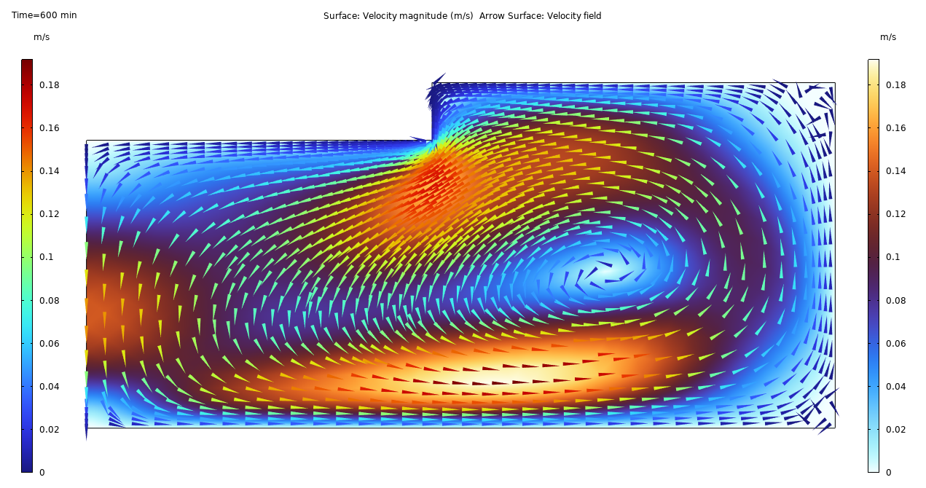
Carrier Gas Flow
Natural convection
  The surface plot shows the temperature field
  The arrow plot shows the direction and magnitude of the flow velocity
Counterclockwise flow field due to natural convection

Slide 19
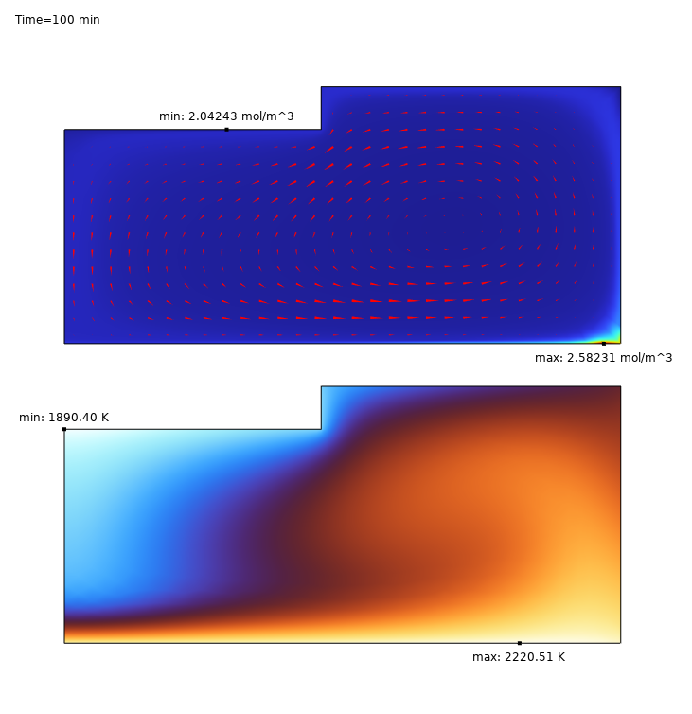
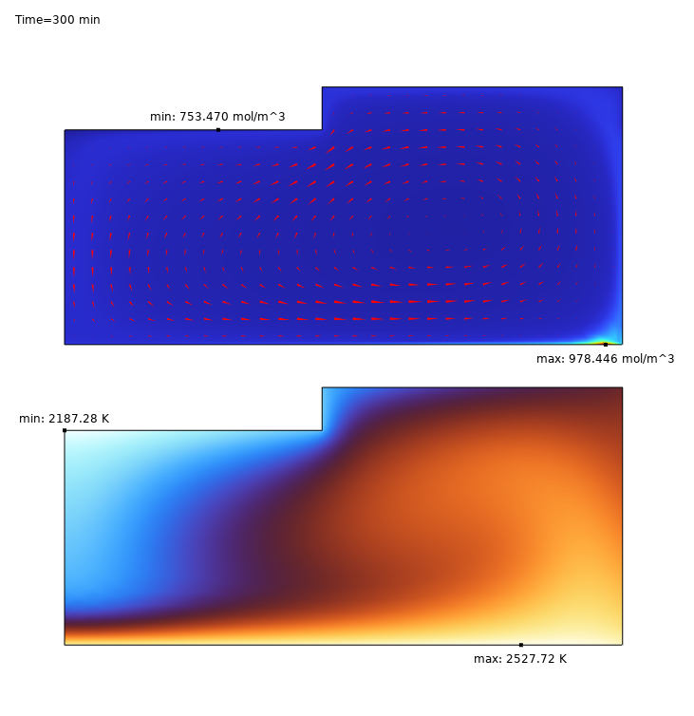
Mass Transfer
The upper plot represents the SiC concentration and mass flux in the carrier gas zone
The lower plot shows the temperature results
100 min
200 min
The temperature in the raw material powder has not reach the sublimation point yet, the SiC concentration in gas zone is very small
When the powder temperature rises to 2500 [K], sublimation begins. More SiC is released into the carrier gas zone.

Slide 20
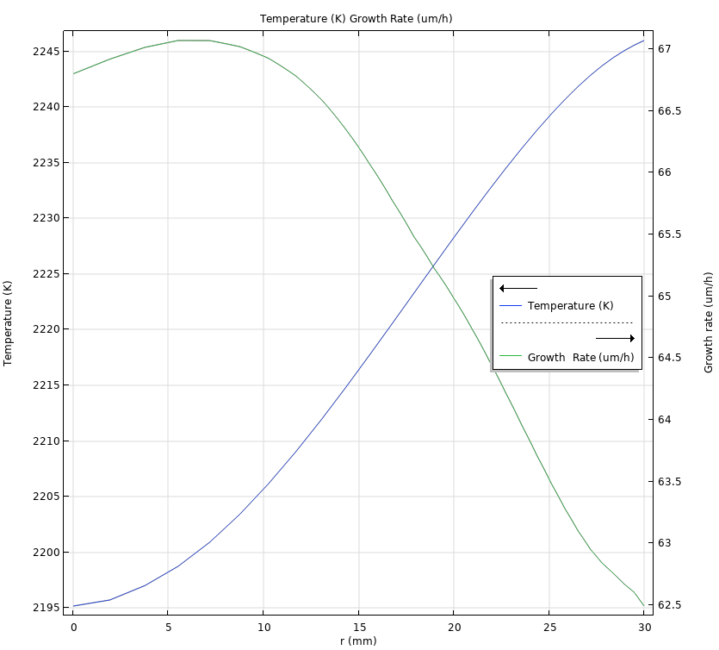
Epitaxial Growth
Temperature distribution and growth rate distribution along the radial direction on the seed crystal surface at 600 minutes
The average growth rate is about 64.7[um/h]
The growth rate is larger at the center of the crystal due to the lower temperature, which makes it more suitable for deposition

Slide 21
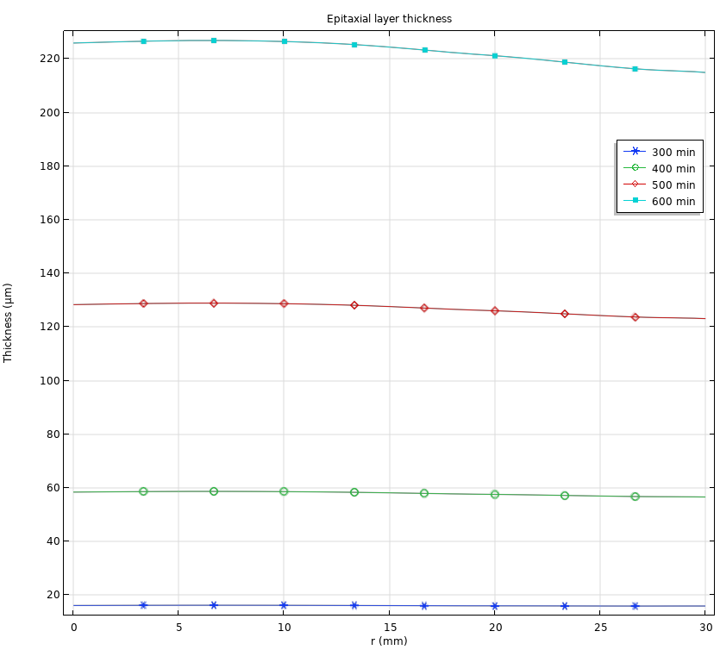
Epitaxial Layer Thickness
Sublimation starts after 300 min and the thickness of the epitaxial layer starts to increase gradually;
The average thickness of the epitaxial layer after 600 min was 221um
Thicker Epitaxial layer at the center, which is the result of a faster deposition rate at the center

Slide 22
CONCLUING REMARKS
Epitaxial Growth of SiC by PVT Method
The fluid flow, heat transfer and mass transfer in the epitaxial growth of SiC by PVT method is investigated. Results can be used to optimize the design of the system.

Slide 23
Possible Extensions of the Model
Deposition flux defined by sublimation and deposition kinetics
  Saturated vapor pressure
  Hertz-Knudsen equation
Introducing Stefan flow
Including Deformed Geometry for large crystal growing
Constant temperature maintained by PID control

