Slide 1
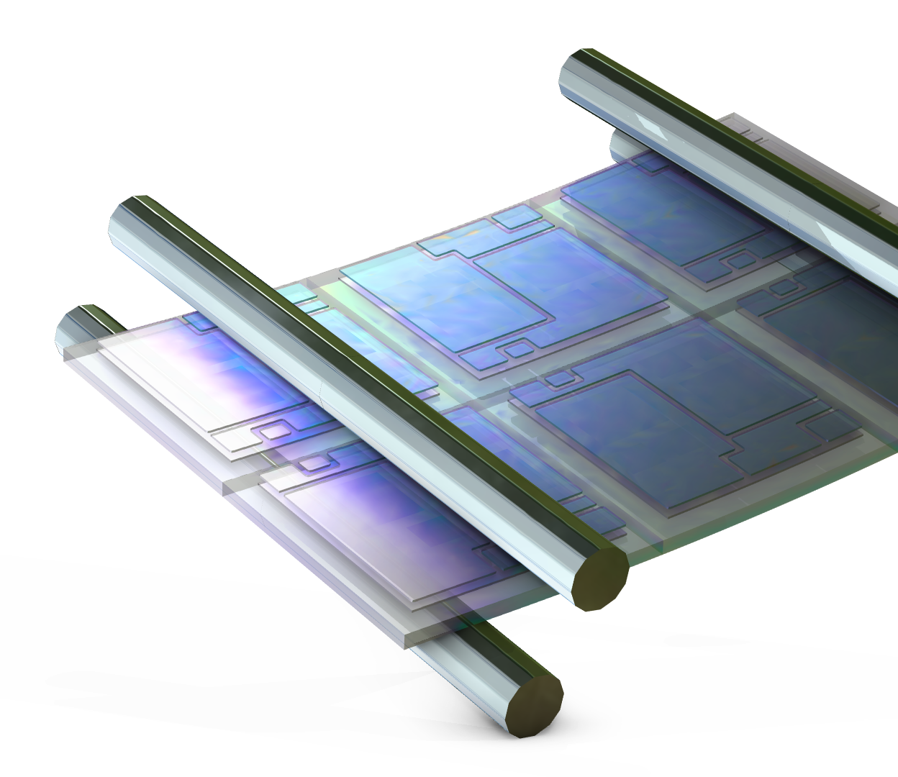
Four-Point Bending
Test of an IGBT Module
Your Name
COMSOL

Slide 2
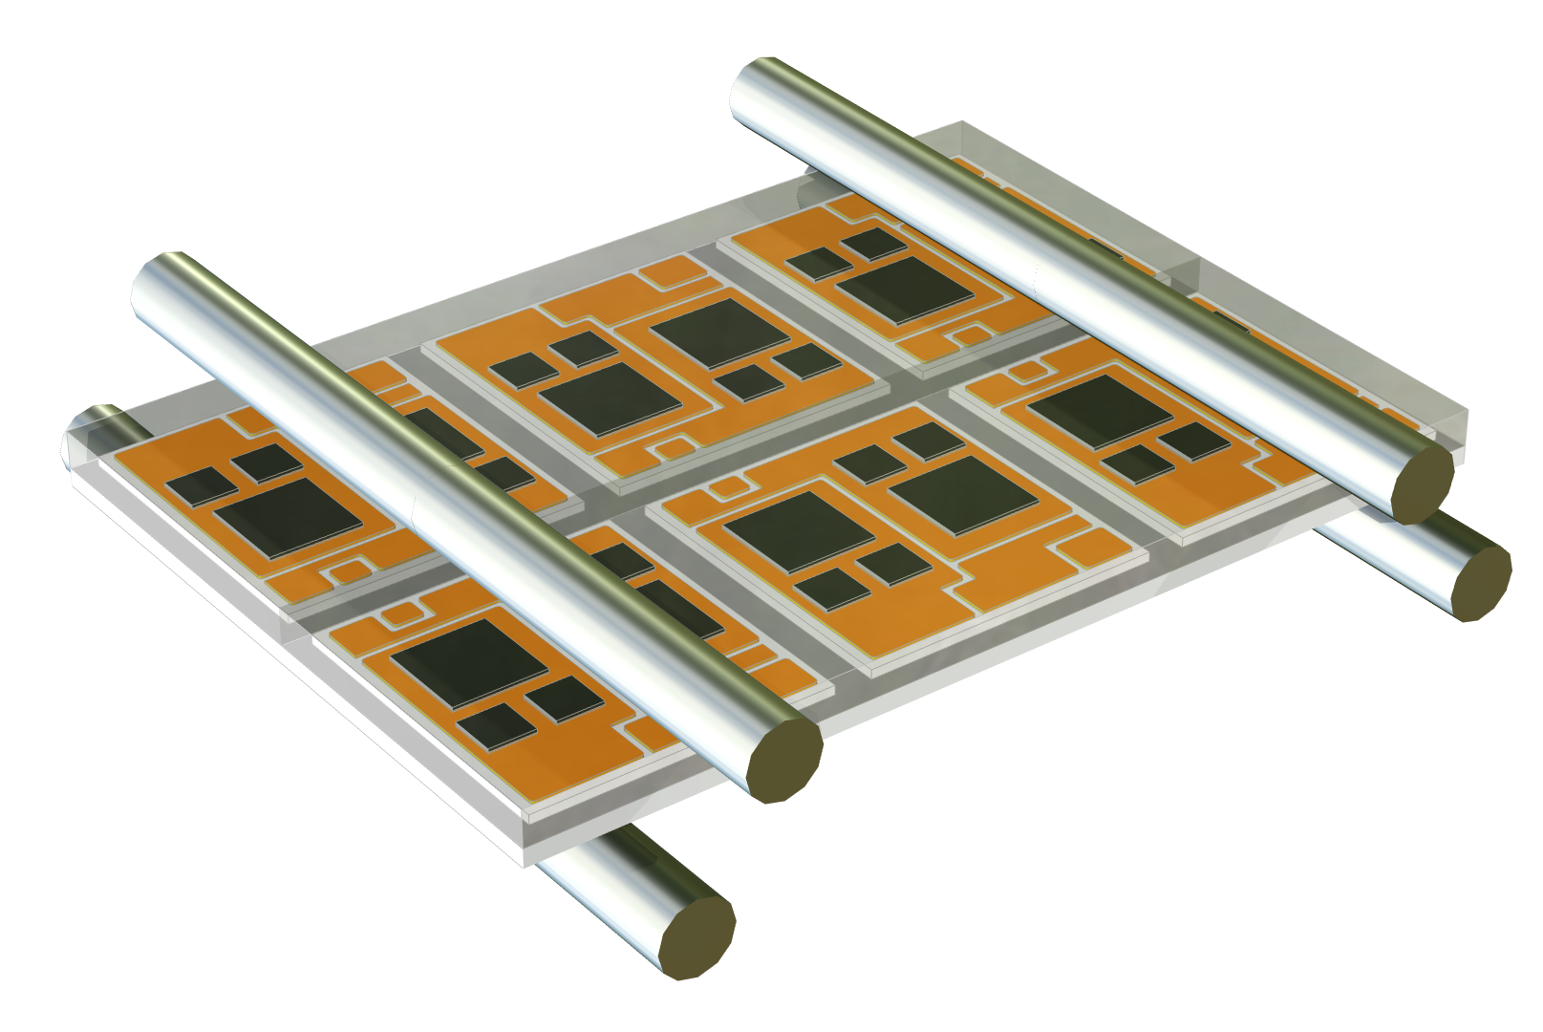
Introduction
Four-point bending test
  Force on the upper pressure rollers causes the IGBT module to bend and deform
  The lower pressure rollers are fixed
Test the flexural strength and warpage of IGBT modules under bending
Reference standards：BS ISO 23212: 2020

Slide 3
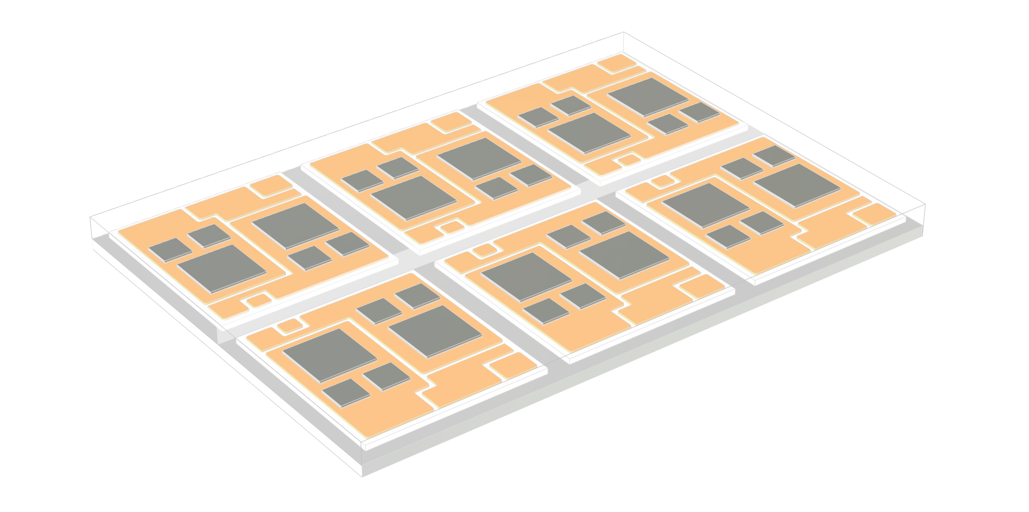
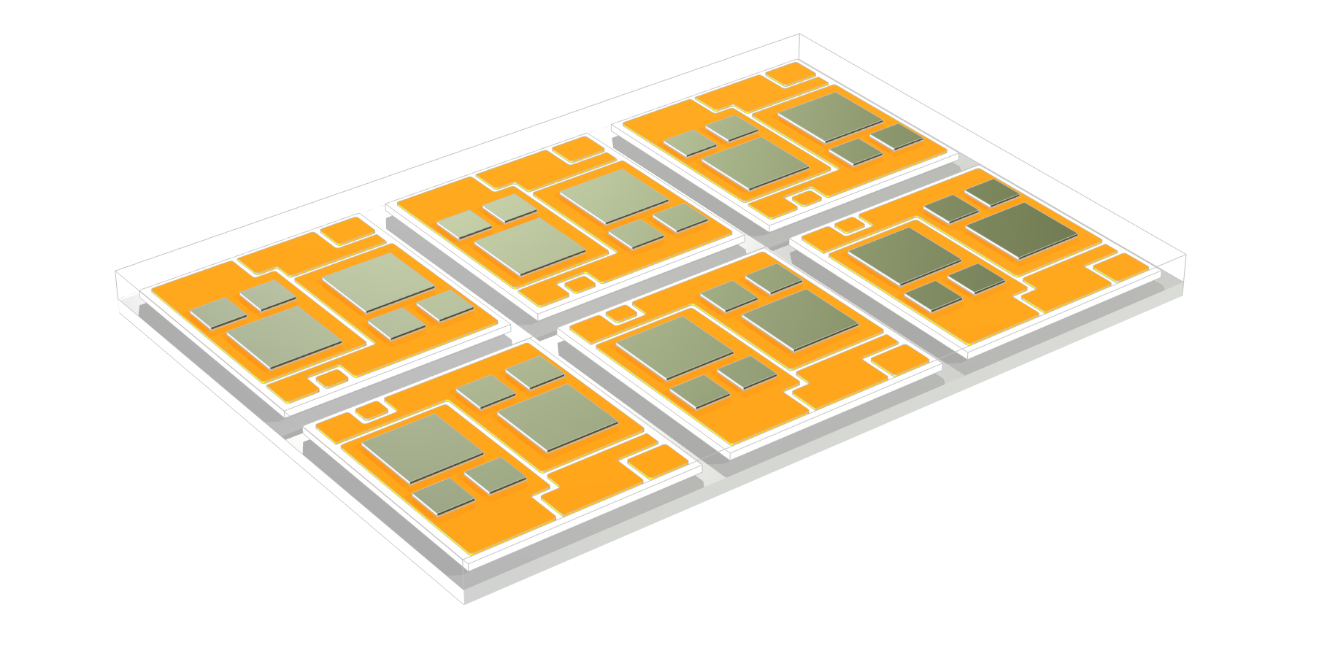
IGBT Module
Composition of the module
  Epoxy molding compound
  Silicon chips
  Solder
  Ceramic Substrate
  Copper substrate
Complete IGBT module consists of 6 small modules

Slide 4
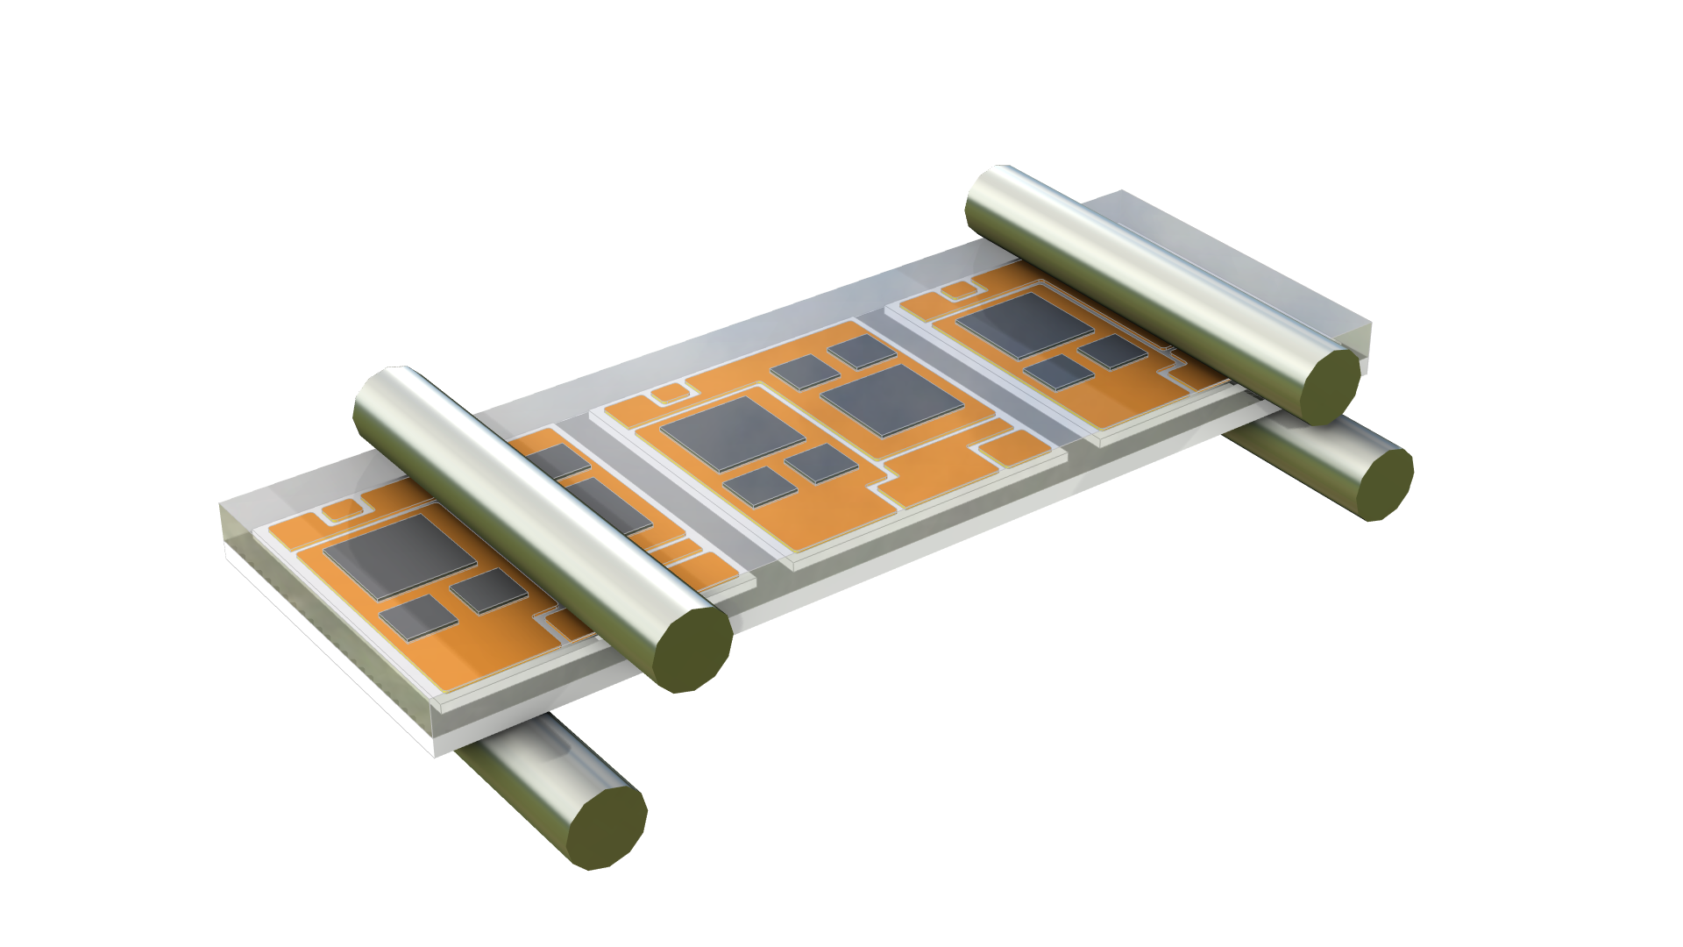
Model Assumptions
F = 2E7[N/m^2]
Symmetry
  Half the geometry is modeled
  Improves computational efficiency
Four contact pairs
  IGBT modules and pressure rollers
  Stabilization suppresses rigid body motion
Slow compression, ignoring inertial effects
  Auxiliary sweep of the load to improve the convergence of the contact problems

Slide 5
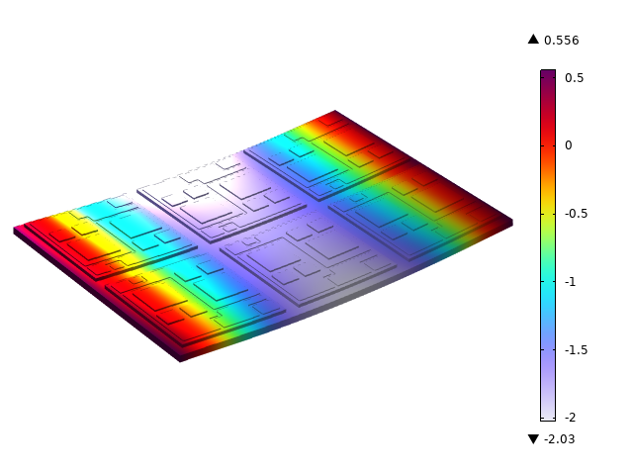
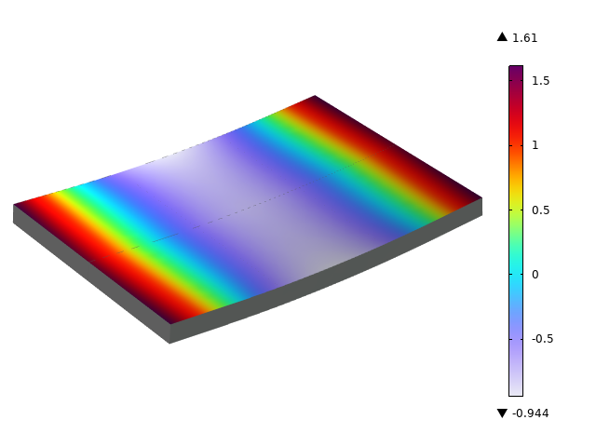
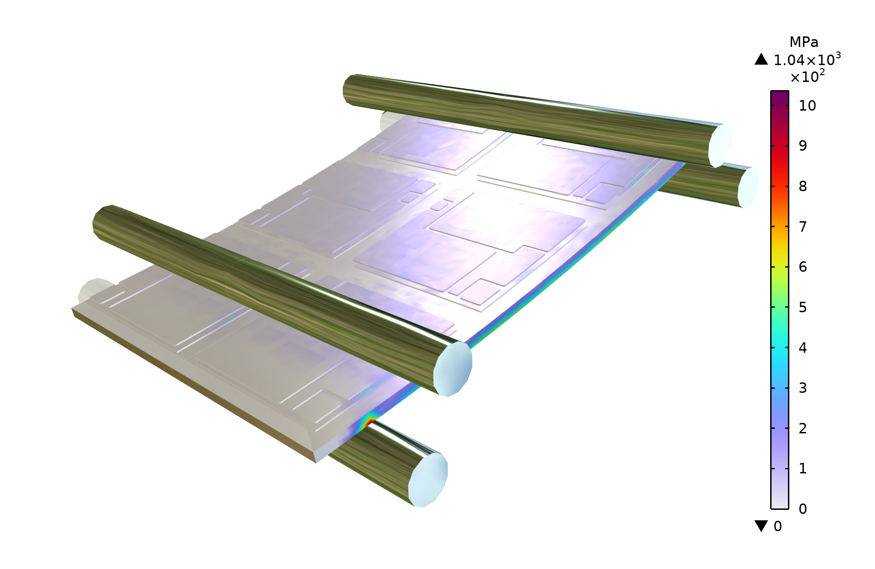
Result: Deformation and Stress
Z-direction displacement (mm)
  The maximum bending deformation is found in the middle of the module
Warpage on the upper surface (mm)
  The warping deformation on both sides is greater
Von mises stress (MPa)
  The maximum stress exceeds the yield stress

Slide 6
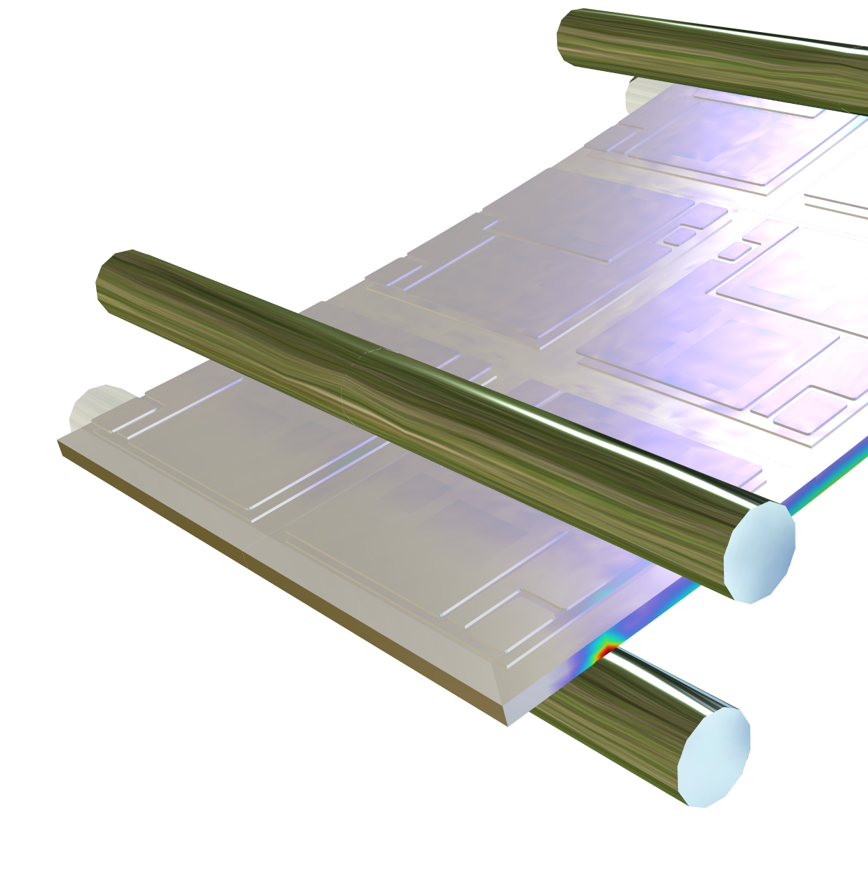
Possible Future Extensions
Consider the plasticity of the materials:
  Include irreversible plastic deformation
Material fracture:
  Flexural stress exceeds the limit, which means that the IGBT modules will fracture
  Damage can be used to calculate crack extension

