Slide 1
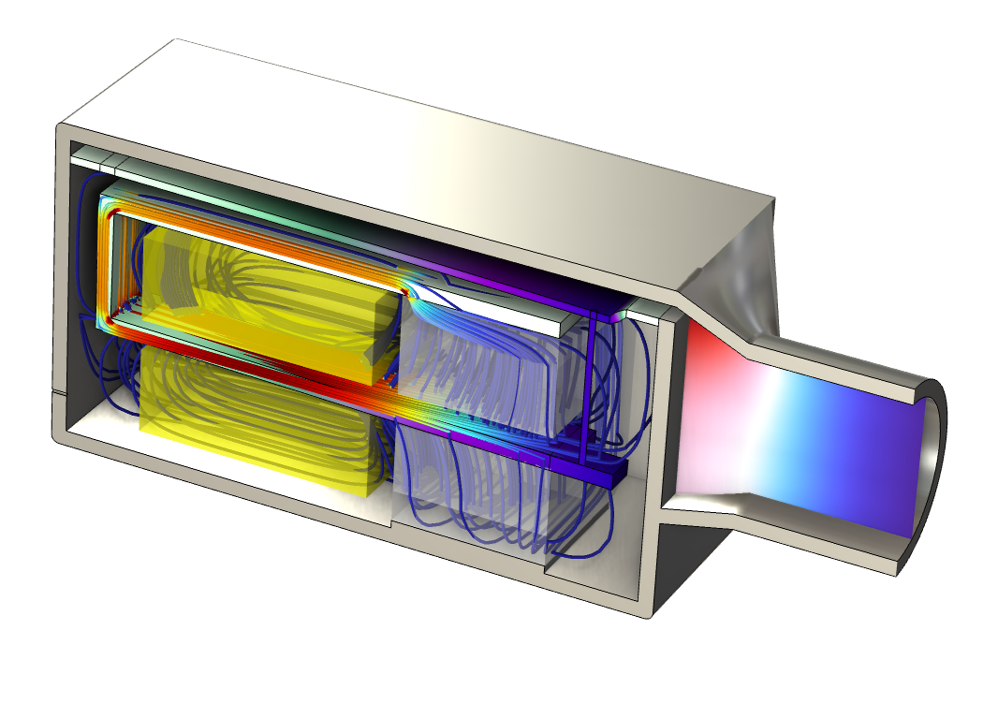
Balanced Armature Transducer –
Frequency Domain Analysis

Slide 2
Background
This is a full vibro-electroacoustic simulation of a balanced armature transducer (also known as a receiver in some industries) which is a high performance miniature loudspeaker often used in hearing aids and other in-ear audio products.
The model is set up using a linear frequency domain perturbation approach on top of the DC analysis of the magnetic system. The electromagnetic coupling to the armature is done using the built-in Magnetomechanical Forces multiphysics coupling.
The vibrating armature is part of a magnetic circuit with alternating flux imposed by the AC coil – causing a strong interaction with the unidirectional permanent (DC) magnetic field in the gap.
The structure to EM coupling (back EMC) comes from the varying air gap in the magnetic flux circuit, that is, a varying reluctance. So it is necessary to include a Deforming Domain in the air region in order to see any effect on the coil impedance.
The measurement setup that consists of a tube and an ear canal simulator (a so-called 711 coupler) is modeled through a transfer matrix representation using the Lumped Port condition. The transfer matrix data of the system is computed in Transfer Matrix of a Tube and Coupler Measurment Setup.
The geometry of the transducer is generic and based on typical dimensions. The material properties used are also generic materials.
Useful reference: R. Christensen, “Lumped Element Modeling of Transducers,” audioXpress, March 2023.

Slide 3
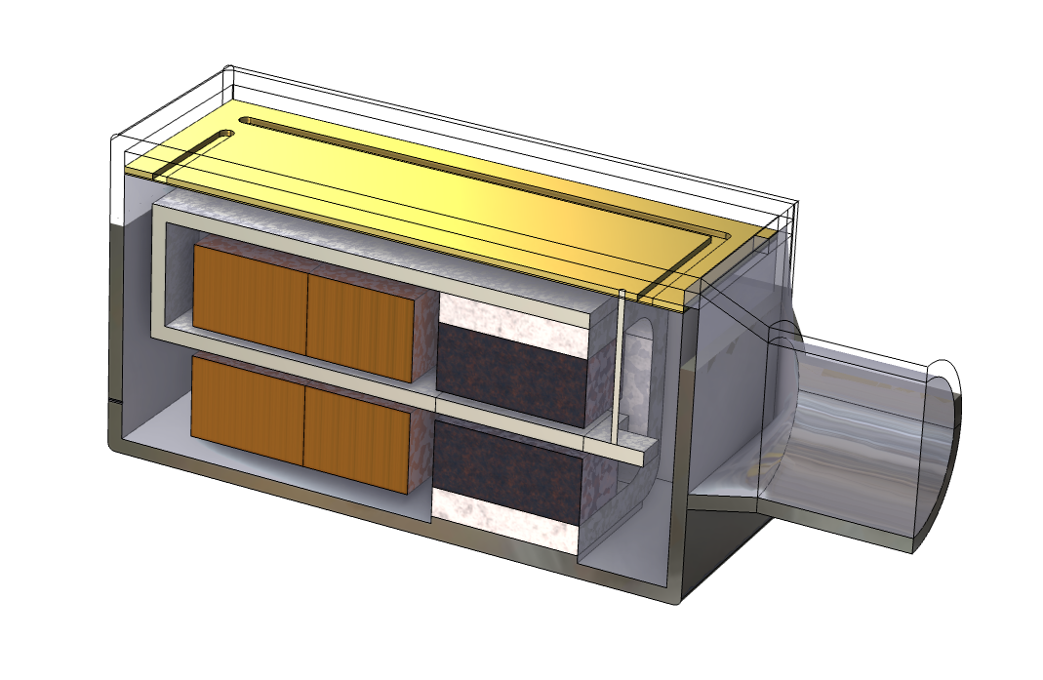
Model Definition: Transducer
Diaphragm (or membrane)
Front volume
Foil
Drive rod/pin
Vent
Spout
Back volume
Magnet
Magnetic/Air Gap
Armature
(magnetic alloy)
Coil
Pole piece

Slide 4
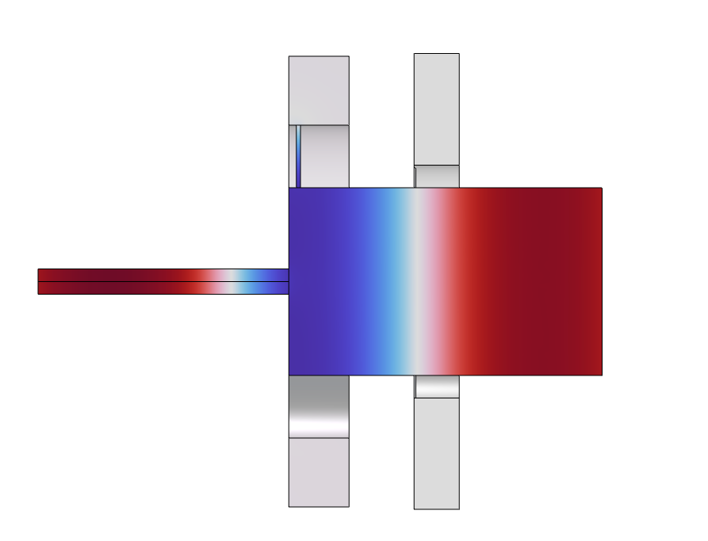
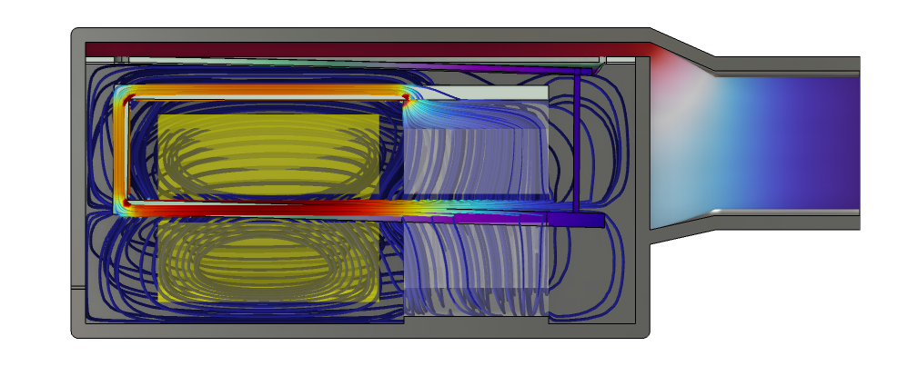
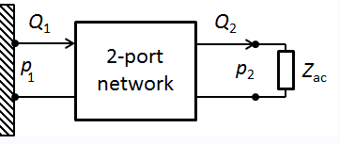
Model Definition: Test Setup
711 Coupler
Lumped port
condition
Balanced armature transducer
Microphone
Tube
Detailed multiphysics FEM model
Test setup replaced by: two-port analogy + microphone impedance

Slide 5
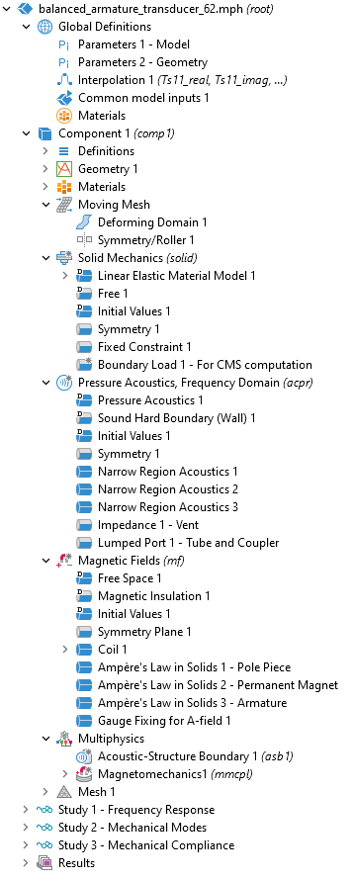
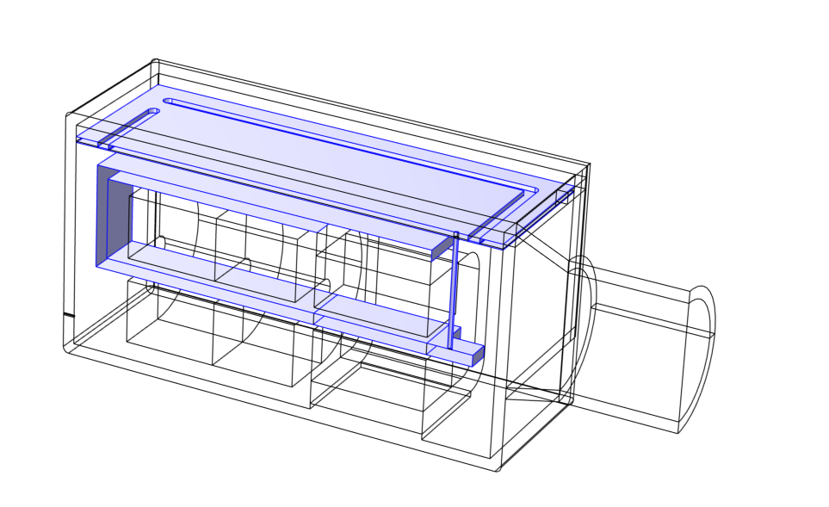
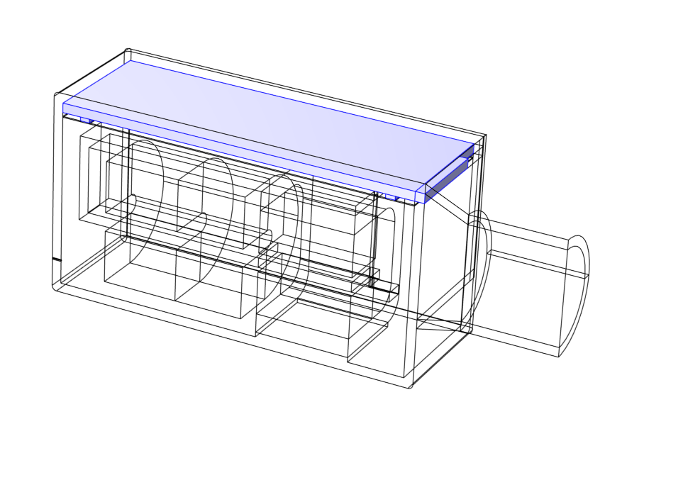
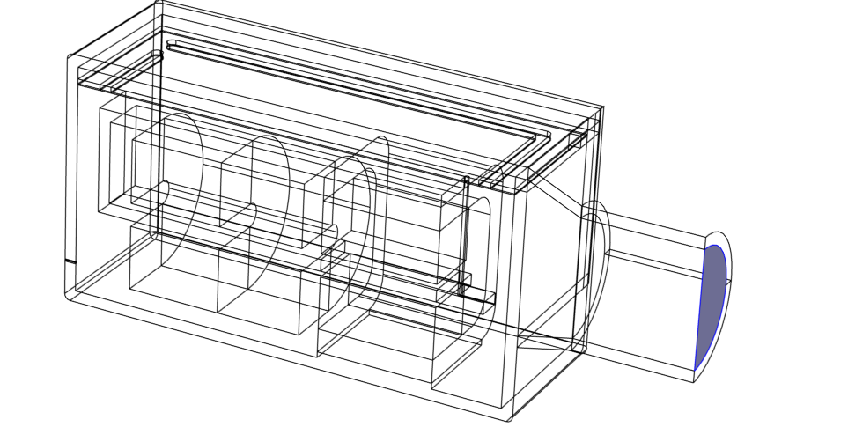
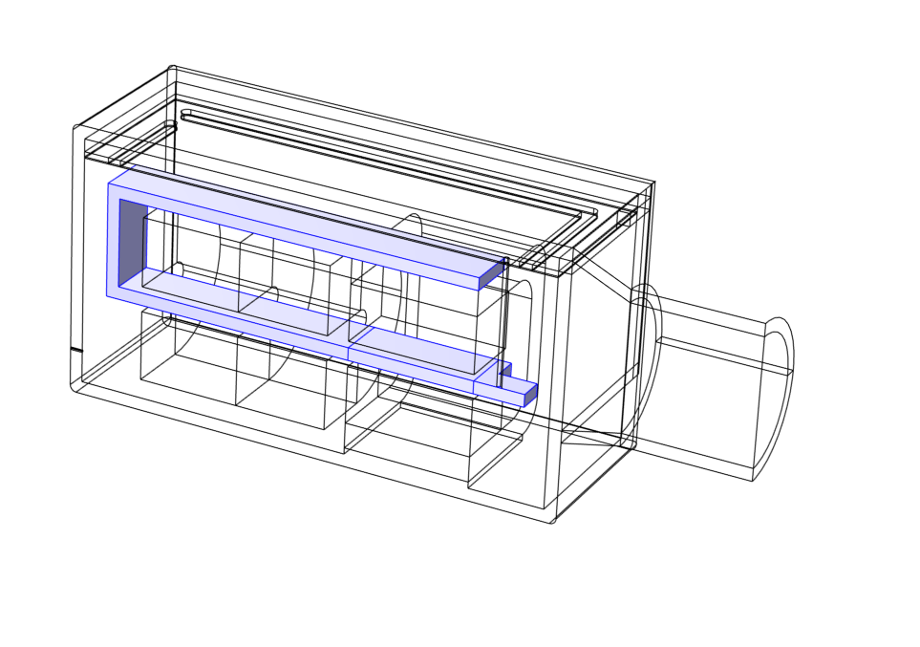
Implementation
Moving Mesh
Solid Mechanics
Pressure Acoustics
  Narrow Region Acoustics for homogenized thermoviscous losses
  Lumped Port condition
Magnetic Fields
Multiphysics
  Acoustic-Structure Boundary
  Magnetomechanical Forces

Slide 6
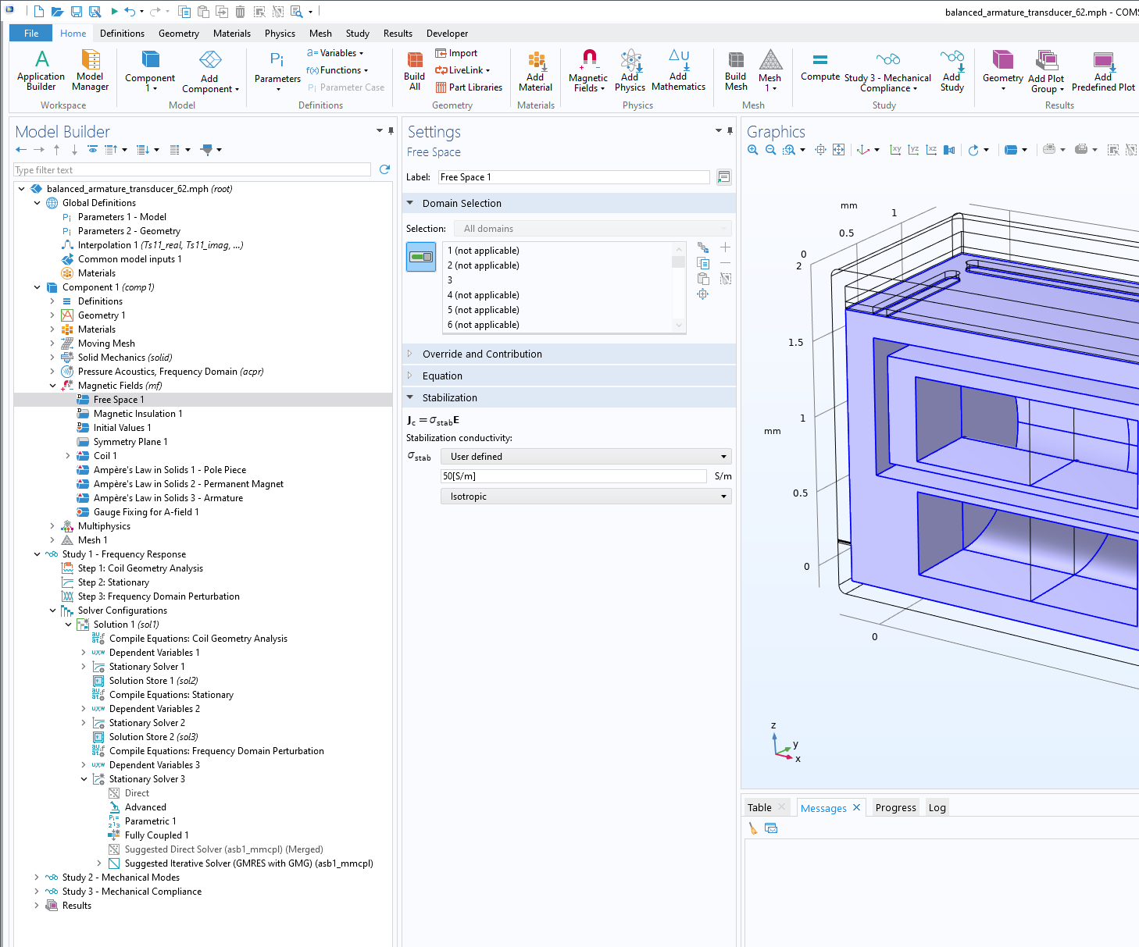
Iterative Solver
To ensure convergence of the iterative solver, add a small electrical conductivity 50 [S/m], to the Free Space.
  If not added, the Gauge Fixing for A-Field yields a more or less singular problem in the frequency domain, as it then imposes
  div(J) = 0.
Select the suggested iterative solver in Stationary Solver 3 used in Frequency Domain Perturbation step: Add the moving mesh variables in a separate Direct Preconditioner.

Slide 7
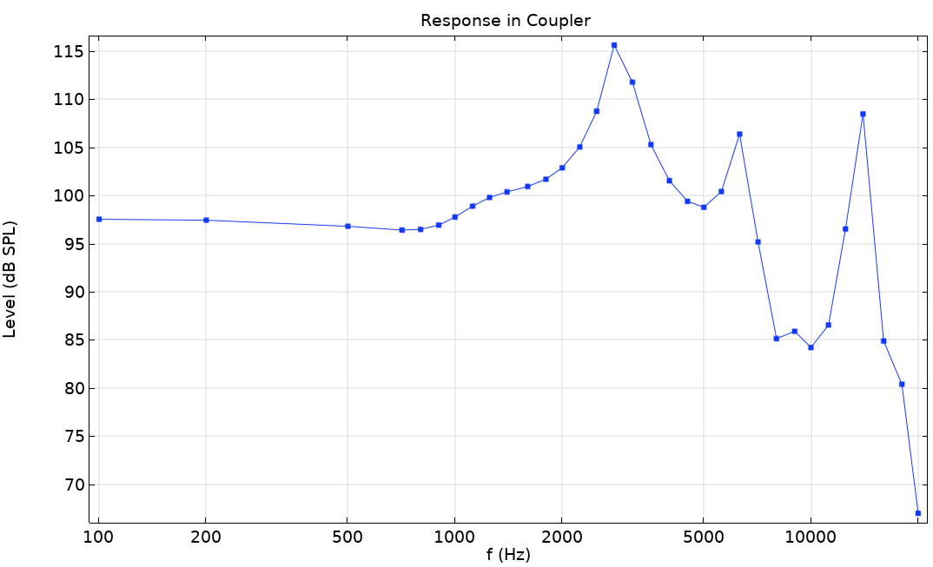
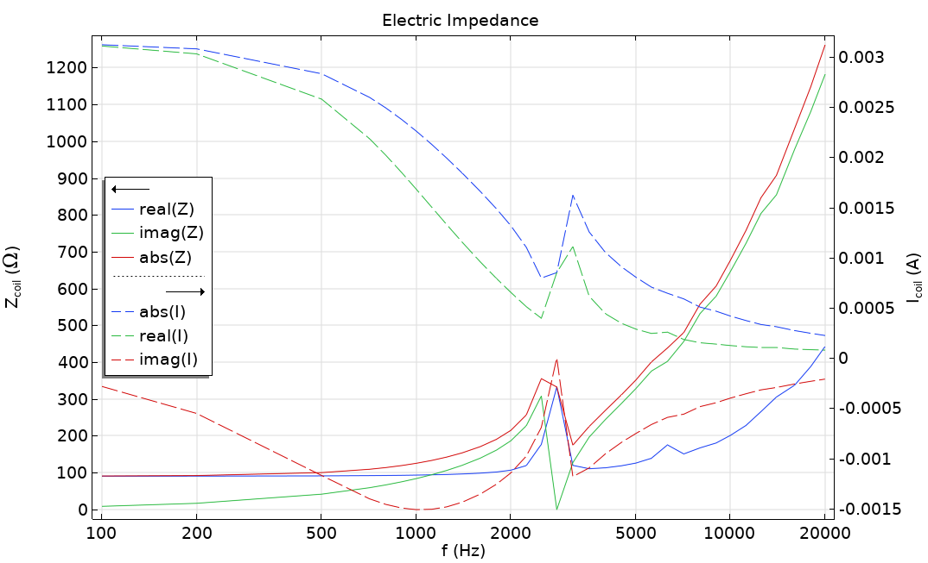
Results
Results include full visualization of the electric, structural and acoustic fields.
The graphs to the right show the response in the coupler as well as the electric impedance of the coil.
SPL at the microphone position in the coupler.
Electric impedance of the coil and the current in the coil.

Slide 8
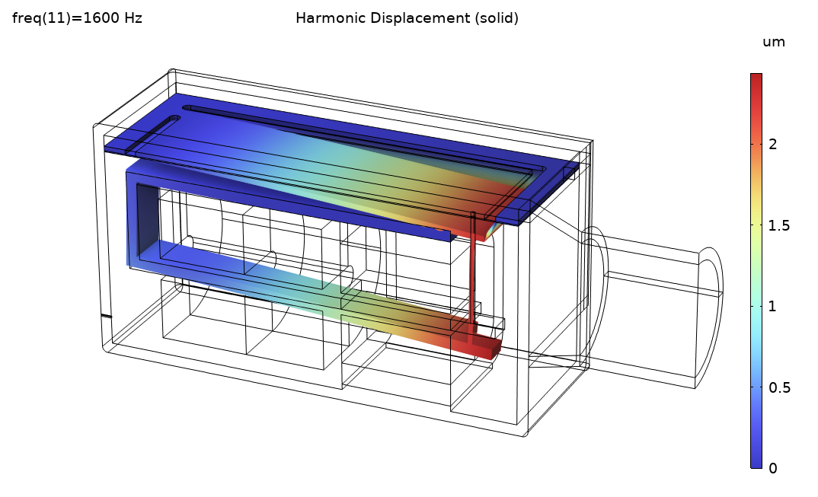
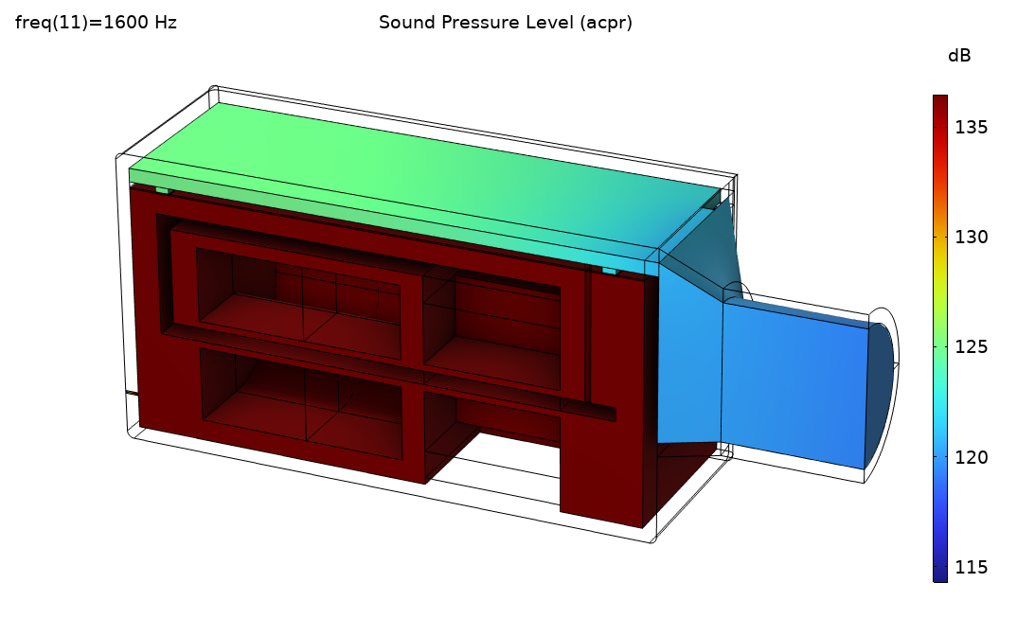
Results
Plots of the displacement (top) and Sound Pressure Level (bottom) at 1.6 kHz.

Slide 9
comsol.com/contact

