Slide 1
Mandel–Cryer effect
COMSOL

Slide 2
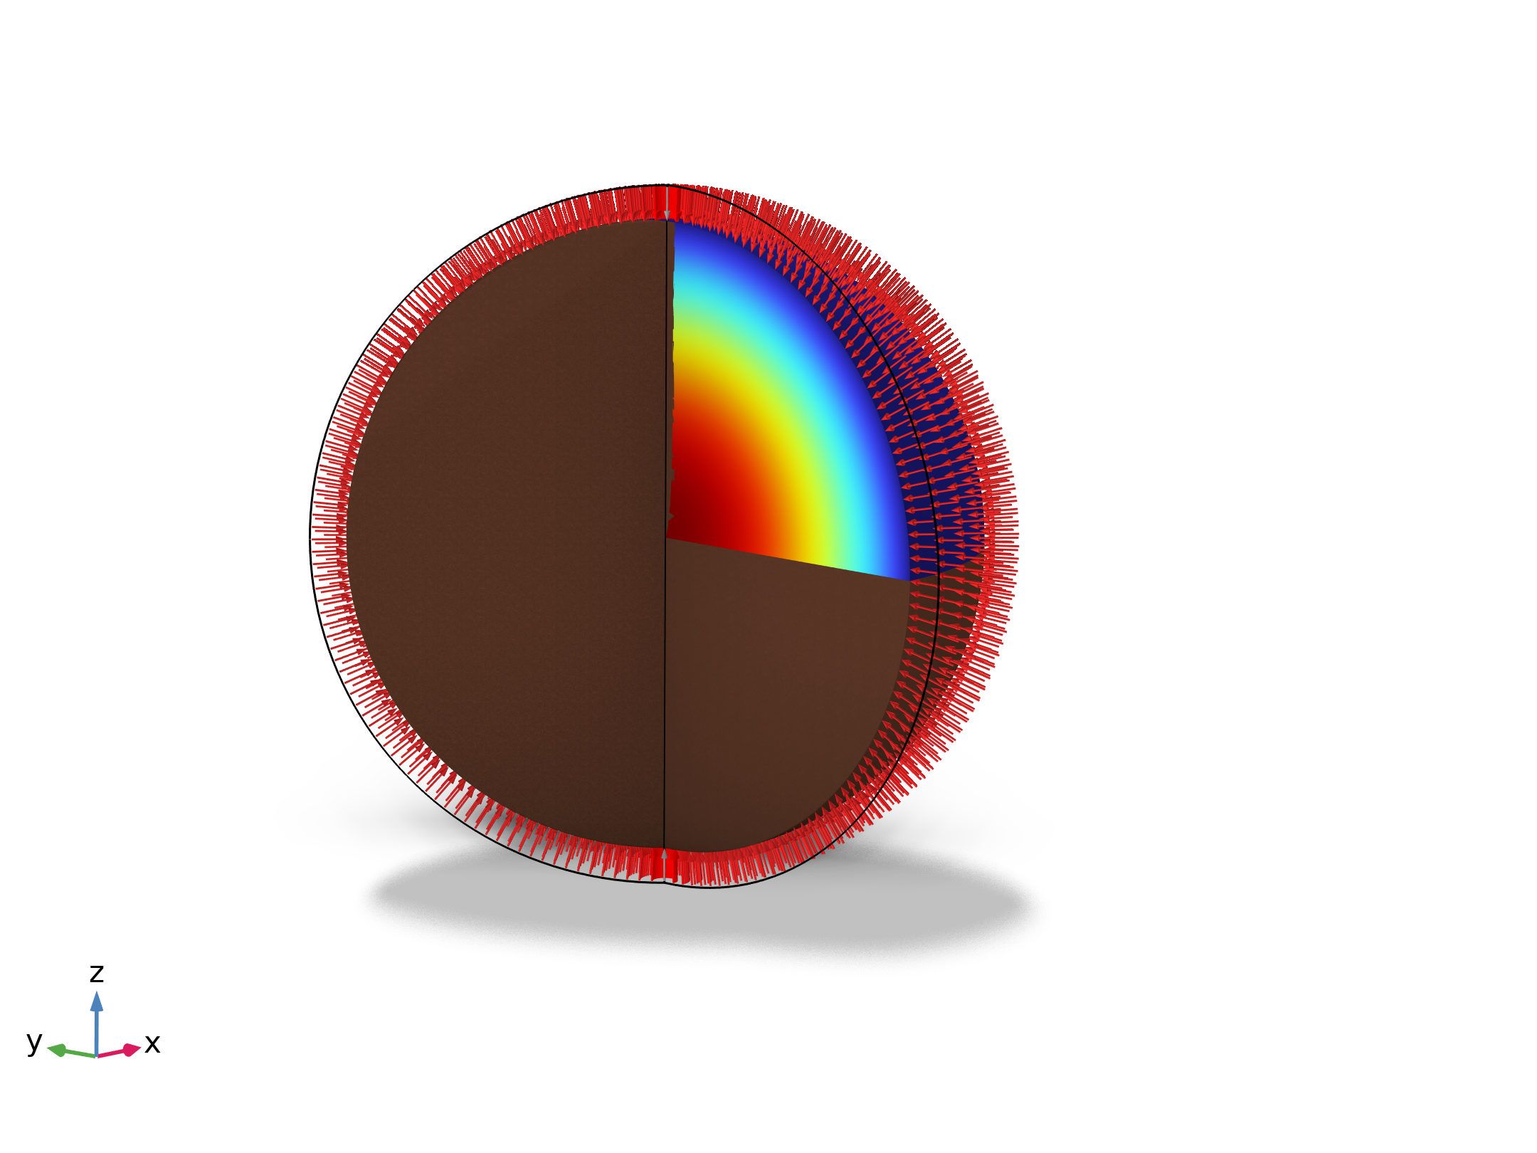
Introduction
Cryer's problem is used as a benchmark for three-dimensional poroelasticity. In this problem the Mandel-Cryer effect, the initial increase in pore pressure, is observed. This effect can only be captured by a two-way coupling between the flow in the pores and the solid deformation.
The coupling is obtained using the Poroelasticity interface that links the Solid Mechanics and Darcy's Law interfaces.

Slide 3
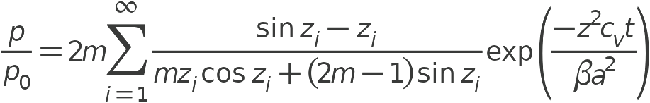

Solution for small deformations
In the case of small deformation, there is an analytical solution for pressure (p) at the center of the sphere as a function of the bulk modulus (K), shear modulus (G), Biot's coefficient (α_{B}), permeability (κ), fluid viscosity (μ _{f}) and storage porosity (S_{p})
z_{i} are the roots of the following nonlinear equation

Slide 4
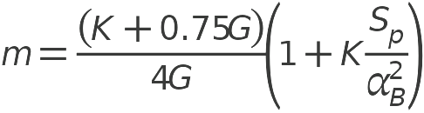


Solution for small deformations
where the following parameters are used

Slide 5
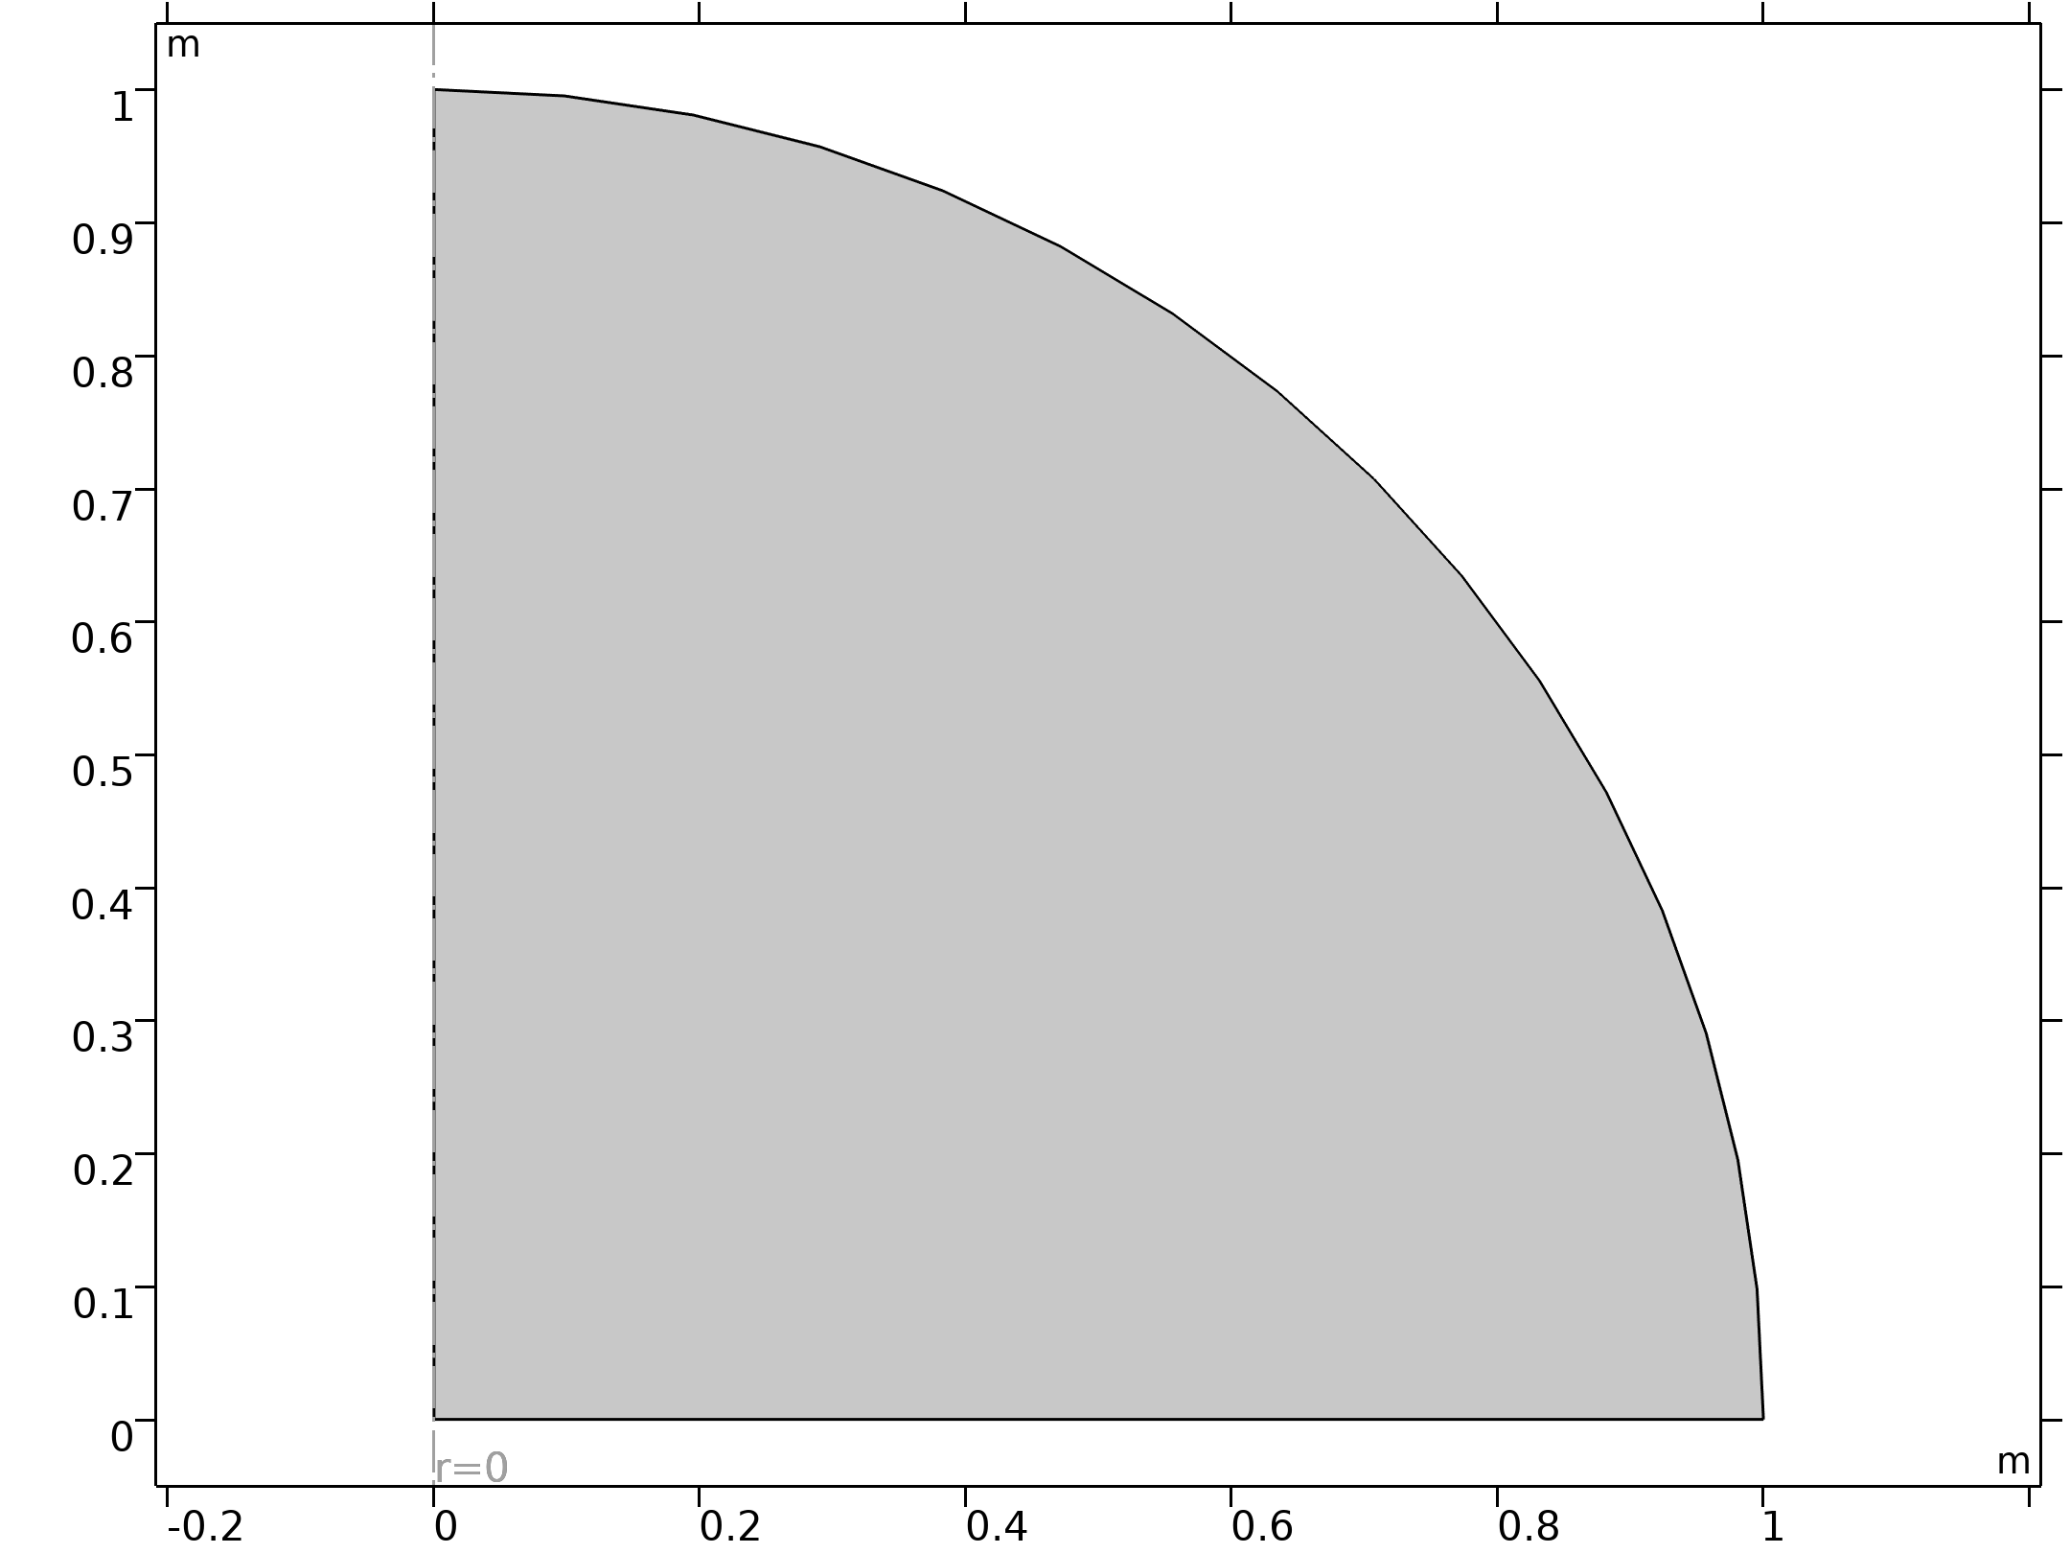
Model
The sphere is modeled using 2D axisymmetric component
A symmetry boundary conditon is applied on the bottom edge
A constant boundary load is applied on the surface
neo-Hookean material
Both constant and Kozeny-Carman permeability model are studied
Geometry 1

Slide 6
Results

Slide 7
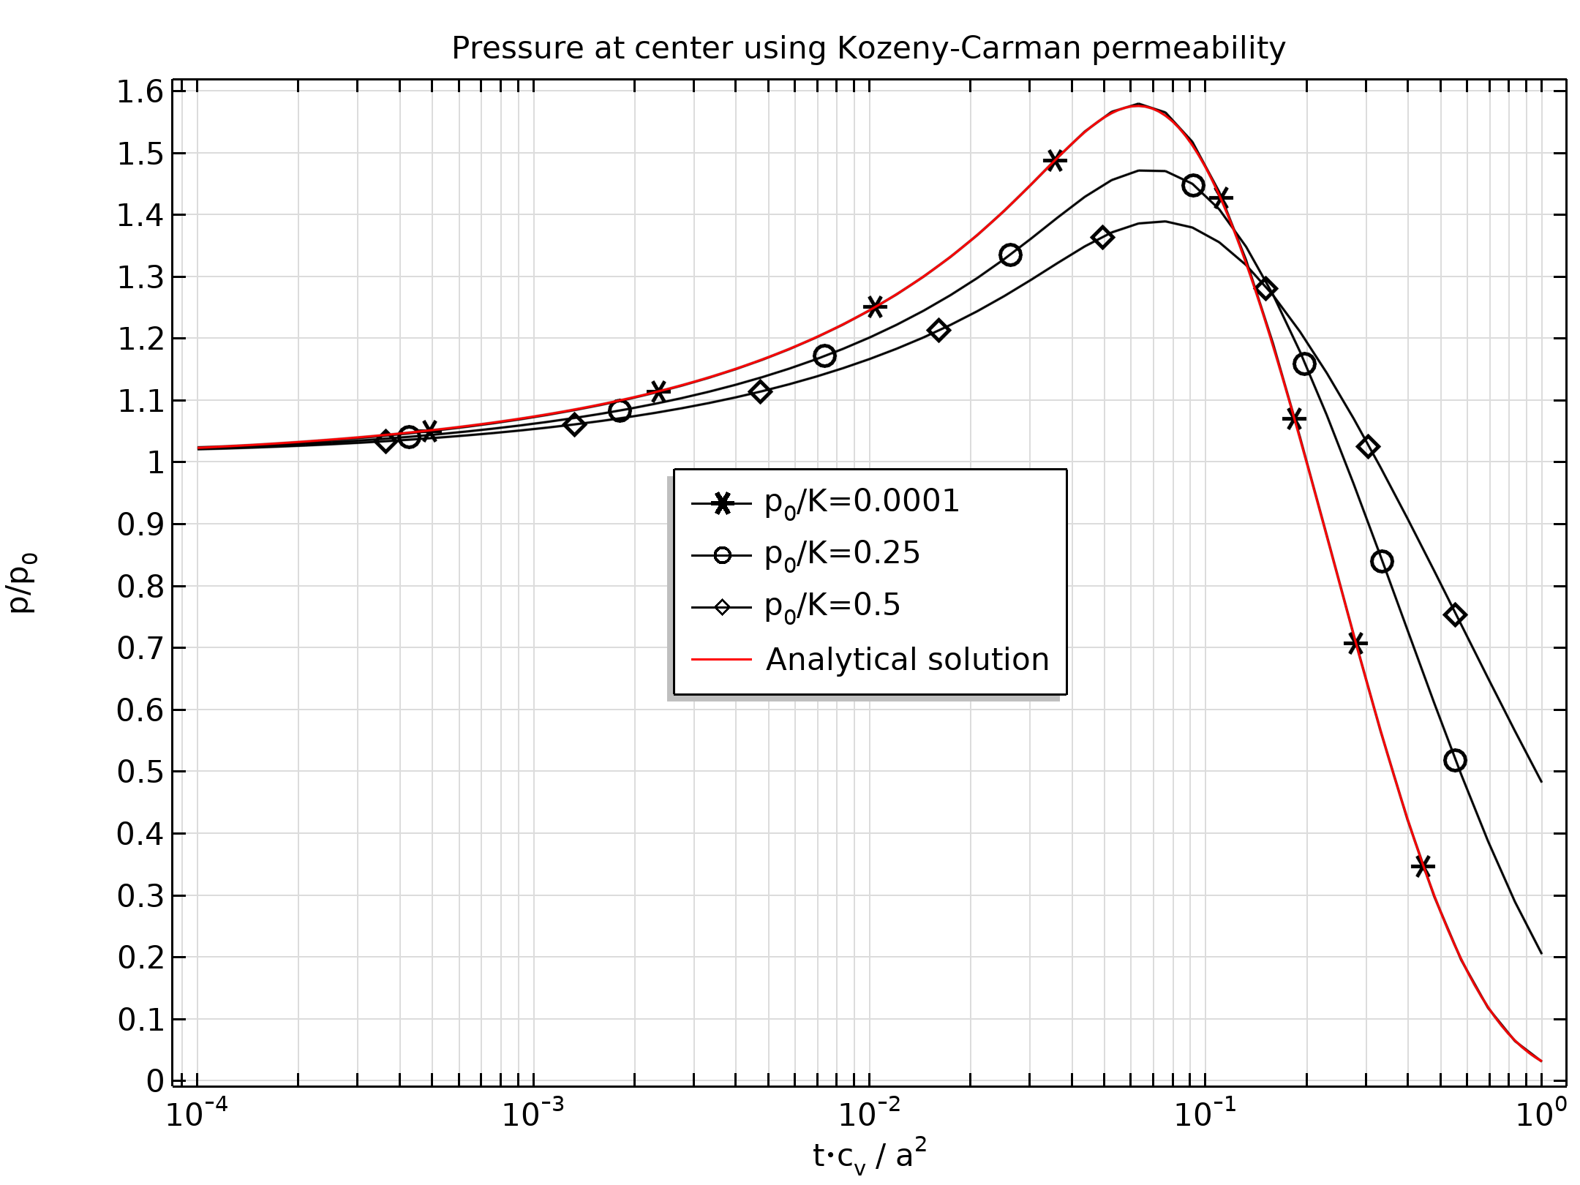
Pressure
The Mandel-Cryer effect is correctly represented by the model.
The model match the analytical solution for small deformation.
Pore pressure evolution during consolidation using the Kozeny-Carman permeability model

Slide 8
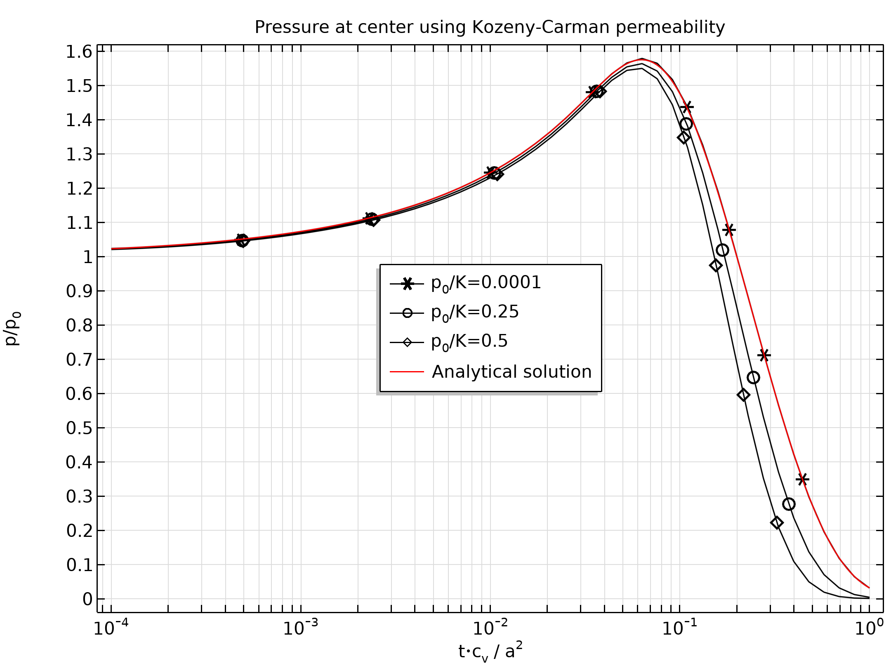
Pressure
The Mandel-Cryer effect is correctly represented by the model.
The model match the analytical solution for small deformation.
Pore pressure evolution during consolidation using a constant permeability

Slide 9
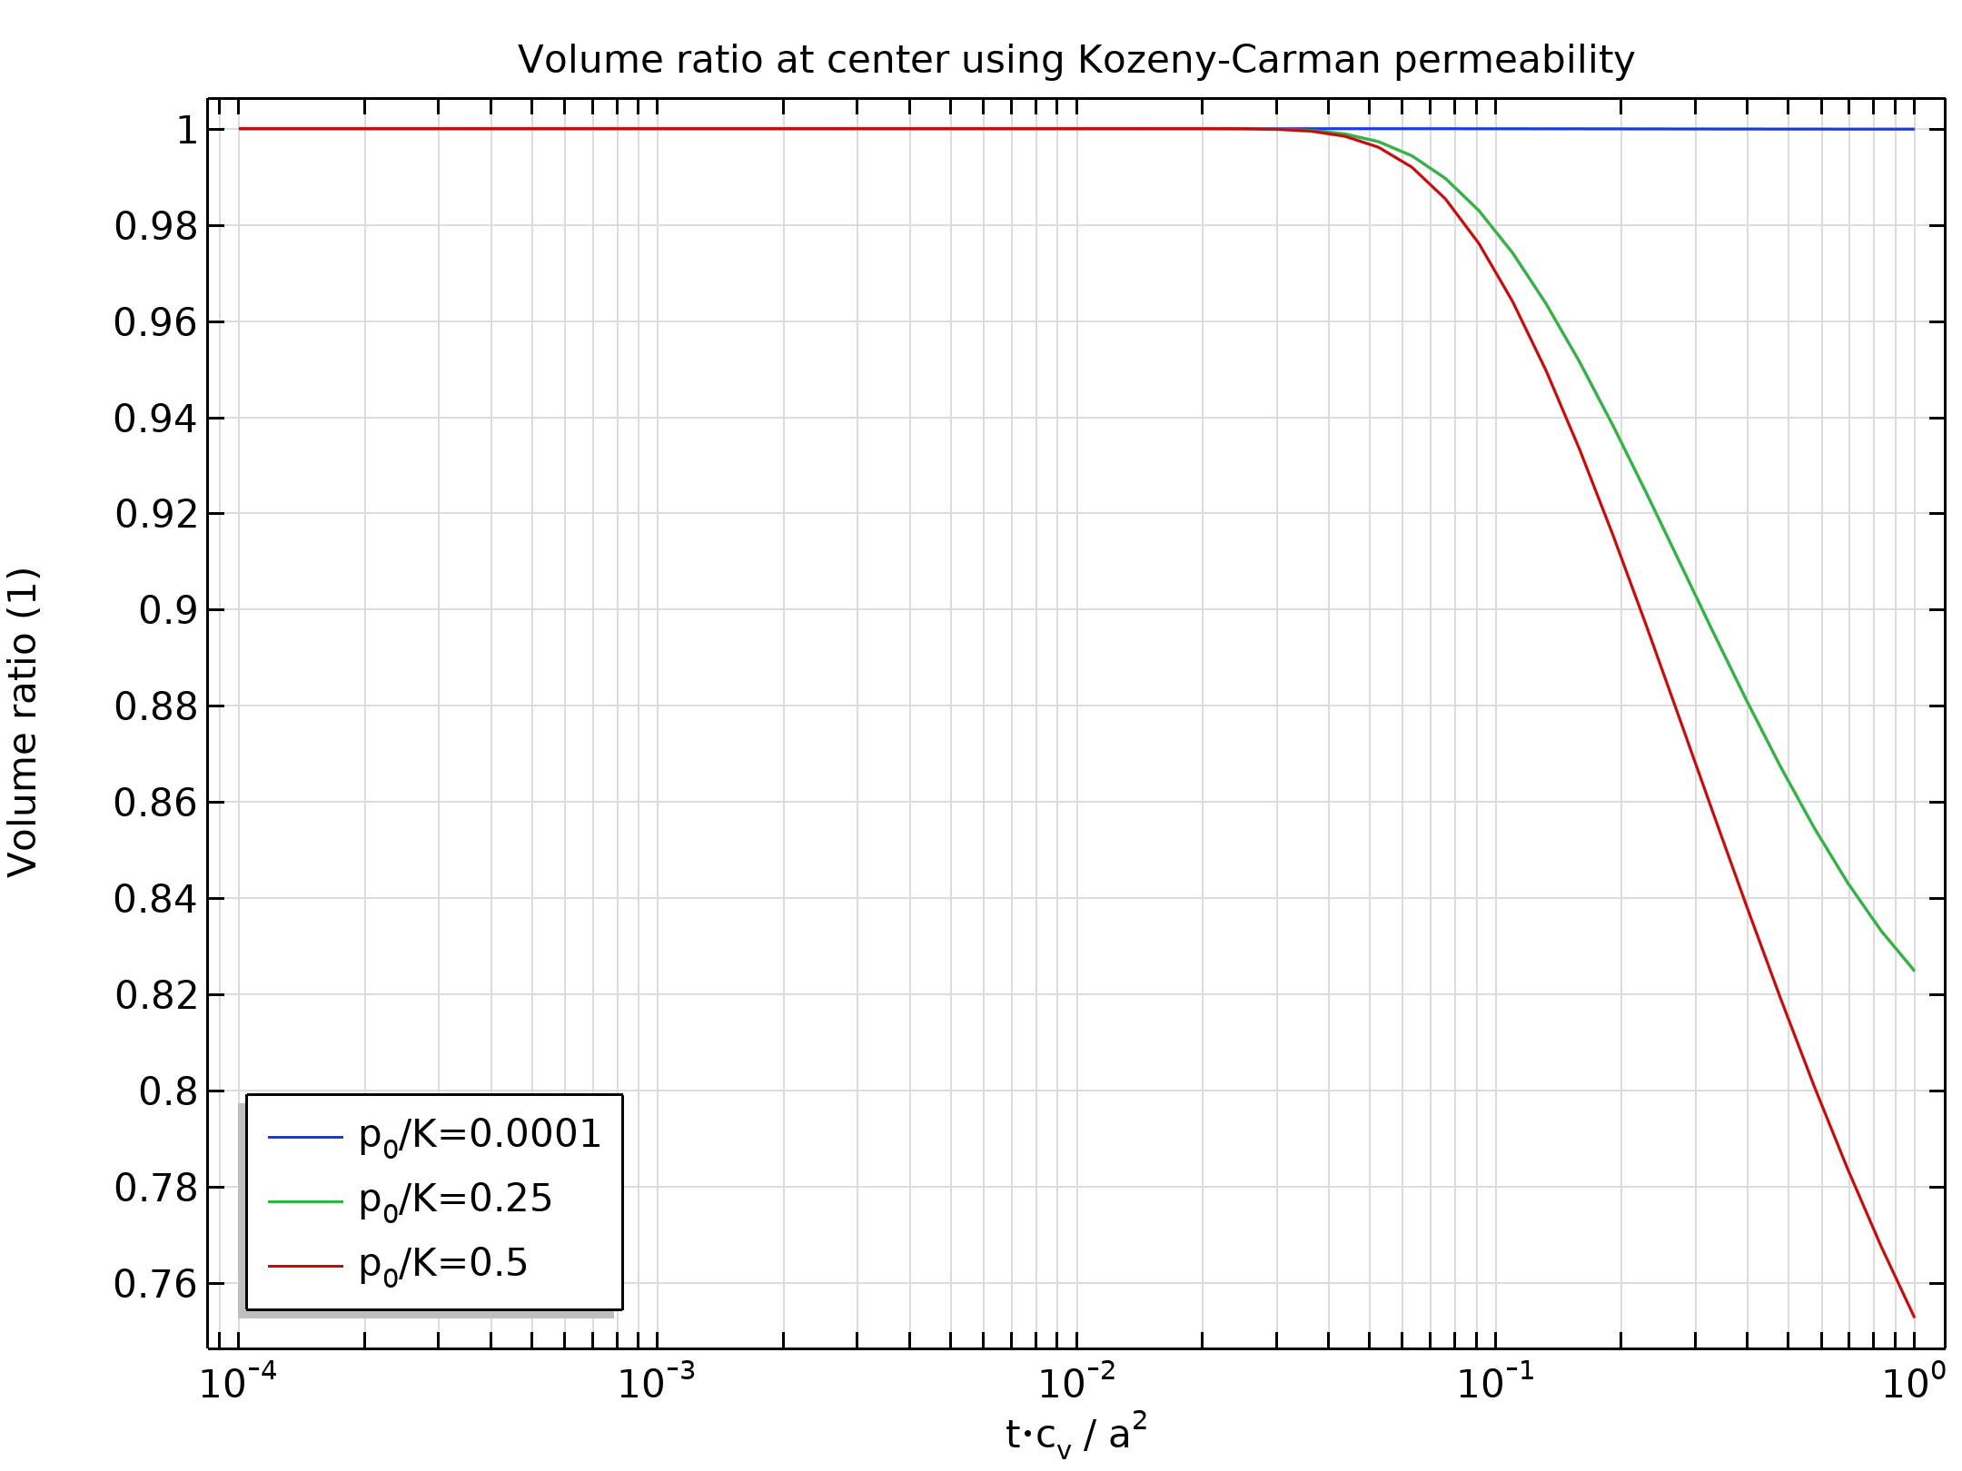
Volume Ratio
Large deformation occurs for higher values of boundary pressure during consolidation.
Volume ratio during the consolidation process

Slide 10
References
Jinhyun Choo, “Large deformation poromechanics with local mass conservation: An enriched Galerkin finite element framework”, Int J Numer Methods Eng, 2018;1-25. DOI https://doi.org/10.1002/nme.5915
Arnold Verruijt, “Theory of Consolidation”, Encyclopedia of Hydrological Sciences, John Wiley & Sons, Ltd., Chichester, UK(2008). DOI https://doi.org/10.1002/0470848944.hsa303.

