Slide 1
Free Convection in a Porous Medium
COMSOL

Slide 2
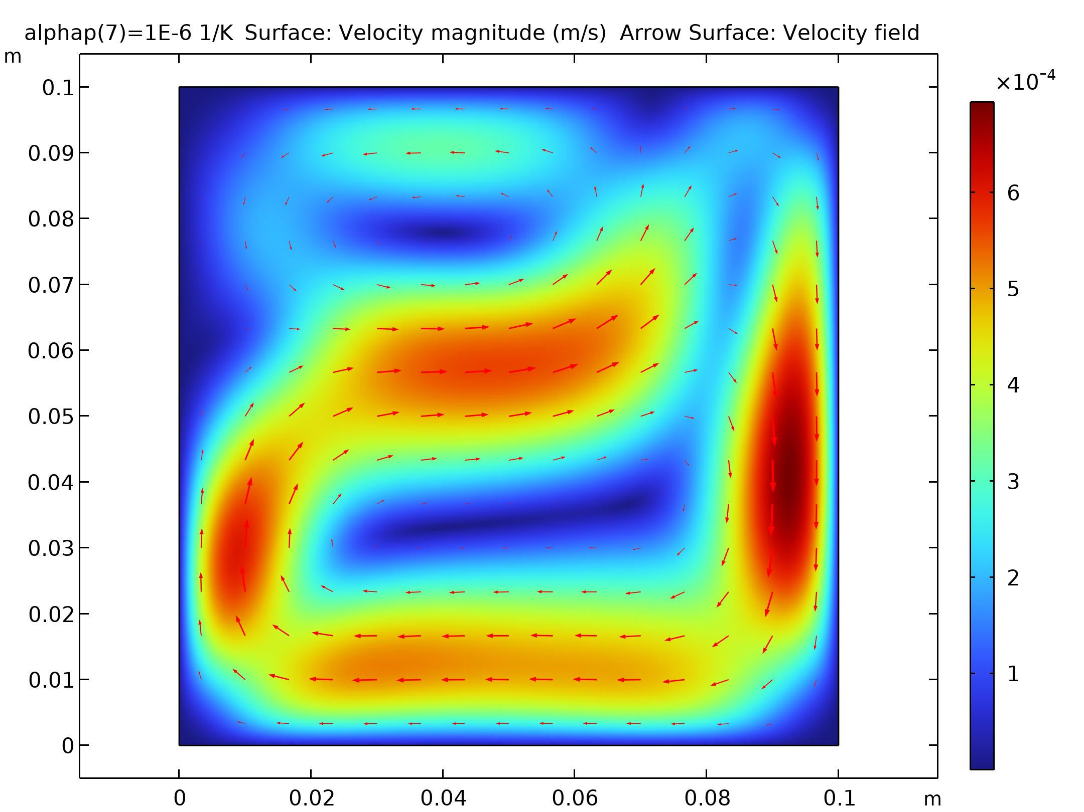
Introduction
This model exemplifies the use of COMSOL Multiphysics for modeling of free convection in porous media
It shows the following COMSOL Multiphysics features:
  Porous media flow
  Multiphysics between fluid flow and heat transfer
  Results that are in excellent agreement with published models in the research journals in the field.
The model has applications in the fields of
  Geophysics
  Chemical engineering
Surface: Velocity magnitude (m/s) Arrow Surface: Velocity field

Slide 3
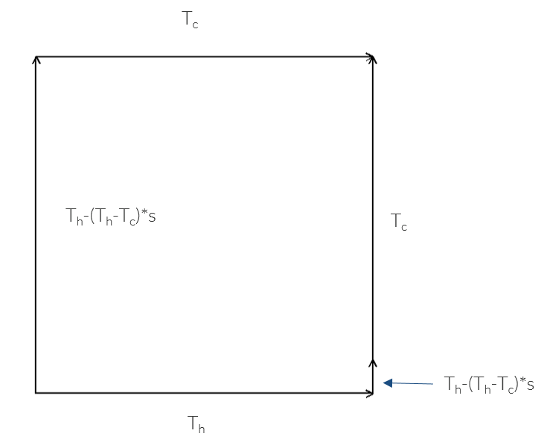
Geometry, Heating and Cooling Surfaces
Enclosed domain with porous material
The walls of the domain are impervious to flow
The walls are either heating or cooling surfaces with linear temperature profiles uniting the cool and hot surfaces
The arc length goes from zero to one along a boundary segment

Slide 4
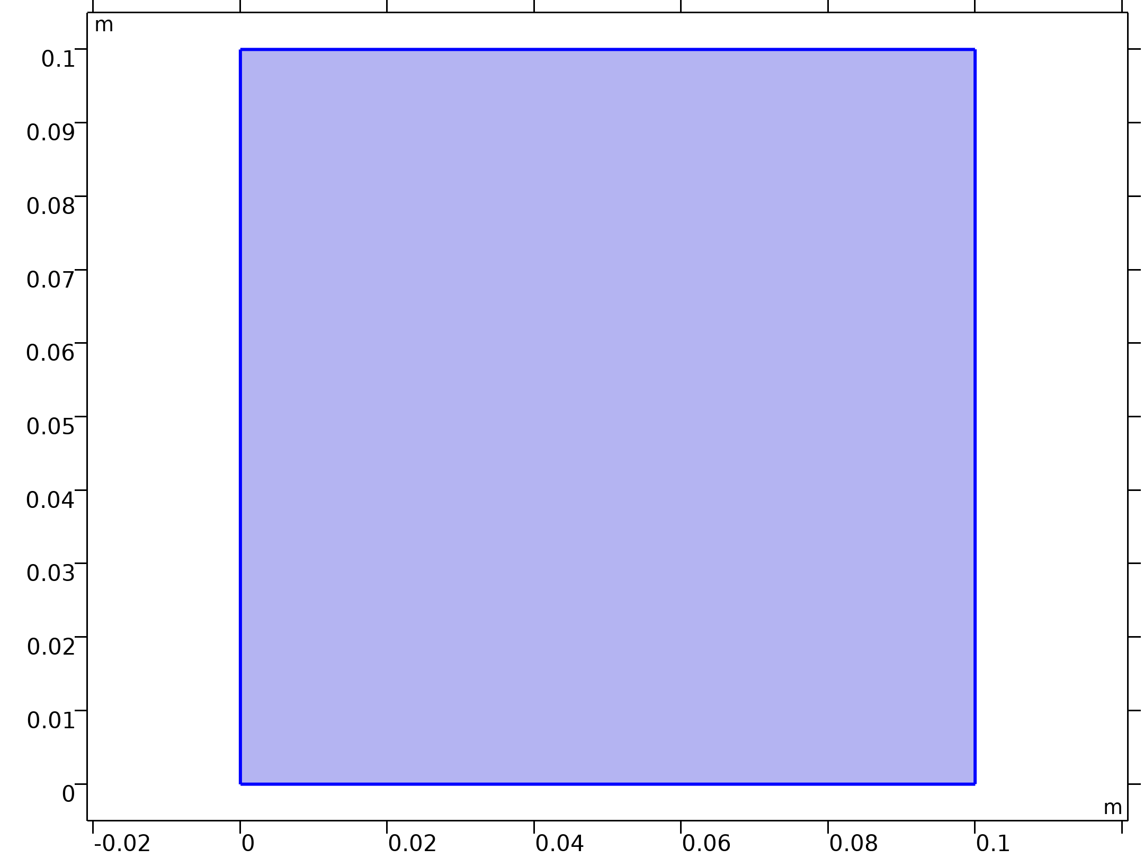
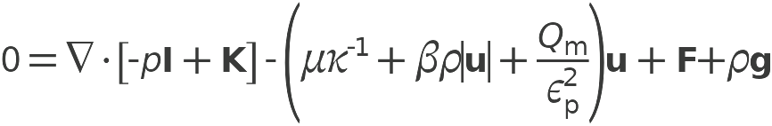

Domain Equations
Momentum and mass balance
with β and Q_{m} = 0, and F = - gβ_{T}(T-T_{c}) this leads to
Brinkman Equations

Slide 5

Domain Equations
Heat balance
Boussinesq buoyant lifting term links flow and heat

Slide 6
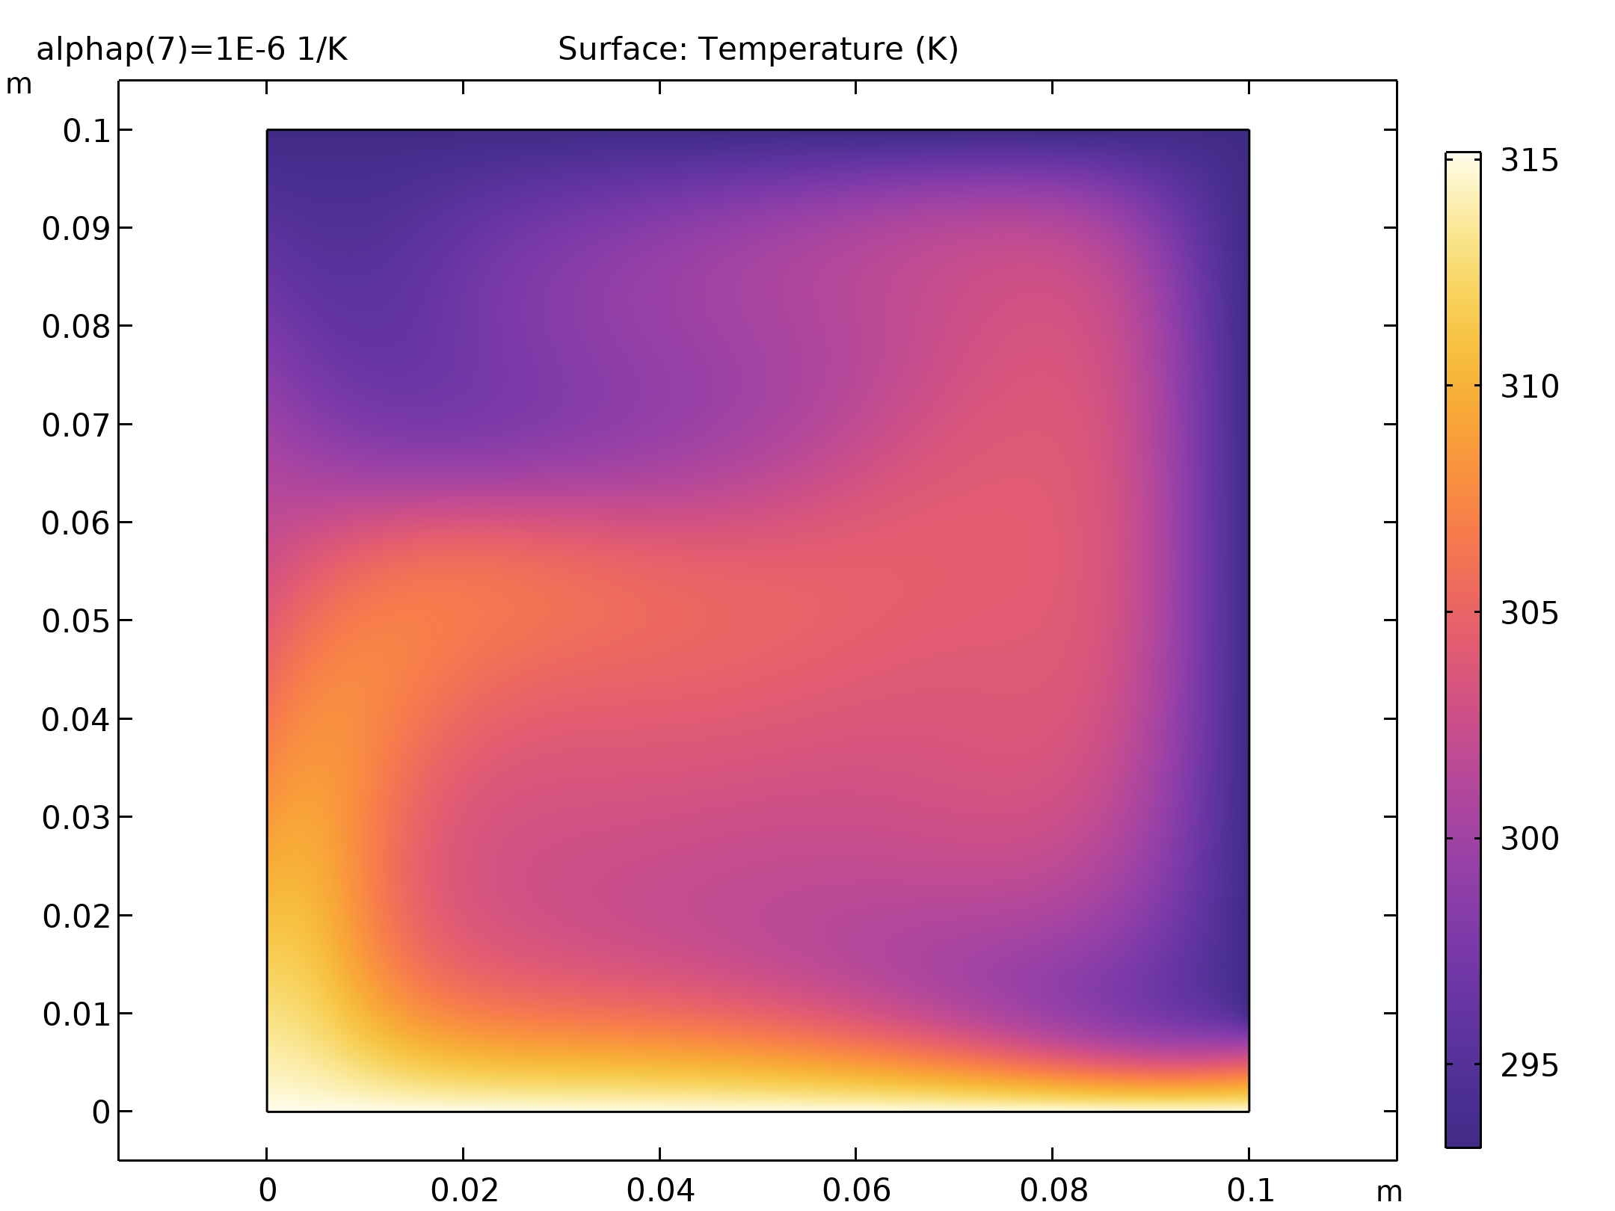
Results
Surface: Temperature (K)

Slide 7
Results
Surface: Velocity magnitude (m/s) Arrow Surface: Velocity field

Slide 8
Concluding Remarks
The model is simple to define and solve in COMSOL Multiphysics
The results give excellent agreement with published scientific papers, see M. Anwar Hossain and Mike Wilson, Natural convection flow in a fluid-saturated porous medium enclosed by nonisothermal walls with heat generation, International Journal of Thermal Sciences, Int. J. Therm. Sci. 41 (2002) 447–454.

