Slide 1
Simulating Antenna Crosstalk on an Airplane's Fuselage
COMSOL

Slide 2
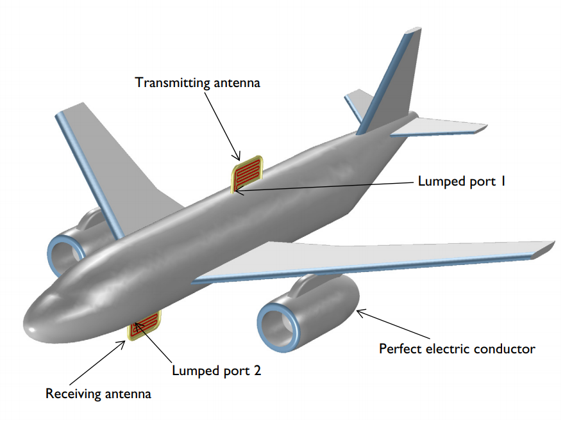
Introduction
Antenna crosstalk, or co-site interference, is problematic when multiple antennas are used on a single large platform
In this example, the interference between two identical antennas at VHF frequency is studied with an S-parameter analysis of different configurations of a receiving antenna installed on an airplane fuselage
The 2D and 3D farfield radiation patterns of a transmitting antenna are computed and the lit and shadow areas on the airplane surface are also visualized
An airplane with ~20 m length of fuselage is simply depicted as an all-metallic structure except for the antenna enclosure. The surrounding air domain and perfectly matched layers are not shown

Slide 3
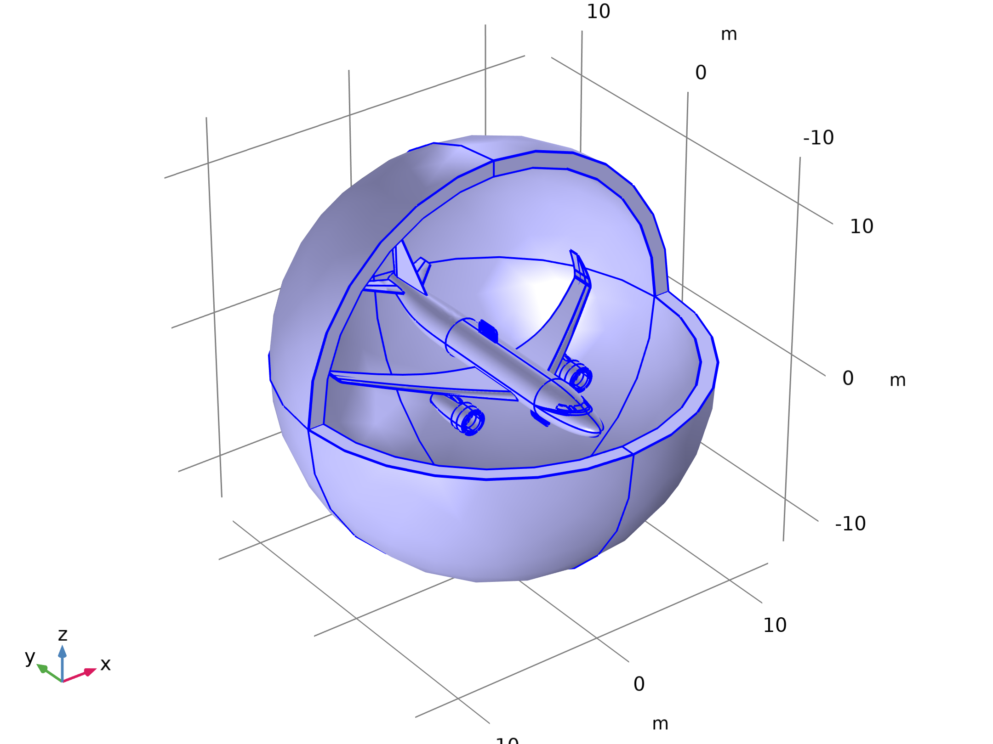

Model Definition
Electromagnetic Waves, Frequency Domain

Slide 4
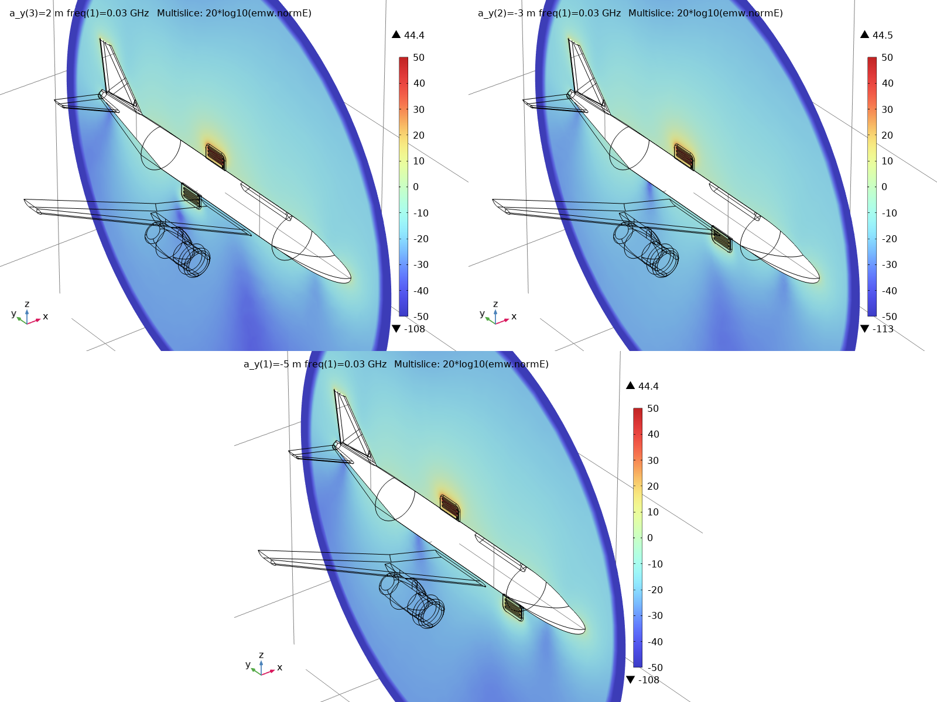
Results
The figure shows the E-field norm distribution in dB scale on a vertical cut plane at each location of the receiving antenna
Regardless of the location, the antenna on the bottom side of the fuselage is reacting to the field from the transmitting antenna on the top of the fuselage, so there is no complete shadow region with any of these three locations
E-field norm plot in dB scale on the yz-plane with the receiving antenna at locations on the fuselage bottom from the rear to front side

Slide 5
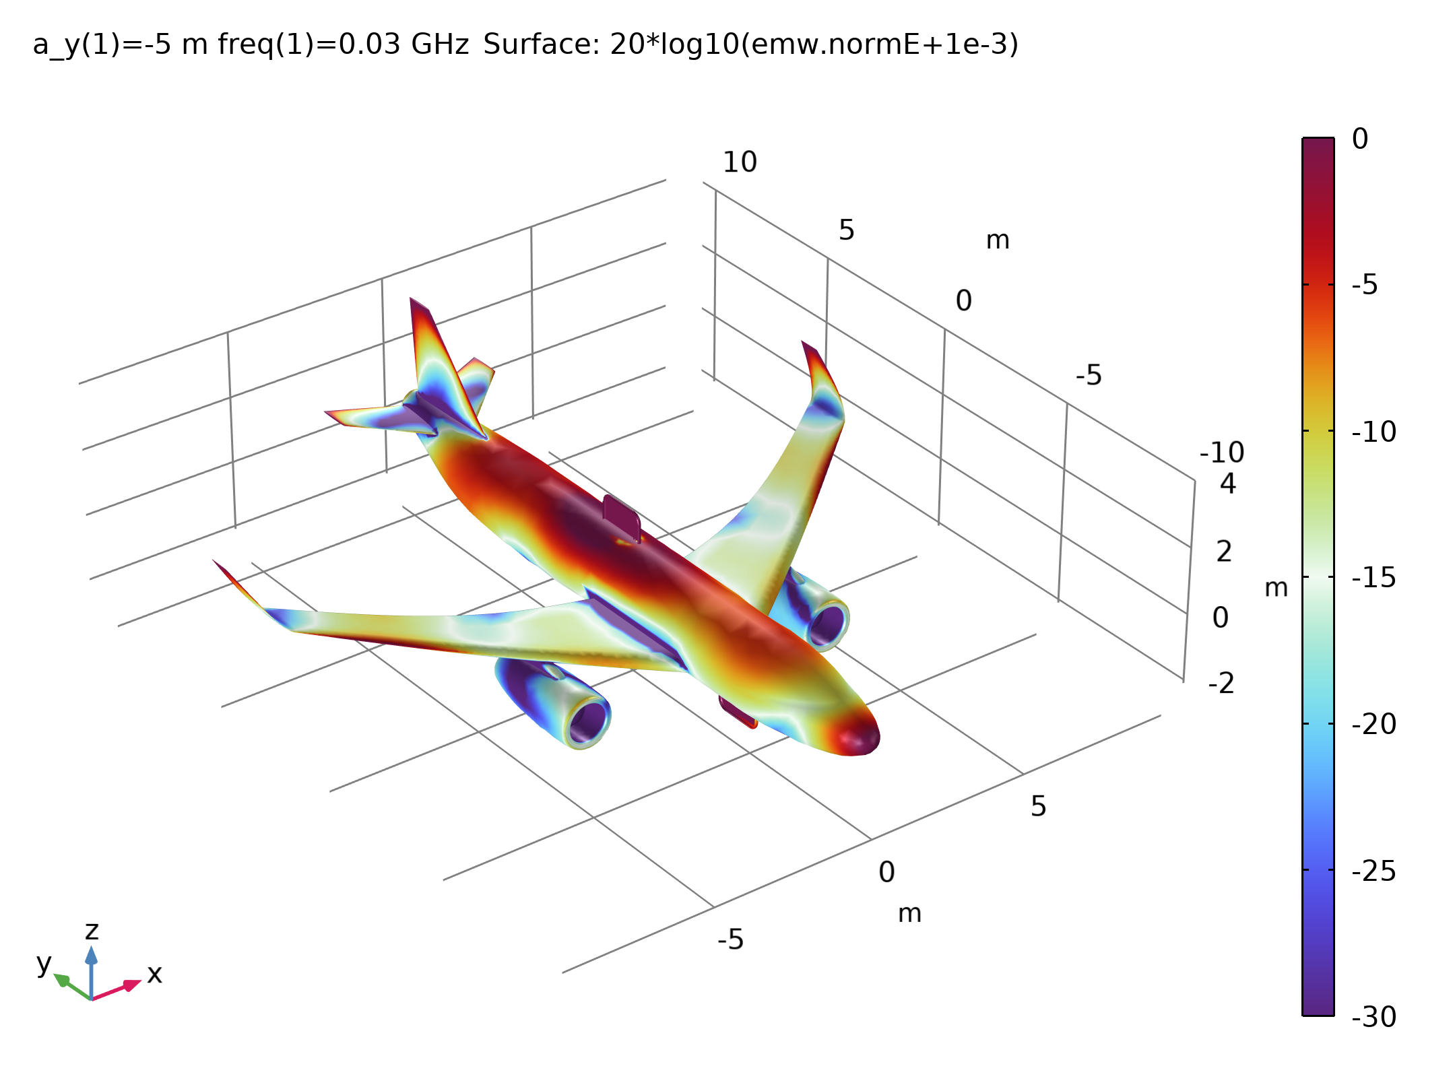
Results
To identify lit and shadow areas, the E-field norm is visualized on the airplane surface in the figure
By adjusting the display color range, the difference between the two categories is emphasized
The areas around turbines, rear wings, and some regions of the bottom side of the main wings and fuselage are relatively less affected by the transmitting antenna
E-field norm on the airplane surface. The visualization color range is adjusted to emphasize the lit and shadow regions due to the transmitting antenna

Slide 6
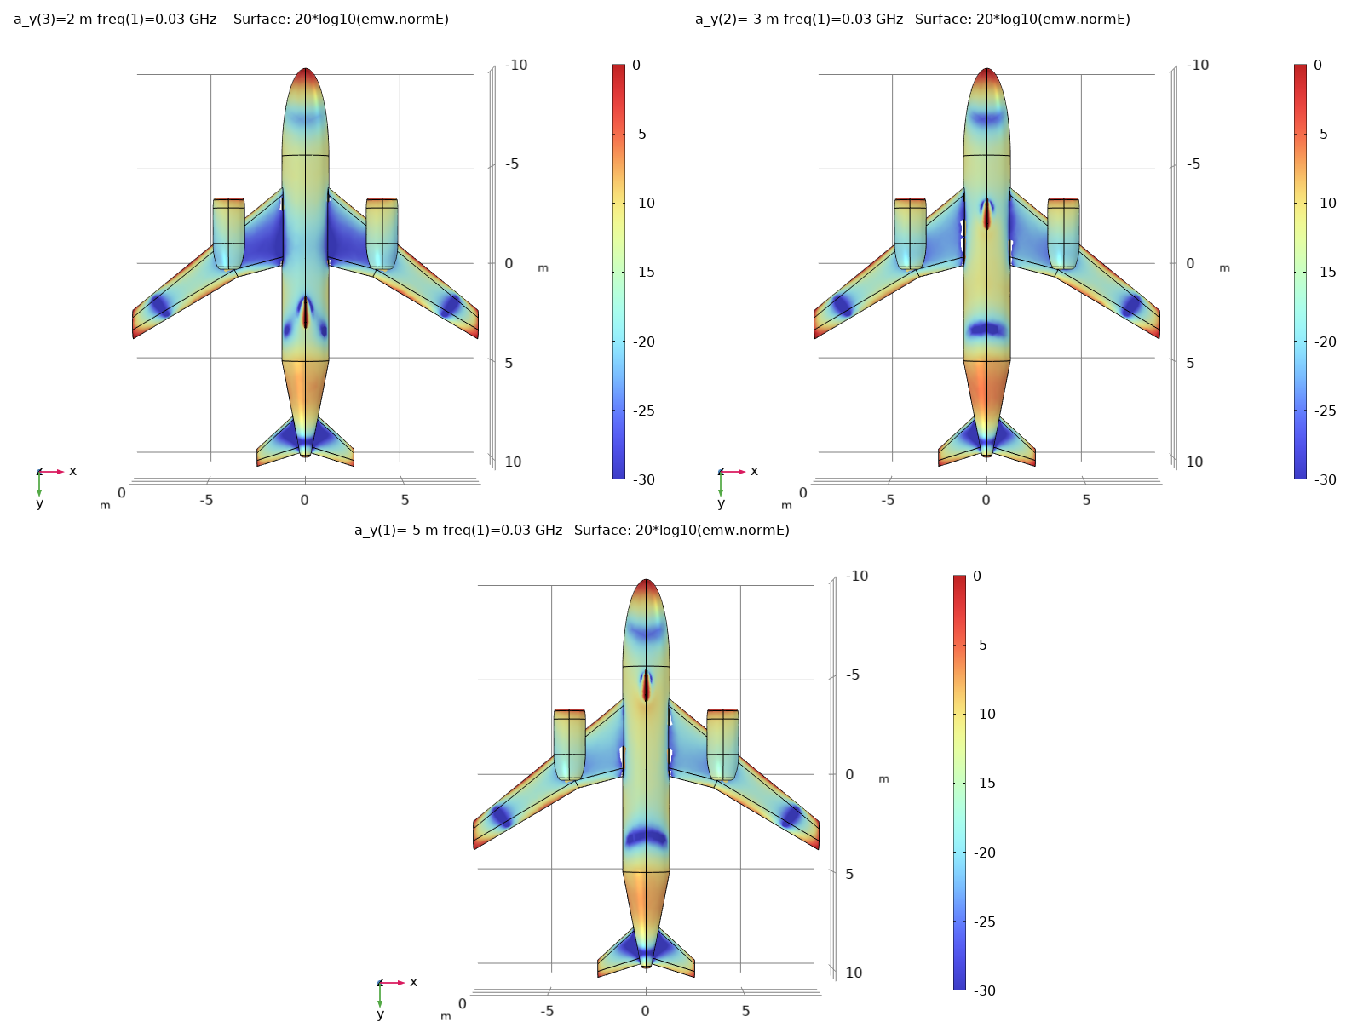
Results
See the figure where the E-field norm is plotted in dB scale while the receiving antenna on the fuselage bottom is moved from the rear to the front side
From the XY view, the shadow area is visible, located at the rear end of the fuselage bottom
E-field norm plot in dB scale from the XY view with the receiving antenna on the fuselage bottom from the rear to front side. The shadow area is located on the rear side

