Slide 1
Shell-and-Tube Heat Exchanger
COMSOL

Slide 2
Background
Shell-and-tube heat exchangers are one of the most widely used type of heat exchanger in the processing industry. They are commonly found in oil refineries, nuclear power plants and other large-scale chemical processes
Two separate fluids at different temperatures flow through the heat exchanger: one through the tubes, the other in the shell surrounding the tubes
Several design parameters and operating conditions influence the optimal performance of a shell-and-tube heat exchanger

Slide 3
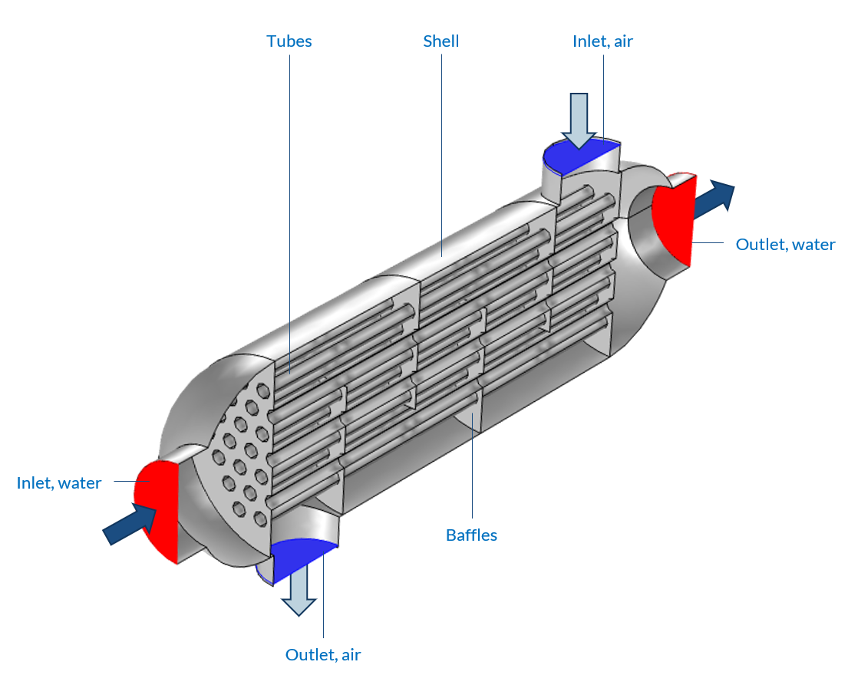
Model Definition
Water flows through the tubes, and air circulates in the shell
Baffles are introduced to create a cross-flow and to increase the exchange surface
All walls are made of structural steel and modeled as shells in 3D
Heat transfer and turbulent flows physics are coupled
Model geometry

Slide 4
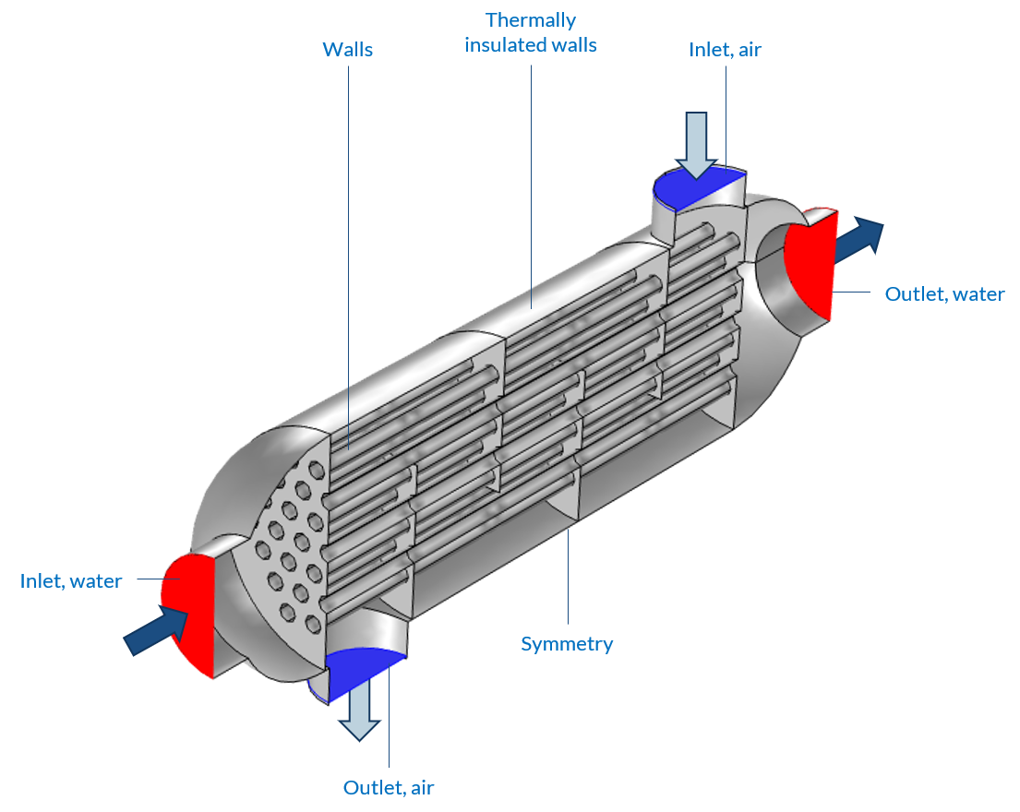
Model Definition
A symmetry is used to reduce the computational cost
The exterior walls are thermally insulated, while the interior walls allow heat exchange
Wall functions are used in addition to the k-ε turbulence model
Model boundary conditions

Slide 5
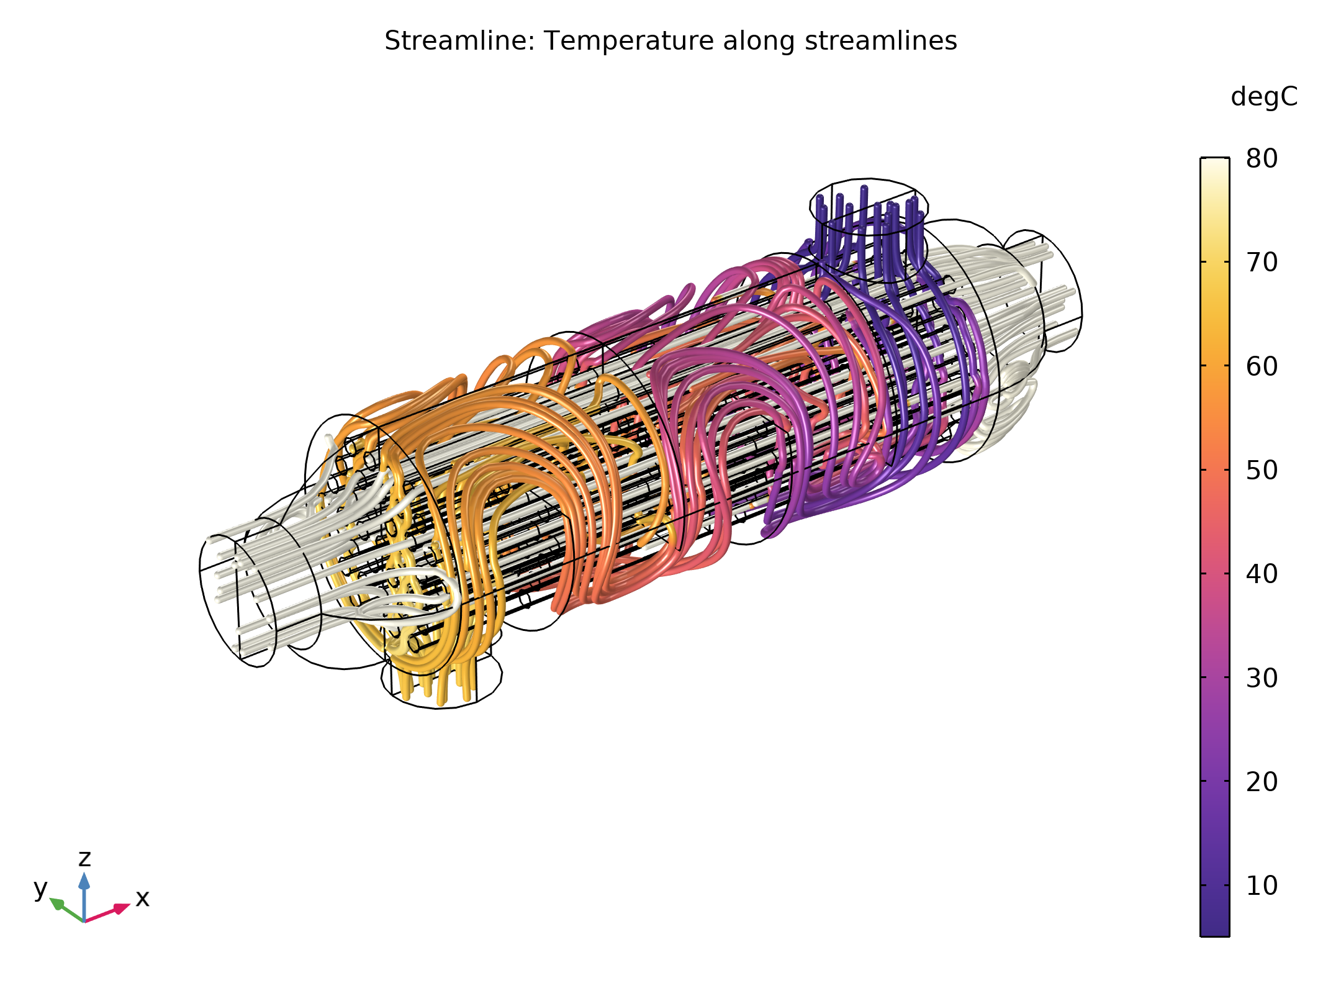
Results
The water is guided through the tubes where it exchanges heat with the air
The temperature difference between air and water at their respective inlet is 75°C, which is reduced to about 13°C at their outlet
The overall heat exchange coefficient of this heat exchanger is 5.9 W/(m².K)
Streamlines in water and air domains. Colored by temperature

Slide 6
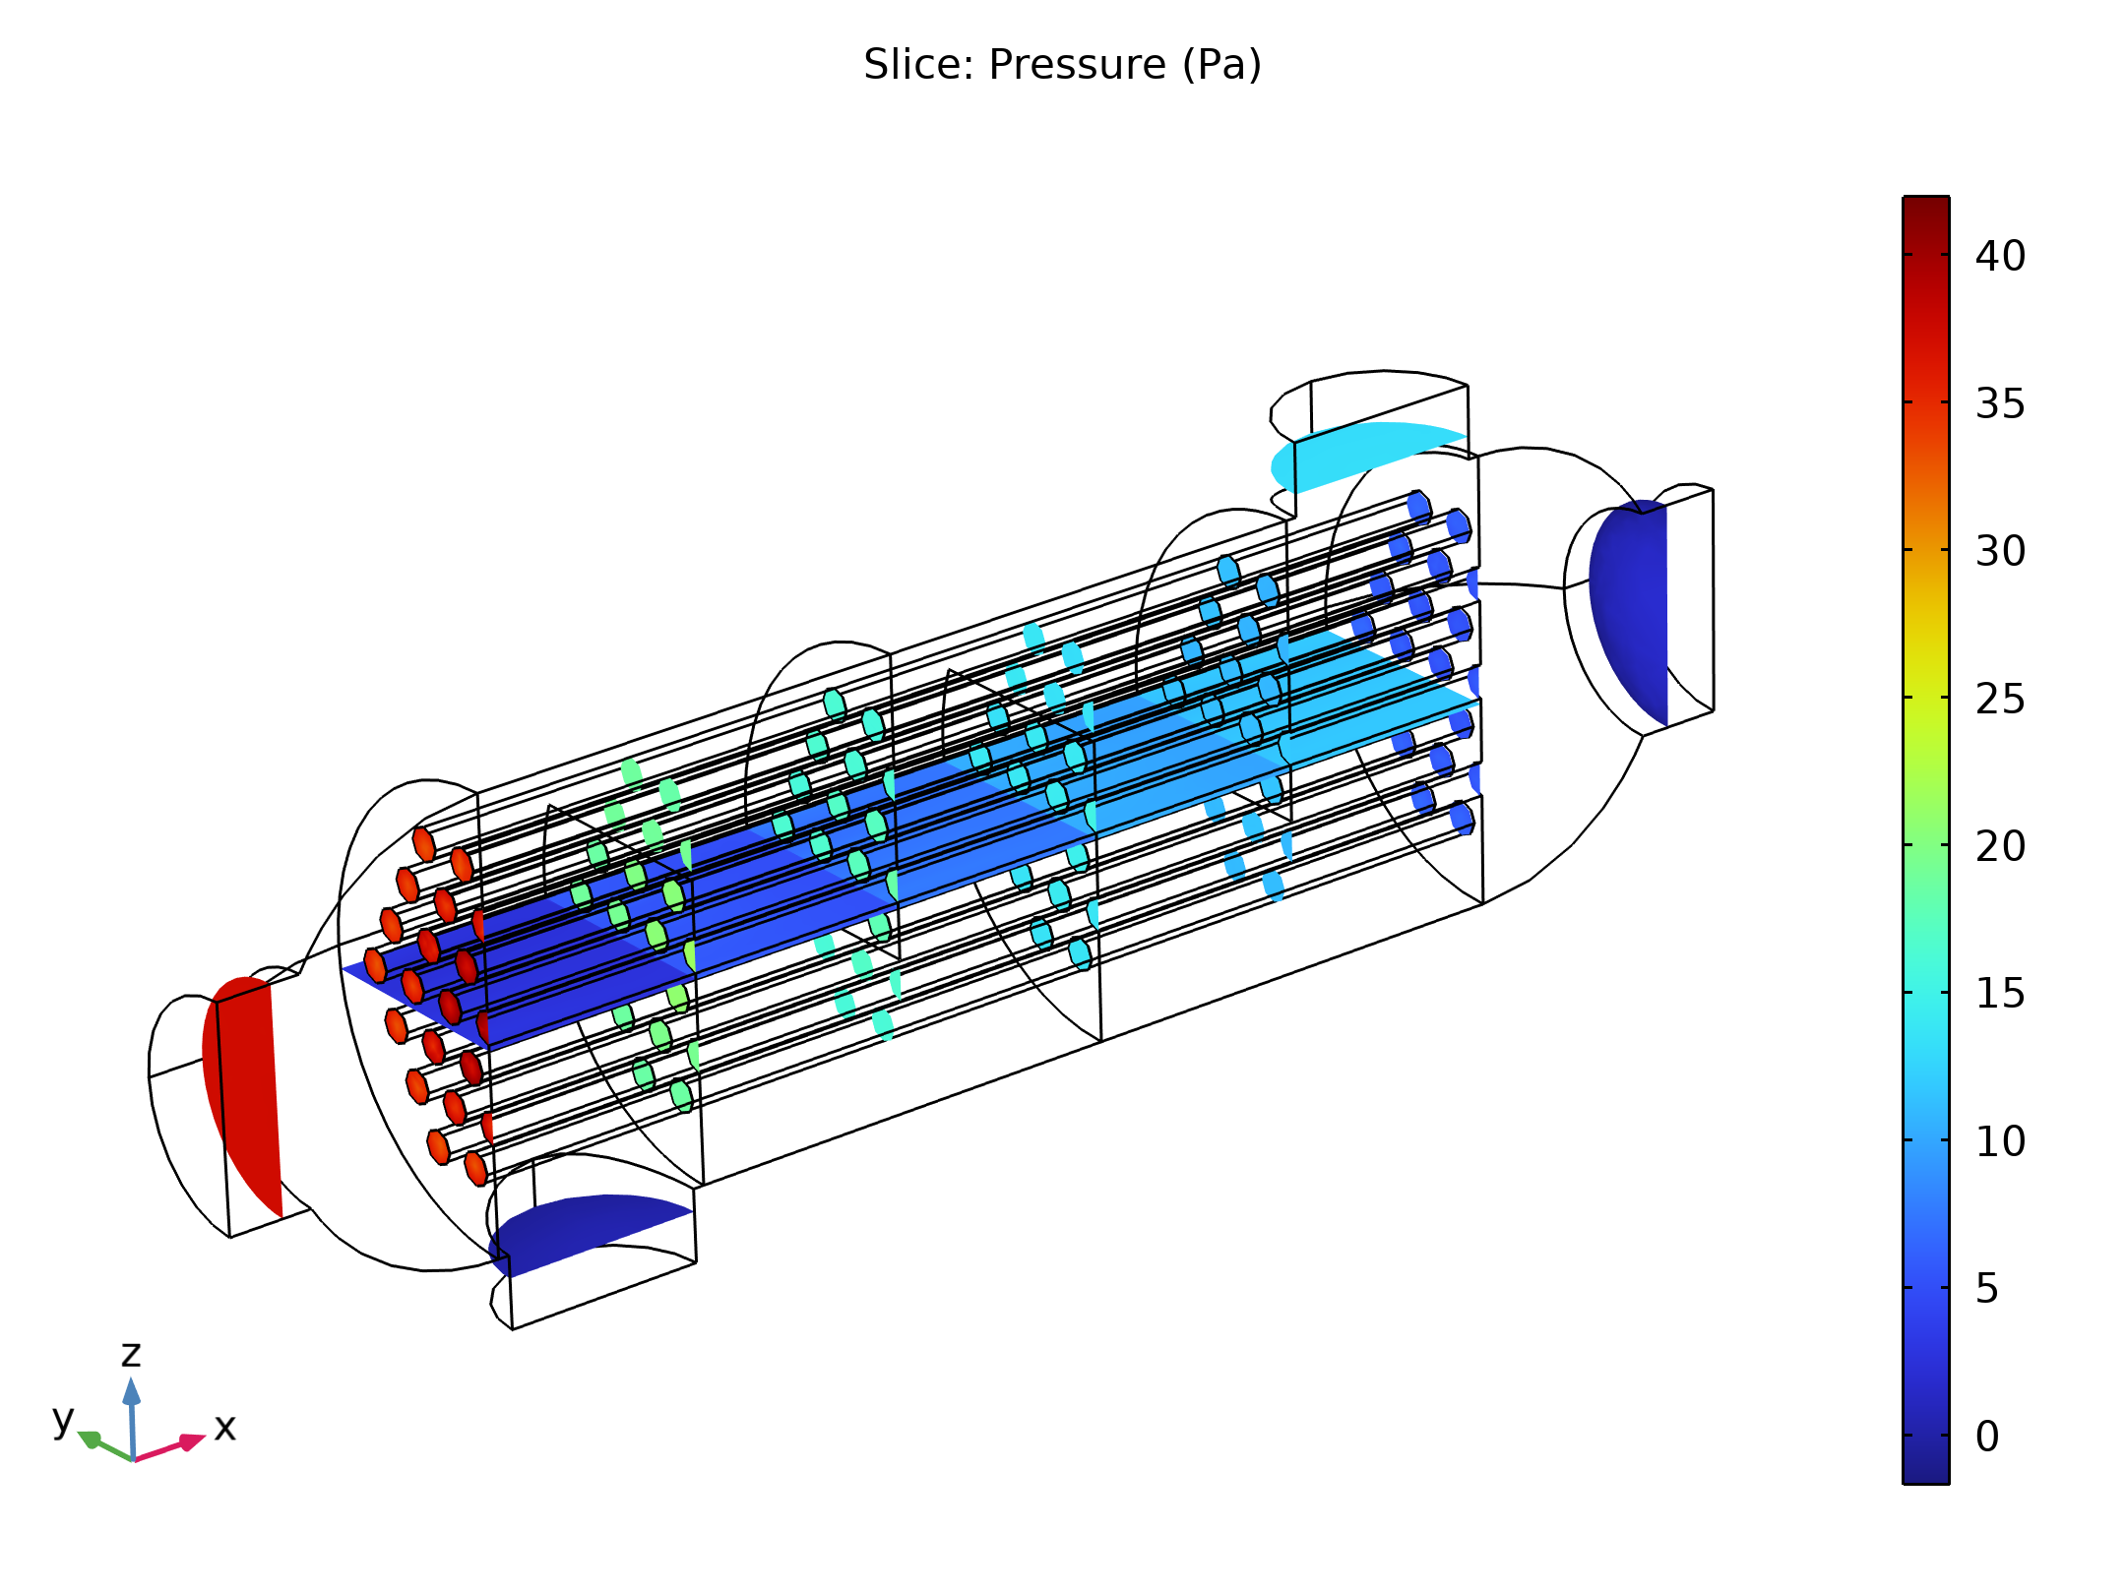
Results
The pressure drop is slightly lower than 40 Pa for water and about 13 Pa for air
Pressure evolution in the air and water domains between inlet and outlet

