Slide 1
LED Bulb Cooling
COMSOL

Slide 2
Background
Light-emitting diode (LED) bulbs are nowadays preferred to incandescent light bulbs because of their higher longevity and energy efficiency
In LED bulbs, light is produced by electroluminescence, but 70% of the electrical power consumed is lost as heat in the process
Geometry and material properties can be optimized during the design process to prevent the bulb from overheating

Slide 3
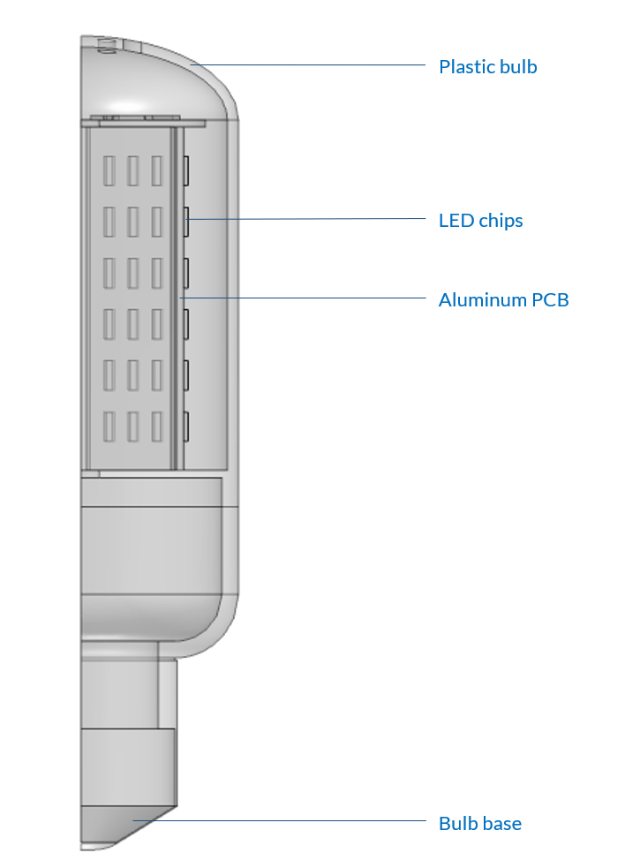
Model Definition
The device consists of an aluminum PCB supporting LED chips inside a plastic bulb
The inside and outside of the bulb are filled with air
Symmetries are used on the 2 planes of symmetry to reduce computational time
Model geometry

Slide 4
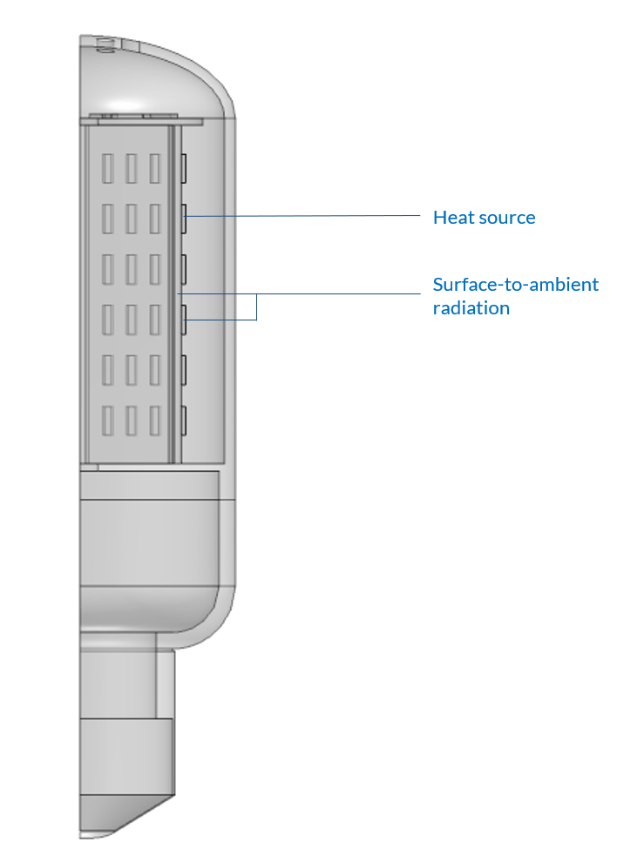
Model Definition
LED chips are considered as heat sources dissipating power equal to the heat losses
The radiative surface-to-ambient heat transfer is taken into account on the PCB and LED chips
Buoyancy forces are taken into account for natural convection inside and outside the bulb
Free boundaries are defined around the bulb, with a pressure constraint on the bottom boundary to close the problem
Model boundary conditions

Slide 5
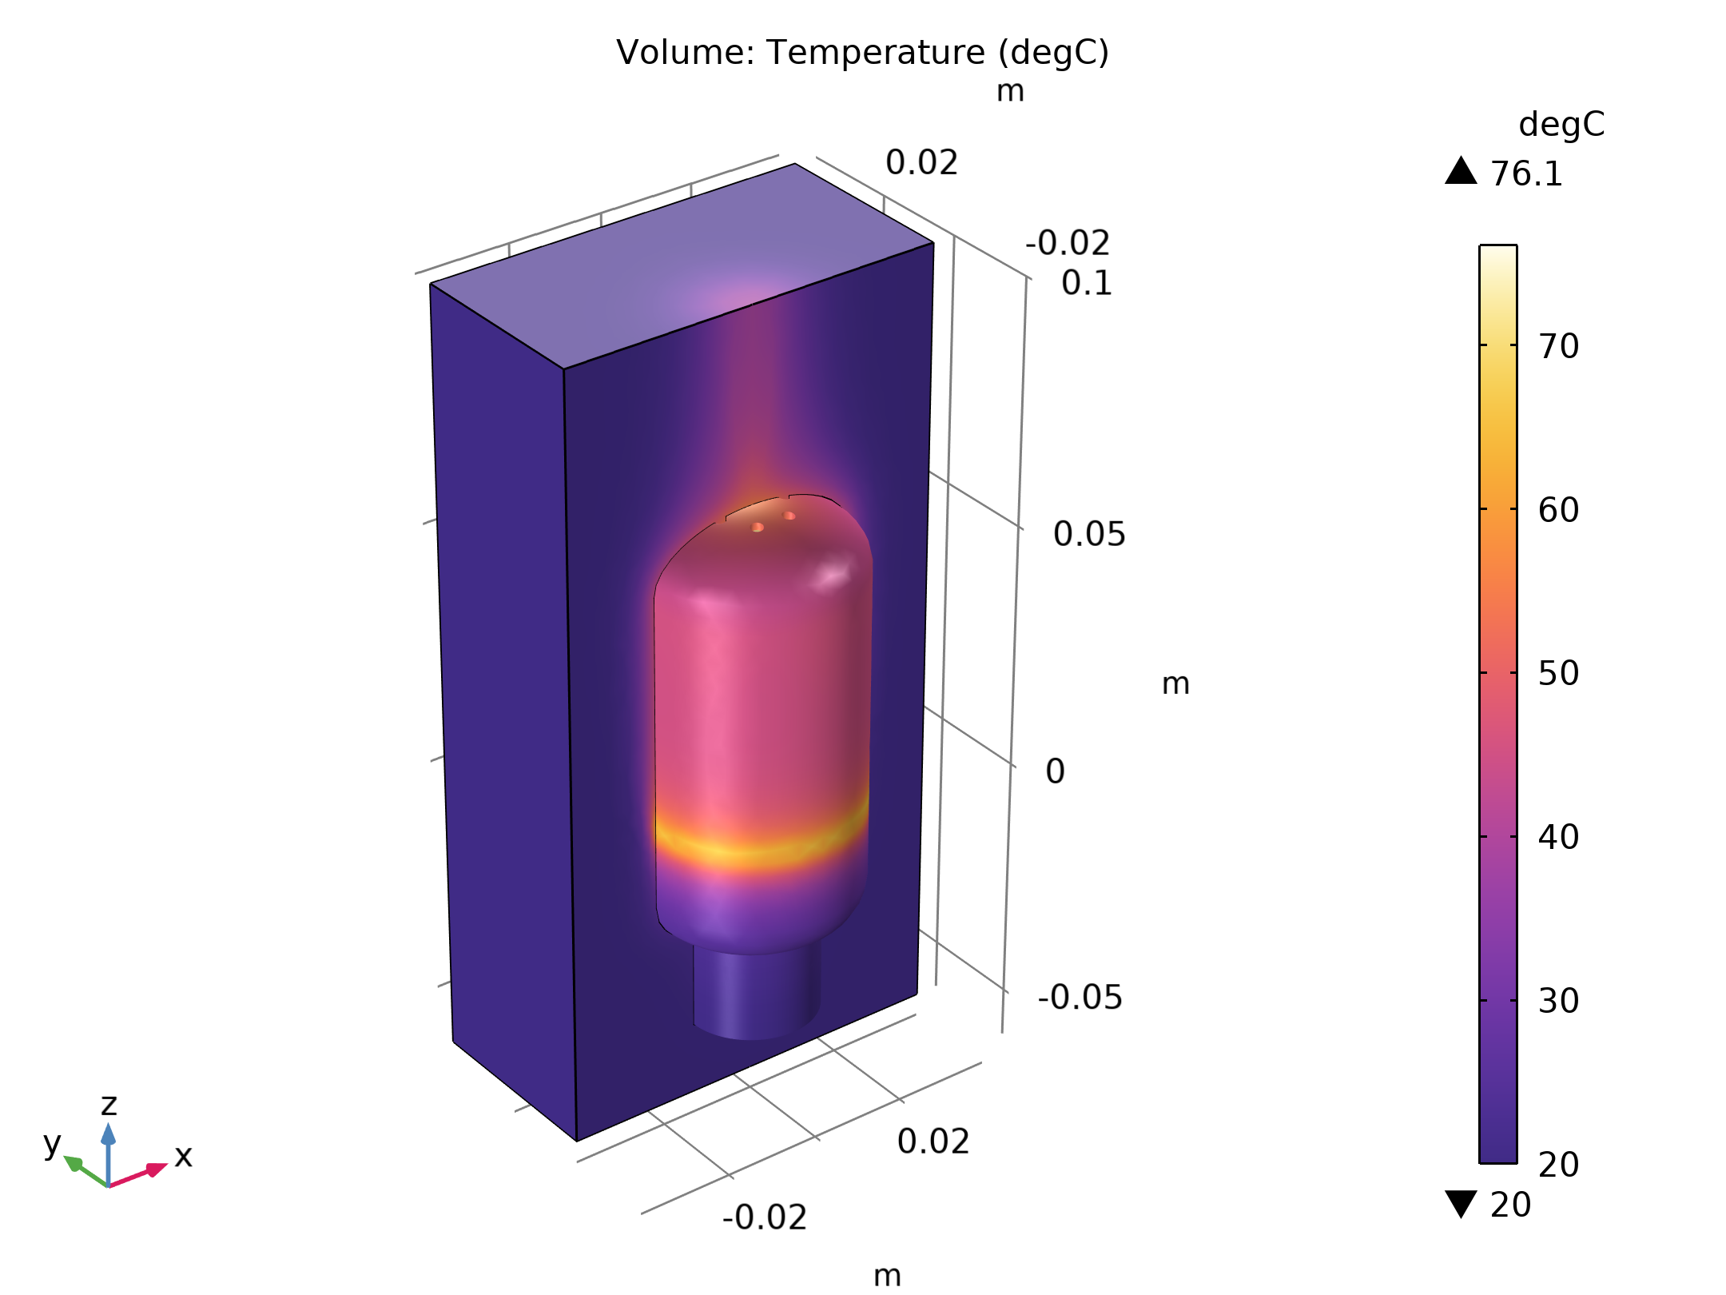
Results
The LED chips are cooled by conduction and convection with the air inside the bulb, and by radiation to the ambient air
The air inside the bulb is itself cooled by conduction with the plastic bulb in contact with ambient air
The hot air inside the bulb can escape through small holes on the top of the bulb
Temperature field outside the LED bulb

Slide 6
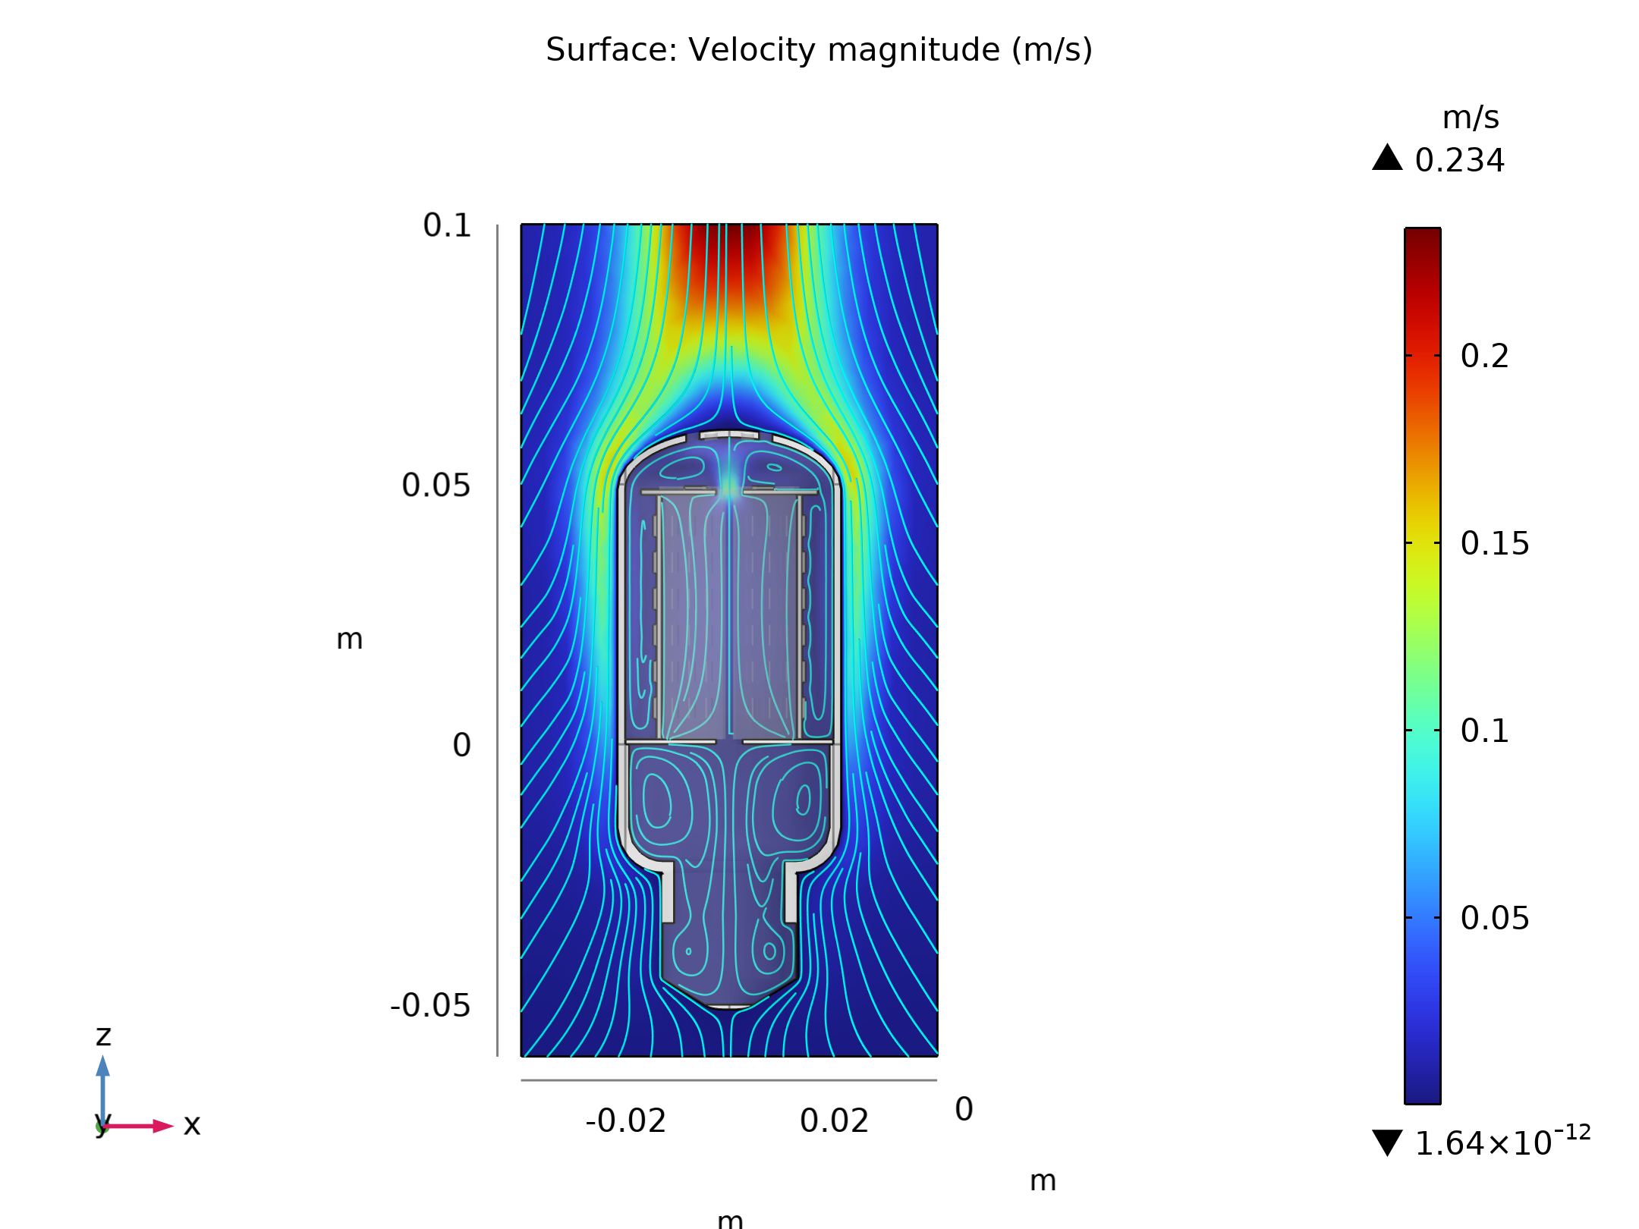
Results
The thin film of hot air around the bulb creates a vertical airflow due to buoyancy forces
Convective cells appear inside the bulb
Velocity field inside and outside the LED bulb

