Slide 1
High-Intensity Focused Ultrasound (HIFU) Propagation Through a Tissue Phantom
COMSOL

Slide 2
Introduction
The high-intensity focused ultrasound is used in many different biomedical applications, such as thermal ablation of tumors, transcranial HIFU surgery, shock wave lithotripsy, and so on
A HIFU signal is focused on a small focal zone, where its intensity reaches higher levels
In this case, nonlinear effects may become significant and one speaks of the propagation of finite amplitude sound waves
The nonlinear nature of the phenomenon results in the energy transfer from lower to higher harmonics
The contribution of the higher-order harmonics grows with the propagation distance

Slide 3
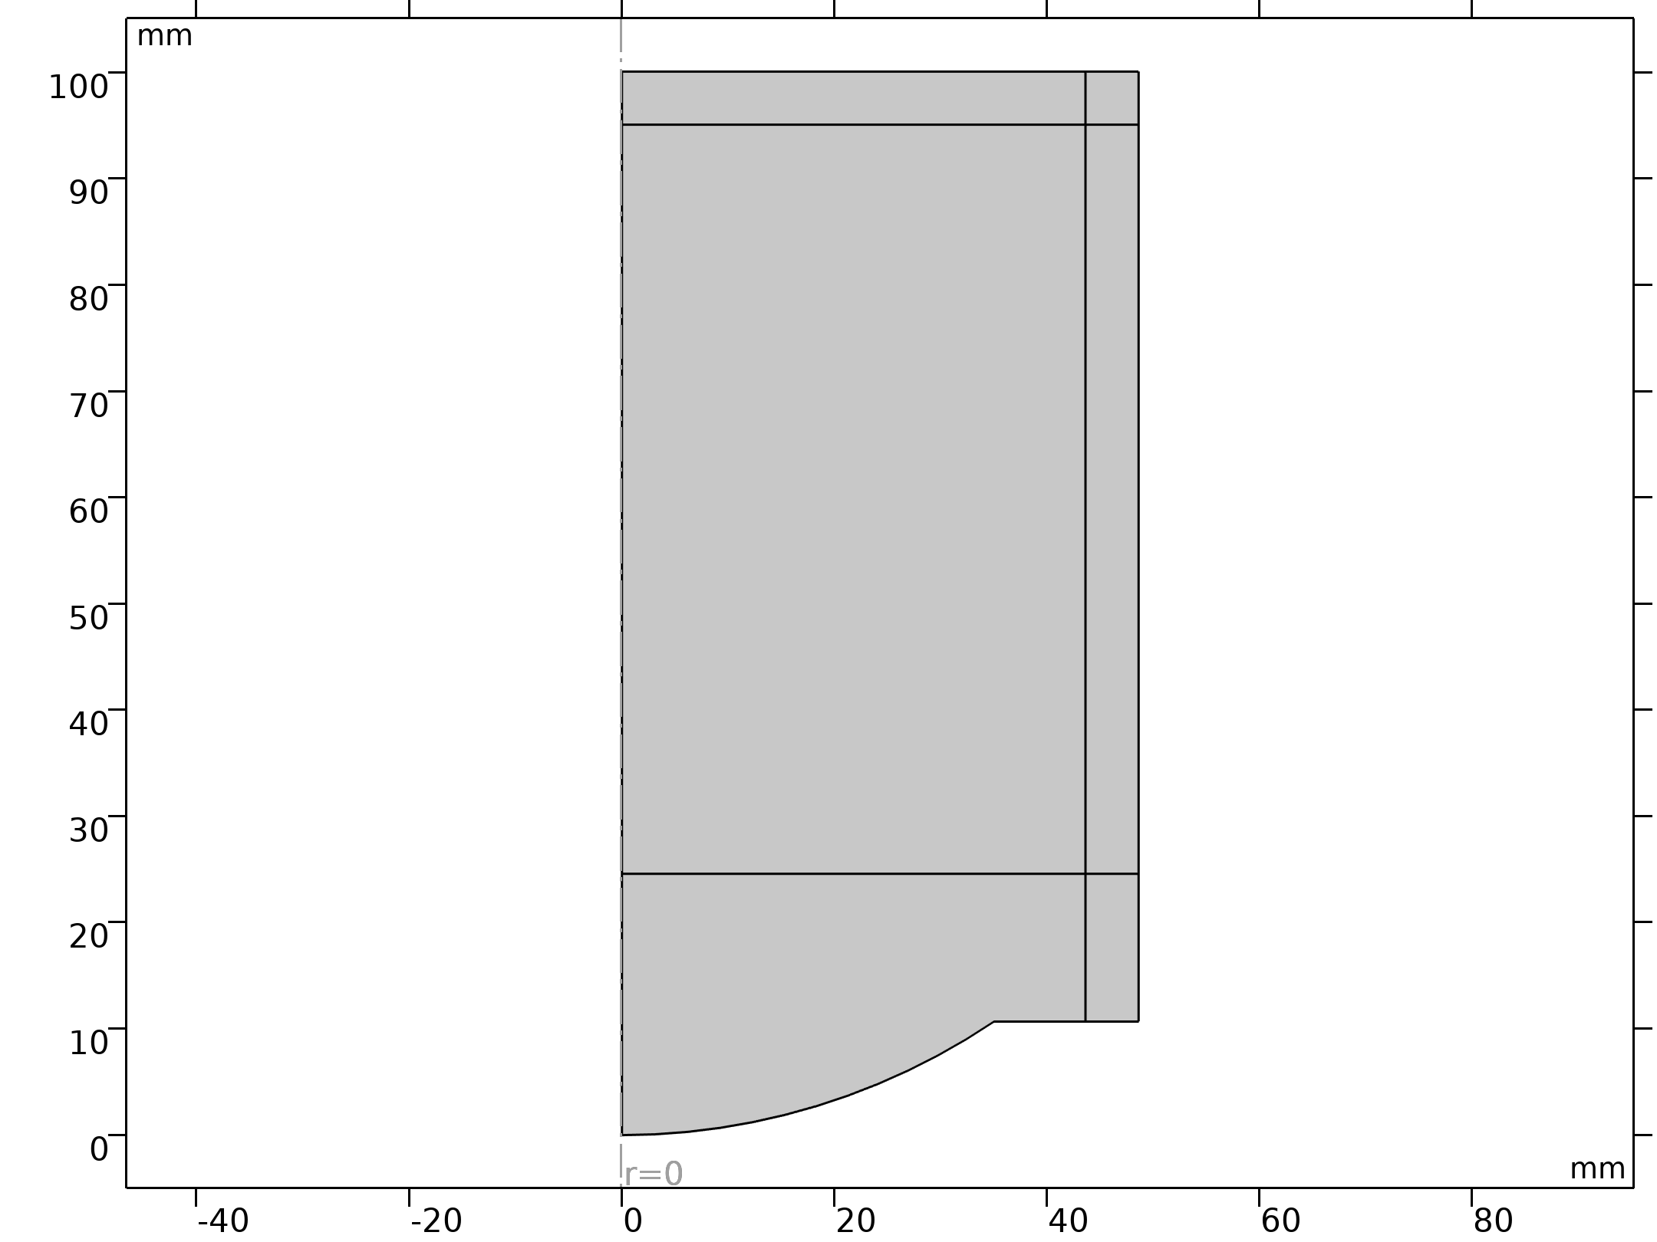
Model Definition
The focusing of an ultrasonic signal is typically achieved either by using a phase delay or a focusing lens on the transducer side
In this model, a spherically focused ultrasound transducer with a concave lens is used to emit the signal
The transducer housing and the lens are assumed to be rigid
The figure shows the model setup
The model geometry is axially symmetric
Geometry 1

Slide 4
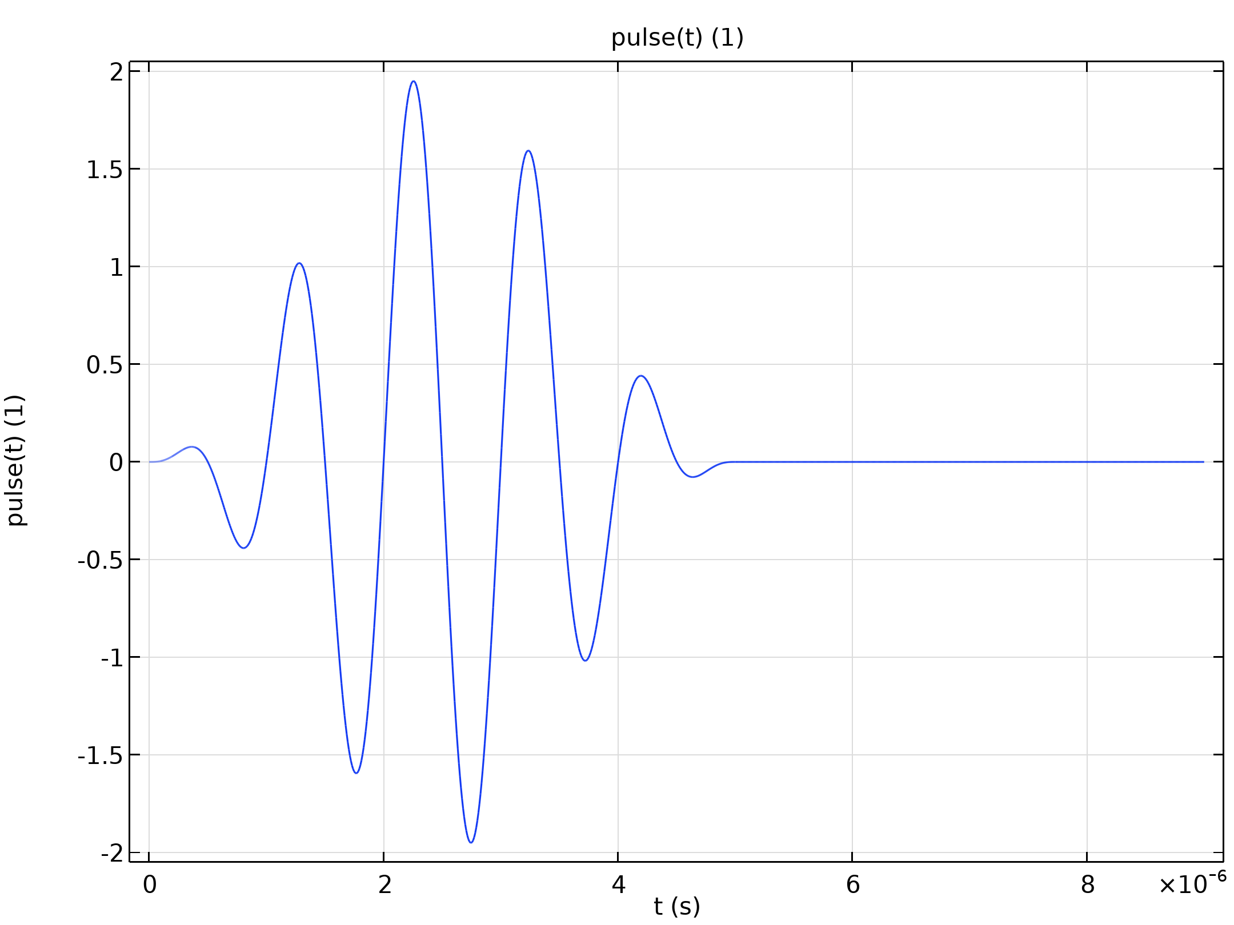
Model Definition
The spherical lens of radius r and aperture a emits a signal that is focused at the focal point F located in the tissue phantom
The signal is a five-cycle tone burst with the amplitude
p₀ = 0.1 MPa and the center frequency f₀ = 1 MHz as shown in the figure
Source signal

Slide 5
Model Definition
The signal amplitude at the source location is high enough to generate higher-order harmonics, but not high enough for the formation of shocks, and therefore no special shock-capturing techniques are required in this model
Source signal

Slide 6
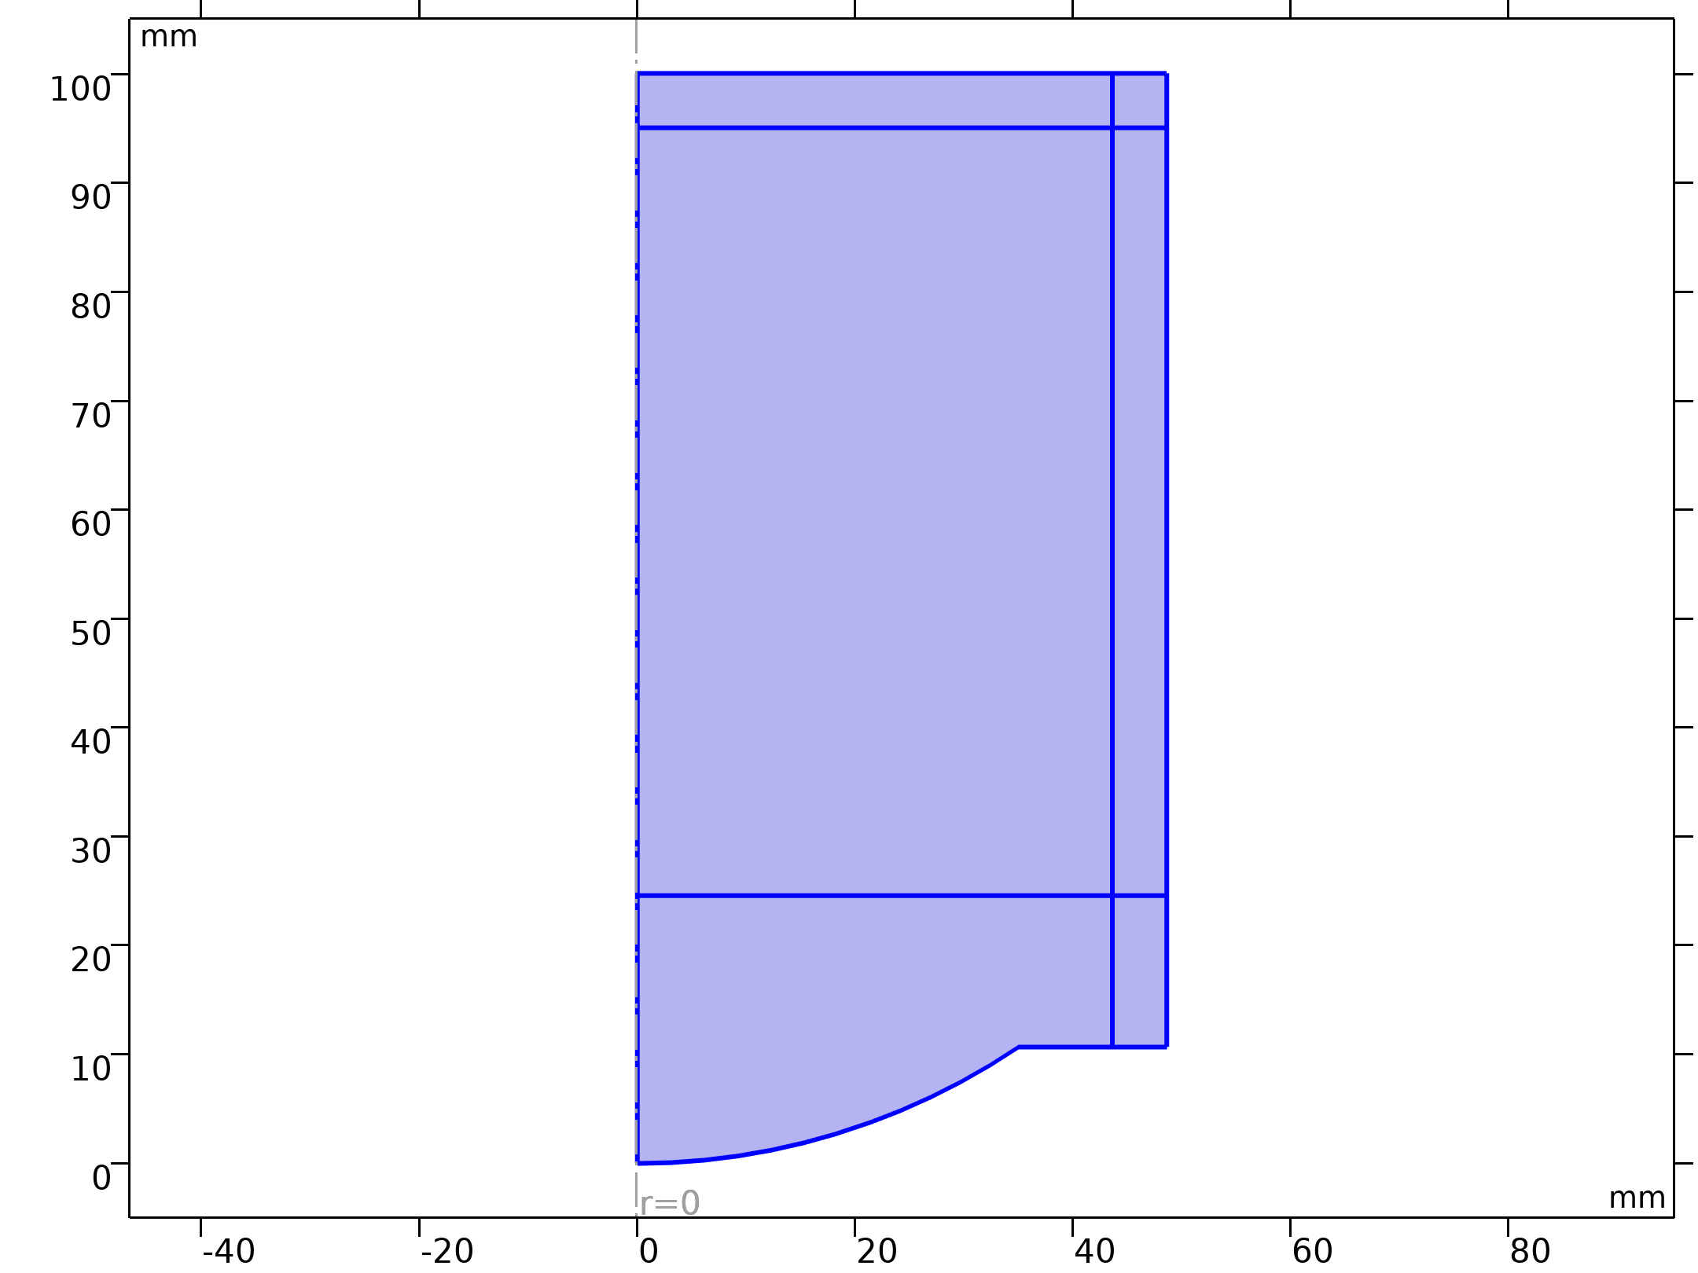
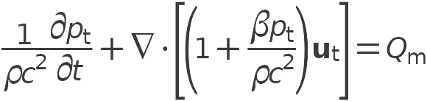


Model Definition
Nonlinear Pressure Acoustics, Time Explicit

Slide 7

Model Definition
Nonlinear Pressure Acoustics, Time Explicit

Slide 8
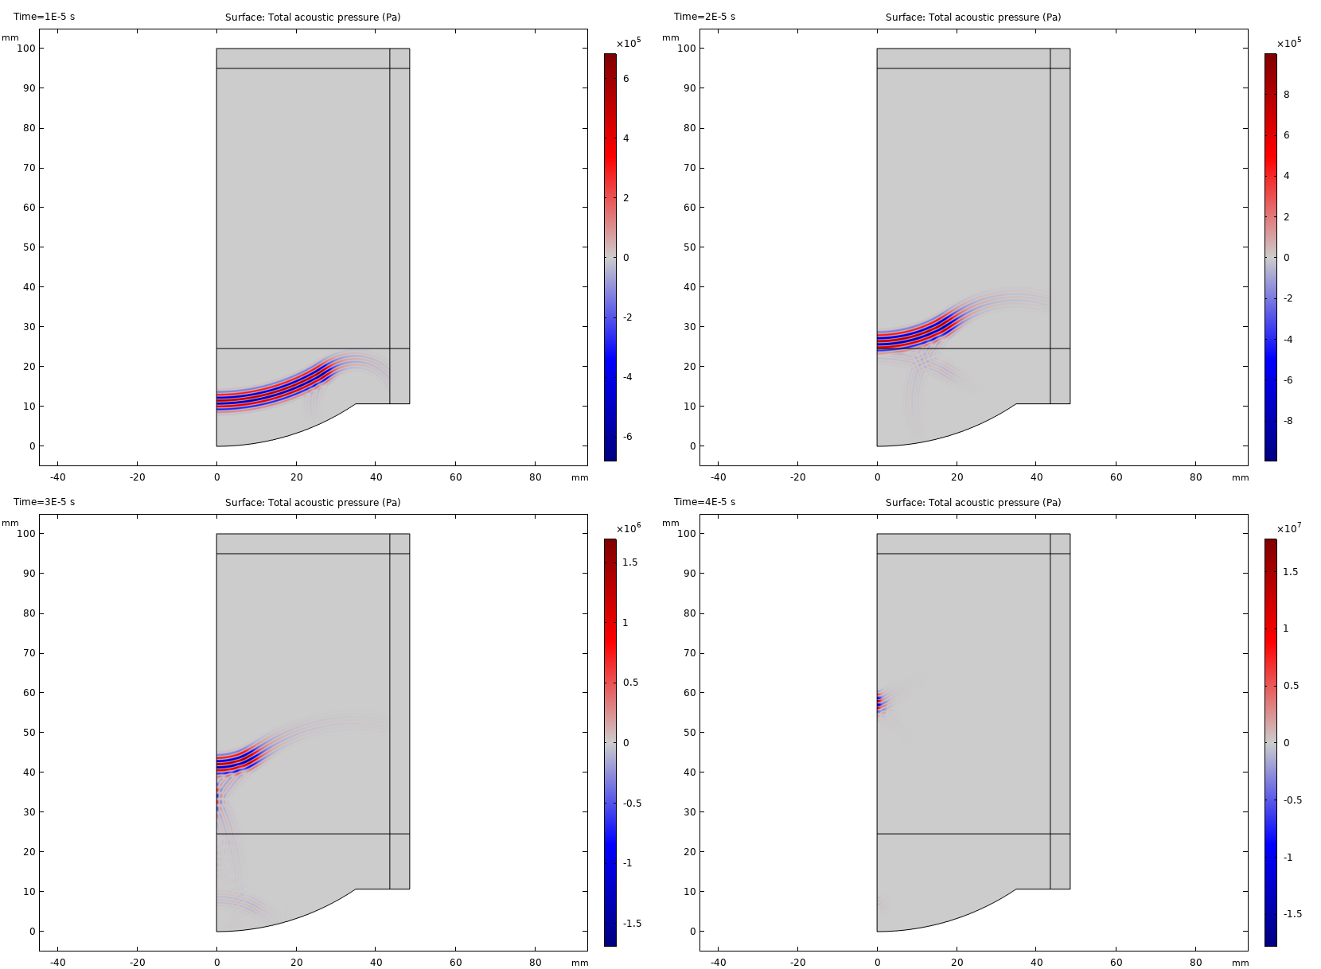
Results
The figure illustrates the evolution of the signal traveling from the source
The tone burst pulse has left the source at t = 10 μs and travels toward the boundary between the water and the tissue phantom domains, which it passes at t = 20 μs with some part being reflected back to the source
Propagation of the ultrasonic signal at times t = 10, 20, 30, and 40 μs

Slide 9
Results
The focusing of the signal becomes visible at t = 30 μs and reaches its maximum at t = 40 μs
The figure also shows that the signal strength increases as it comes closer to the focal zone
Propagation of the ultrasonic signal at times t = 10, 20, 30, and 40 μs

Slide 10
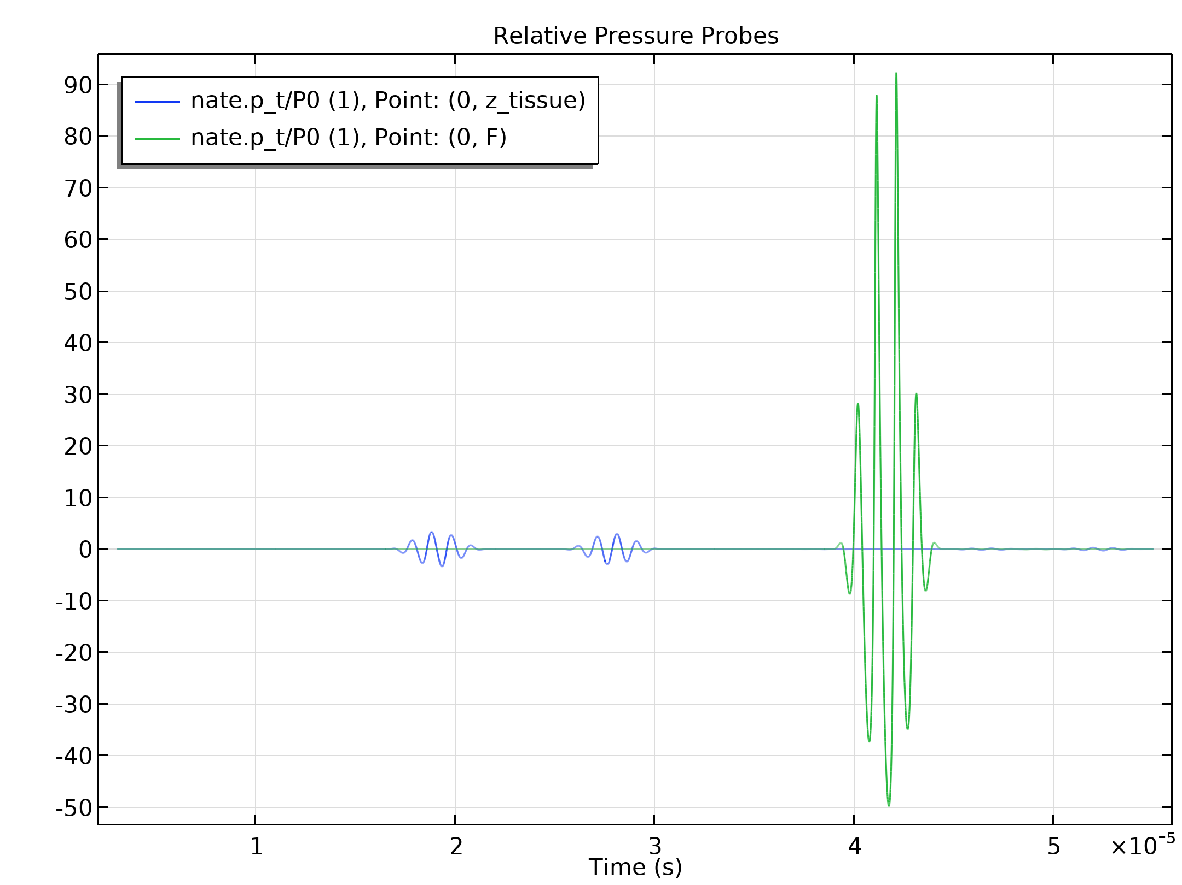
Results
This is confirmed by the plots of the signal at the water/tissue interface and at the focal point depicted in the figure
The acoustic pressure amplitude at the focal point is about 10 times greater than that at the water/tissue interface
Another observation is that the positive pressure peaks are almost twice as high as the negative ones at the focal point
This indicates that the signal becomes highly nonlinear as it reaches the focal zone

Slide 11
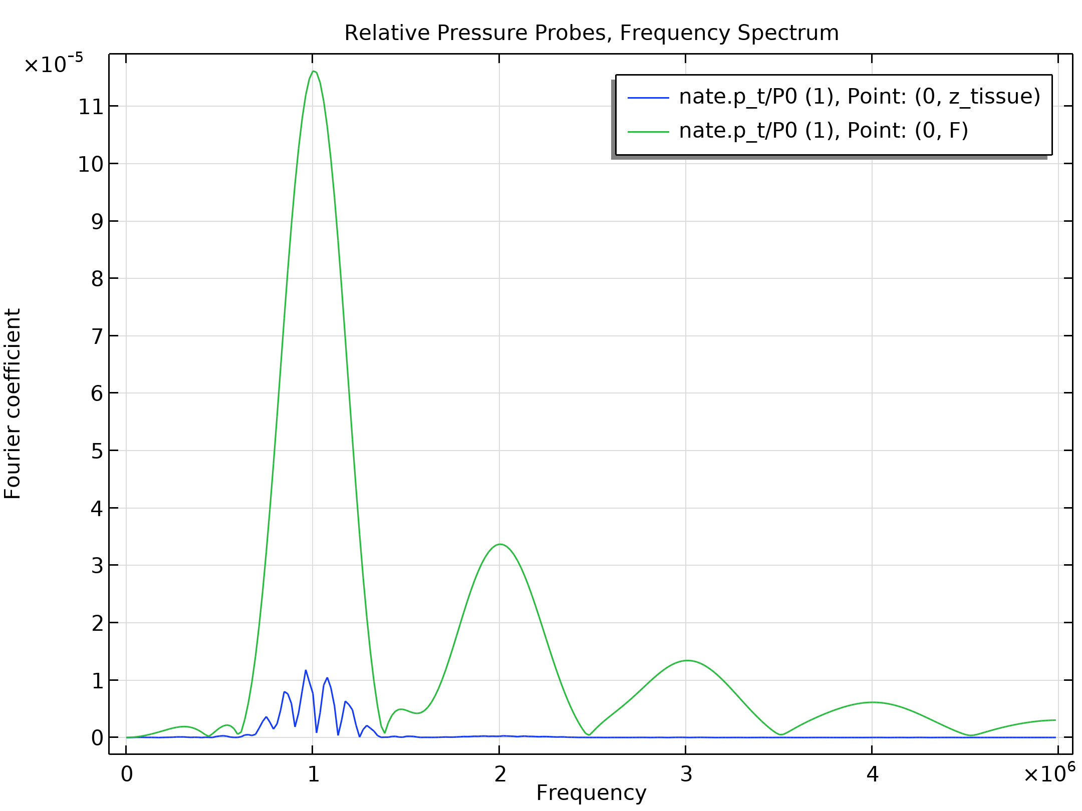
Results
The figure shows the frequency content of the recorded signals
The frequency content of the signal entering the tissue phantom is not much different from the source signal
That is, the propagation up to this point is linear
The signal at the focal point is however highly nonlinear, which is seen from the number of generated higher-order harmonics
Frequency spectrum of the acoustic pressure at the water/tissue interface and at the focal point

Slide 12
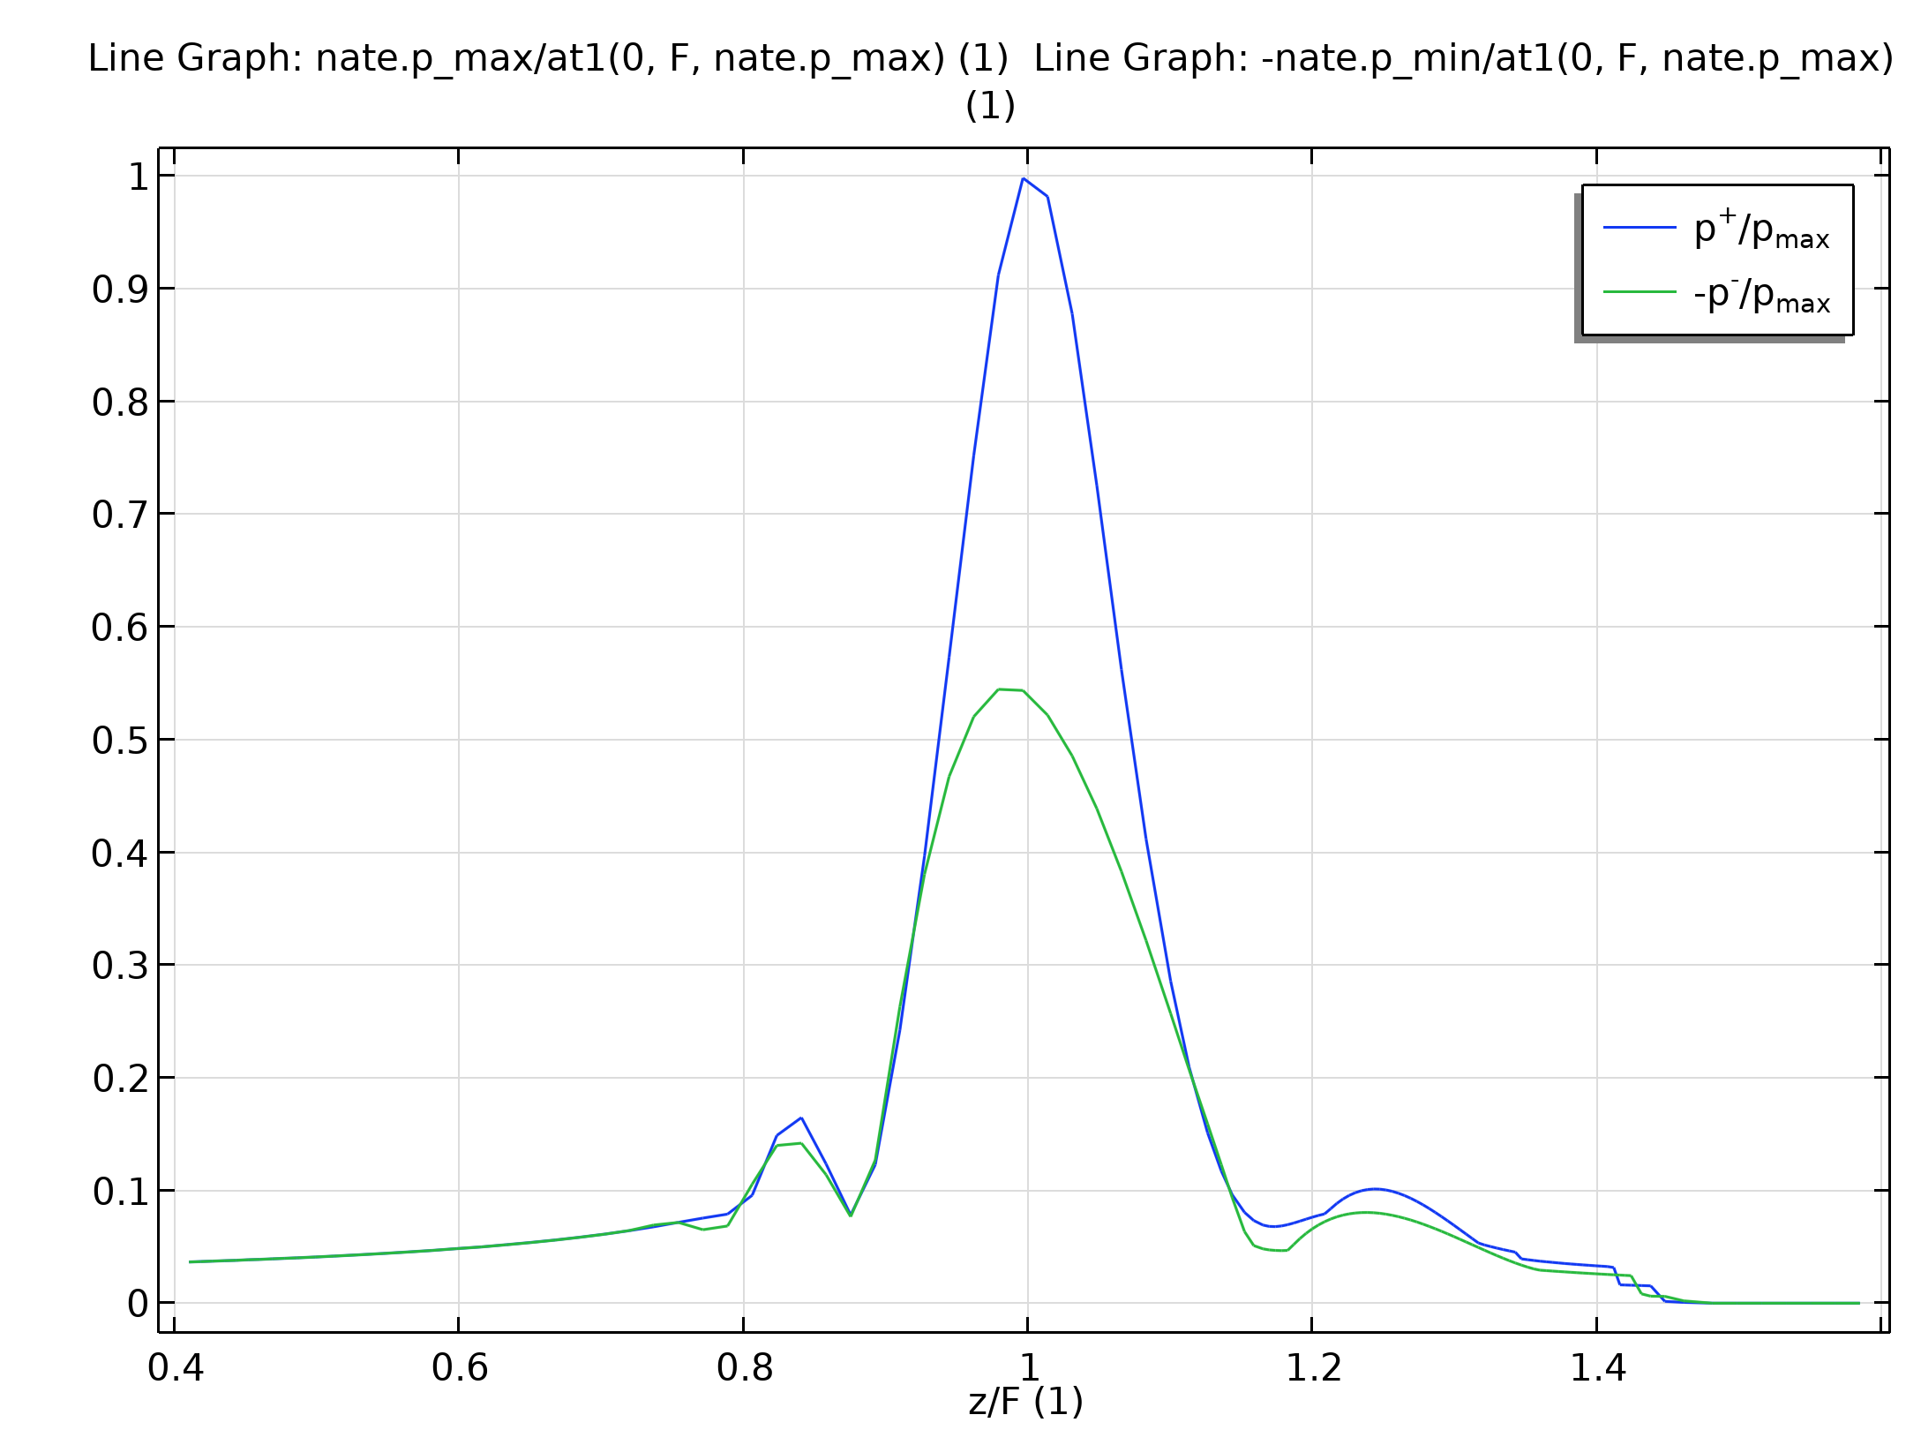
Results
The figure shows plots of the calculated minimum and maximum on-axis pressures
The values are computed according to the following formulas:
  p⁻ = min_{t ∈[0,Tend]}(p)
  p⁺ = max_{t ∈ [0, Tend]}(p)
and are normalized with respect to the maximum pressure at the focal point
the figure shows that p⁺ is almost twice as high as p⁻, which is a distinctive feature of nonlinear propagation of a HIFU signal
Frequency spectrum of the acoustic pressure at the water/tissue interface and at the focal point

Slide 13
Results
The bounds of the focal zone are also seen in the figure
Frequency spectrum of the acoustic pressure at the water/tissue interface and at the focal point

Slide 14
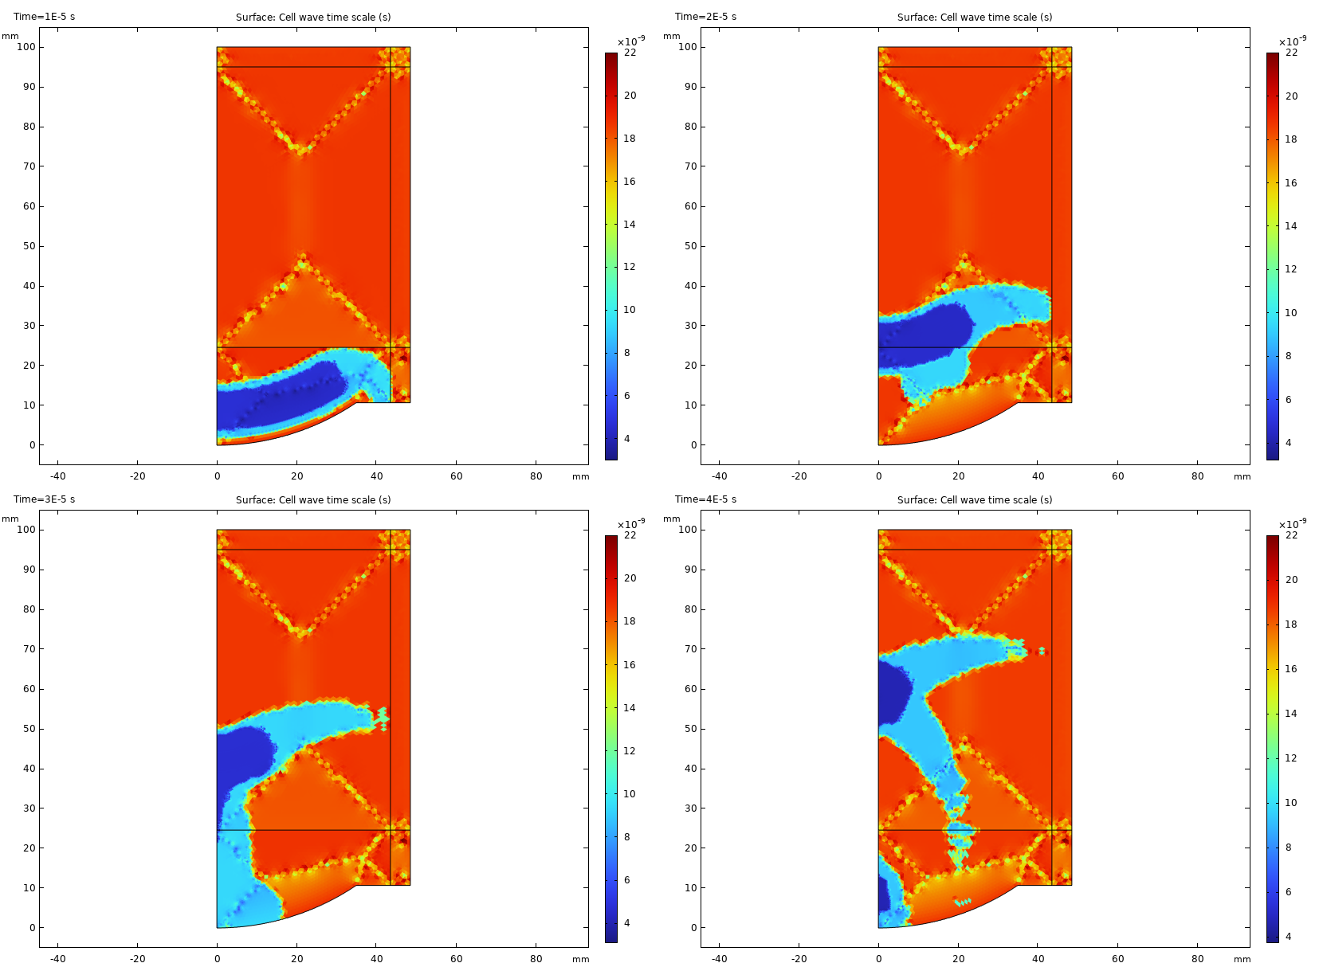
Results
The figure shows the values of the cell wave time scale elte.wtc variable, that the time step is proportional to
The smaller values are found for the smaller mesh elements in the vicinity of the signal, while the larger values are used in the rest of the computational domain
Cell wave time scale at times t = 10, 20, 30, and 40 μs

