Slide 1
Nonisothermal Reacting Flow in a Methane Steam Reformer

Slide 2
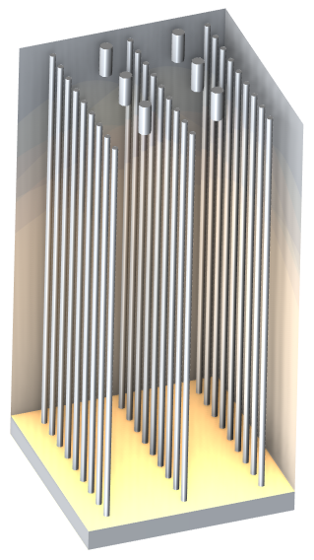
Background
Steam reforming is a process that can be used to produce syngas (hydrogen and carbon monoxide) from methane
Reactions occur in a multitube plug flow reactor with burners. The tubes are filled with a catalytic porous material
The furnace heats the tubes to compensate for the endothermic reactions
Two approaches to model a single-tube reactor are studied:
  Simplified perfectly mixed model (Reaction Engineering physics interface)
  Space-dependent model with coupled physics (Nonisothermal Reacting Flow multiphysics)
Multitube reactor in a top-fired furnace.

Slide 3
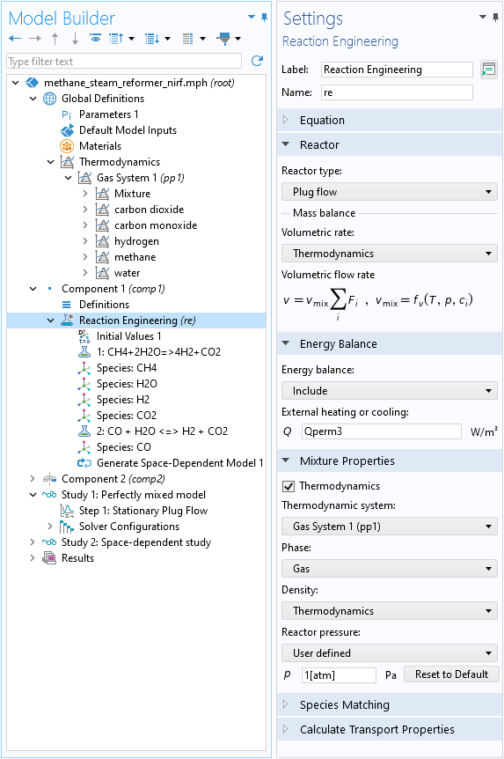
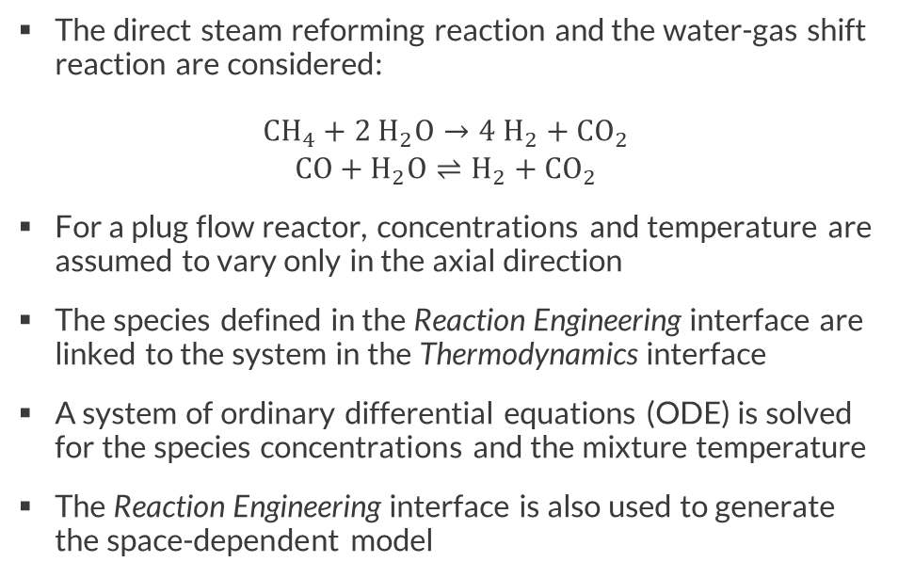
Model Definition
Perfectly Mixed Model
The direct steam reforming reaction and the water-gas shift reaction are considered:
$$\begin{matrix}{CH}_{4}+{2 H}_{2}O→{4 H}_{2}+{CO}_{2} \\ CO+H_{2}O⇌H_{2}+{CO}_{2}\end{matrix}$$
For a plug flow reactor, concentrations and temperature are assumed to vary only in the axial direction
The species defined in the Reaction Engineering interface are linked to the system in the Thermodynamics interface
A system of ordinary differential equations (ODE) is solved for the species concentrations and the mixture temperature
The Reaction Engineering interface is also used to generate the space-dependent model

Slide 4
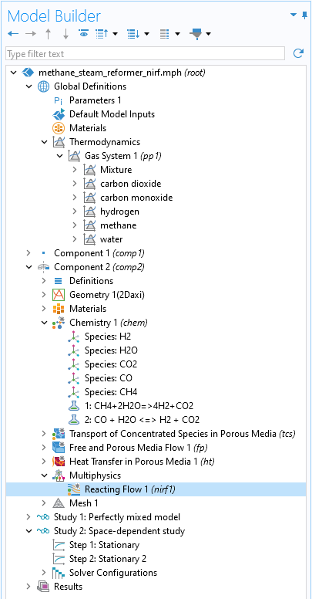
Model Definition
Space-Dependent Model
The space-dependent model uses a Chemistry interface to define the reaction, and three transport interfaces
The Transport of Concentrated Species in Porous Media interface solves the mass transport equations for all species
The Free and Porous Media Flow interface solves the momentum equation for the mixture
The Heat Transfer in Porous Media interface solves the temperature equation in the whole domain
All four interfaces are solved together with the Nonisothermal Reacting Flow coupling to ensure conservation of mass, momentum and energy

Slide 5
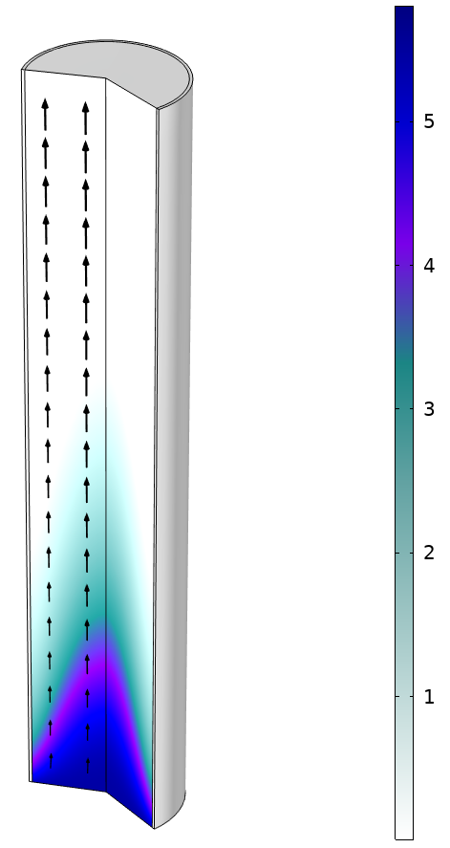
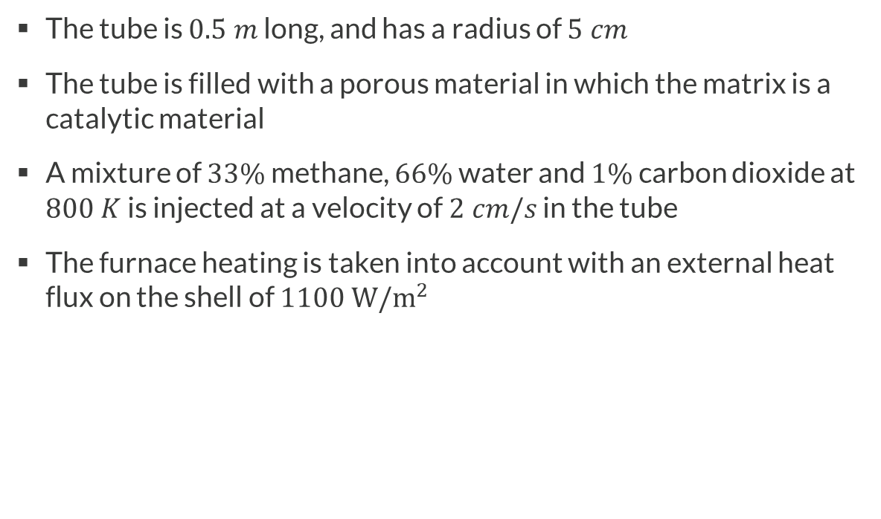
Model Definition
Single-Tube Reactor
Copper tube shell
Outlet
The tube is $0.5 m$ long, and has a radius of $5 cm$
The tube is filled with a porous material in which the matrix is a catalytic material
A mixture of $33\%$ methane, $66\%$ water and $1\%$ carbon dioxide at $800 K$is injected at a velocity of $2 cm/s$ in the tube
The furnace heating is taken into account with an external heat flux on the shell of $1100 W/m^{2}$
Catalytic porous material
Inlet
Molar concentration (mol/m^3) of methane and velocity field.

Slide 6
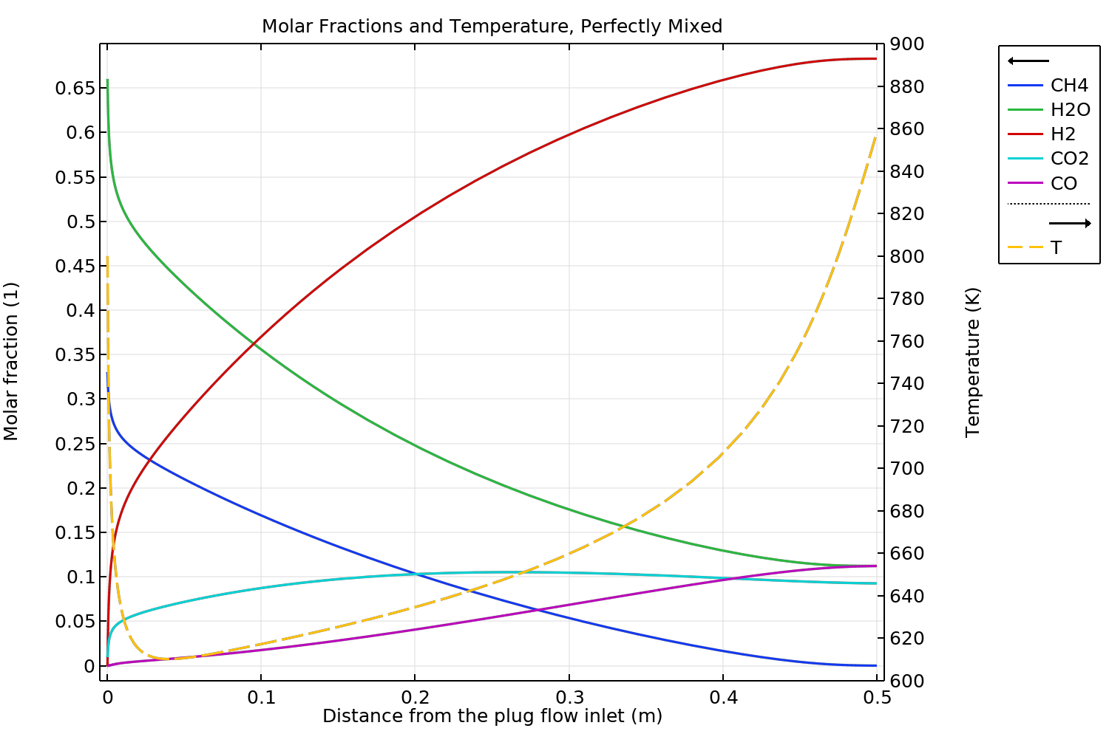
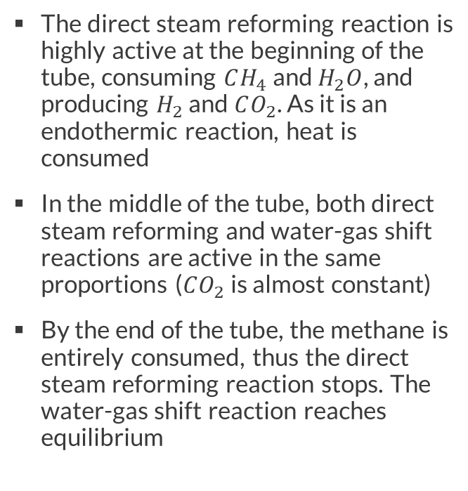
Results
Perfectly Mixed Model
The direct steam reforming reaction is highly active at the beginning of the tube, consuming $CH_{4}$ and $H_{2}O$, and producing $H_{2}$ and $CO_{2}$. As it is an endothermic reaction, heat is consumed
In the middle of the tube, both direct steam reforming and water-gas shift reactions are active in the same proportions ($CO_{2}$ is almost constant)
By the end of the tube, the methane is entirely consumed, thus the direct steam reforming reaction stops. The water-gas shift reaction reaches equilibrium
Molar fractions (1) and temperature (K) in the domain with the Reaction Engineering model.

Slide 7
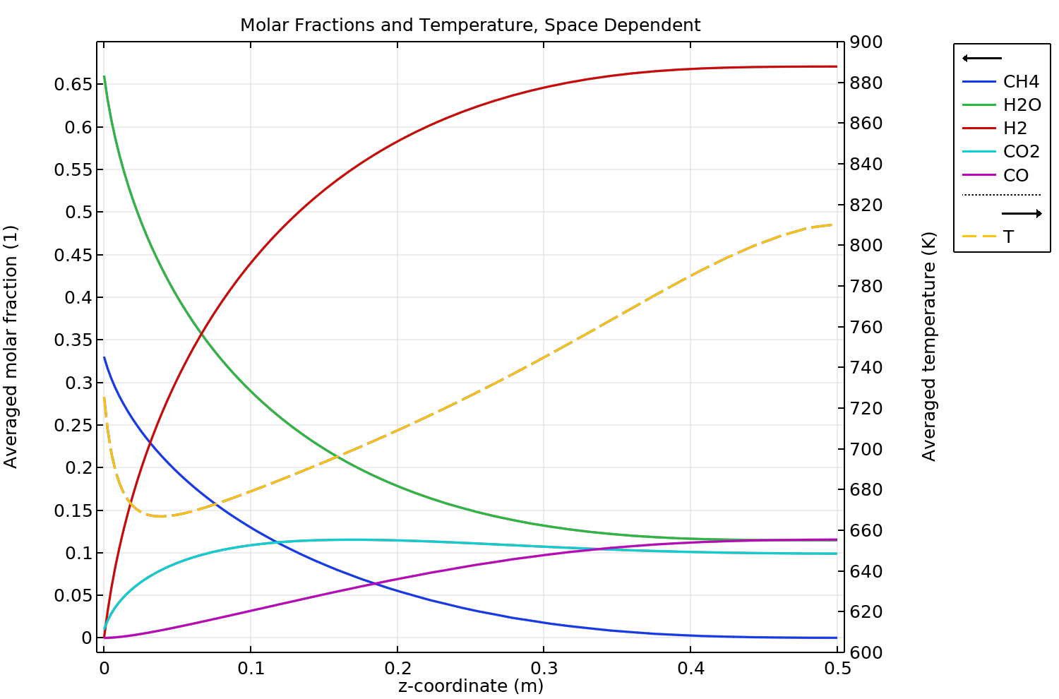
Results
Space-Dependent Model
The results of the Nonisothermal Reacting Flow coupling are qualitatively comparable with the Reaction Engineering interface
The direct steam reforming reaction is predominant close to the inlet, then the water-shift gas reaction activates, and equilibrium is reached at the outlet
The direct steam reaction is less active at the beginning of the tube, explaining why the temperature drop is less severe
Averaged molar fractions (1) and temperature (K) in the domain with the Nonisothermal Reacting Flow model.

Slide 8
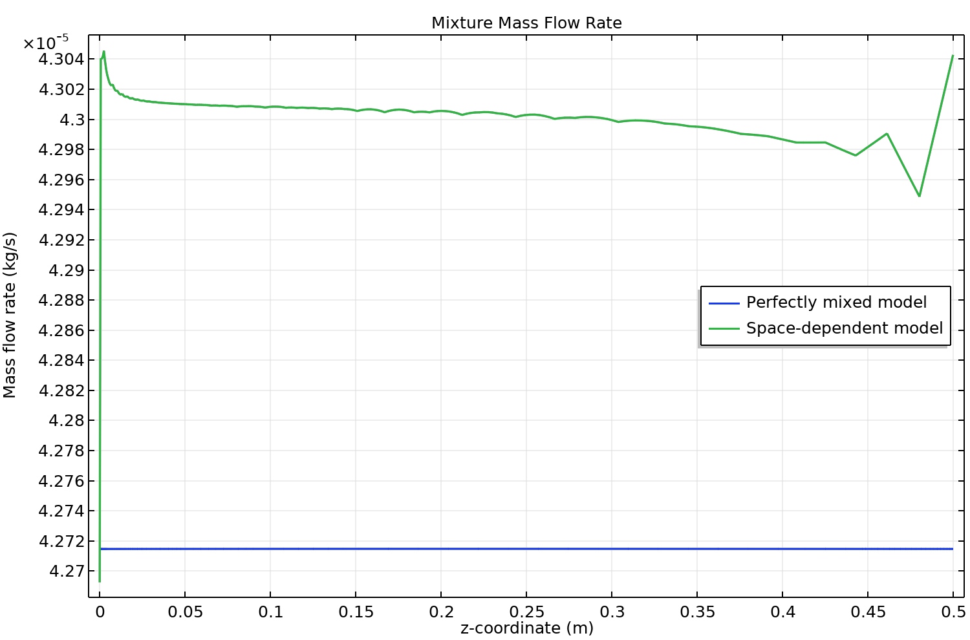
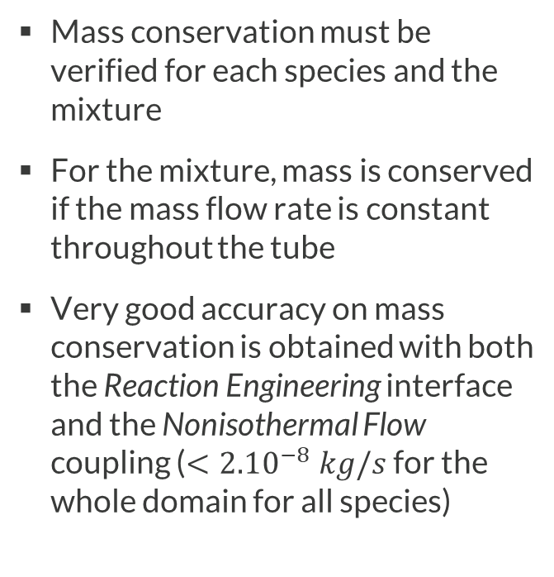
Results
Mass Conservation
Mass conservation must be verified for each species and the mixture
For the mixture, mass is conserved if the mass flow rate is constant throughout the tube
Very good accuracy on mass conservation is obtained with both the Reaction Engineering interface and the Nonisothermal Flow coupling ($<{2.10}^{−8} kg/s$ for the whole domain for all species)
Mass conservation verification for both models.

Slide 9
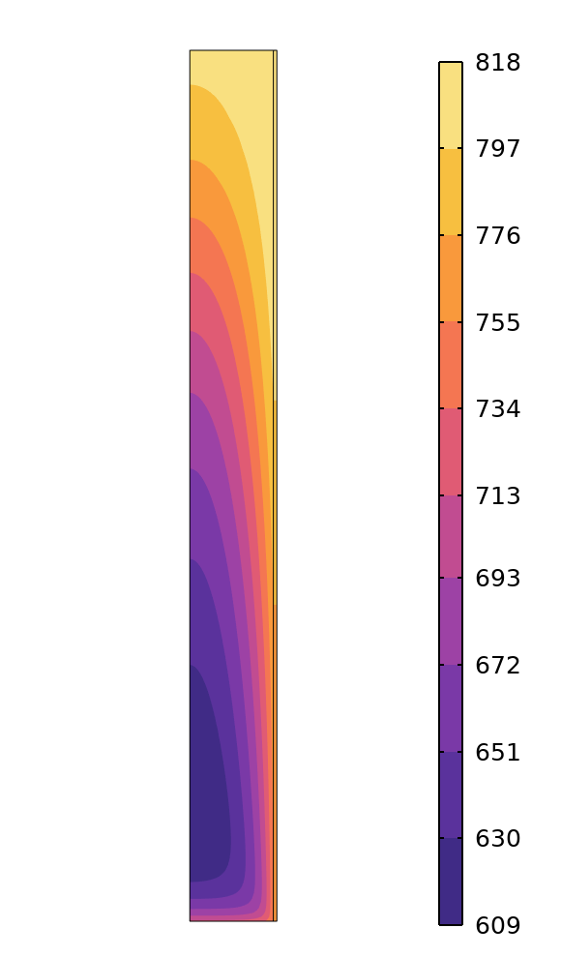
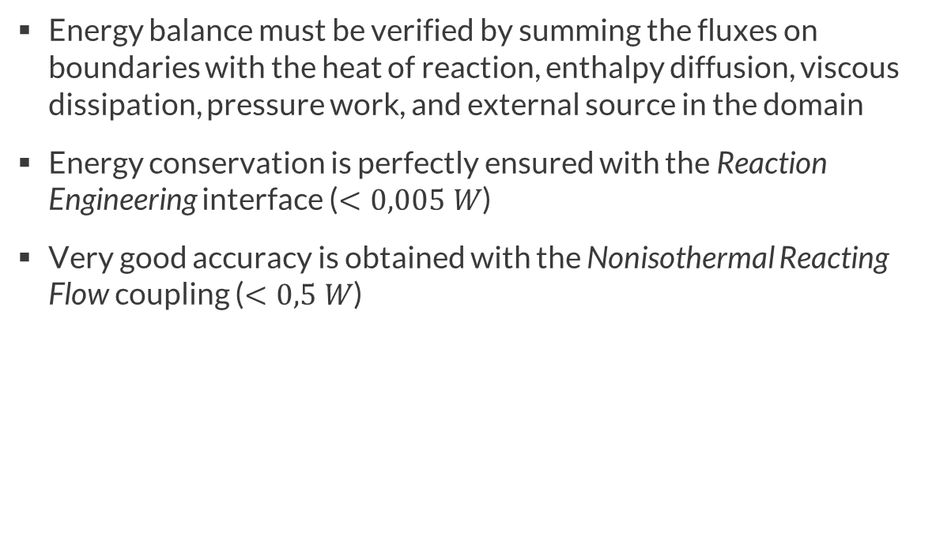
Results
Energy Conservation
Energy balance must be verified by summing the fluxes on boundaries with the heat of reaction, enthalpy diffusion, viscous dissipation, pressure work, and external source in the domain
Energy conservation is perfectly ensured with the Reaction Engineering interface ($<0,005 W$)
Very good accuracy is obtained with the Nonisothermal Reacting Flow coupling ($<0,5 W$)
Temperature field (K) in the domain.

Slide 10
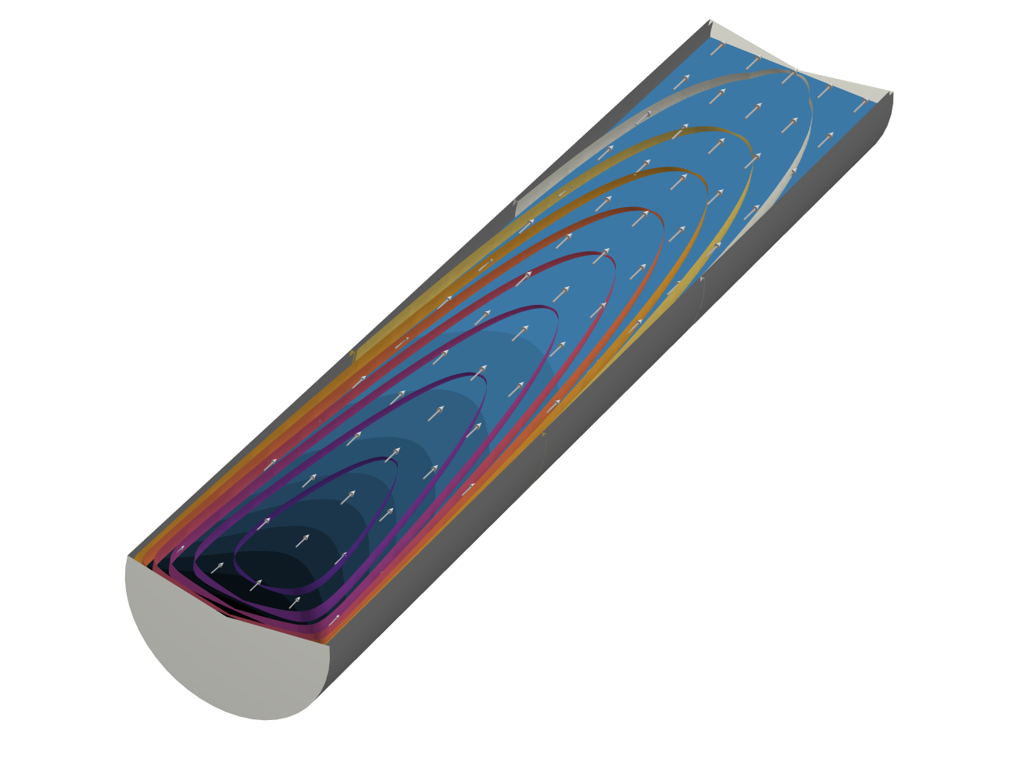
Conclusion
The results of the Reaction Engineering interface and the Nonisothermal Reacting Flow coupling are qualitatively in good accordance
The main strengths of the Reaction Engineering interface are its ease of setup and ability to provide results quickly
The main strengths of the Nonisothermal Reacting Flow coupling are its general applicability and ability to provide detailed results
Mass fraction of H2, temperature isosurfaces, and velocity field.

