Slide 1
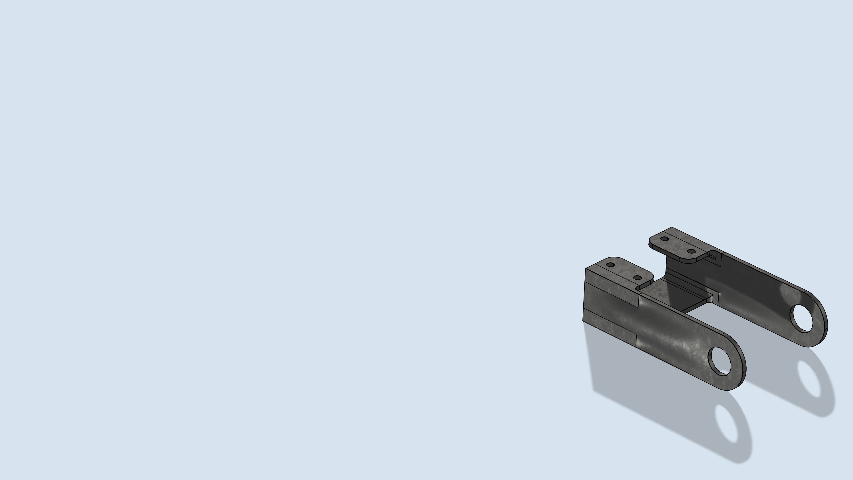
Bracket — Eigenfrequency
Shape Optimization

Slide 2
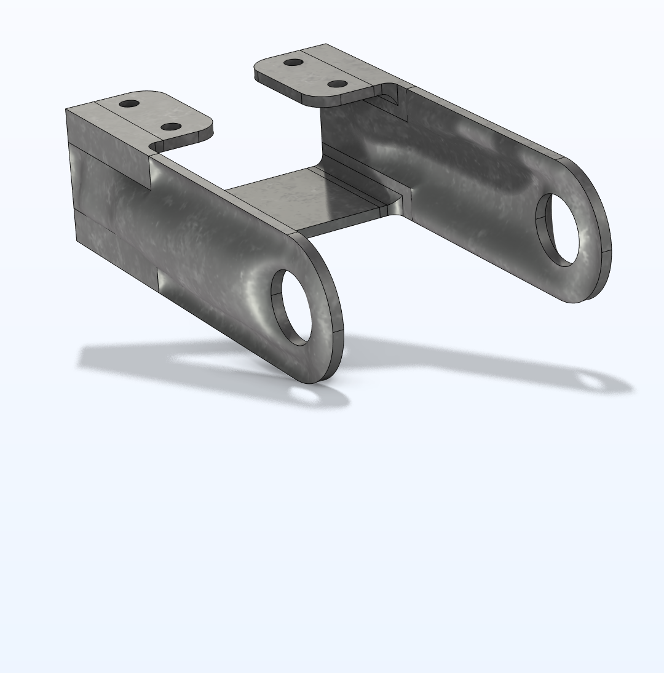
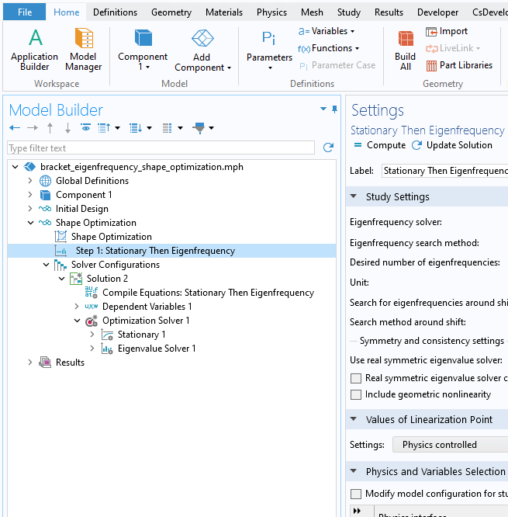
Bracket — Eigenfrequency Shape Optimization
Maximize Lowest Eigenfrequency
Stationary Then Eigenfrequency
MMA algorithm and Free Shape Boundary achieves a 100 % increase in the lowest eigenfrequency.
Eigenvalue/
eigenfrequency optimization with shape- and topology optimization interfaces requires Stationary Then Eigenfrequency study step
https://www.comsol.com/model/118721

