Slide 1
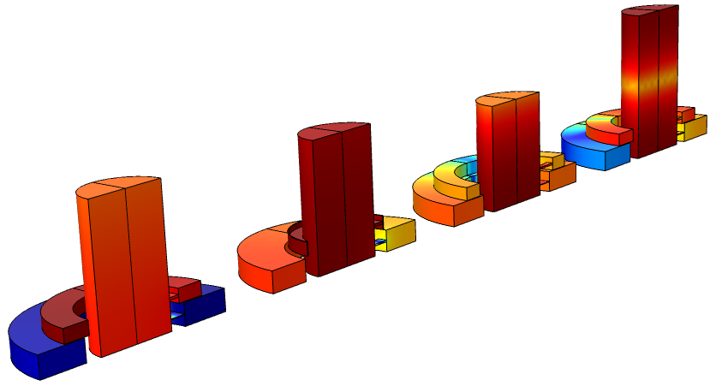
Tutorial:
Ear-Canal Simulator Optimization

Slide 2
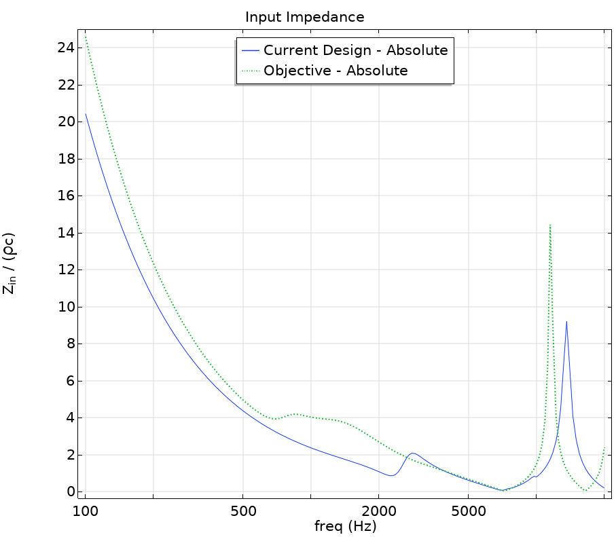
Ear-Canal Simulator Optimization
The human ear canal shows a complex response to the acoustic stimulus, as demonstrated in the Ear Canal Acoustics tutorial.
  www.comsol.com/model/86281
Ear-canal simulators are used for simulating the acoustics of a standardized human ear canal and can be used for measurements on all sorts of devices.
In this model, optimization is shown as a powerful tool to tune the ear-canal simulator design to match any input impedance curve.
Input impedance response of the initial design compared to the objective.

Slide 3
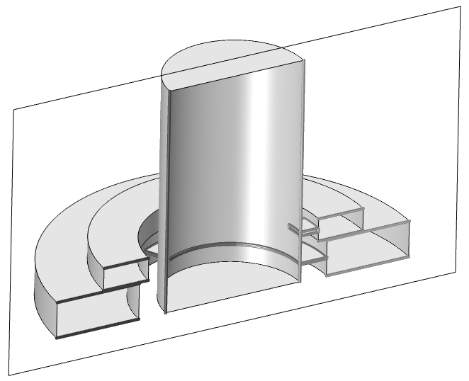
Geometry and Model Setup
The geometry and setup is inspired by the Generic 711 Coupler tutorial.
  www.comsol.com/model/12227
The geometry is based on parameters that will be changed during the optimization.
The impedance of the measurement microphone is modeled through an RCL approach.
The thermoviscous losses in the coupler volume are approximated using several Narrow Region Acoustics domains
Source
Symmetry plane
Measurement microphone
Geometry of the coupler.

Slide 4
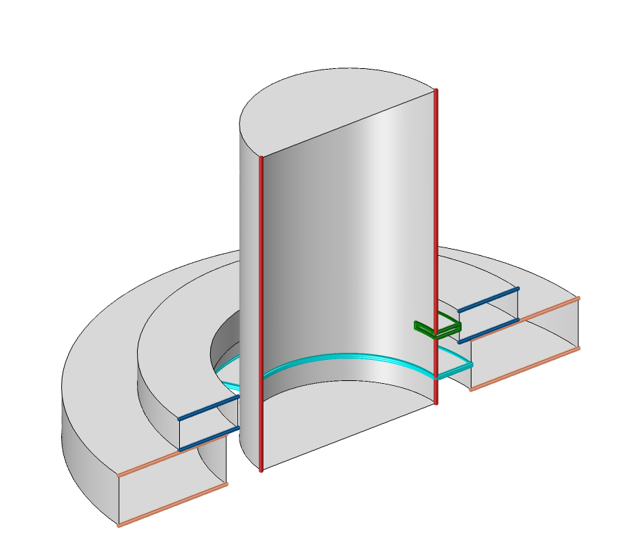
Control parameters
Nine parameters are changed during the optimization:
  Height of the main cavity (Red)
  Height, width, and angle of the bottom slit (Light blue)
  Height, width, and angle of the top slit (Green)
  Width of the bottom ring (Orange)
  Width of the top ring (Dark blue)
Dimensions of the coupler that will be modified are highlighted.

Slide 5
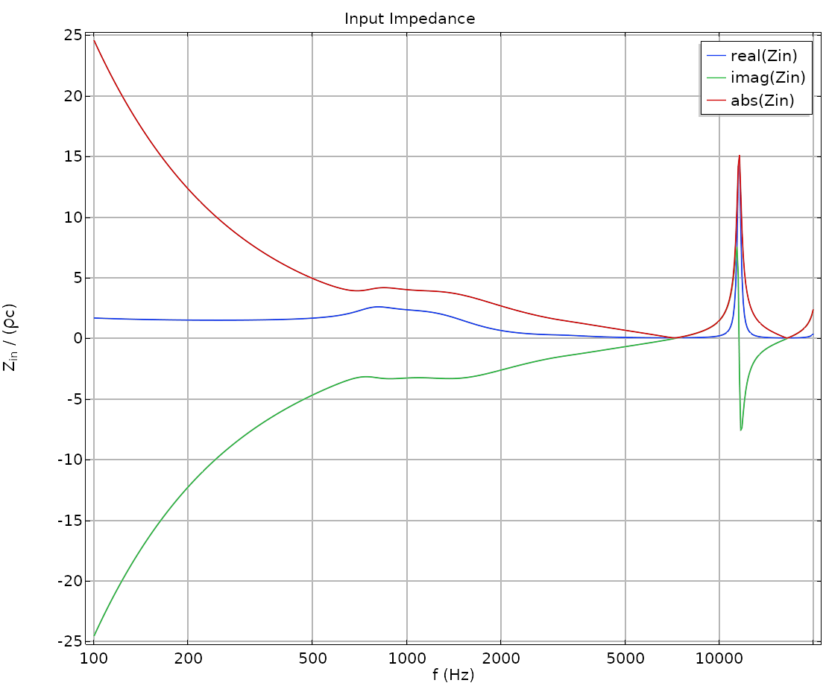
Target Impedance
The target input impedance represents the acoustic response of a specific ear, but it can also be based on measurements, or a response specified by a standard.
Ear-canal simulators are usually tuned for frequency ranges, as it is not possible to match the impedance for the whole frequency range with just a single coupler. The model optimizes the response in the following frequency ranges:
  Low Frequency (100 Hz – 1 kHz)
  Mid Frequency (1 kHz – 7 kHz)
  High Frequency (7 kHz – 20 kHz)
Input Impedance of the trimmed ear canal.

Slide 6
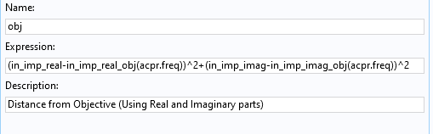
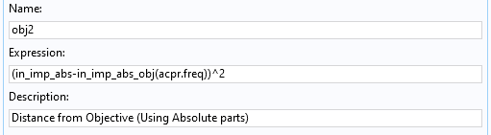
Optimization Setup
At low frequency, the optimization minimizes the sum of the squared difference of the real and imaginary parts of the impedance.
At medium and high frequencies, the influence of the split between real and imaginary part is less relevant, so the absolute part is used.
The optimization is fast owning to the 2nd order nature of the BOBYQA optimization algorithm.
Functions minimized during the optimization.

Slide 7
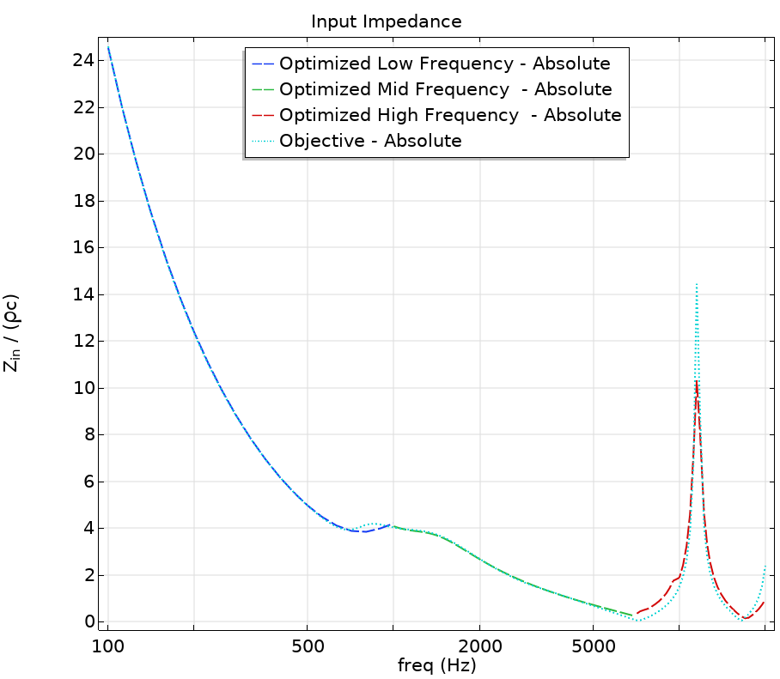
Results
Three different designs are created through optimization:
  Low Frequency (Dark blue)
  Medium Frequency (Green)
  High Frequency (Red)
The optimized designs follow the objective curve (Light blue) closely.
Absolute Input impedance of the various designs compared to the objective

Slide 8
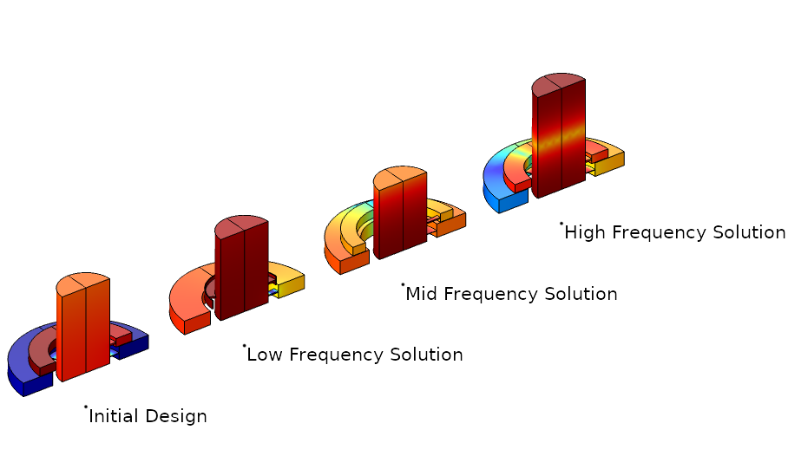
Conclusions
Optimization is a powerful tool that helps the design of acoustics systems with a complex response.
The main principles used in this tutorial are also applicable to other problems like material parameter estimation, acoustic properties fitting, or trade-off studies.
Initial and proposed designs.

Slide 9
info@comsol.com

