Slide 1
Isotropic Scattering in a Cylindrical Furnace, Benchmark 1

Slide 2
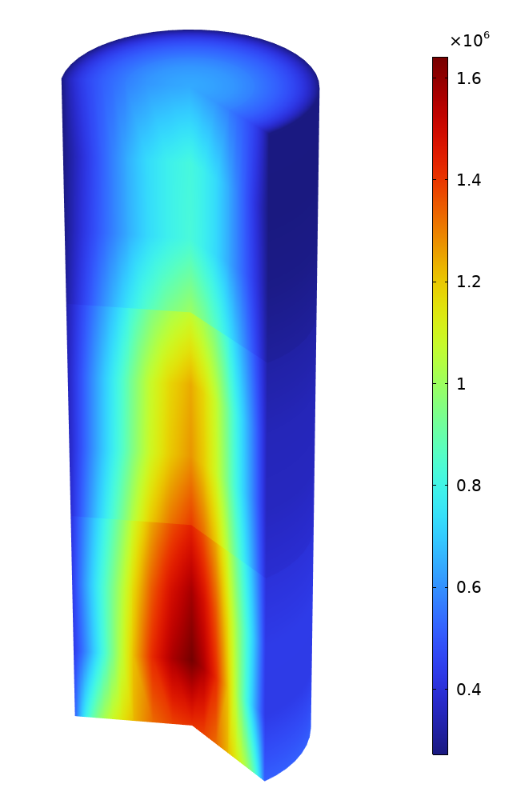
Background
The discrete ordinates method (DOM) was originally developed to study neutron transport, but has proved to be applicable to study radiative heat transfer
Since the angular space has to be discretized, this method can quickly become high-demanding in terms of computation time and memory
To reduce the cost of such computations, one can take advantage of the symmetries in the model, such as the axisymmetry
This model is benchmark to validate the implementation of DOM for 2D axisymmetric setups
The results of COMSOL Multiphysics are compared to reference Monte Carlo results
Incident radiation in a cylindrical furnace.

Slide 3

Model Definition
2 m
The cylindrical furnace is modeled with a 2D axisymmetric geometry
The domain is divided in 6 subdomains to setup the temperature
12 m
Model geometry and definition.

Slide 4
Model Definition
Radiation in Participating Media
Outlet
1500 K
1400 K
The model uses the Level Symmetric Even (LSE) S2 quadrature set, and thus solves for 4 radiative intensities
The temperature is imposed in the 6 subdomains
The exterior wall is a black surface at a temperature of 800 K
At the inlet, blackbody radiation at a temperature of 1500 K is considered
At the outlet, blackbody radiation at a temperature of 1200 K is considered
Radiation scattering in the domain is isotropic
1700 K
1500 K
1800 K
1600 K
Inlet
Model geometry and definition.

Slide 5
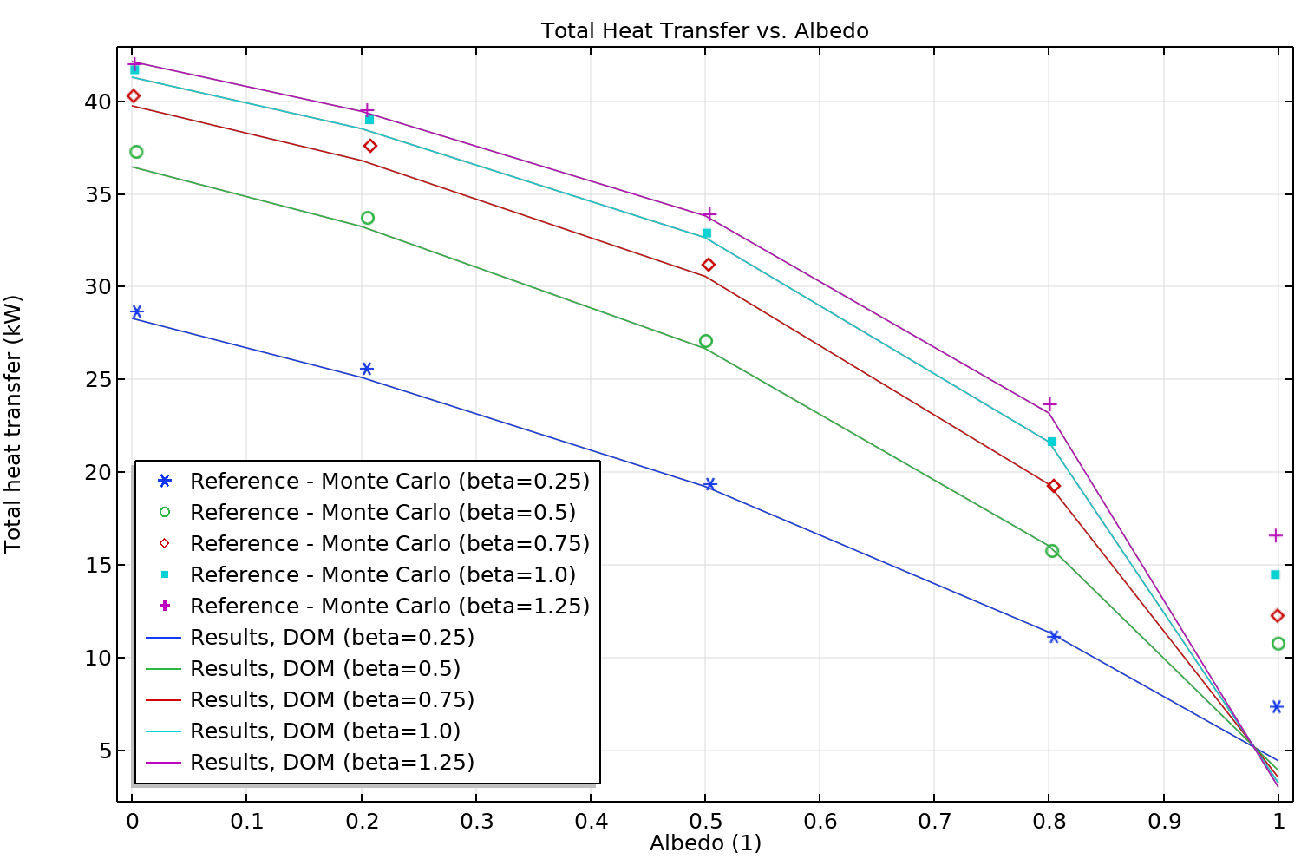
Results
Heat Flux
A parametric study with different values for albedo and extinction coefficient is performed
Except for purely scattering radiation (albedo = 1), results with the LSE S2 quadrature set are in very good accordance with the highly accurate Monte Carlo reference results
Total heat transfer on the side wall, comparison of DOM and Monte Carlo results.

Slide 6
References
[1] R .P. Gupta, T.F. Wall, J.S. Truelove, “Radiative scatter by fly ash in pulverized-coal-fired furnaces: Application of the Monte Carlo method to anisotropic scatter”, International Journal of Heat and Mass Transfer, vol. 26, Issue 11, pp. 1649-1660 , 1983.

