Slide 1
Vibrating Micromirror with Viscous and Thermal Damping: Transient Behavior
Notes:
You can use the heading from the application documentation for the title.

Slide 2
Background and Motivation
Micromirrors are used in certain MEMS devices to control optic elements. This example of a vibrating micromirror surrounded by air uses the Thermoviscous Acoustics, Transient, the Shell, and the Pressure Acoustics, Transient interfaces to model the fluid-solid interaction in the time domain. The model illustrates a mirror that is initially actuated for a short time and then exhibits damped vibrations. Using the thermoviscous acoustics interface the full details of viscous and thermal damping of the mirror from the surrounding air is included
This models is based on the existing Vibrating Micromirror with Viscous and Thermal Damping model from the application library. In this version of the tutorial the frequency domain analysis is extended to a transient analysis
This model requires the Acoustics Module and the Structural Mechanics Module

Slide 3
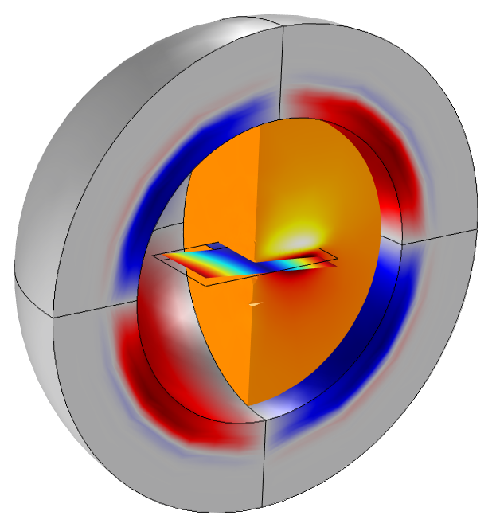
Model Setup
Open the Application library model vibrating_micromirror and exchange the frequency domain interfaces with their transient counterparts. Multiphysics couplings work out-of-the-box
Shell
The transient PML capabilities of Pressure Acoustics are coupled to the Thermoviscous Acoustics domain to set up efficient non reflecting boundary conditions (NRBCs).
Thermoviscous Acoustics, Transient
Pressure Acoustics, Transient (PMLs)

Slide 4
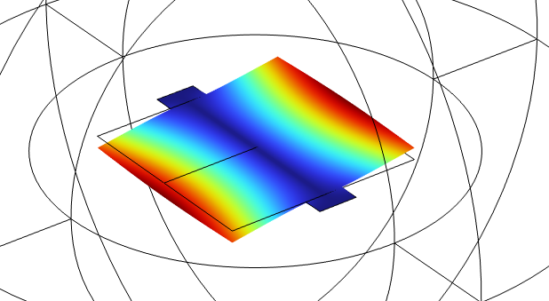
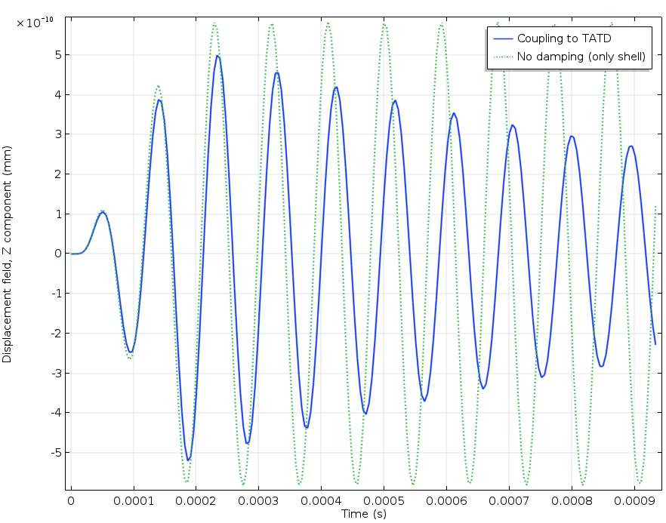
Results
Displacement of mirror corner
Load applied for two periods

Slide 5
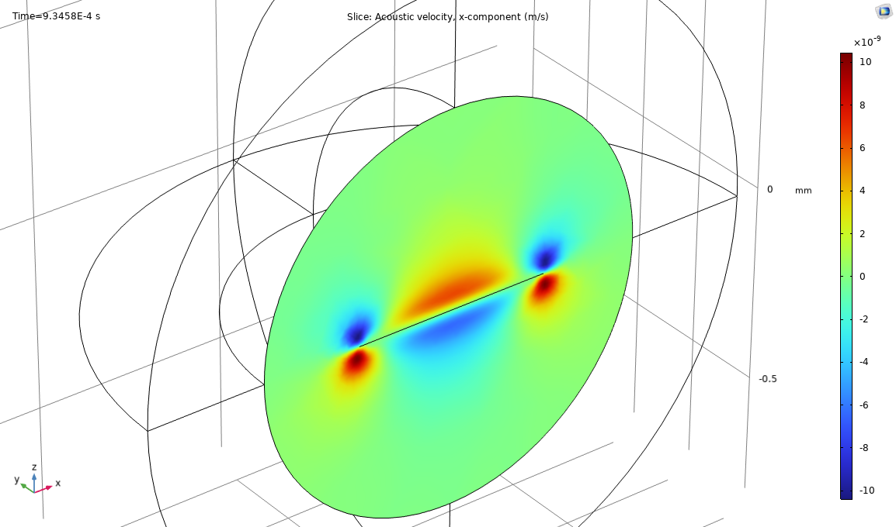
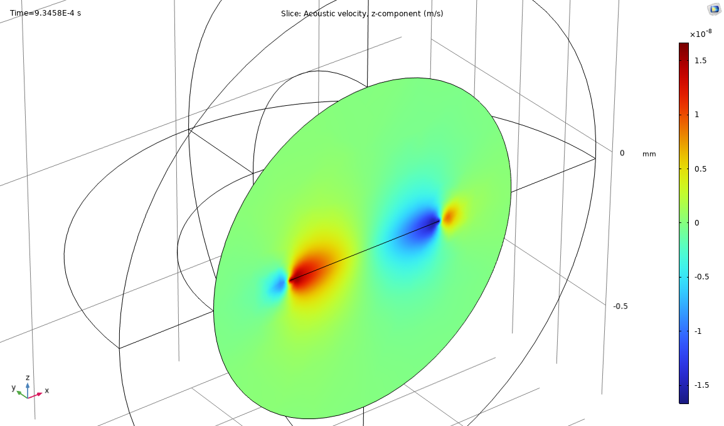
Results
Acoustic velocity variations x-component (left) and z-component (right). The no-slip condition at the micromirror surface gives rise to the viscous boundary layer.

Slide 6
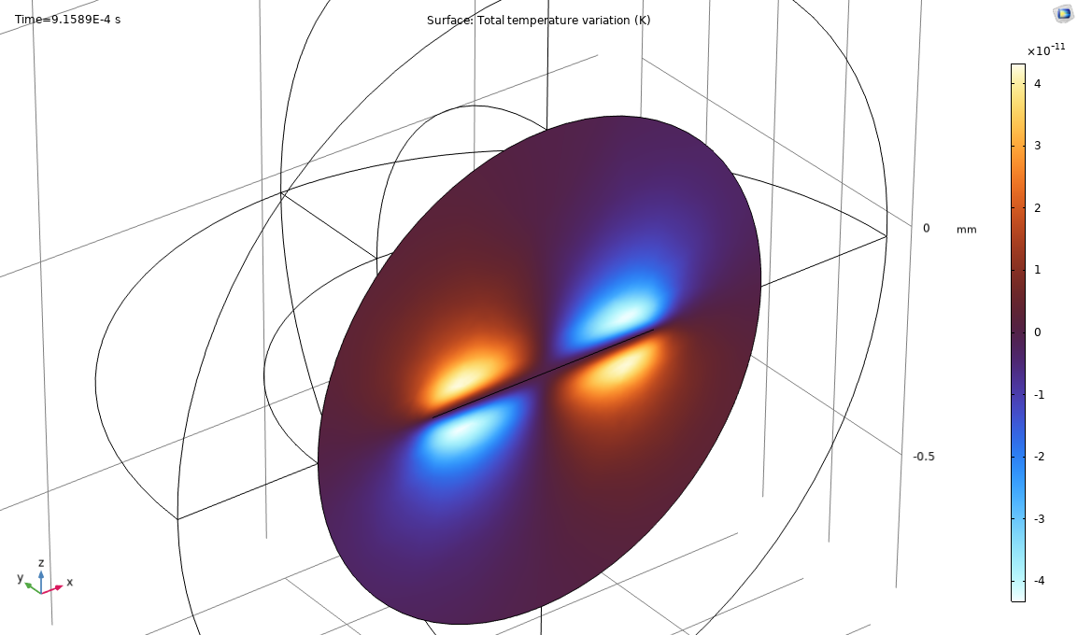
Results
Acoustic temperature variations around the micromirror. The isothermal condition at the mirror surface gives rise to the acoustic thermal boundary layer.

