Slide 1
Silicon-Graphite Blended Electrode with Thermodynamic Voltage Hysteresis

Slide 2
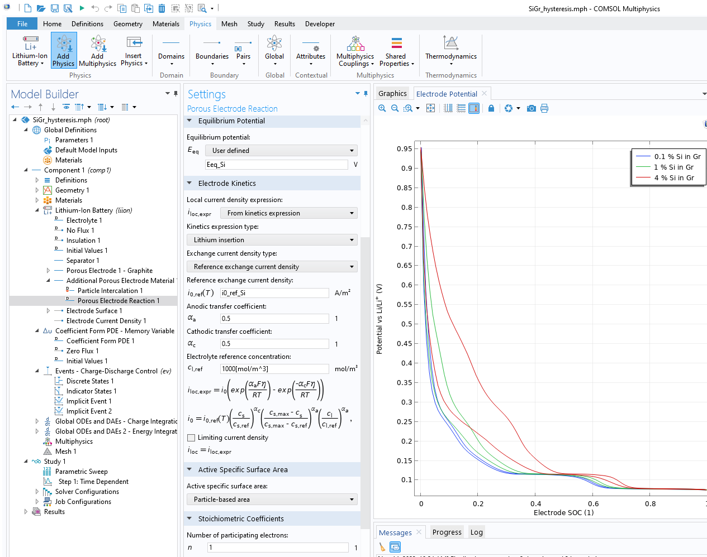
Background
Silicon (Si) is added to graphite (Gr) in the negative electrode of lithium-ion batteries in order to increase capacity.
Silicon–graphite blended electrodes exhibit voltage hysteresis, or “path dependence”, due to the impact of the charge–discharge history on the equilibrium potential of the lithium–silicon intercalation reaction.
This model demonstrates how to:
  Add Si as an Additional Electrode Material to a Porous Electrode in the Lithium-Ion Battery interface.
  Define a memory variable capable of handling the voltage hysteresis using an additional Coefficient Form PDE interface.

Slide 3
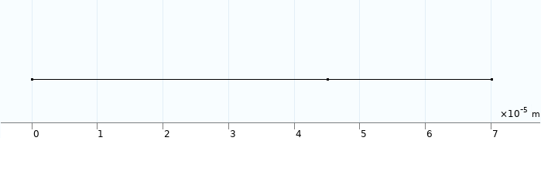
Geometry
The model is formulated in 1D.
“Half-cell” model with two domains:
  Blended porous electrode:
  graphite + silicon
  Separator
A lithium metal counter electrode is defined on one boundary to provide lithium-ion flux during charge–discharge.
When evaluating the results, the electrode potential at the current collector is expressed with respect to a reference electrode placed at the porous electrode–separator boundary.
Lithium metal counter electrode
Current collector
Reference electrode
Blended porous electrode
Separator
x

Slide 4
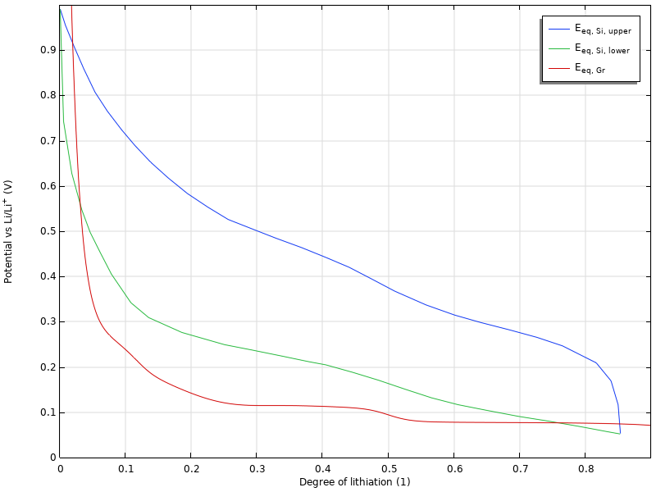
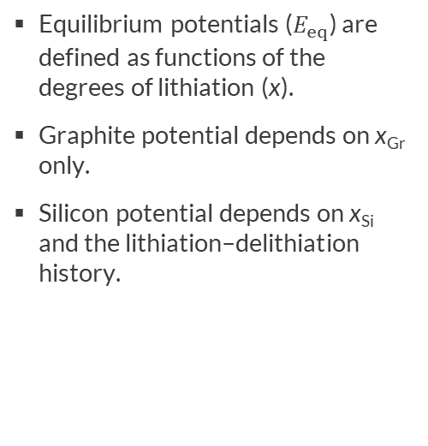
Equilibrium Potentials
Equilibrium potentials ($E_{eq}$) are defined as functions of the degrees of lithiation (x).
Graphite potential depends on x_{Gr} only.
Silicon potential depends on x_{Si} and the lithiation–delithiation history.
Delithiation
Lithiation

Slide 5
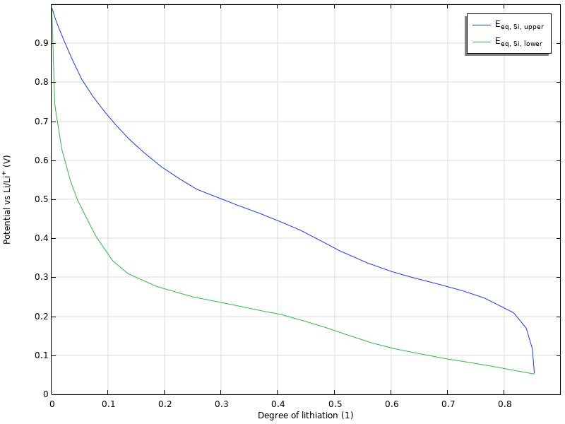
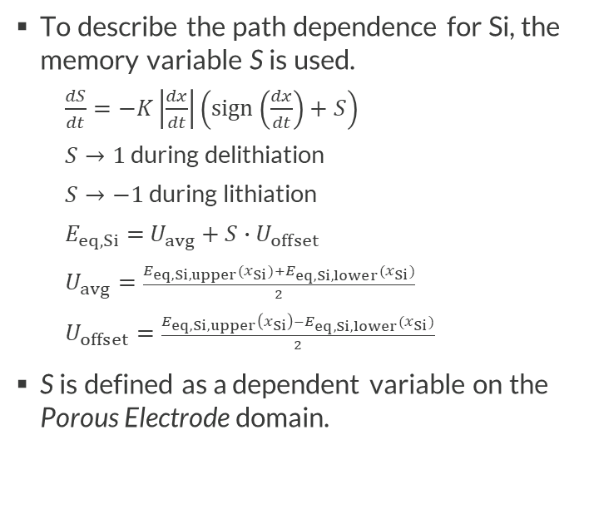
Memory-Hysteresis Variable S
To describe the path dependence for Si, the memory variable S is used.
$\frac{dS}{dt}=−K\left|\frac{dx}{dt}\right|\left(sign\left(\frac{dx}{dt}\right)+S\right)$
$S→1$during delithiation
$S→−1$during lithiation
$E_{eq, Si}=$ $U_{avg}+{S∙U}_{offset}$
$U_{avg}=\frac{E_{eq,Si, upper}(x_{Si})+E_{eq,Si, lower}(x_{Si})}{2}$
$U_{offset}=\frac{E_{eq,Si, upper}\left(x_{Si}\right)−E_{eq,Si, lower}(x_{Si})}{2}$
S is defined as a dependent variable on the Porous Electrode domain.
$$S=1$$
$$−1<S<1$$
$$S=−1$$

Slide 6


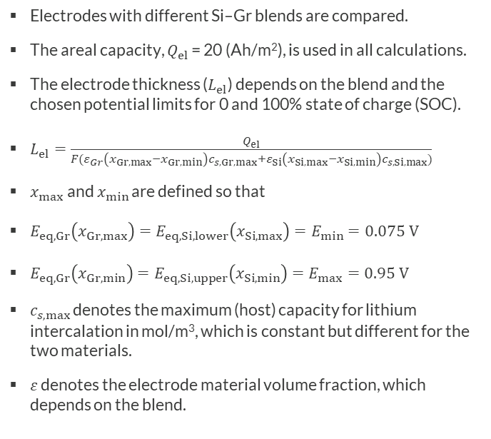




Electrode Capacity and Thickness
$$x_{Si,min}$$
Electrodes with different Si–Gr blends are compared.
The areal capacity, $Q_{el}$ = 20 (Ah/m²), is used in all calculations.
The electrode thickness ($L_{el}$) depends on the blend and the chosen potential limits for 0 and 100% state of charge (SOC).
$L_{el}=\frac{Q_{el}}{F(ε_{Gr}\left(x_{Gr,max}−x_{Gr,min}\right)c_{s,Gr,max}+ε_{Si}\left(x_{Si,max}−x_{Si,min}\right)c_{s,Si,max})}$
$x_{max}$and $x_{min}$ are defined so that
$E_{eq,Gr}\left(x_{Gr,max}\right)=E_{eq,Si,lower}\left(x_{Si,max}\right)=E_{min}=0.075 V$
$E_{eq,Gr}\left(x_{Gr,min}\right)=E_{eq,Si,upper}\left(x_{Si,min}\right)=E_{max}=0.95 V$
$c_{s,max}$ denotes the maximum (host) capacity for lithium intercalation in mol/m³, which is constant but different for the two materials.
$ε$ denotes the electrode material volume fraction, which depends on the blend.
$$E_{max}$$
$$x_{Si,max}$$
$$E_{min}$$
$$x_{Gr,min}$$
$$x_{Gr,max}$$

Slide 7
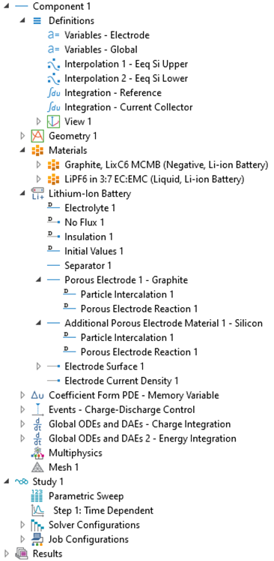
Model Setup
The Si equilibrium potentials are defined under Definitions.
The Gr intercalation is defined in the Porous Electrode node, and the Si intercalation is defined in the Additional Porous Electrode Material node, both in the Lithium-Ion Battery interface.
The Coefficient Form PDE interface defines the memory variable S.
The Events and Global ODEs nodes are used for charge–discharge control and charge and energy integrations.
A Parametric Sweep is run for a range of Si–Gr blends
and C-rates:
  Complete lithiation–delithiation cycle simulated between the potential limits (0.95–0.075 V).

Slide 8
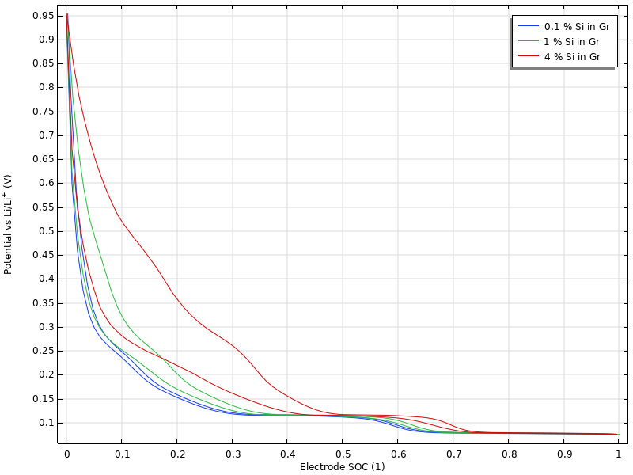
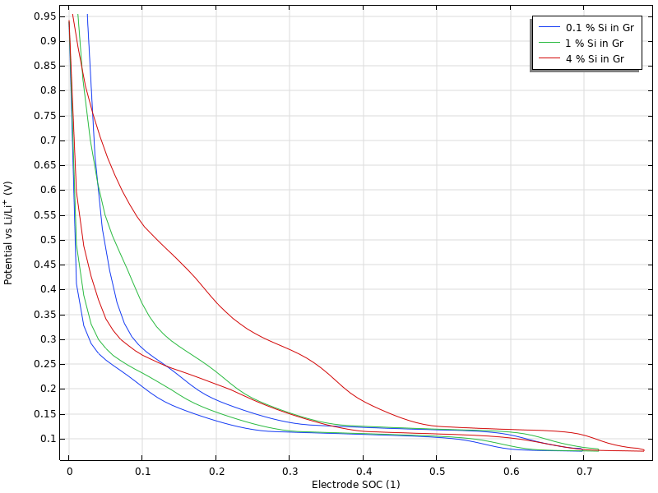
Results: Electrode Voltage vs. SOC
0.1 C Charge–Discharge Cycle
1 C Charge–Discharge Cycle

Slide 9
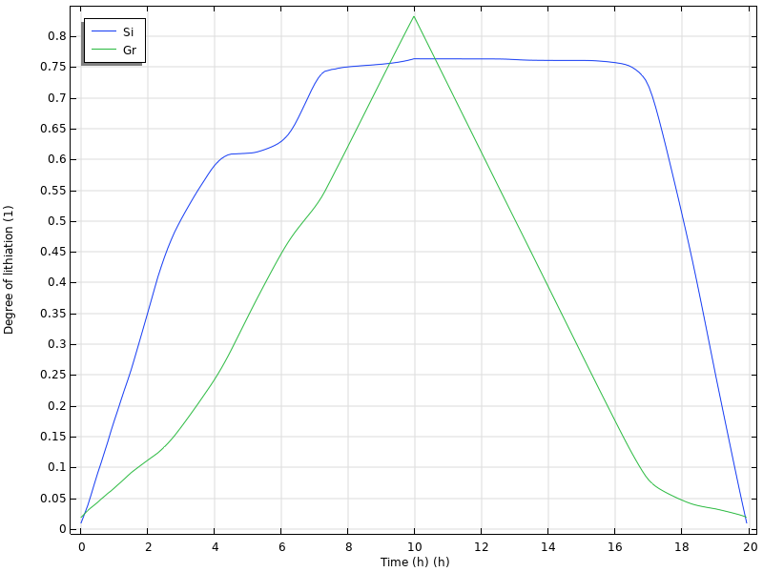
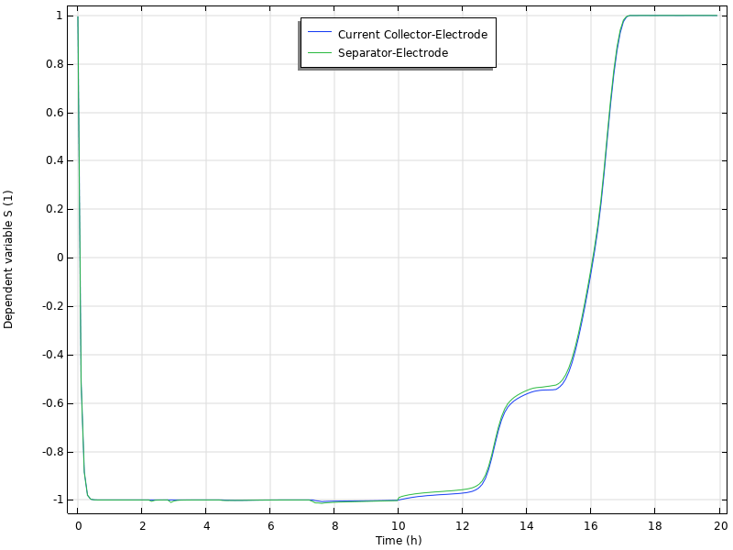
Results: Lithiation Levels and Memory Variable at 0.1 C
Electrode-Averaged Lithiation Levels
Memory Variable

Slide 10
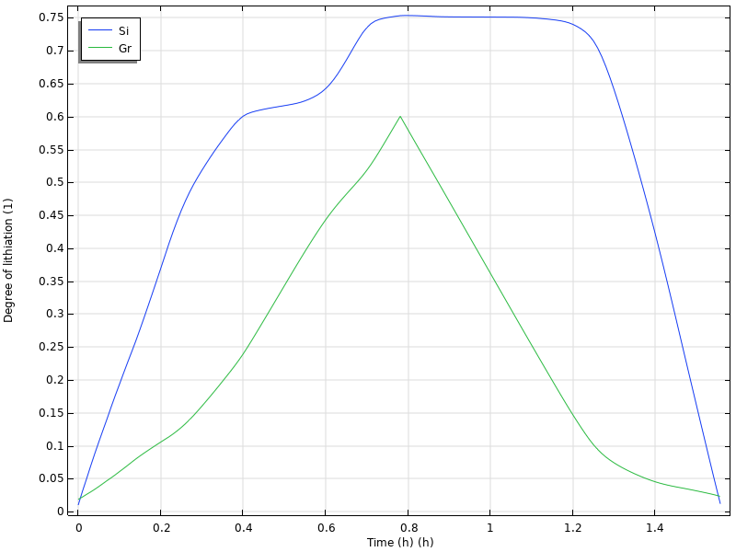
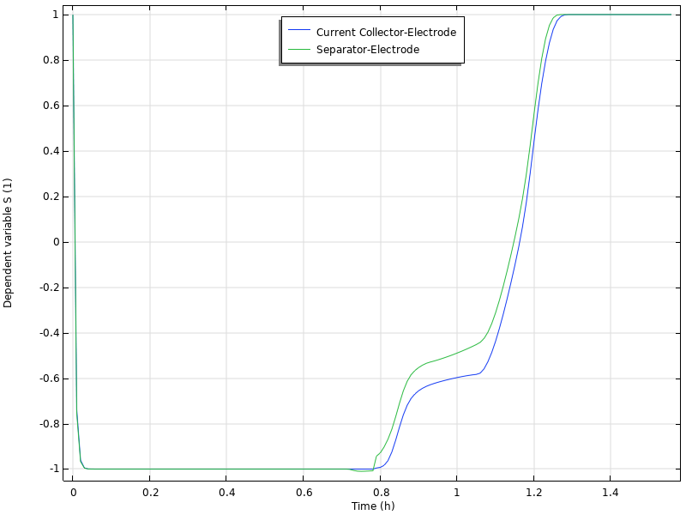
Results: Lithiation Levels and Memory Variable at 1 C
Electrode-Averaged Lithiation Levels
Memory Variable

Slide 11
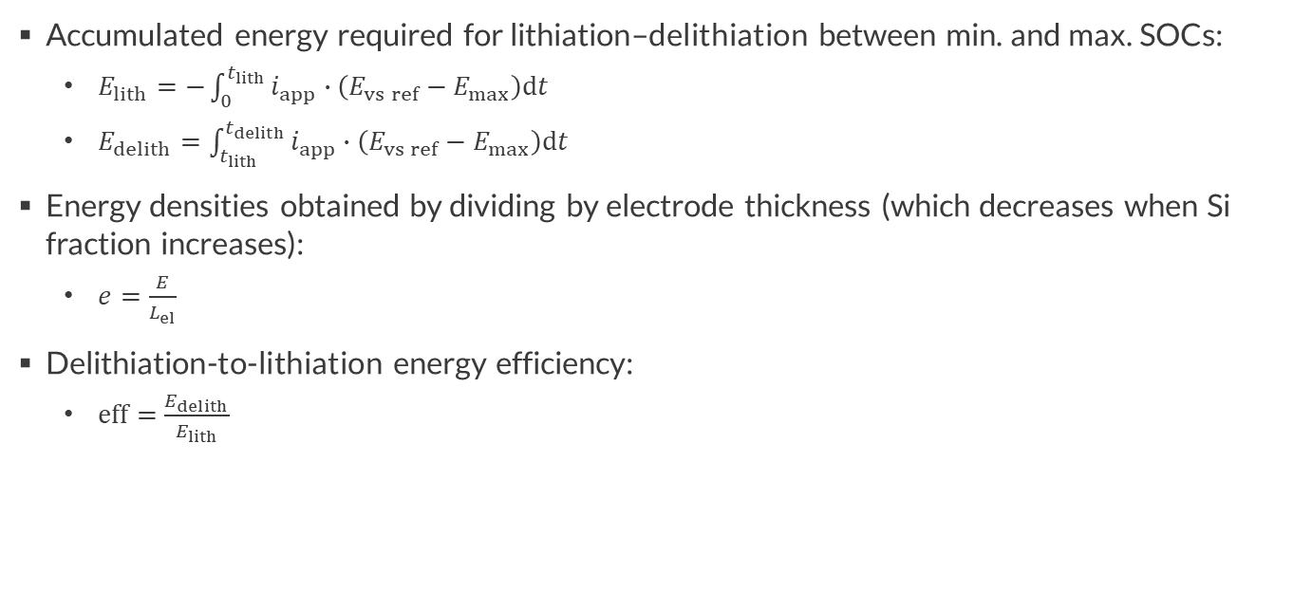
Energy Density Measures
Accumulated energy required for lithiation–delithiation between min. and max. SOCs:
  $E_{lith}=−\int_{0}^{t_{lith}}{i_{app}}∙\left(E_{vs ref}−E_{max}\right)dt$
  $E_{delith}=\int_{t_{lith}}^{t_{delith}}{i_{app}}∙\left(E_{vs ref}−E_{max}\right)dt$
Energy densities obtained by dividing by electrode thickness (which decreases when Si fraction increases):
  $e=\frac{E}{L_{el}}$
Delithiation-to-lithiation energy efficiency:
  $eff=\frac{E_{delith}}{E_{lith}}$

Slide 12
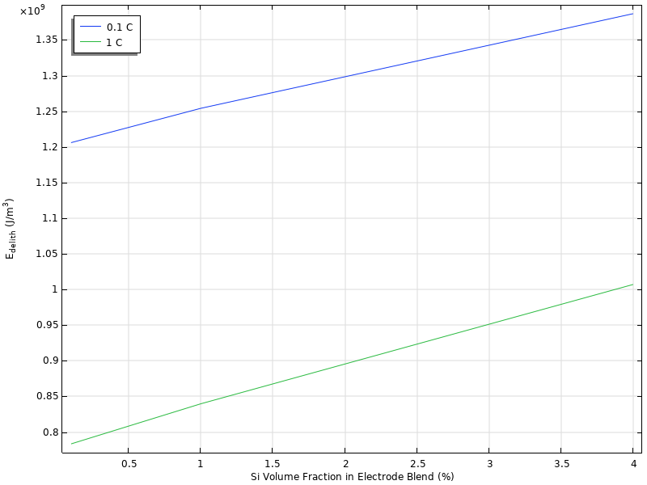
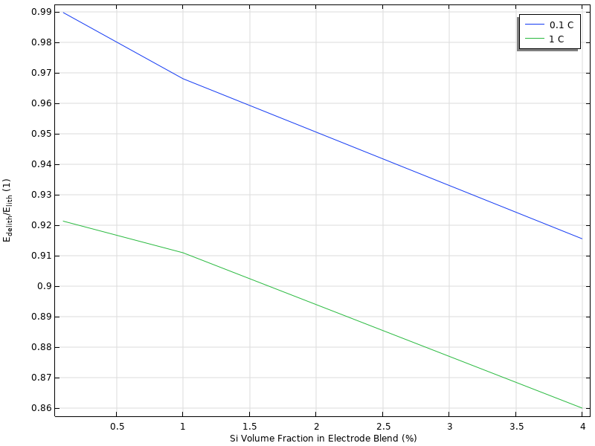
Results: Energy Densities
Delithiation Energy Densities
Delithiation-to-Lithiation Energy Efficiencies

Slide 13
Summary of Results
Hysteresis more prominent at lower lithiation levels:
  Gr intercalation dominates at high SOCs
Relative usage of Si and Gr depends both on current and SOC.
Increasing the Si content:
  Increases energy density
  Lowers energy efficiency

Slide 14
References
D. R. Baker, M. W. Verbrugge, and X. Xiao, “An approach to characterize and clarify hysteresis phenomena of lithium-silicon electrodes,” Journal of Applied Physics, vol. 122, 165102, 2017. https://doi.org/10.1063/1.4995277

