Slide 1
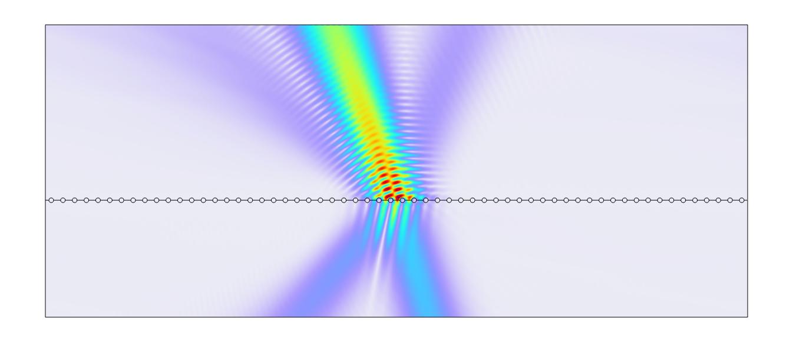
Gaussian beam illumination of a periodic structure

Slide 2
Introduction
These slides discuss how to efficiently compute a Gaussian beam illuminating a periodic structure.
  For example , a laser beam on a metasurface or diffraction grating, as shown on right.
The most straightforward approach is by using a simulation domain that is larger than the beam and apply absorbing boundary conditions.
  Because the beam spot size may be much larger than a wavelength, this approach could have substantial memory requirements.
Maxwell’s equations are linear, and so we can use superposition to decompose the Gaussian beam into a summation of plane waves.
A plane wave excitation of a periodic structure requires only a single unit cell with periodic boundary conditions.
  Simulate multiple plane waves at different angles of incidence and then sum the results.
In short, we replace one very large simulation with many simulations of a single unit cell. This can drastically reduce the computational requirements.

Slide 3
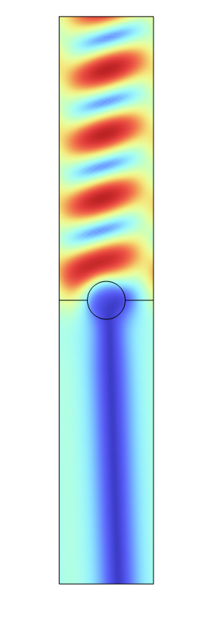
Plasmonic Wire Grating
The example generally follows the plasmonic wire grating (PWG) model from the App DB.
  https://www.comsol.com/model/plasmonic-wire-grating-wave-optics-14705
  We recommend reviewing the model first, as this approach is a superset of that model.
Most parameters match the PWG example.
  Wavelength (lam0) is 441 nm.
  Periodicity (d) is 400 nm.
TE Electric fields on the PWG

Slide 4
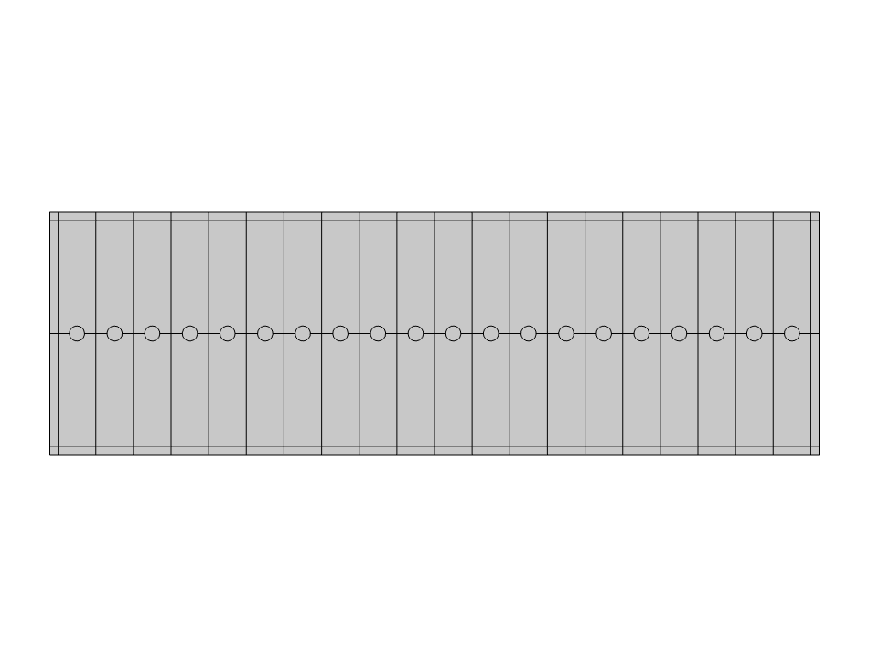
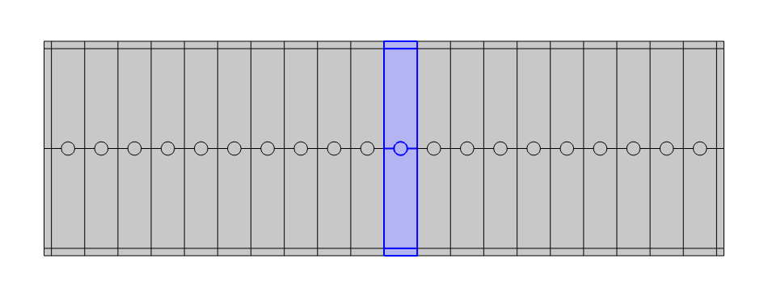
Geometry and simulation domain
The full domain is N periodic blocks surrounded by a PML layer.
  We assume N is even.
We want the results in the entire domain of interest (grey), but because of periodicity we only simulate a single unit cell (blue).
We extrude the simulation results from the unit cell to the entire domain (eg. map from blue to grey).
Domain with N = 20
Simulation domain

Slide 5
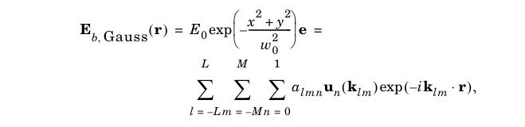
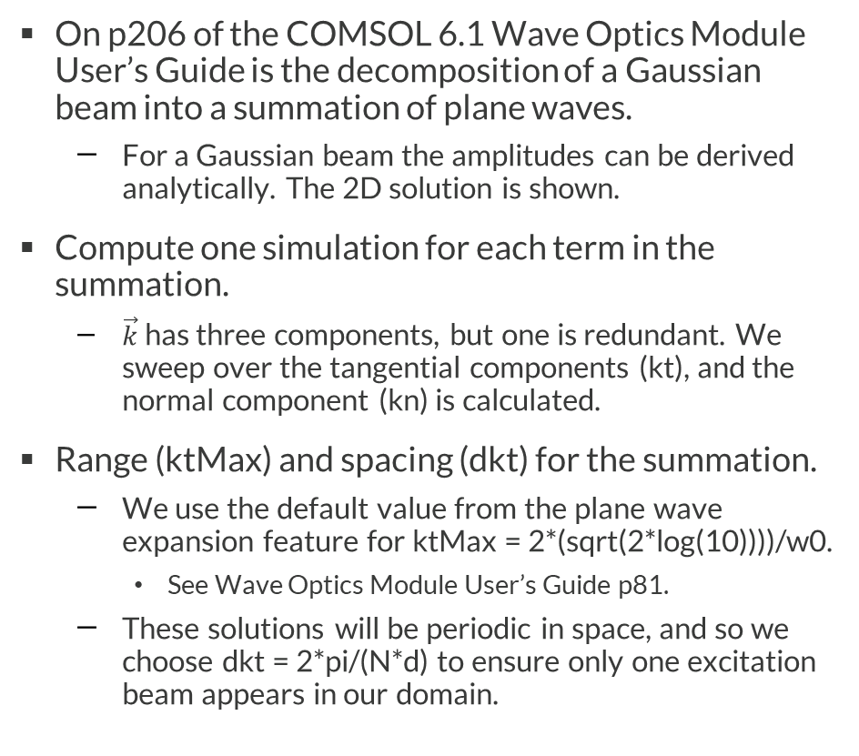
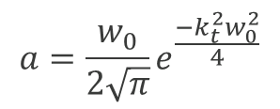
Gaussian Beam Decomposition
On p206 of the COMSOL 6.1 Wave Optics Module User’s Guide is the decomposition of a Gaussian beam into a summation of plane waves.
  For a Gaussian beam the amplitudes can be derived analytically. The 2D solution is shown.
Compute one simulation for each term in the summation.
  $\vec{k}$ has three components, but one is redundant. We sweep over the tangential components (kt), and the normal component (kn) is calculated.
Range (ktMax) and spacing (dkt) for the summation.
  We use the default value from the plane wave expansion feature for ktMax = 2*(sqrt(2*log(10))))/w0.
    See Wave Optics Module User’s Guide p81.
  These solutions will be periodic in space, and so we choose dkt = 2*pi/(N*d) to ensure only one excitation beam appears in our domain.
$$a=\frac{w_{0}}{2\sqrt{π}}e^{\frac{−k_{t}^{2}w_{0}^{2}}{4}}$$

Slide 6
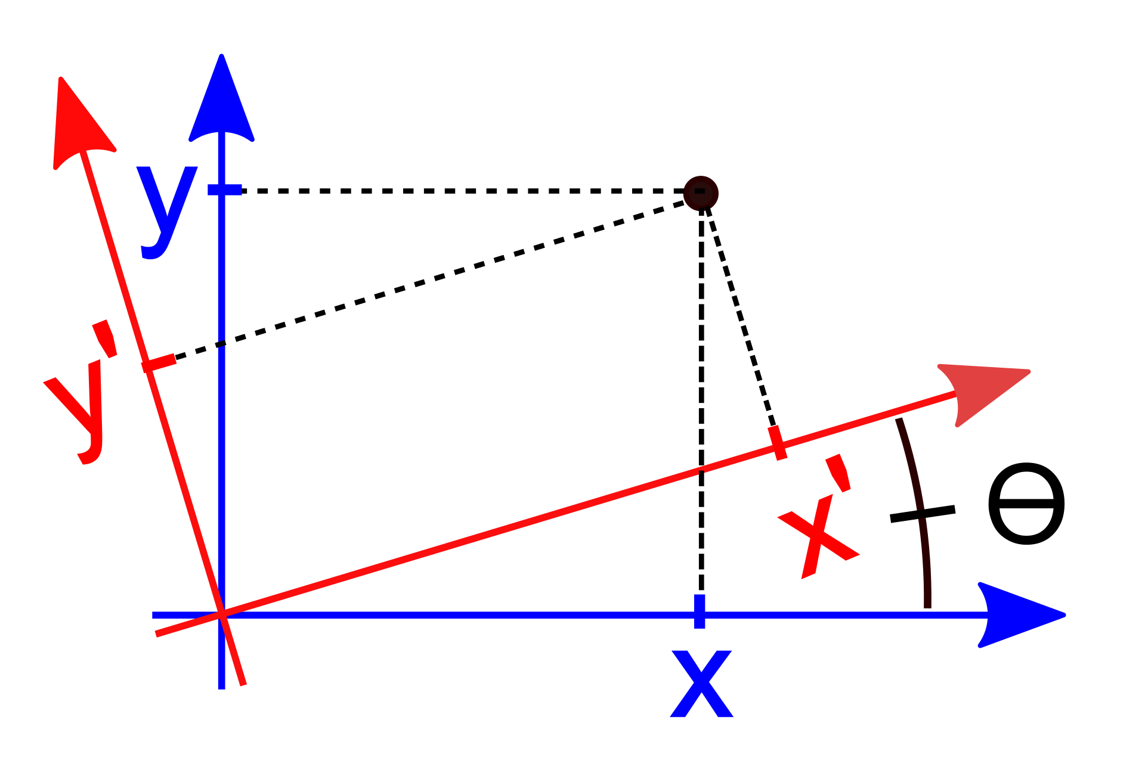
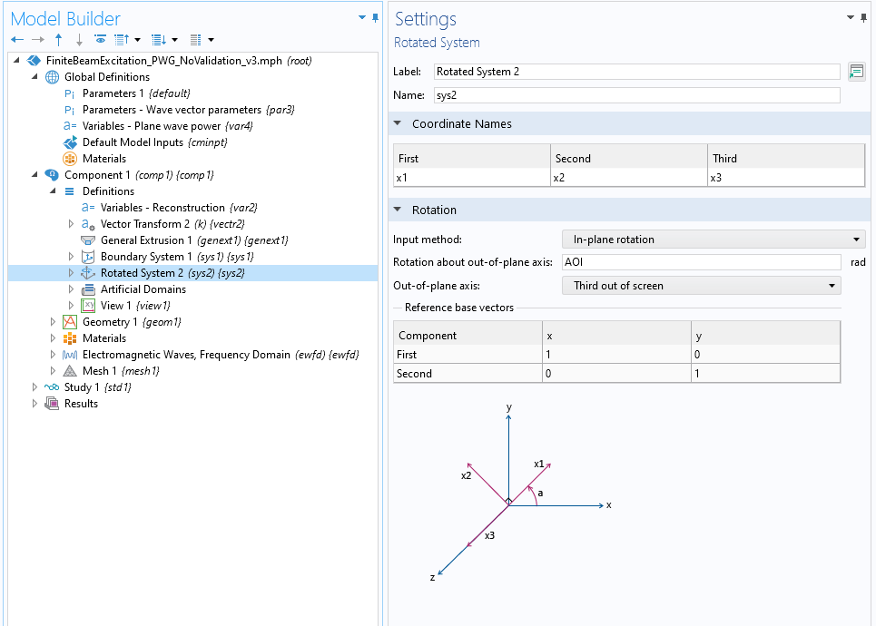
Coordinate systems
Beam definition parameters
  AOI is the angle of incidence for the Gaussian beam.
  w0 is the beam width at the focus, where the focal plane is centered on the origin and normal to the beam direction.
We define a rotated coordinate system, rotated by AOI, which is the reference frame for the Gaussian beam.
  We sweep over the tangential wave vectors (kt) that compose the Gaussian beam. kt and kn are defined in this reference frame.
Global coordinate system
Rotated coordinate system
Θ=AOI
Image of coordinate systems taken from https://en.wikipedia.org/wiki/Rotation_of_axes

Slide 7
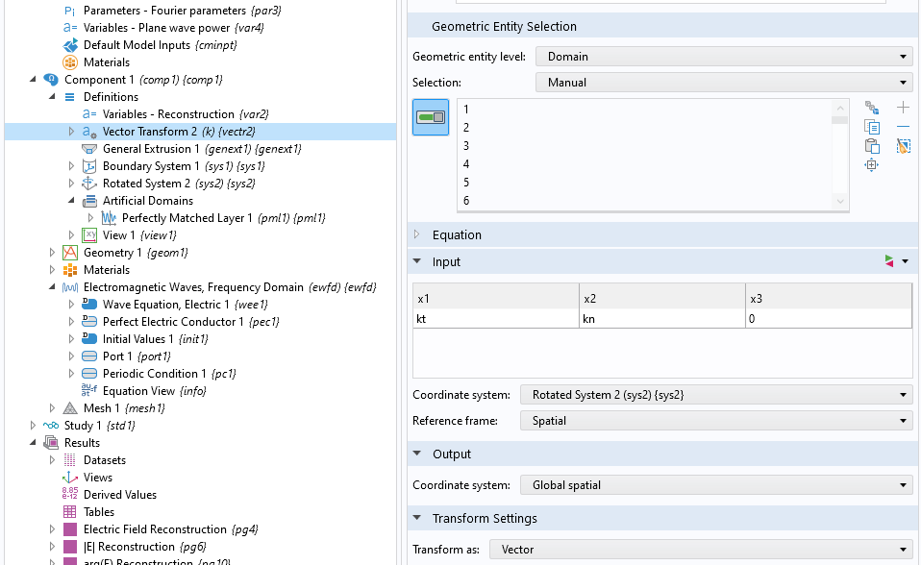
Vector transform
A vector transformation calculates kx and ky in the global coordinate system based on kt and kn in the rotated coordinate system
Global coordinate system
Rotated coordinate system
Image of coordinate systems taken from
https://en.wikipedia.org/wiki/Rotation_of_axes

Slide 8
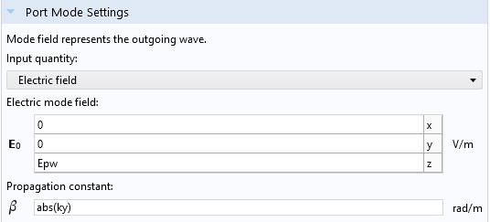
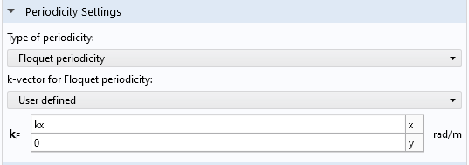
Unit cell simulation
We use a user-defined Port and Periodic Condition.
  This is done so we have precise control over the excitation phase.
  Epw is a plane wave: E0*exp(-j*(kx*x+ky*y)).
PMLs on the top and bottom, with scale factor abs(k0/ky) to handle the AOI.
Study 1 is an auxiliary sweep the tangential wave vector in the rotated frame.
  range(-ktMax, dkt, ktMax).

Slide 9
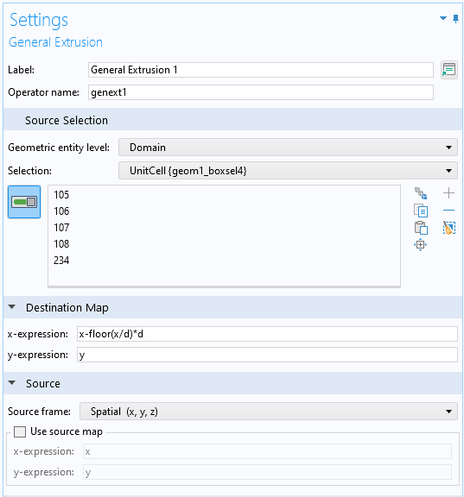
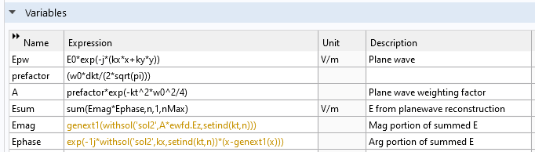
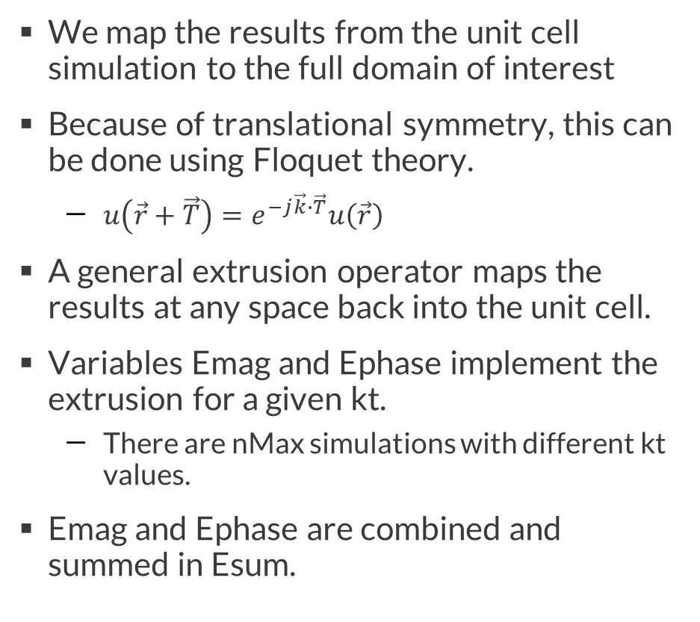
Extruding and summing the results
We map the results from the unit cell simulation to the full domain of interest
Because of translational symmetry, this can be done using Floquet theory.
  $u\left(\vec{r}+\vec{T}\right)=e^{−j\vec{k}∙\vec{T}}u\left(\vec{r}\right)$
A general extrusion operator maps the results at any space back into the unit cell.
Variables Emag and Ephase implement the extrusion for a given kt.
  There are nMax simulations with different kt values.
Emag and Ephase are combined and summed in Esum.

Slide 10
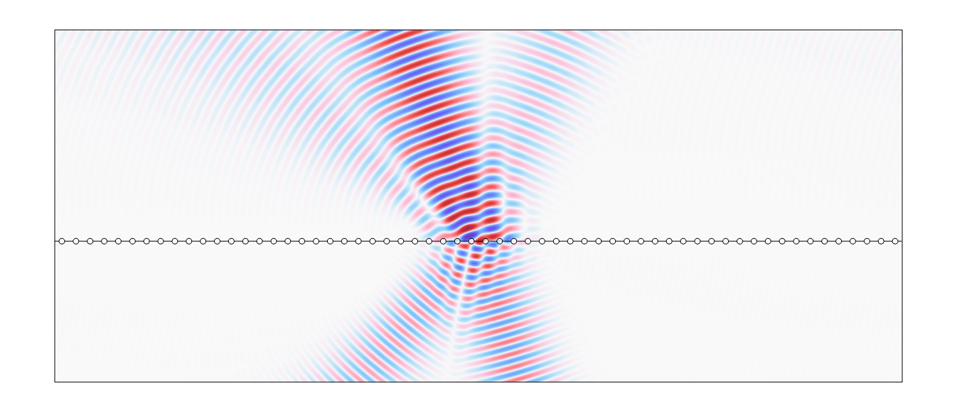
Results (1/2)
Complex E-field and |E| are shown on the top and bottom, respectively
Diffraction orders and interference effects are clearly captured
Parameters
  AOI = 20[deg]
  w0 = 2*lam0
  N = 60
Using the default settings for dkt and ktMax, this is accomplished in 39 simulations of the unit cell.

Slide 11
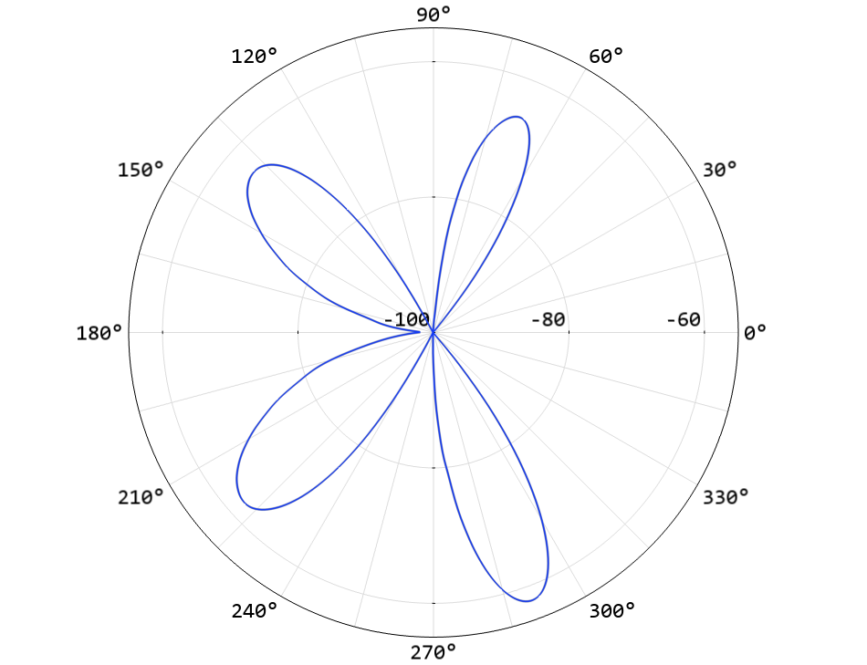
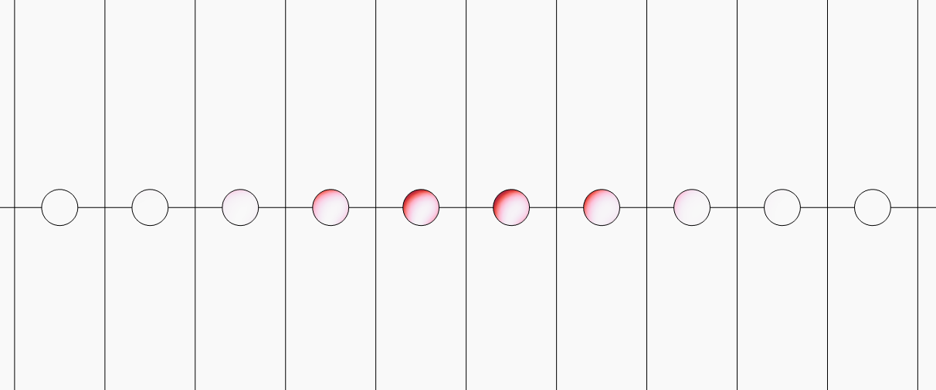
Results (2/2)
The previous slide showed the E-field results, but often we want other evaluations like resistive losses and far-field.
Procedure
  Add another “Electromagnetic Waves, Frequency Domain” interface and setting the Initial Values to Esum.
  Add another study that solves the new interface.
  Right click the study, and select “Get Initial Value”.
The results of this new study will now contain the desired variables derived from Esum.
Results
  (Left) Resistive losses in the plasmonic wires.
  (Right) Far-field results on the right.
  Parameters are the same as the previous slide. Note that the substrate here is n=1 here so that the Far-Field Domain node can be used.

Slide 12
Validation
To validate this method, we can compare against two different approaches
  Scattered field simulation
  Full simulation of a beam
Scattered field
  This is approach is easily implemented when the substrate index is set to n=1, so that only the scattering from the wires is considered.
  Using the analytic Gaussian beam formulation - the function Egb(r,z) - this can be used as validation as long as the beam spot size is not too small. At that point the traditional beam formulation breaks down. With spot sizes of at least 5λ, the results agree as expected for a variety of AOIs.
  The built-in Gaussian beam plane wave expansion can be used for any spot size, but only at AOI = 0. The agreement is excellent.
Full simulation of a beam
  This is implemented with a Port exciting the Gaussian beam via the function Egb(r,z). This is approach is not recommended as it assumes the wave is coming from an infinite waveguide, but yields reasonable results against both the method presented here as well as the scattered field formulation for a variety of AOIs.
  This approach has the benefit of allowing a comparison with a substrate. Agreement is good, as long as the Gaussian beam formulation is valid (above, spot sizes not too small).

Slide 13
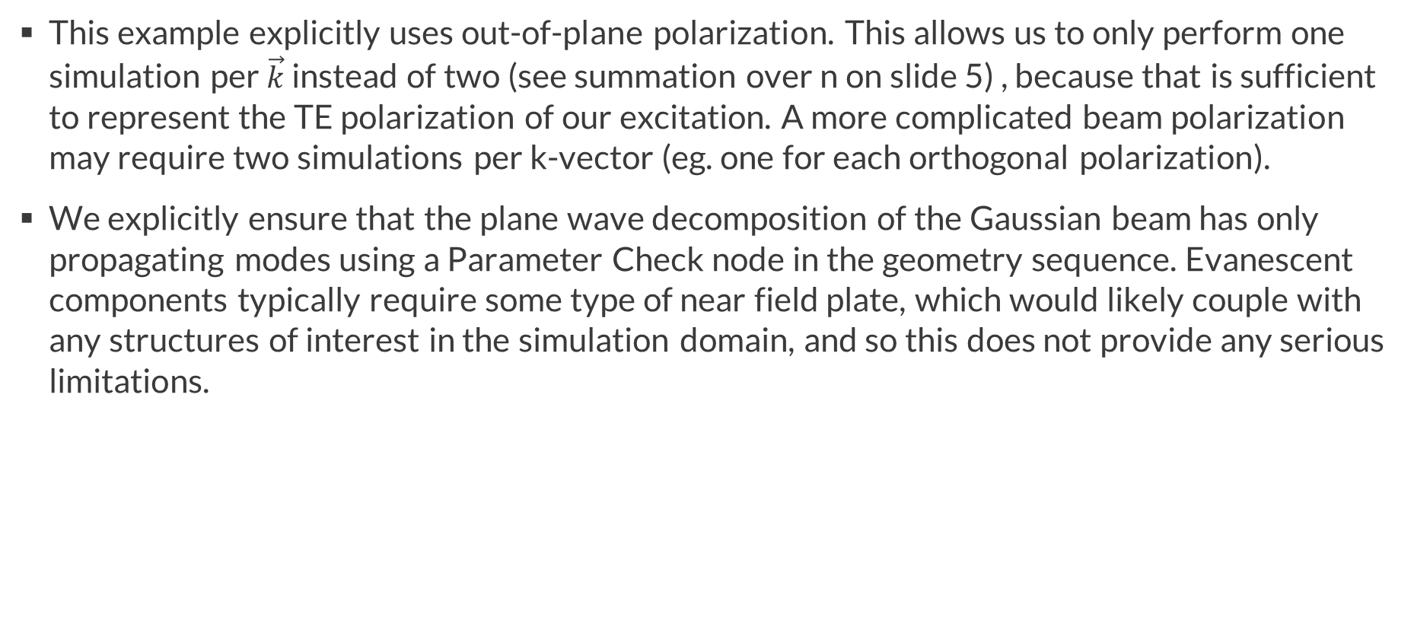
Usage notes (1/2)
This example explicitly uses out-of-plane polarization. This allows us to only perform one simulation per $\vec{k}$ instead of two (see summation over n on slide 5) , because that is sufficient to represent the TE polarization of our excitation. A more complicated beam polarization may require two simulations per k-vector (eg. one for each orthogonal polarization).
We explicitly ensure that the plane wave decomposition of the Gaussian beam has only propagating modes using a Parameter Check node in the geometry sequence. Evanescent components typically require some type of near field plate, which would likely couple with any structures of interest in the simulation domain, and so this does not provide any serious limitations.

Slide 14
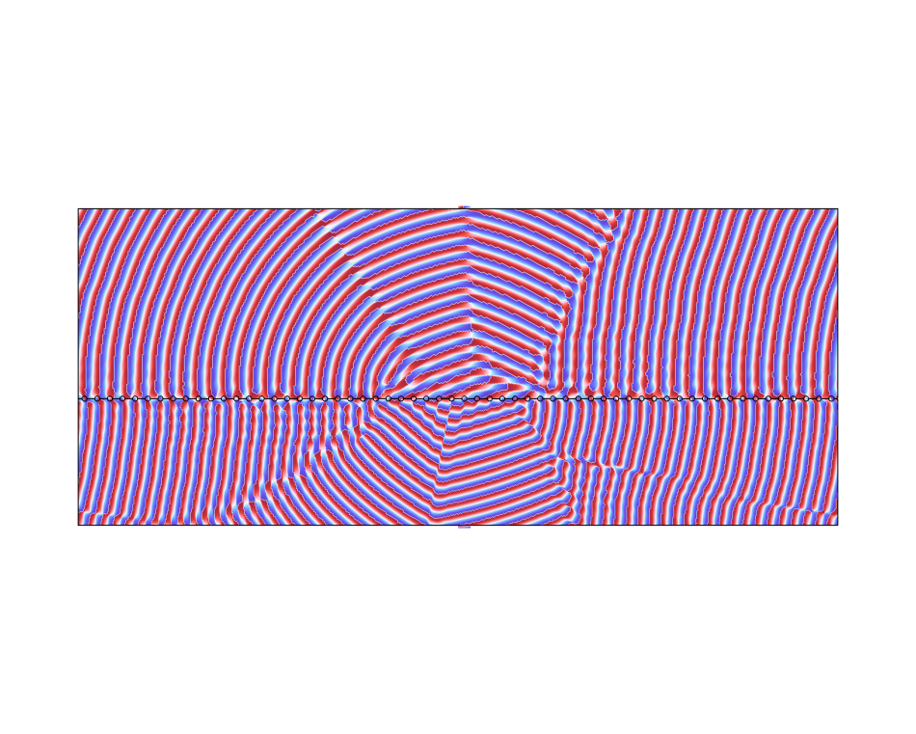
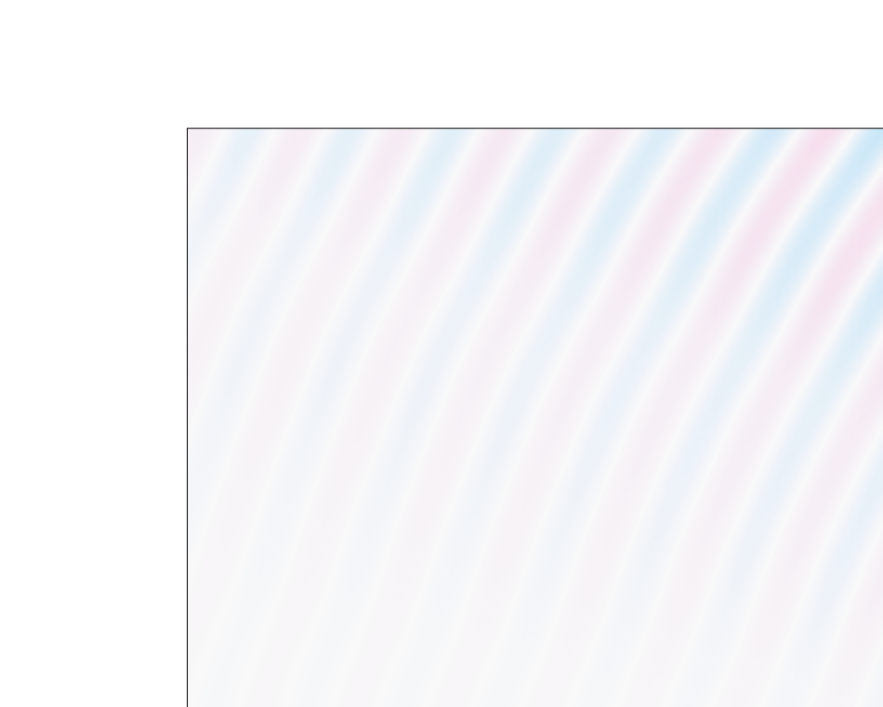
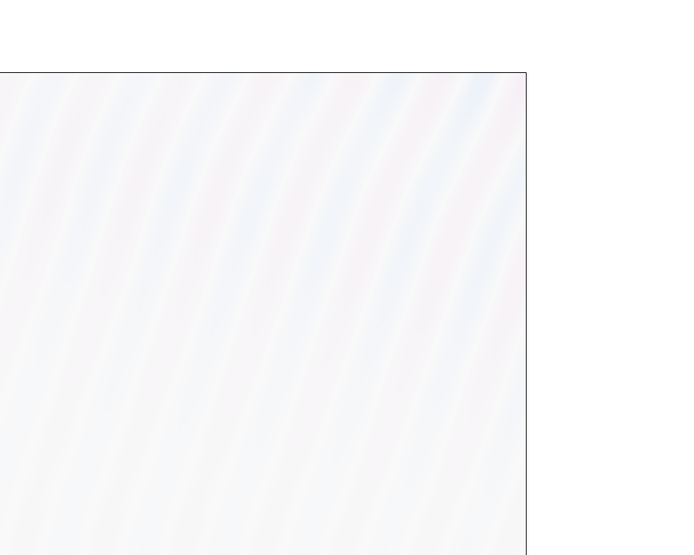
Usage notes (2/2)
This decomposition approach makes the fields periodic in x based on our choice of dkt. If outgoing radiation is passing through the +/- x boundaries of the full domain, these will appear as incoming waves on the other side. This can be faintly seen below, as well as more clearly in the arg(E) plot. This can be reduced by either A) changing the geometry or B) increasing dkt, at the expense of more plane wave simulations

