Slide 1
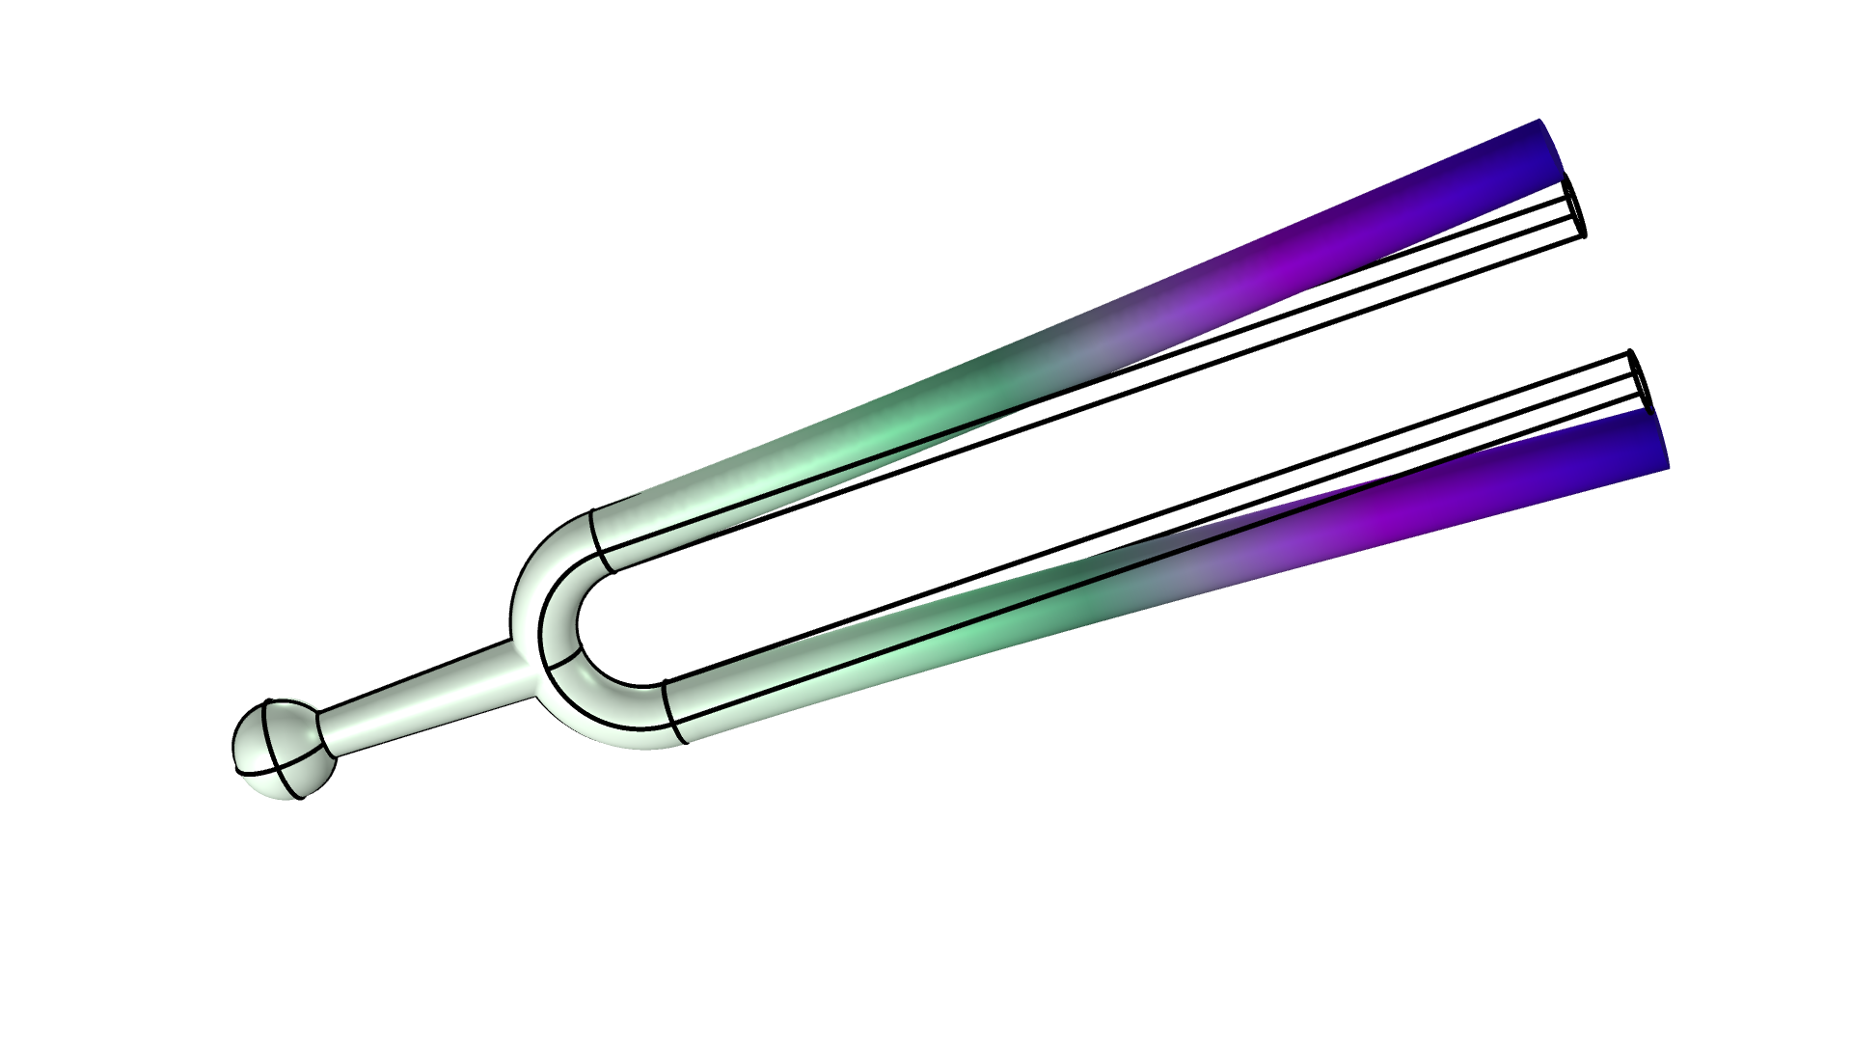
Optimization of a
Tuning Fork

Slide 2
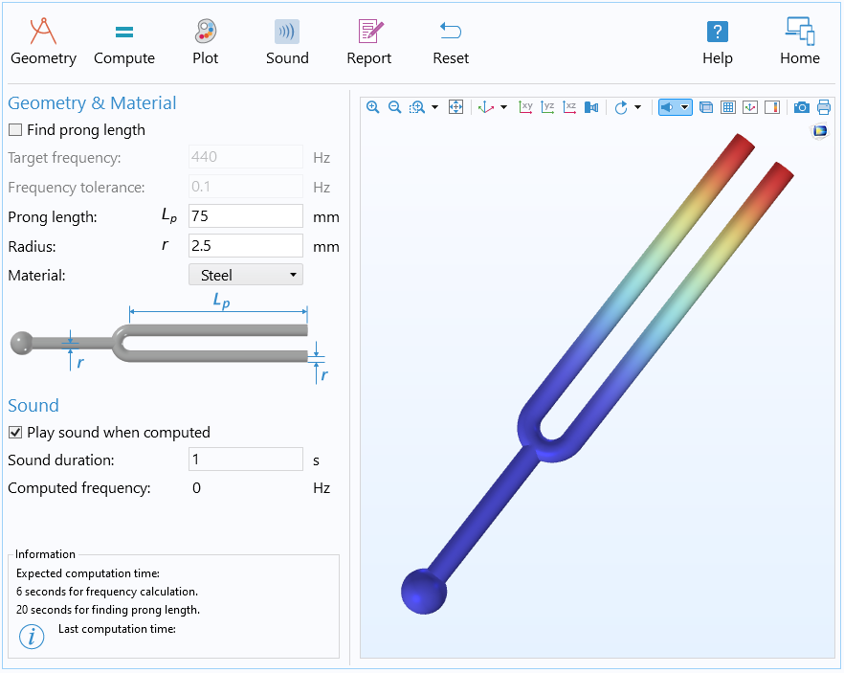
Optimization of a
Tuning Fork
The application supports changing
Material
Target frequency
The output is
The optimal prong length
The eigenfrequency sound
A report detailing the computation result
A COMSOL Multiphysics model file (mph)
Optimization of a Tuning Fork

