Slide 1
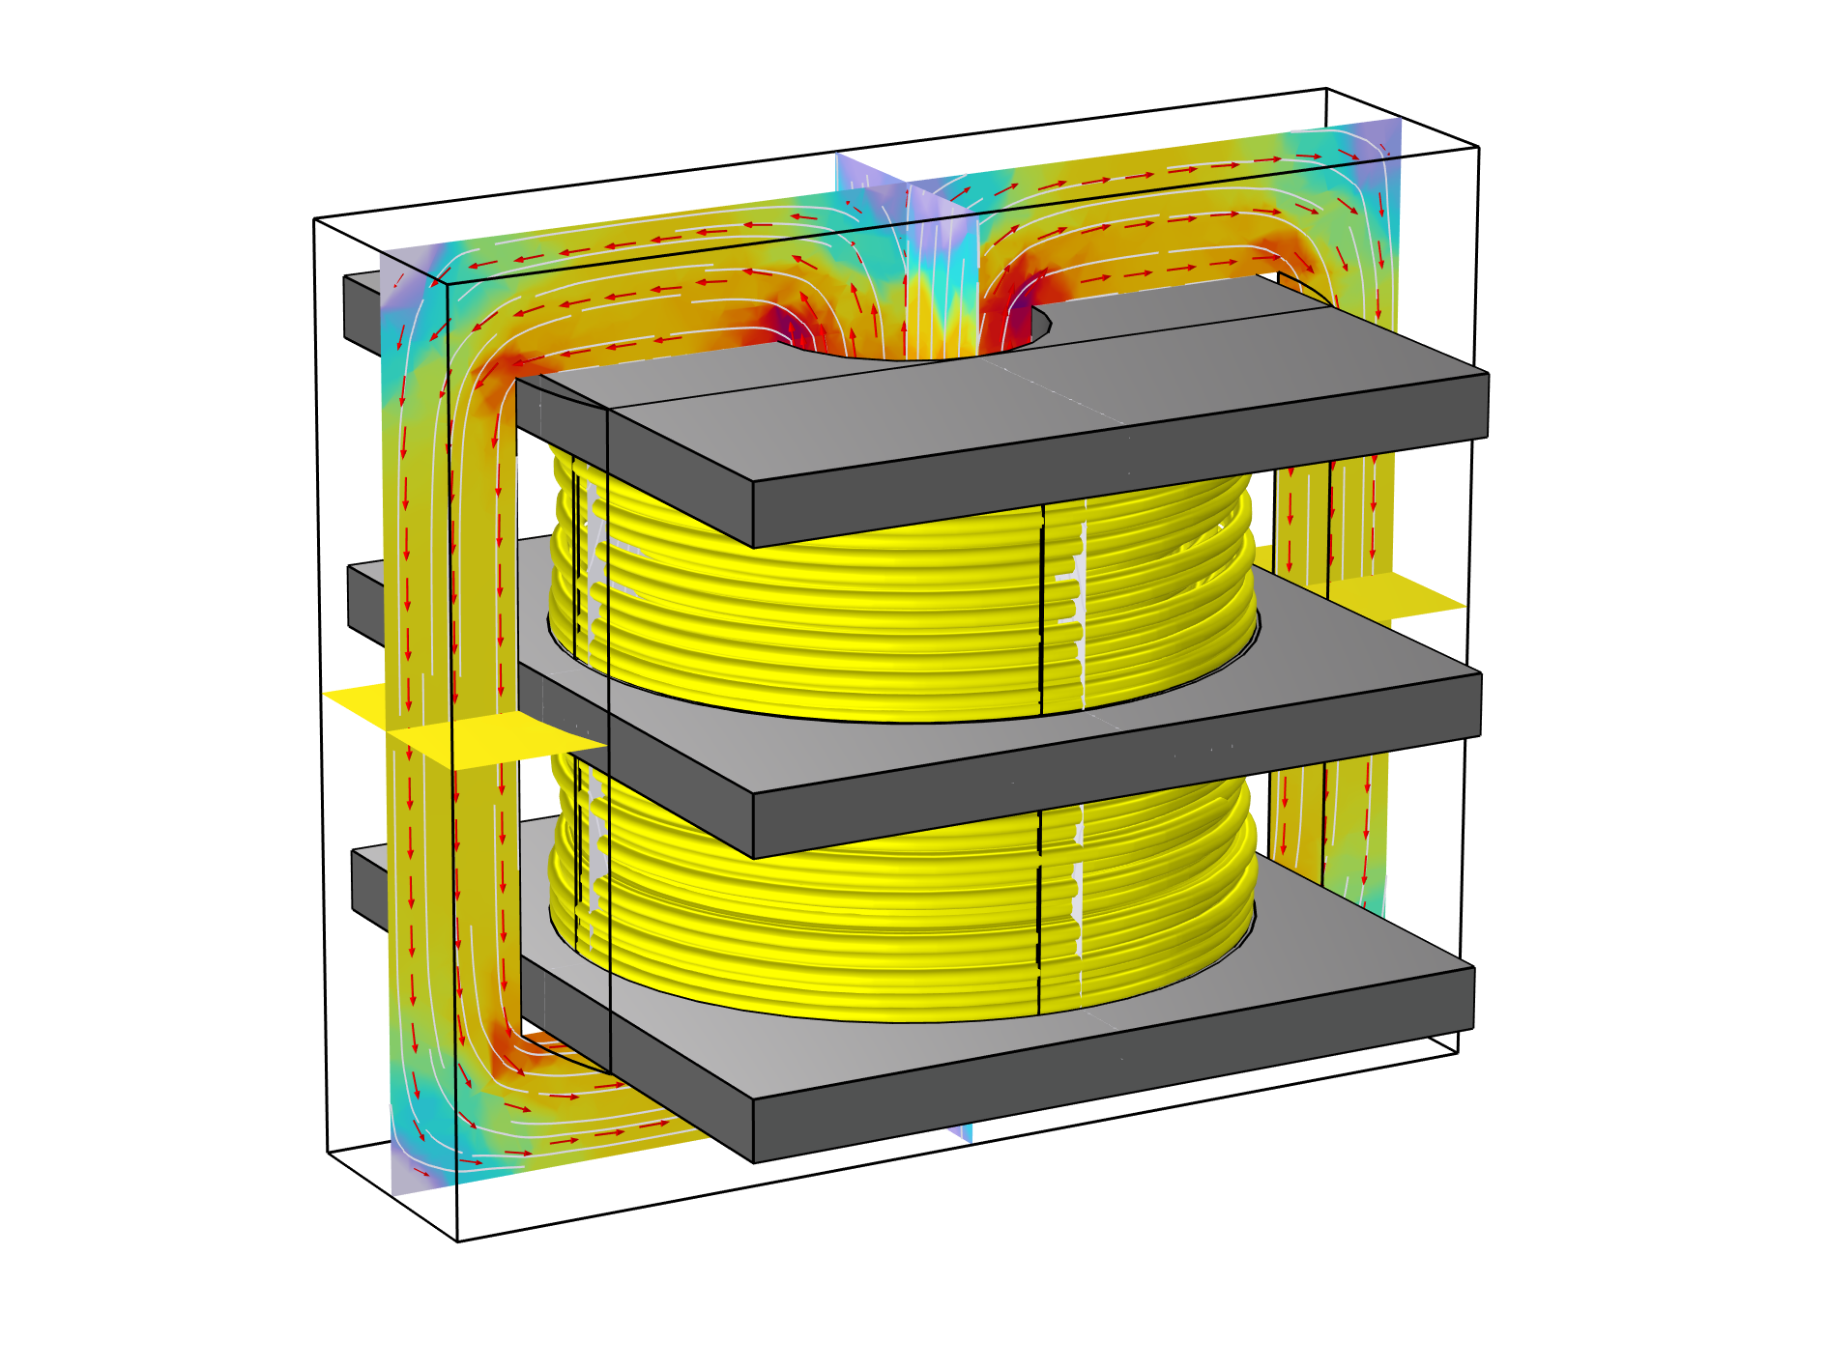
High Voltage Ferrite Core Transformer

Slide 2
Objective
Extraction of equivalent circuit parameters of the transformer
Inductive and resistive parameters:
  Primary coil magnetizing inductance
  Primary coil resistance
  Primary coil leakage inductance
  Primary coil leakage resistance
Capacitive parameters:
  Primary coil self-capacitance
  Secondary coil self-capacitance
High Voltage Ferrite Core Transformer

Slide 3
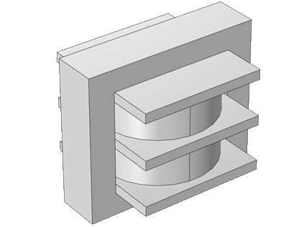
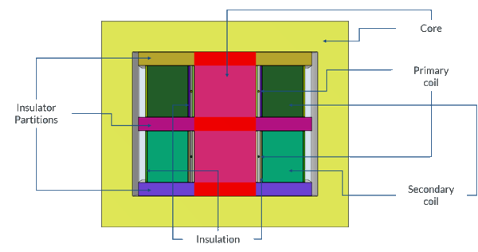
Model Inputs
Transformer 3D model
Transformer sectional view and materials
Primary voltage = 10 Vp
Excitation frequency = 50 kHz
Windings comprise of 2 sections with insulator partition between them
Primary: 2 turns ; Secondary: 600 turns
Materials. Coil wire: copper; core: ferrite; insulating material: PET

Slide 4
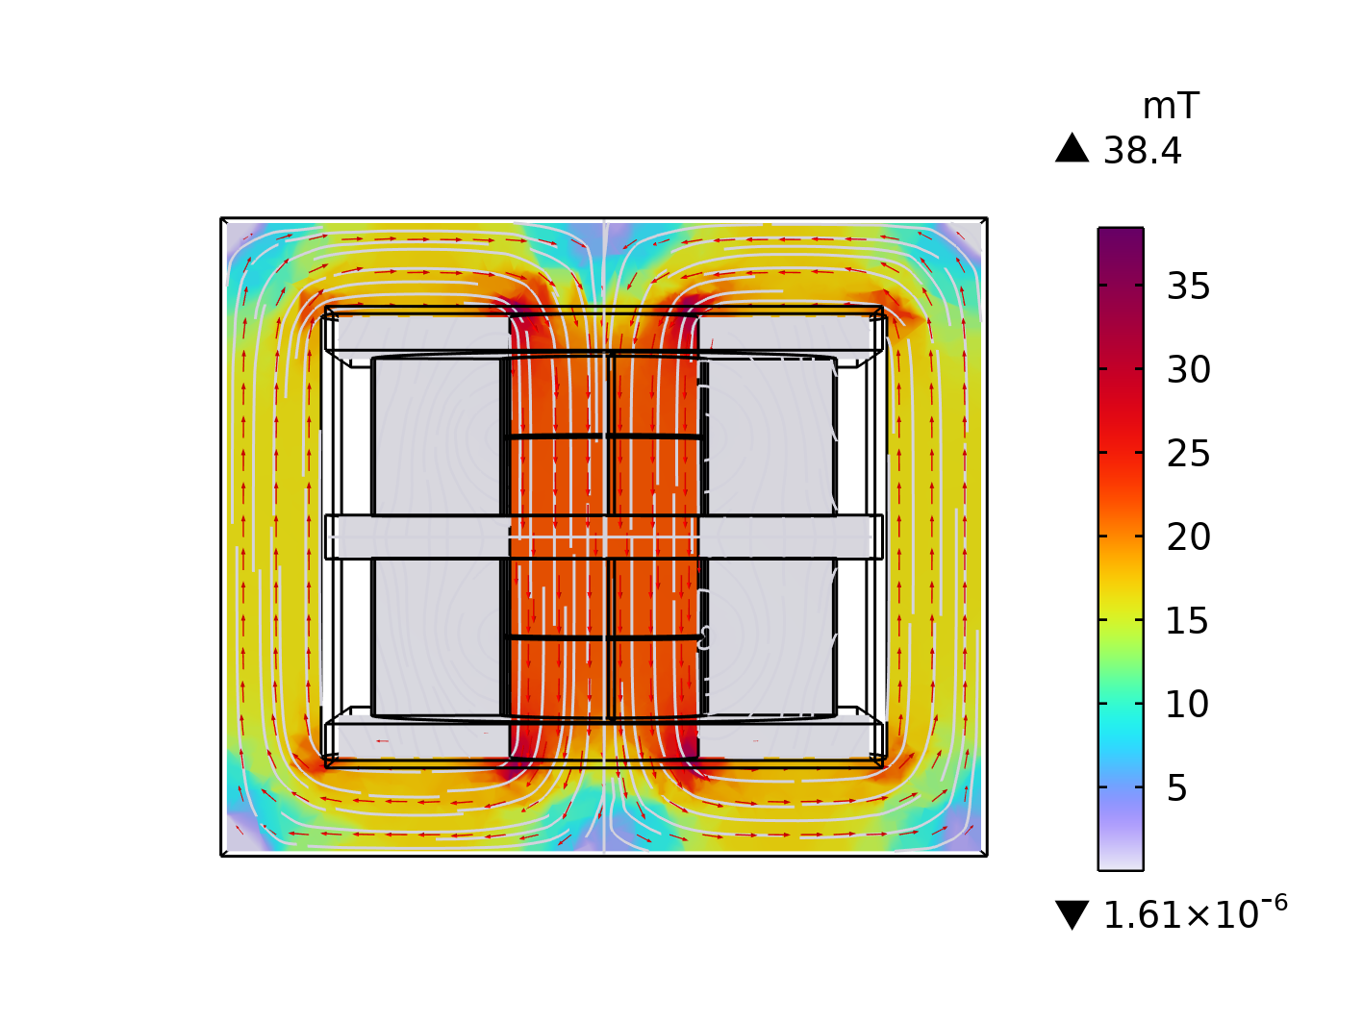
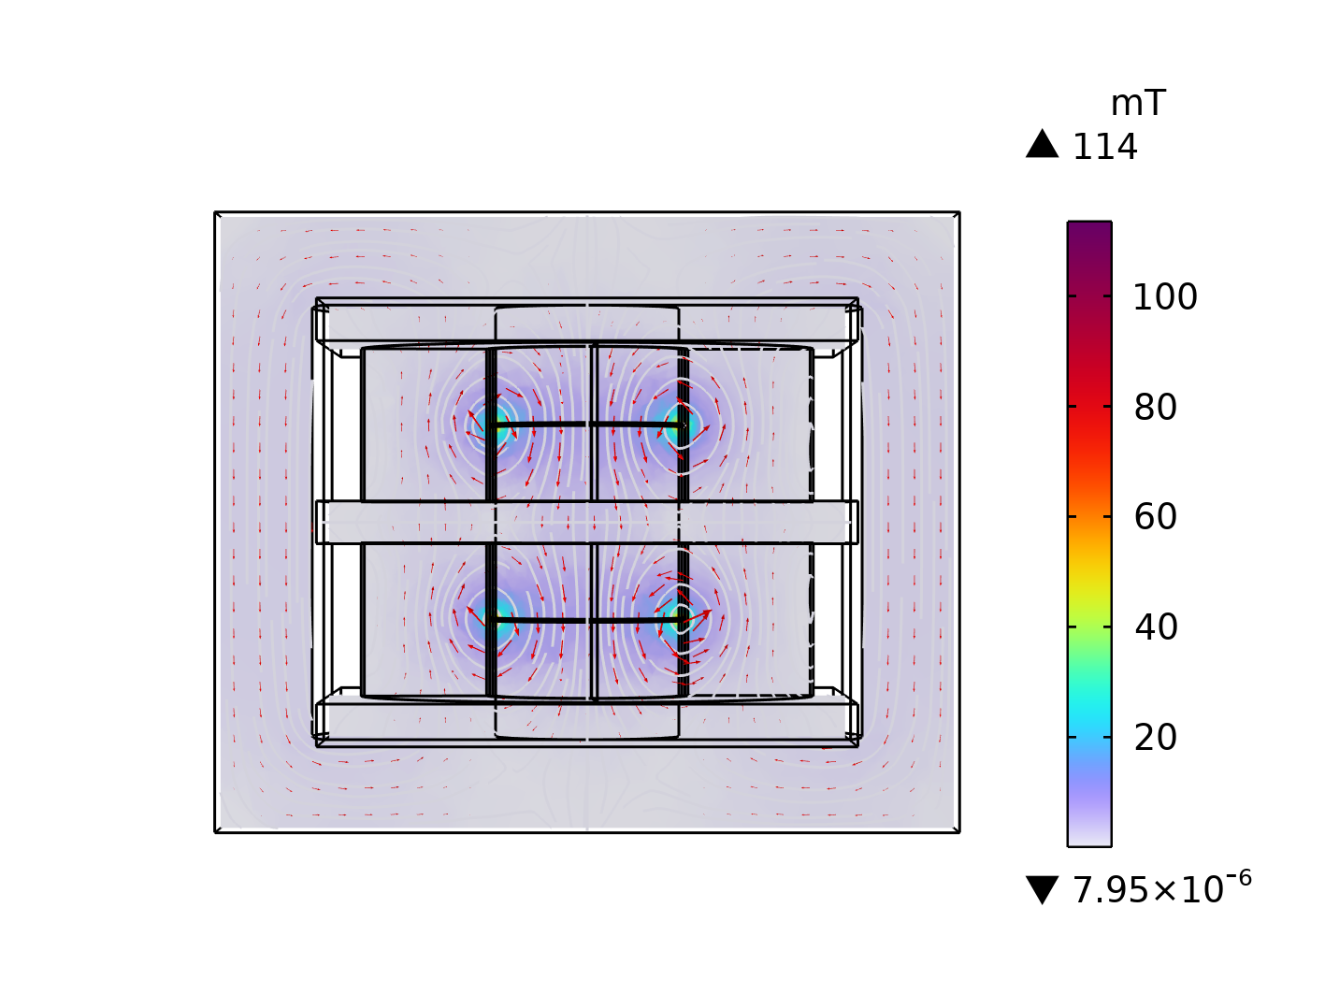
Open-Circuit Test and Short-Circuit Test
Open Circuit Test (OCT)
  Primary coil voltage = 10 V
  Secondary coil current = 0 A
Short Circuit Test (SCT)
  Primary coil voltage = 10 V
  Secondary coil voltage = 0 V
Results (OCT)
  Magnetizing inductance = 44.7 µH
  Primary coil resistance = 76.4 mΩ
Results (SCT)
  Leakage inductance = 0.25 µH
  Leakage resistance = 19.2 mΩ
Flux density distribution for open-circuit test
Flux density distribution for short-circuit test

Slide 5
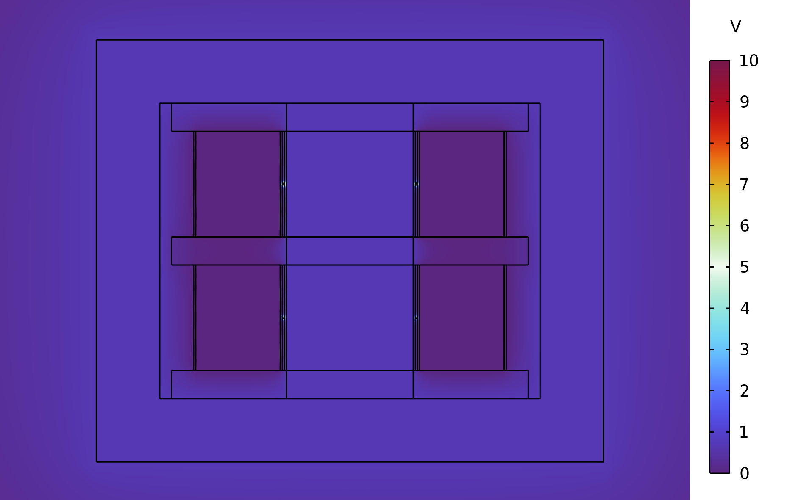
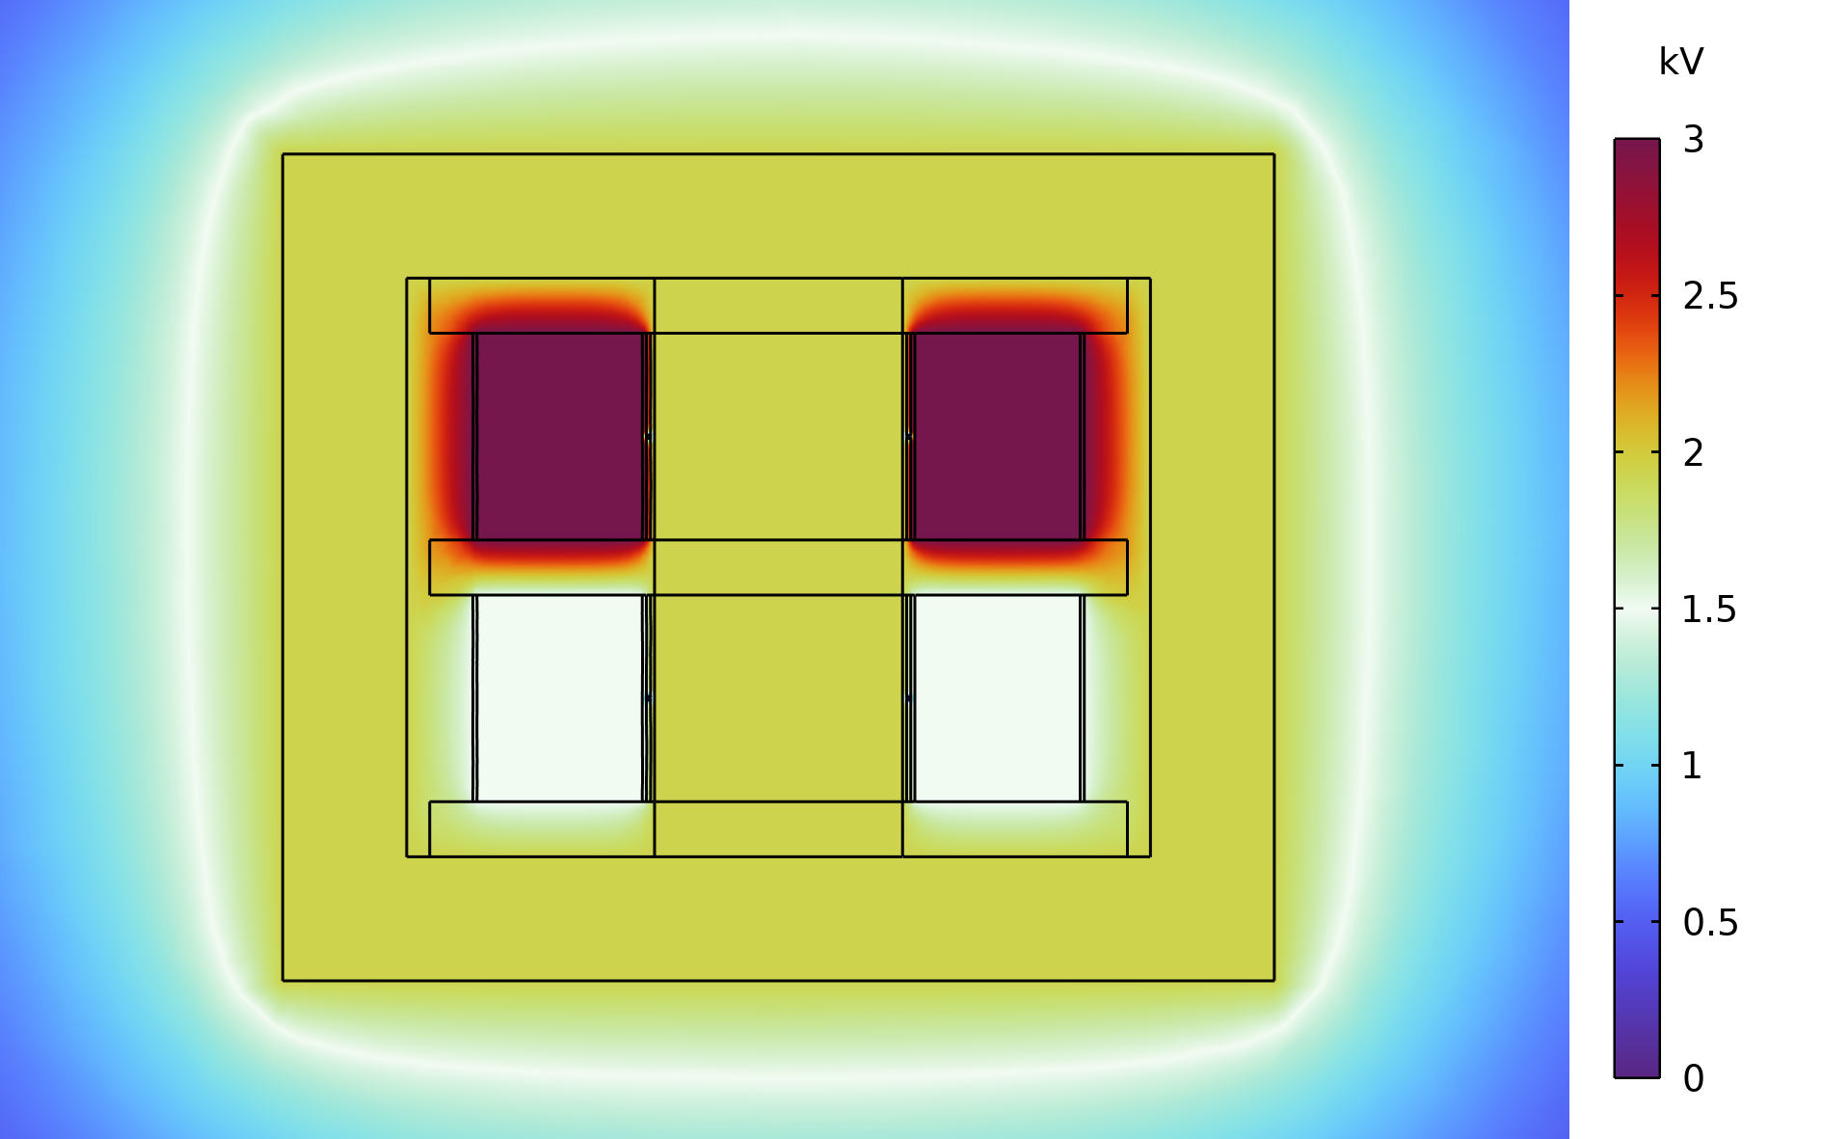
Extraction of Parasitic Capacitances
Primary self-capacitance
  Primary coil turn 1 voltage = 5 V
  Primary coil turn 2 voltage = 10 V
  Secondary coil section 1 voltage = 0 V
  Secondary coil section 2 voltage = 0 V
  Core surface: Floating potential
Secondary self-capacitance
  Primary coil turn 1 voltage = 0 V
  Primary coil turn 2 voltage = 0 V
  Secondary coil section 1 voltage = 1.5 kV
  Secondary coil section 2 voltage = 3 kV
  Core surface: Floating potential
Results
  Primary self capacitance = 14 pF
  Secondary self capacitance = 30.5 pF
Potential distribution for primary self-capacitance
Potential distribution for secondary self-capacitance

Slide 6
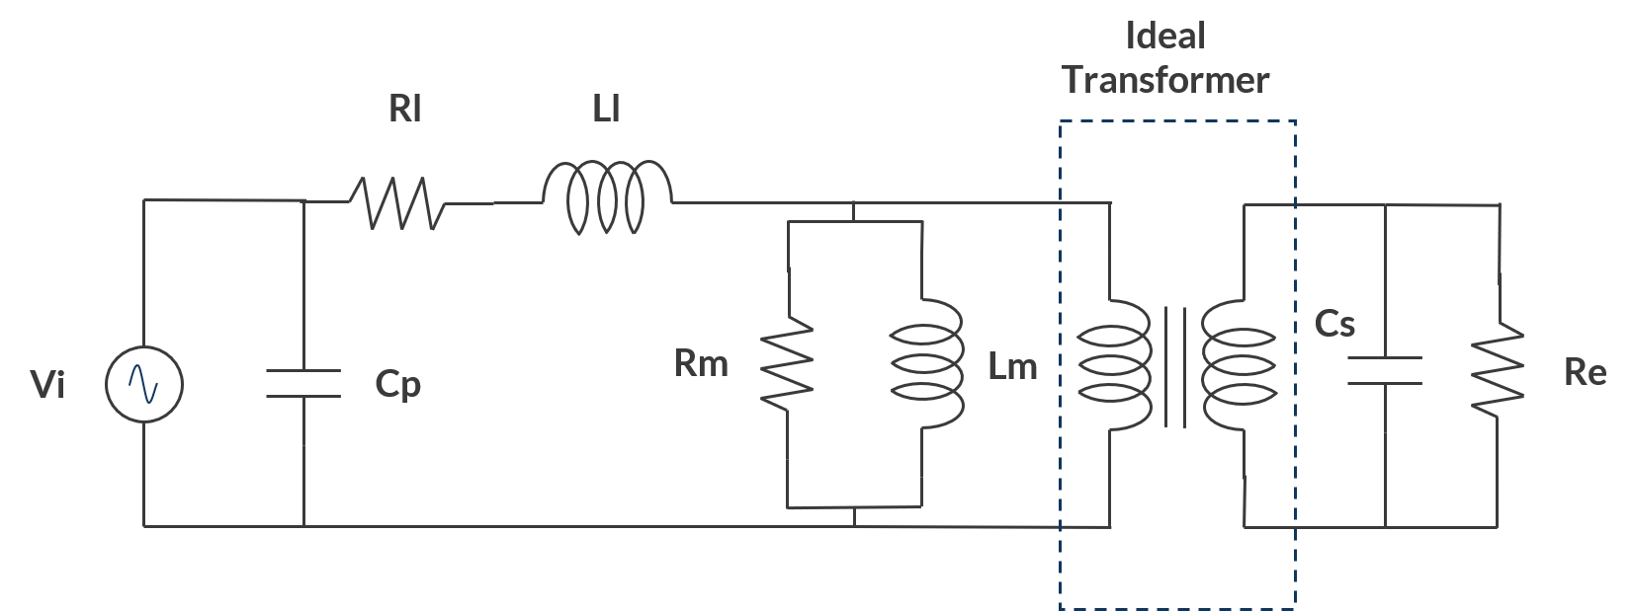
Equivalent lumped circuit of the transformer
Parameters from 3D
Primary
  Feeding, resistance, capacitance, inductance
Secondary
  Inductance, capacitance, external load
Primary to secondary transformer
Magnetizing impedance
Equivalent circuit elements
Magnetizing impedance
Cp = 14 pF
Cs = 30.5 pF
Rl = 19.2 mΩ
Ll = 0.25 µH
Rm = 2587.6 Ω
Lm= 44.7 µH

Slide 7
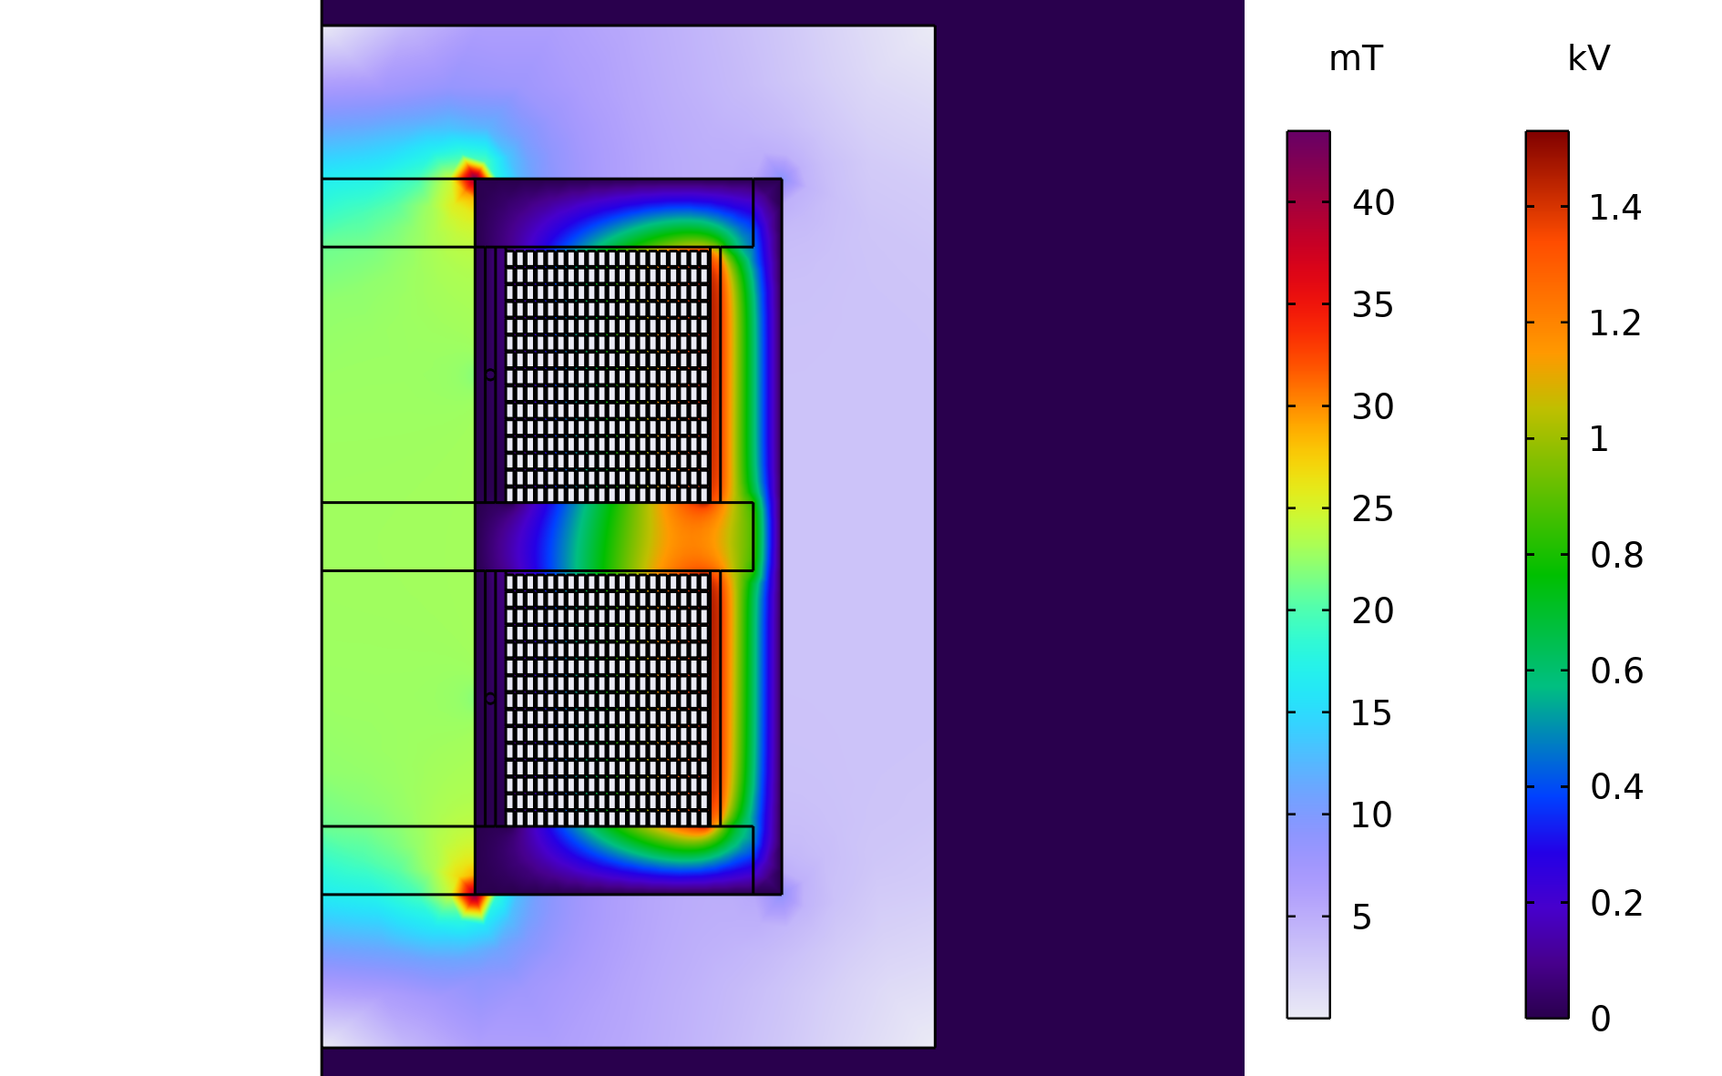
2D Axisymmetric
Axisymmetric geometry created using cross section of 3D model
Magnetic and Electric Fields (mef) interface used to model inductive and capacitive effects
Primary coil modelled using Single conductor coil domain feature
Secondary coil modelled using RLC coil group domain feature
Magnetic field and potential distribution

Slide 8
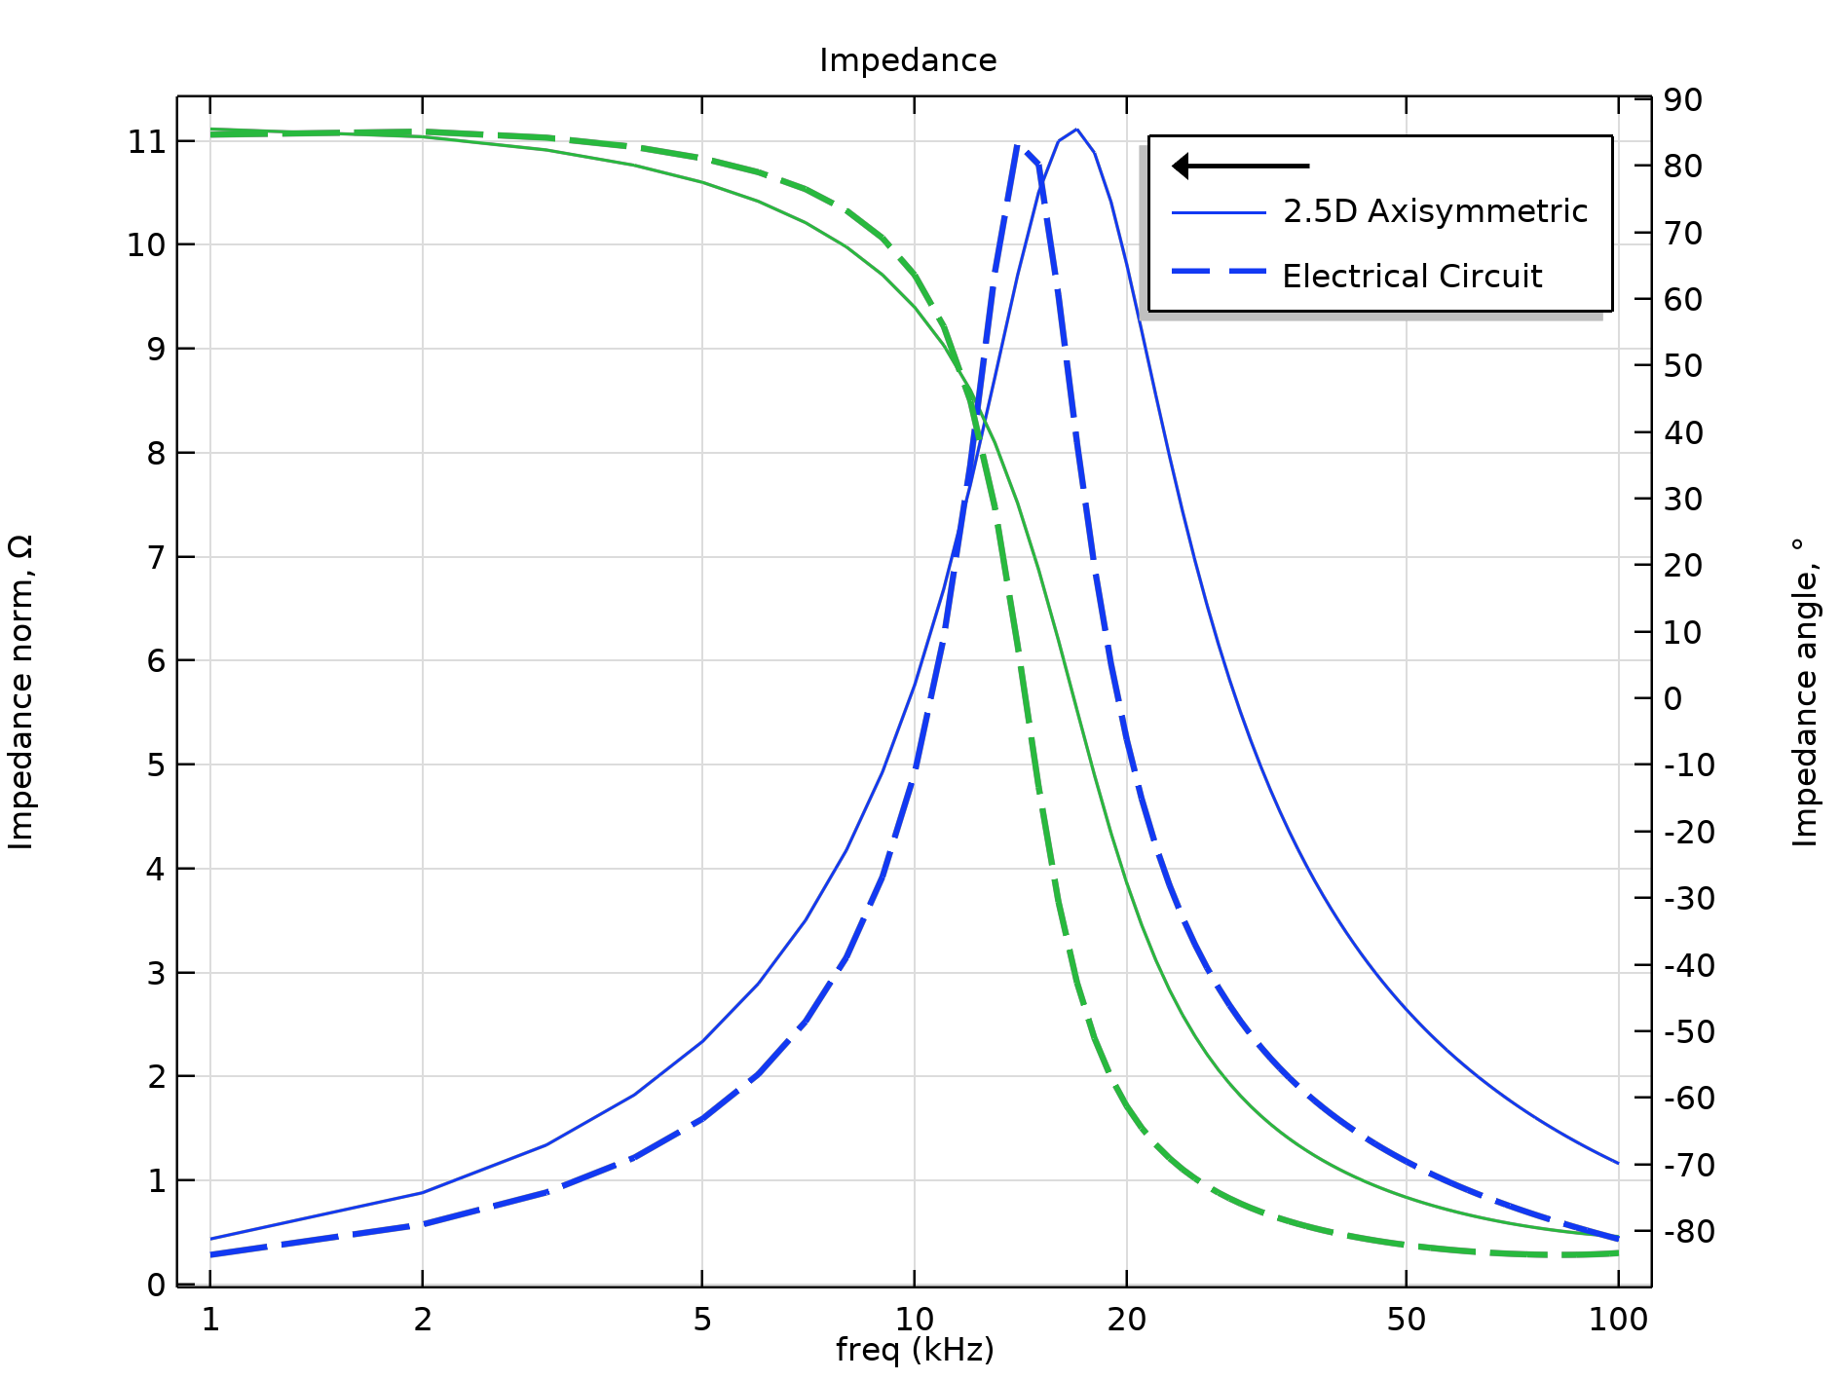
Results
A coupled lumped circuit analysis shows that the primary draws a capacitive current and the secondary induced voltage is greater than the value calculated using the turns ratio
A coupled analysis performed on a 2D axisymmetric model using the Magnetic and electric fields (mef) interface corroborates the coupled lumped circuit analysis
  i.e. the primary draws a leading current and secondary voltage is greater than the expected value using the turns ratio

Slide 9
Conclusions
A coupled analysis including both inductive and displacement currents should not be used to extract the equivalent circuit parameters of a transformer since inductive and capacitive effects are mutually opposite
It is recommended that
  Magnetizing and leakage inductances should be extracted using mf interface
  Parasitic capacitances should be extracted using es or Electrostatics (es) interface

