Slide 1
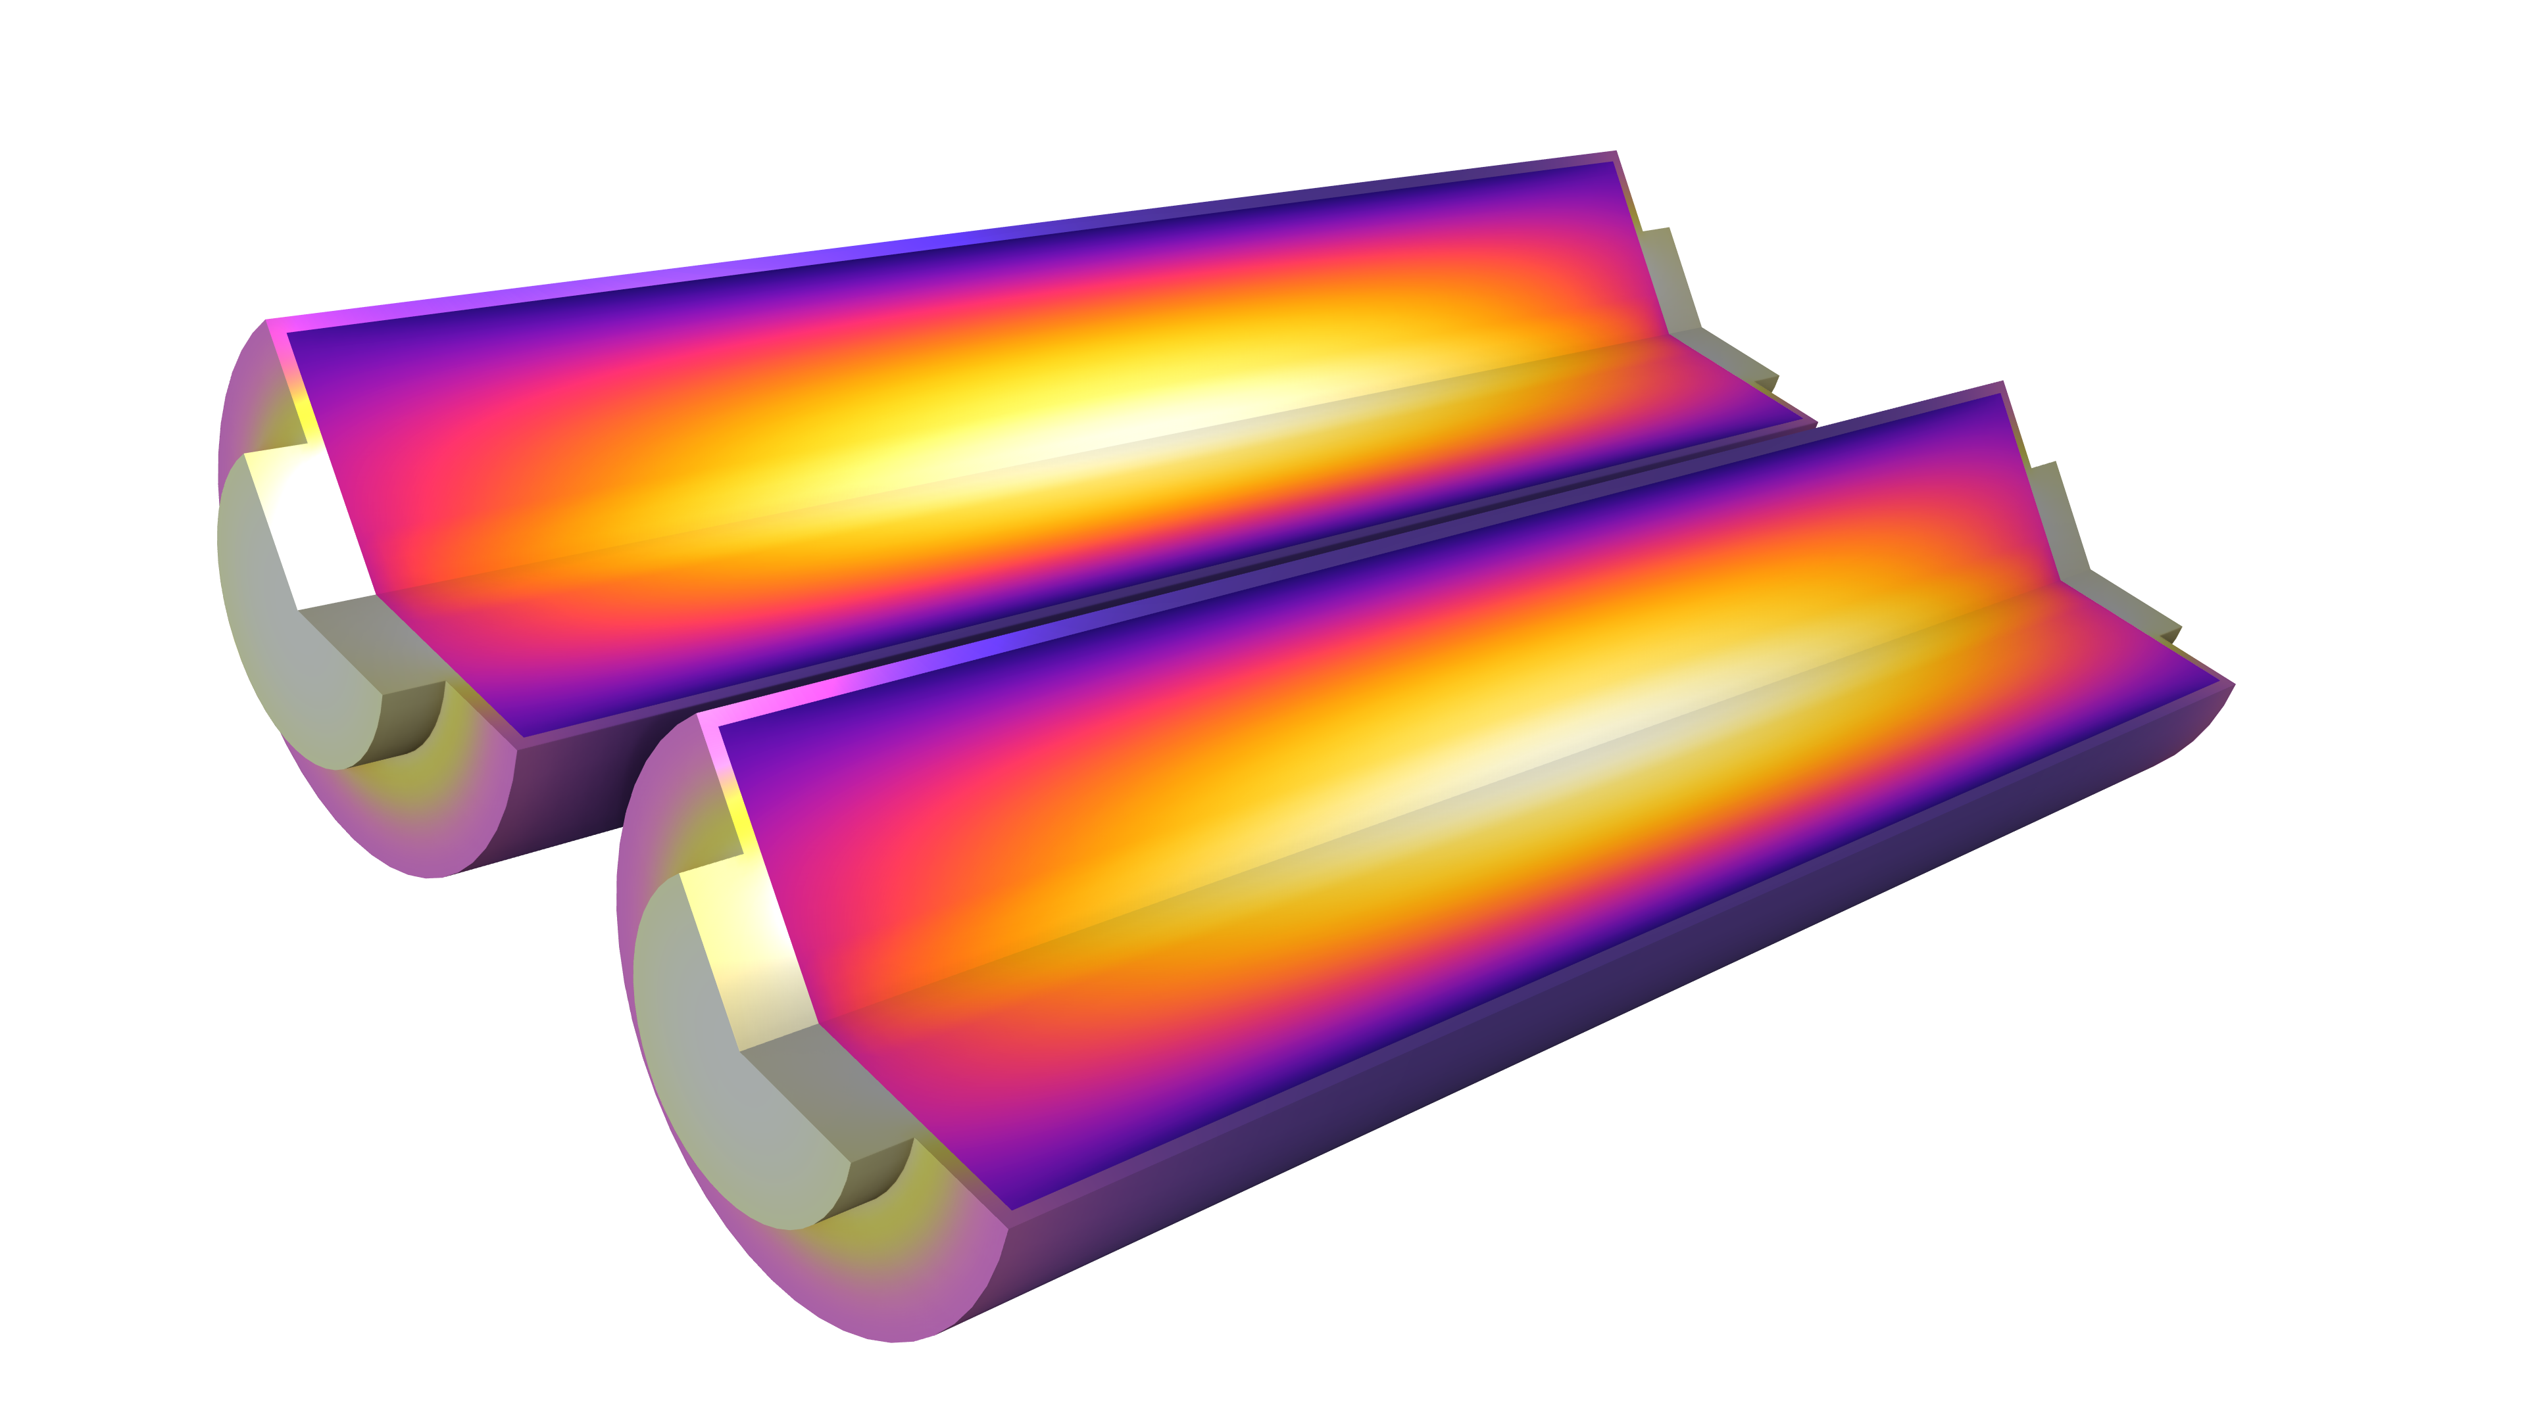
Battery Cell Thermal Runaway

Slide 2
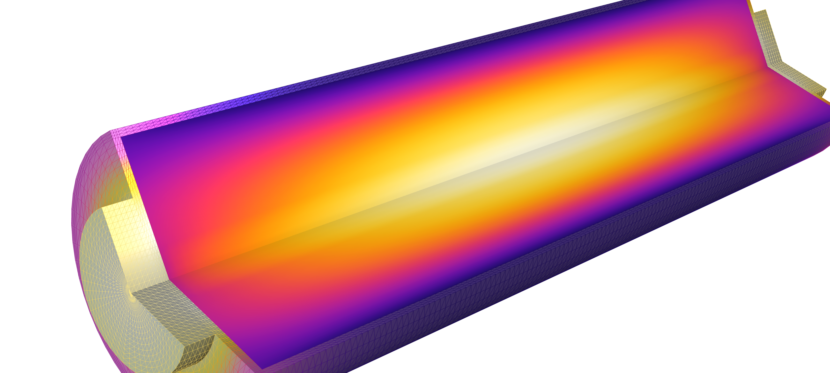
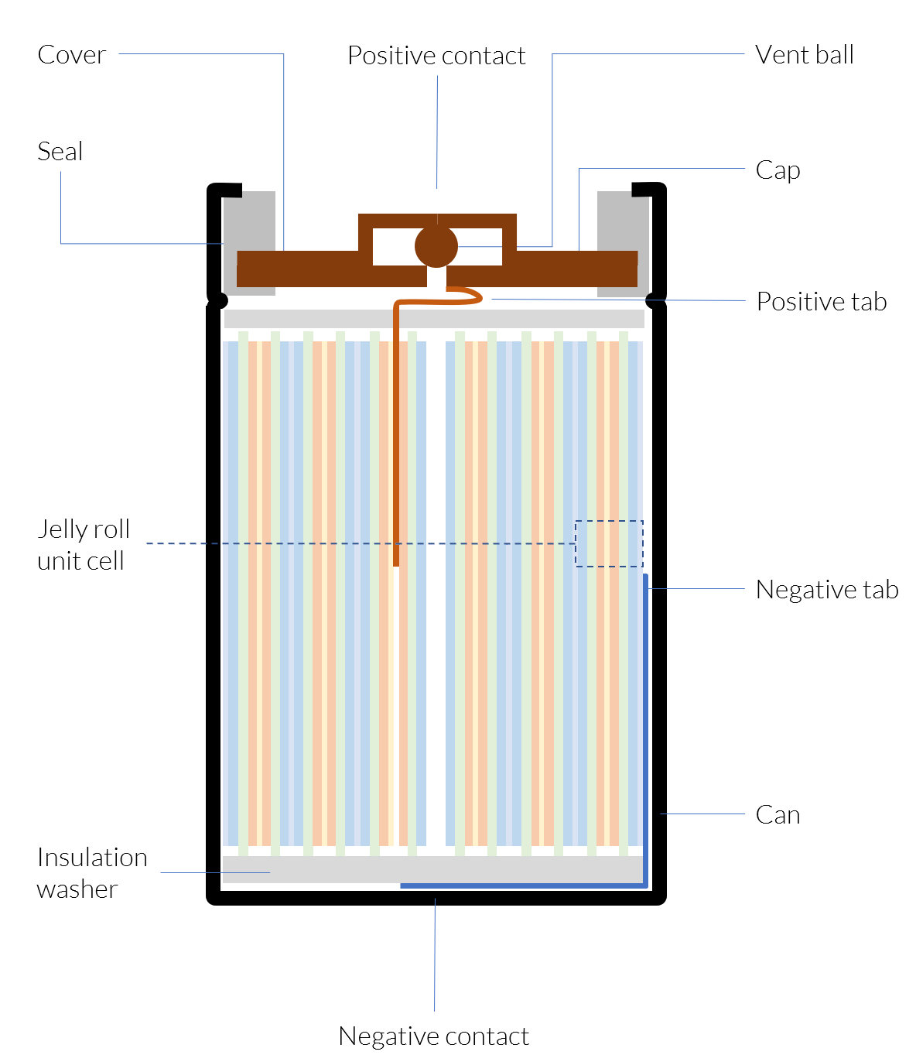
Background
The active materials of lithium-ion battery cells may decompose when subjected to elevated temperatures. The rate of the decomposition reactions typically depends exponentially on temperature according to the Arrhenius law. The decomposition reactions are typically exothermic. The interplay between external cooling (or heating), decomposition reaction rates and enthalpies, and cell thermal mass governs the heating dynamics of a cell. | When increased heat generation due to the decomposition reactions is not counteracted by dissipation of heat, a battery cell exhibits thermal runaway, which results in an exponential temperature increase. Thermal runaway leads to battery failure and may also cause fire and even explosions.

Slide 3
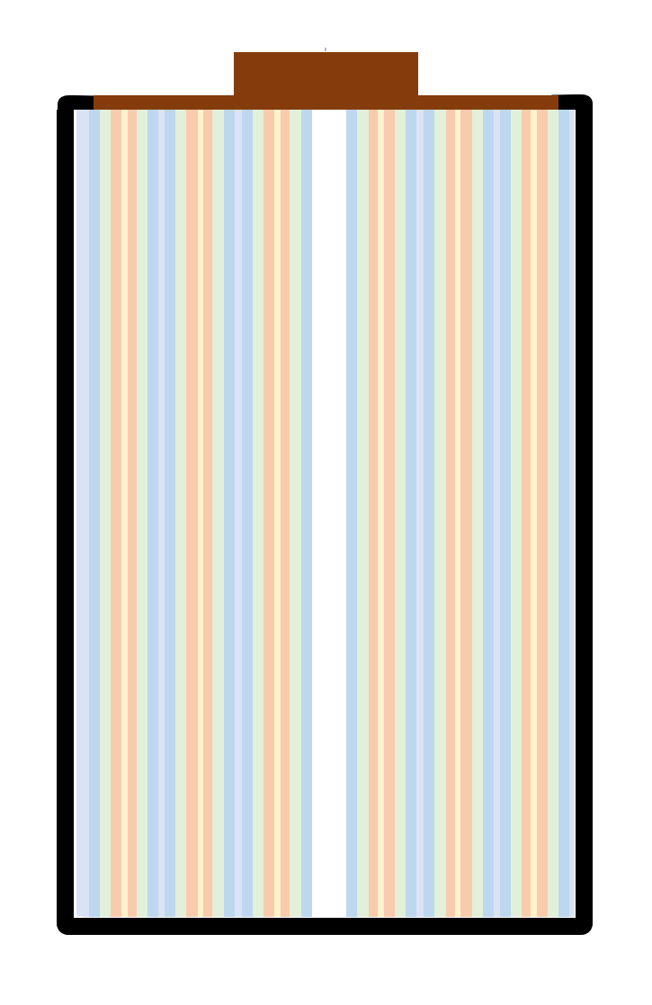
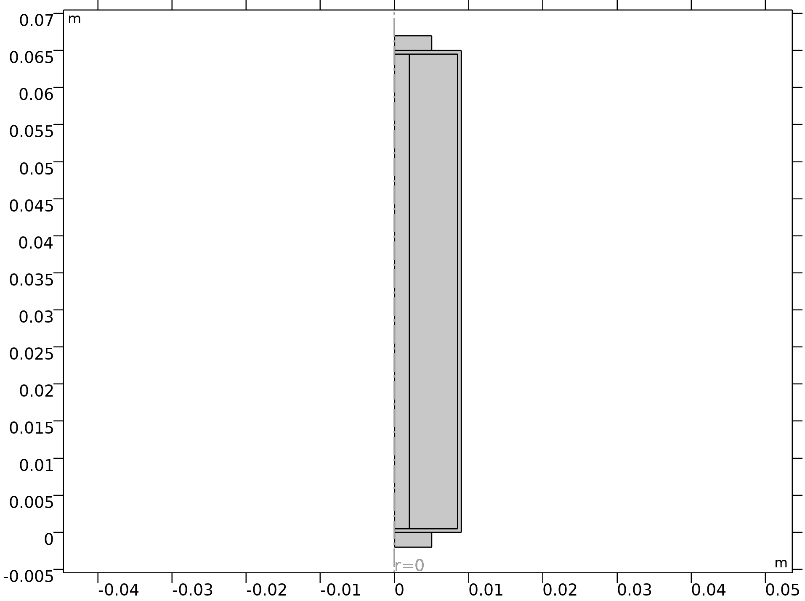
Model Overview
Simplified
description
of the inner
structure
Rotational
symmetry
This model simulates the temperature dynamics in a cylindrical battery after being placed in an oven. The battery is assumed to be at open circuit throughout the whole experiment. As the temperature increases, various exothermal decomposition reactions are activated, which in turn results in further heating of the battery. | Four different reactions are considered, involving the decomposition of the: Solid electrolyte interface (SEI) at the negative electrode Negative electrode active material Positive electrode active material Electrolyte The decomposition reactions are based on papers by Kim et al. and Hatchard et al. (See the end of this presentation for references.)

Slide 4


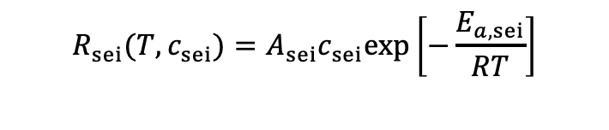


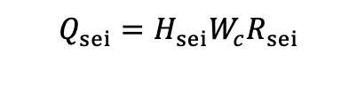
Solid Electrolyte Interface Decomposition
Decomposition Rate:
Notations:
$$R_{sei}(T,c_{sei})=A_{sei}c_{sei}exp\left[−\frac{E_{a,sei}}{RT}\right]$$
$$c_{sei}$$
Dimensionless concentration of
lithium (Li)-containing meta stable species in the SEI
$$H_{sei}$$
Heat of reaction
Material Balance:
$$\frac{dc_{sei}}{dt}=−R_{sei}$$
$$W_{c}$$
Volume-specific carbon (graphite) content in the jelly roll
Heat Source:
$$Q_{sei}=H_{sei}W_{c}R_{sei}$$

Slide 5
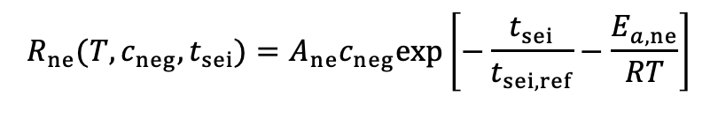
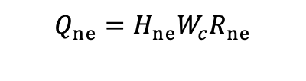


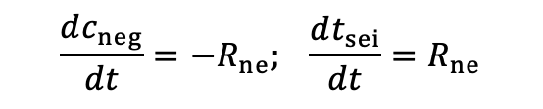
Negative Electrode Active Material Decomposition
Decomposition Rate:
Notations:
$$R_{ne}(T,c_{neg},t_{sei})=A_{ne}c_{neg}exp\left[−\frac{t_{sei}}{t_{sei, ref}}−\frac{E_{a,ne}}{RT}\right]$$
$$c_{neg}$$
Dimensionless concentration of intercalated Li-species in the negative electrode
Material Balance:
$$t_{sei}$$
Dimensionless SEI layer thickness
$$\frac{dc_{neg}}{dt}=−R_{ne}; \frac{dt_{sei}}{dt}=R_{ne}$$
Heat Source:
$$Q_{ne}=H_{ne}W_{c}R_{ne}$$

Slide 6

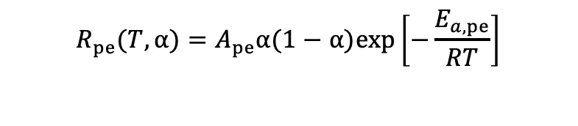



Positive Electrode Active Material Decomposition
Decomposition Rate:
Notations:
$$R_{pe}(T,α)=A_{pe}α(1−α)exp\left[−\frac{E_{a,pe}}{RT}\right]$$
$$α$$
Degree of conversion of positive electrode material
Material Balance:
$$W_{p}$$
Volume-specific positive-active content in
the jelly roll
$$\frac{dα}{dt}=R_{pe}$$
Heat Source:
$$Q_{ne}=H_{pe}W_{p}R_{pe}$$

Slide 7

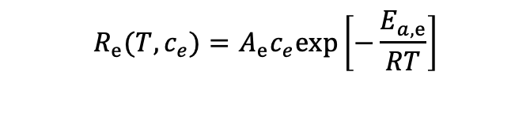



Electrolyte Decomposition
Decomposition Rate:
Notations:
$$R_{e}(T,c_{e})=A_{e}c_{e}exp\left[−\frac{E_{a,e}}{RT}\right]$$
$$c_{e}$$
Dimensionless electrolyte concentration
Material Balance:
$$W_{e}$$
Volume-specific electrolyte content in
the jelly roll
$$\frac{dc_{e}}{dt}=−R_{e}$$
Heat Source:
$$Q_{ne}=H_{e}W_{e}R_{e}$$

Slide 8
Model Geometry
The geometry is defined in 2D assuming axial symmetry
18650 form factor; 9 mm radius and 65 mm height
Anisotropic thermal conductivities in the jelly roll
  Higher conductivity in the layers
  (z-direction) than across the
  layers (r-direction)
Cooling on all exterior boundaries
Steel casing
Mandrel,
inactive
Jelly roll,
active material

Slide 9
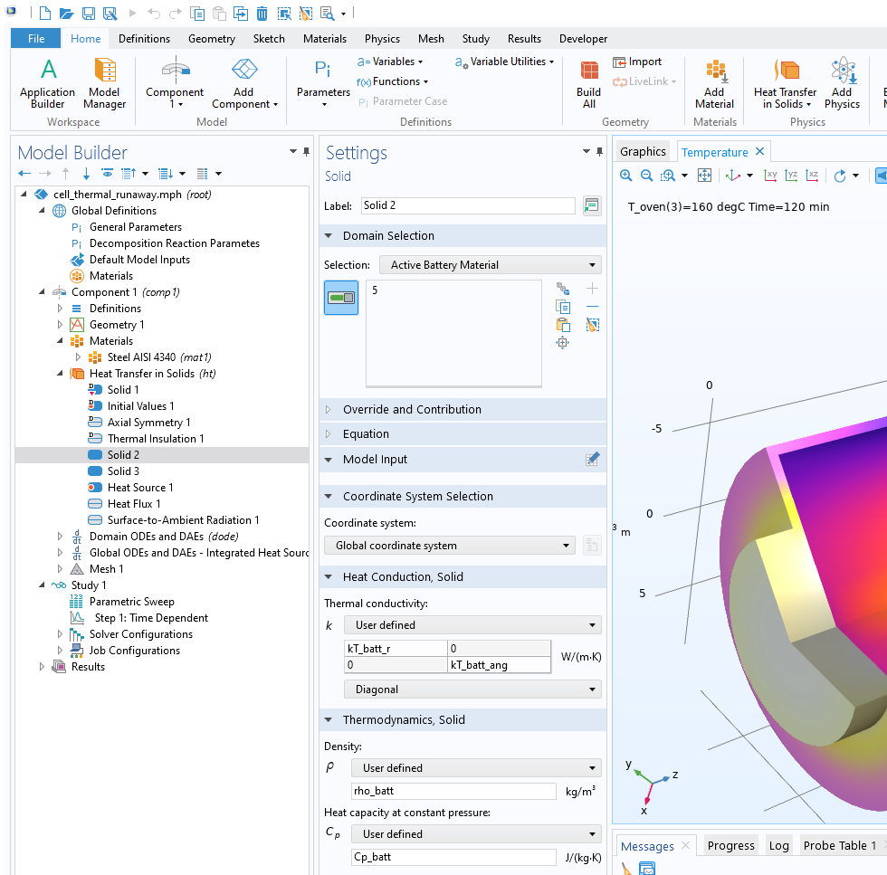
Model Setup
Heat Transfer
  Anisotropic thermal conductivities in the active material
  Heat sources from decomposition reactions
  Convective heat flux
  Surface-to-ambient radiation
Domain ODEs
  Solve for the dependent variables c_{sei}, c_{neg}, t_{sei}, α, and c_{e} in the jelly roll domain
Global ODEs and DAEs
  Compute integrals of total heat sources
Study
  Parametric sweep for the oven temperatures 150°C, 155°C, and 160°C
  Time-dependent solver

Slide 10
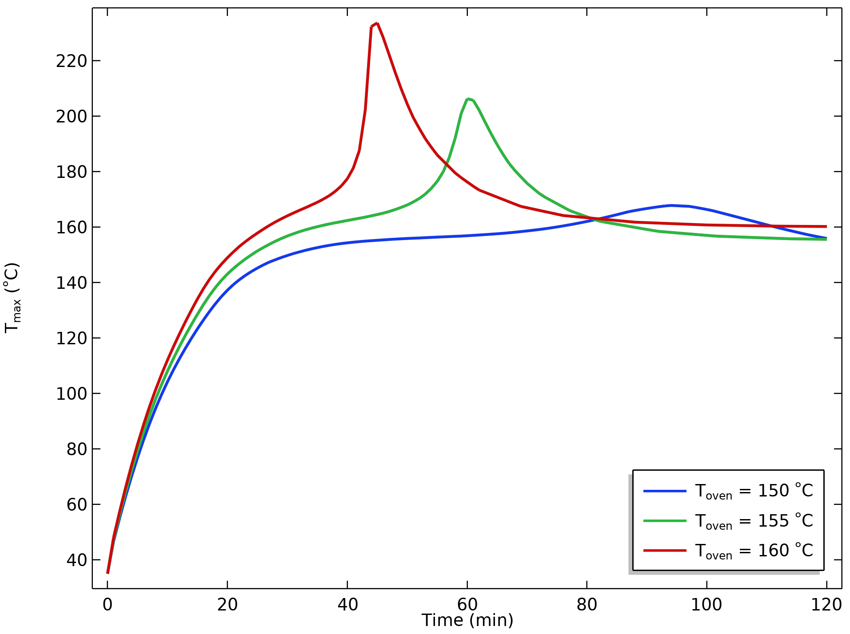
Maximum Temperatures
There is moderate “runaway” at 150°C.
Onset of temperature comes earlier for higher oven temperatures.
Temperature reaches above
220°C for the most severe case.
Maximum battery temperature at different oven temperatures.

Slide 11
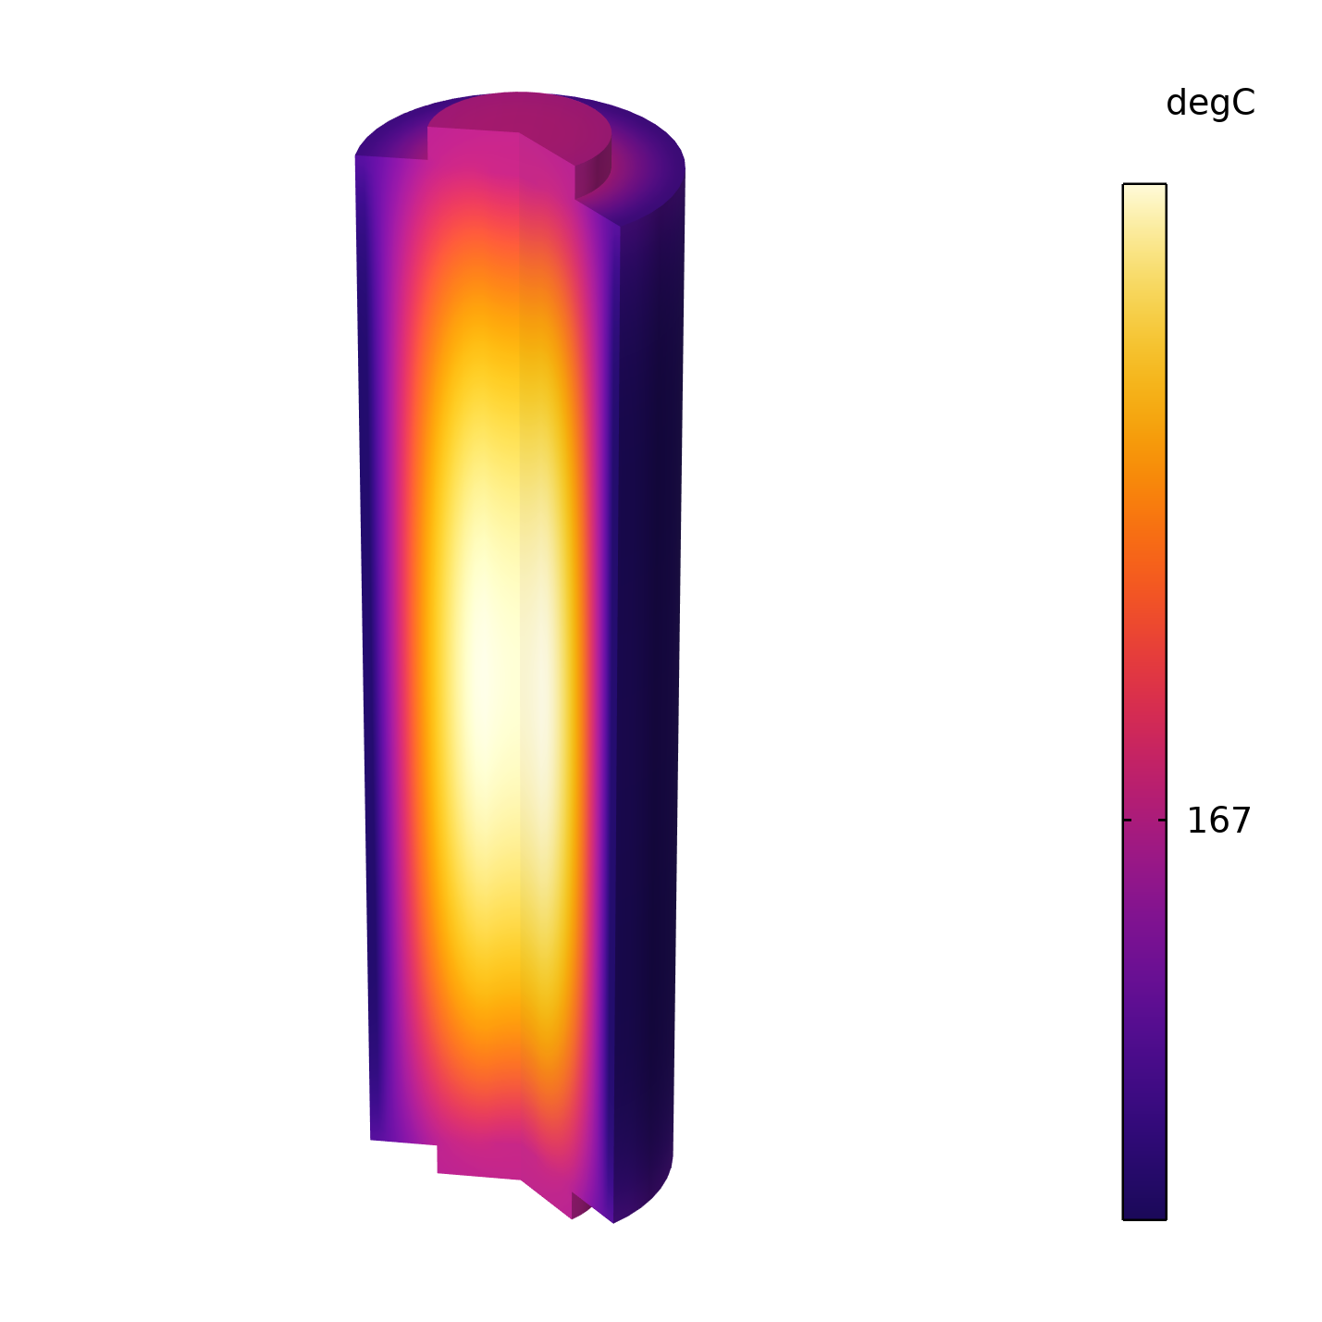

Internal Temperatures
T_{oven} = 150°C; t = 94 min
T_{oven} = 160°C; t = 45 min

Slide 12
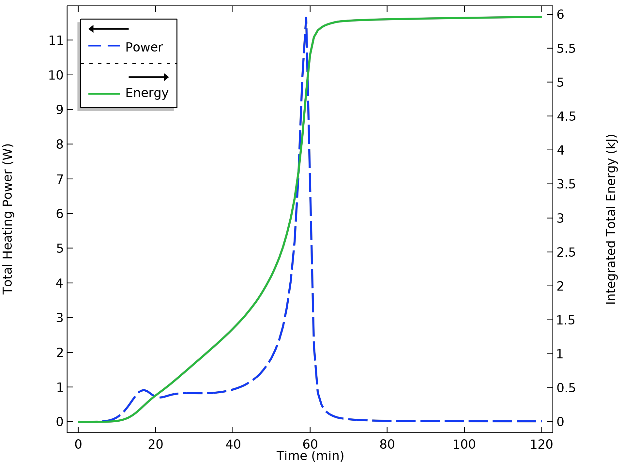
Heating Power and Integrated Heating Energy
Total power curve features two visible peaks.
Total heat release is about 6 kJ at an oven temperature of 150°C.
T_{oven} = 155°C.

Slide 13
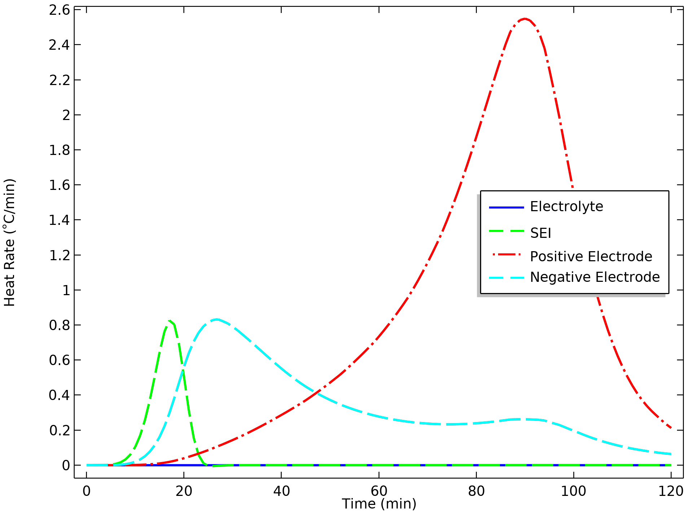
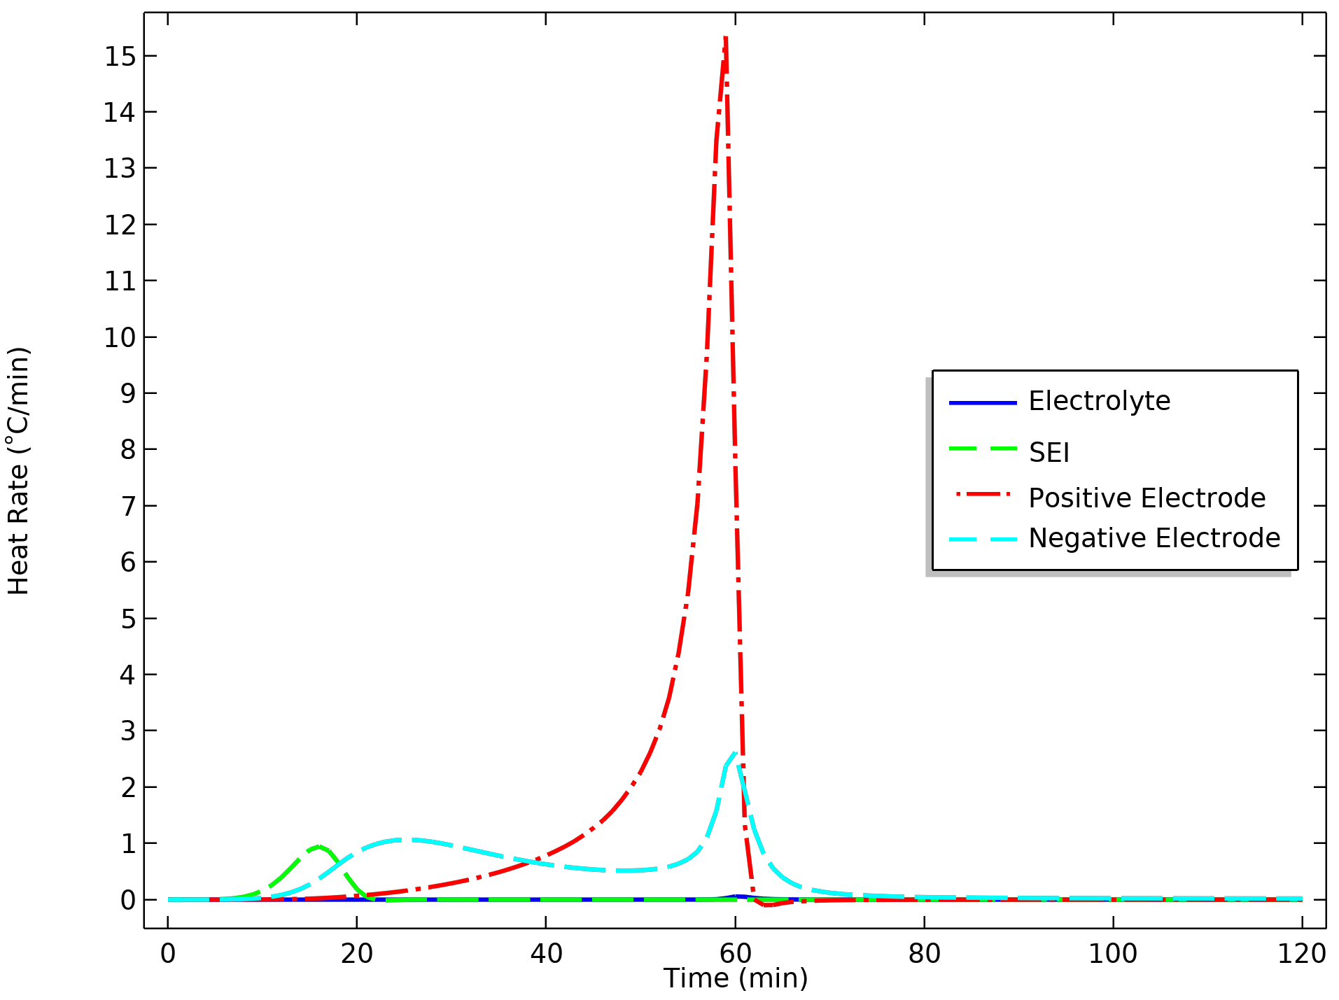
Heating Rates
T_{oven} = 150°C
T_{oven} = 155°C

Slide 14
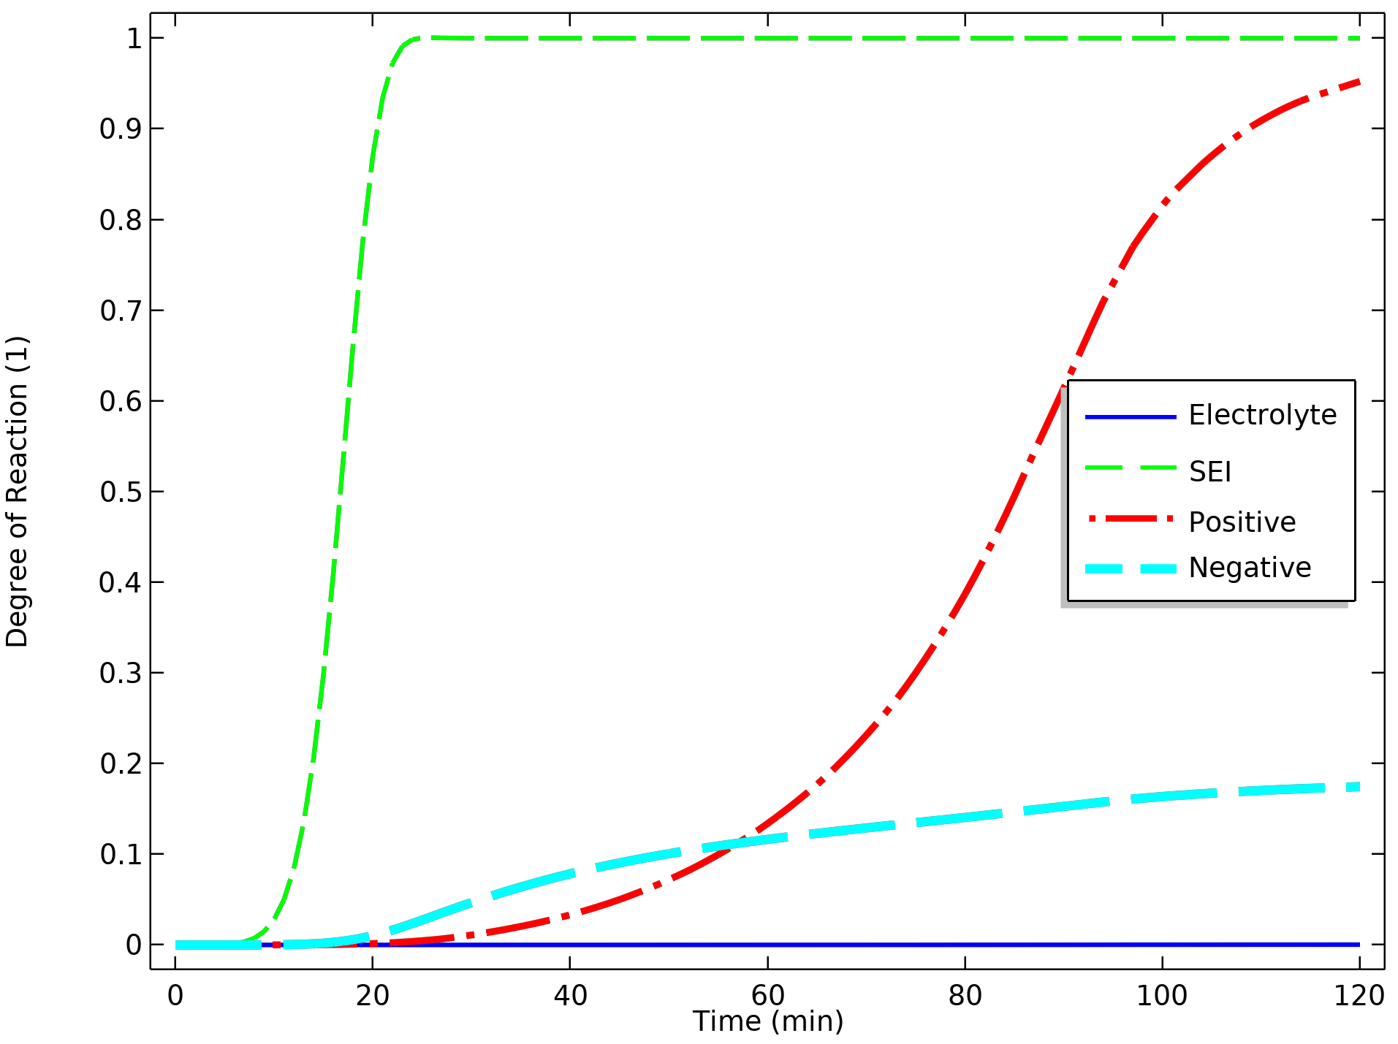
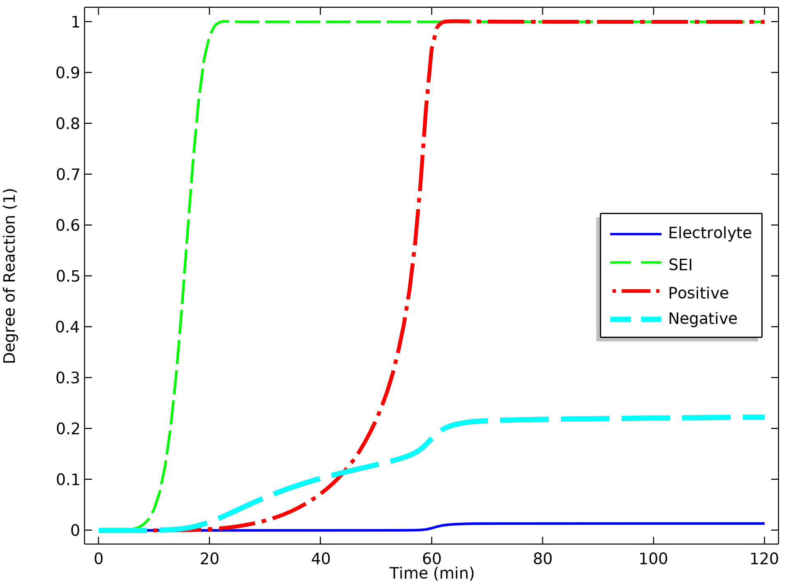
Degree of Reaction Completion
T_{oven} = 150°C
T_{oven} = 155°C

Slide 15
Concluding Remarks
Physics and Equation-Based Modeling
Straightforward to describe the anisotropic properties of the jelly roll
User-friendly definition of the heat sources using equation-based modeling

Slide 16
References
G.H. Kim, A. Pesaran, and R. Spotnitz, “A Three-Dimensional Thermal Abuse Model for Lithium-Ion Cells,” Journal of Power Sources, vol.170, pp. 476–489, 2007.
T. D. Hatchard et al., “Thermal Model of Cylindrical and Prismatic Lithium-Ion Cells,”
Journal of the Electrochemical Society, vol. 148, no. 7, pp. A755–A761, 2001.

