Slide 1
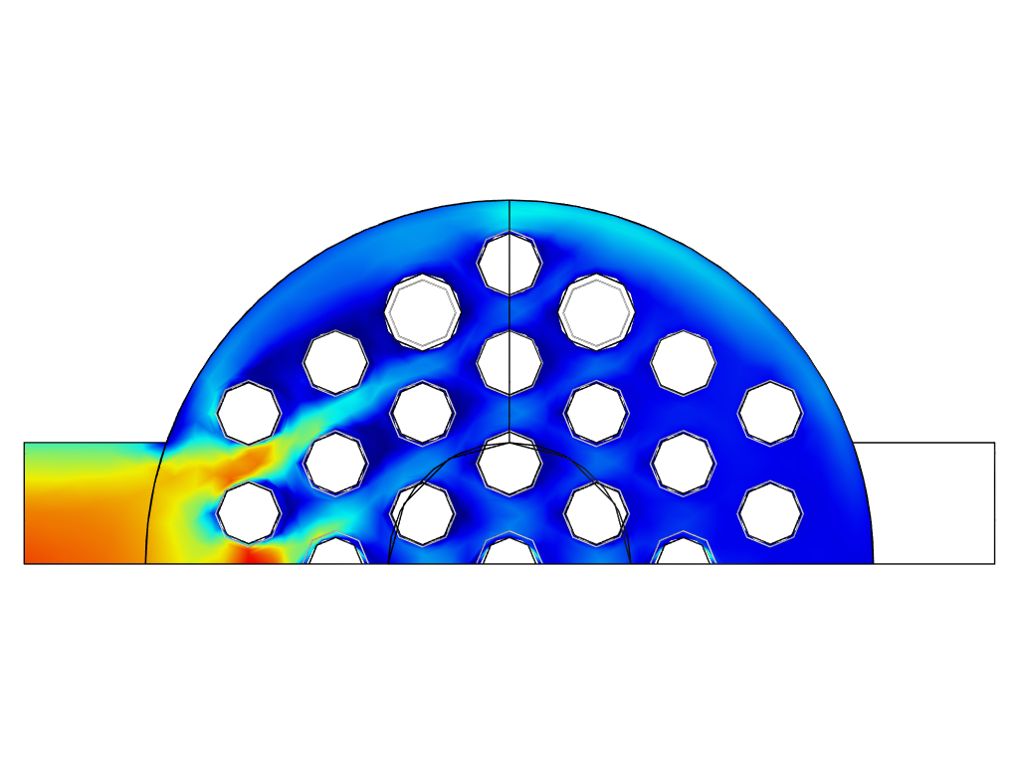
Optimization of a Heat Exchanger with Turbulent Flow

Slide 2
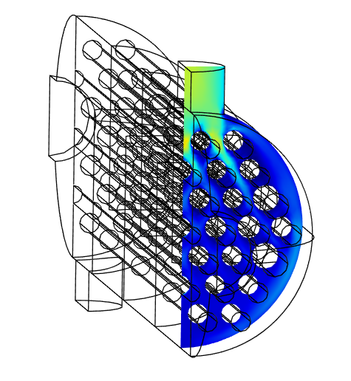
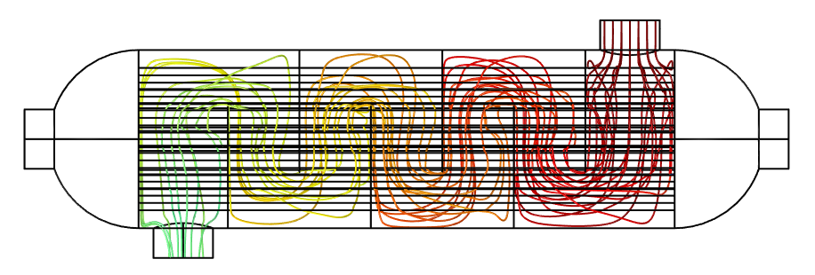
Optimization Setup
Control and heat
Fluid
The translation and scaling of the pipes is handled by the Transformation feature
Both fluids are water with inlet temperatures of
30 ºC and 80 ºC
The flow is pressure driven and the objective is to maximize the heat transfer
The Reynolds number is approximately 10,000. The k-epsilon turbulence model is used
Optimization of a Heat Exchanger with Turbulent Flow

Slide 3
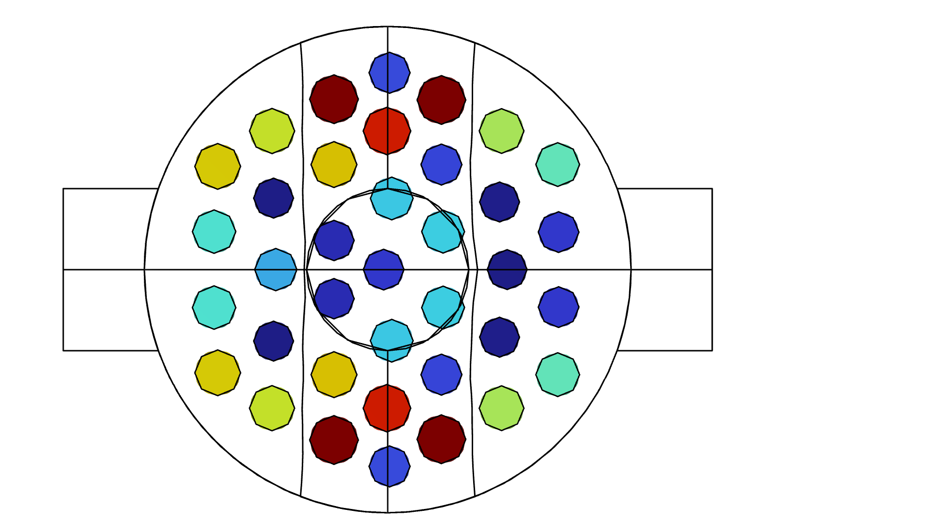
Result
Non-uniform pipe size can improve performance
Discussion
Performance
Manufacturing
Perspective
Some pipes should be larger. Some should be smaller. All are moved a bit.
There is a tendency for bigger pipes towards smaller pipes near the center.
The heat transfer rate is improved by around
20 %.
The design is qualitatively identical to the starting point so manufacturing ought to be possible
Practical heat exchanger often use more pipes and more segments, which might explains why the efficiency is only around 50 %

