Slide 1
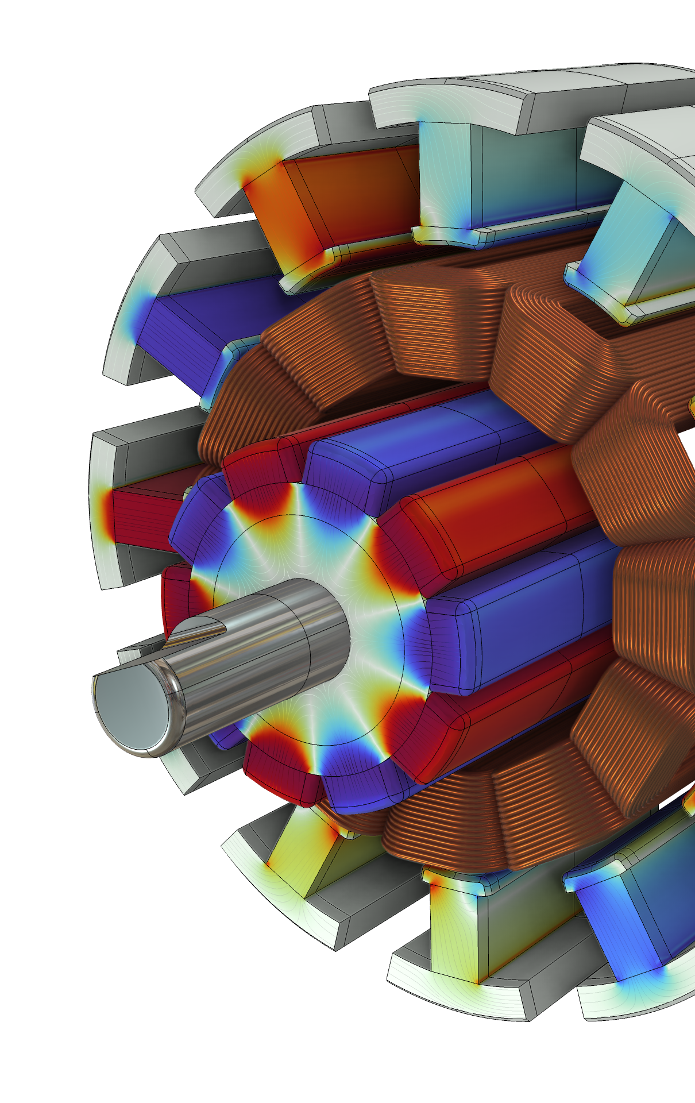
Computing Loss, Temperature, and Efficiency in Electric Motors

Slide 2
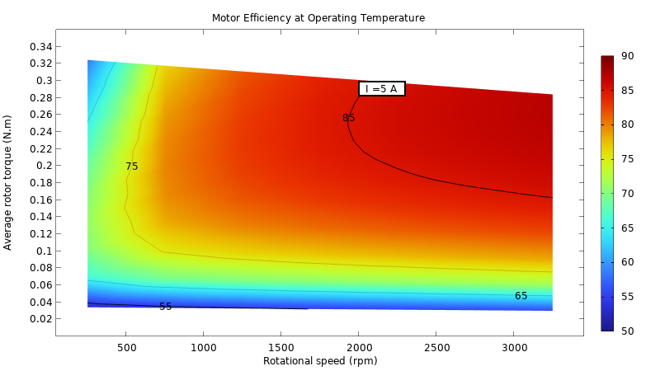
Objective
Compute iron and copper losses
Obtain temperature rise as a result of electromagnetic heating
Inputs:
  Geometry
  Materials
  Current excitation
Outputs:
  Iron and copper loss variation with rotor speed and stator current
  Temperature distribution
  Efficiency map
More details and more stories from
  Computing Loss, Temperature, and Efficiency in Electric Motors

Slide 3
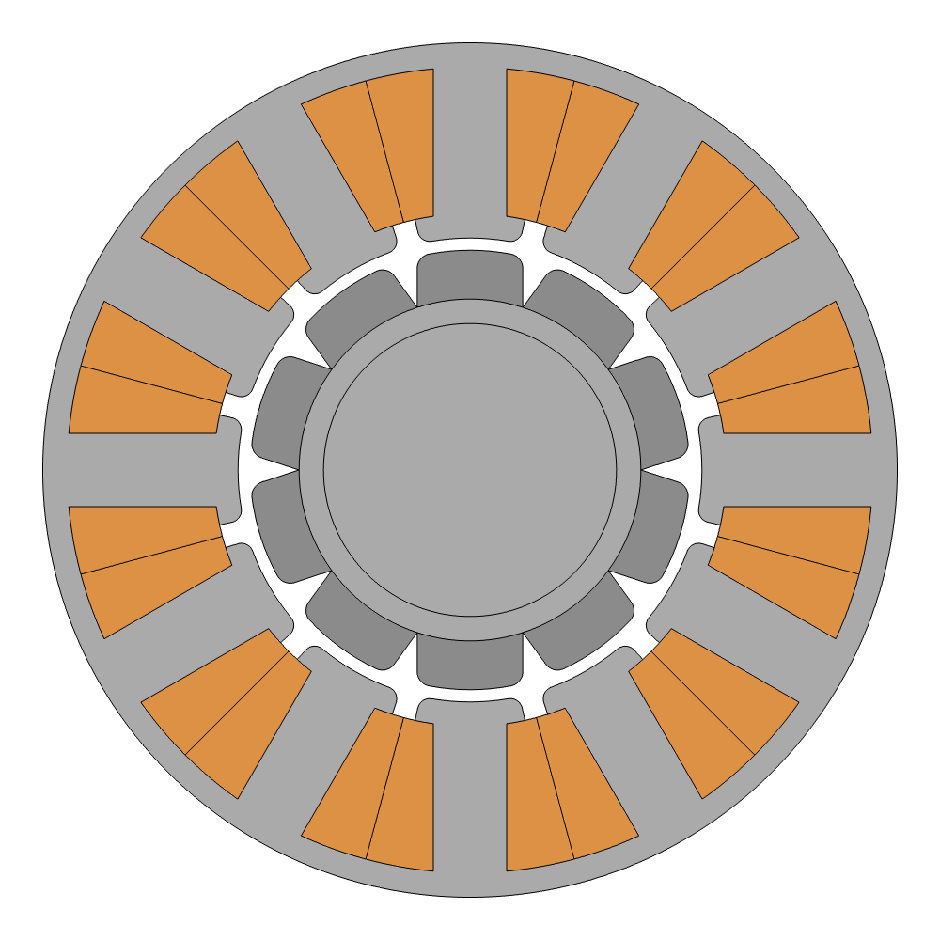
Electric Motor Geometry
Internal rotor
  External diameter: 35 mm
  Rotor diameter: 18 mm
  Transverse length: 80 mm
  Stator yoke and rotor iron thickness = 1 mm
Use two geometry parts:
  12 slots stator
  10 poles surface mounted permanent magnets rotor
Geometry parts allow easy extension to different number of poles/slot and size

Slide 4
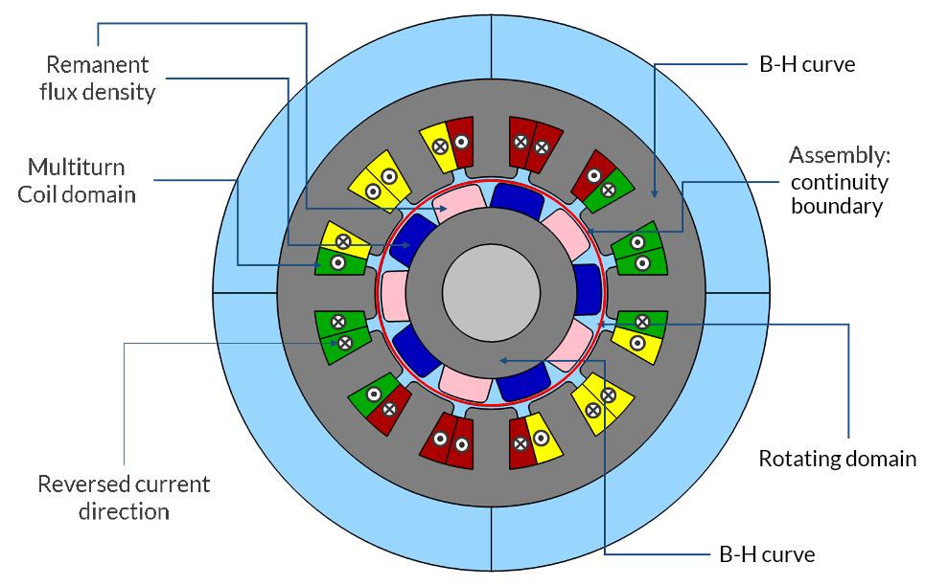
Materials and Constitutive Relations
Material from AC/DC Module Material Library or built-in
Stator and Rotor Iron
  Soft Iron
  B-H curve
Rotor magnets
  BOMATEC BMN-35
  Remanent flux density
Slots wires
  Copper, 10 turns, 80% filling factor
  Described by three “Coil” features, one per phase as in the image

Slide 5
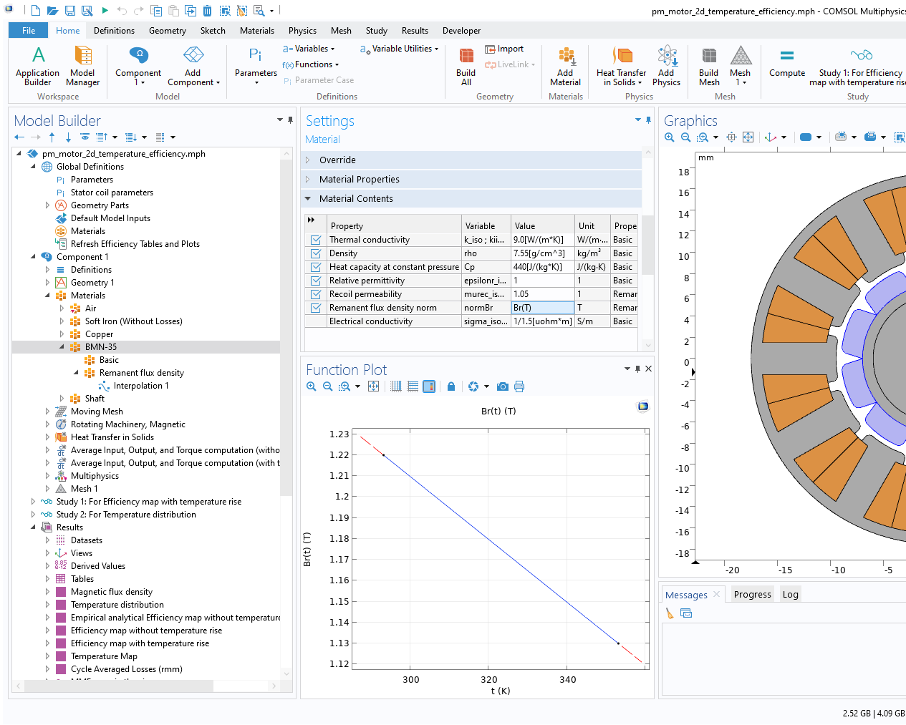
Material Temperature Dependency
Remanent flux density in magnets
Wire conductivity in coils

Slide 6
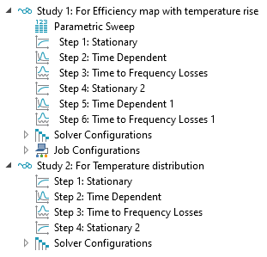
Study Steps
Study 1: For obtaining efficiency map with temperature rise
  Parametric sweep on currents and speed
  Initial magnetic field distribution
  Motor rotation
  Iron and copper losses
  Temperature rise
  Motor rotation including temperature rise
  Loss calculation including temperature rise
Study 2: For getting temperature rise distribution
  Single configuration
  Faster to solve
  Focus on temperature

Slide 7
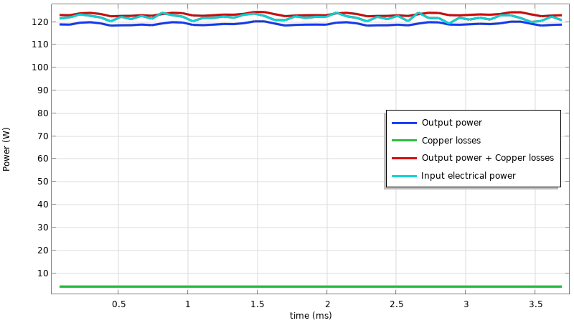
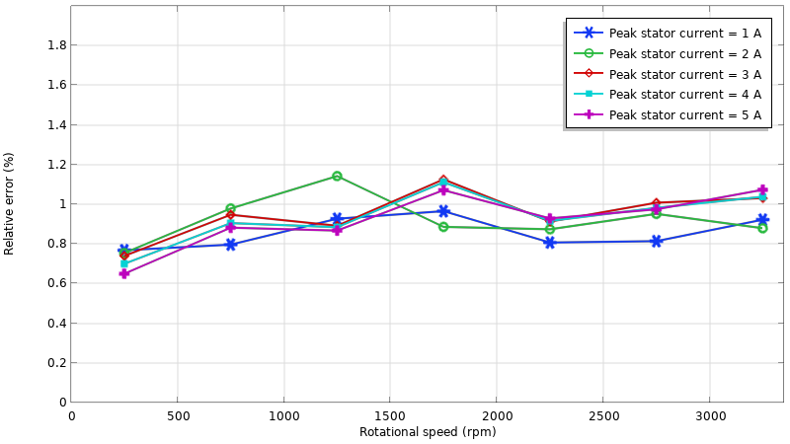
Verification of Power Balance
Instantaneous values of input electrical power, mechanical output power and copper losses
(rotor speed = 3250 rpm, current = 10 A)
Relative error between time averaged values of input electrical power and the sum of output power with copper losses
The input electrical power should be equal to the sum of output power and the copper losses
Power balance can be examined for instantaneous as well as the averaged power values for different combinations of rotor speed and stator current values

Slide 8
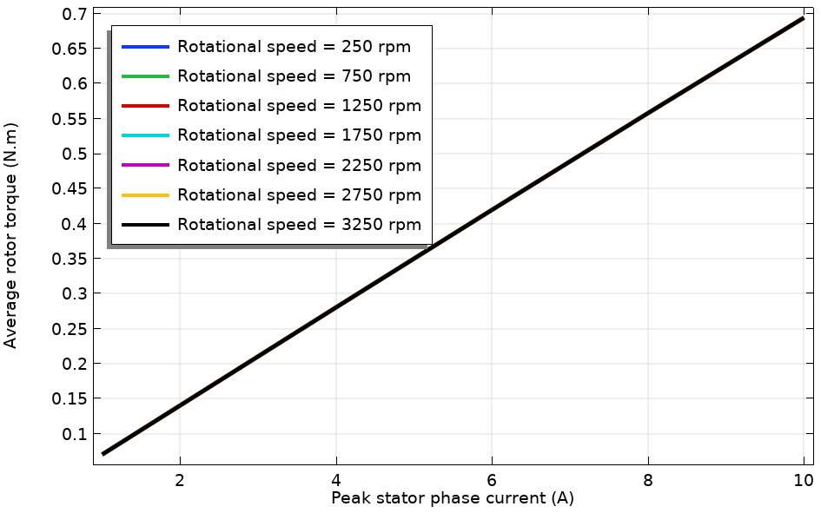
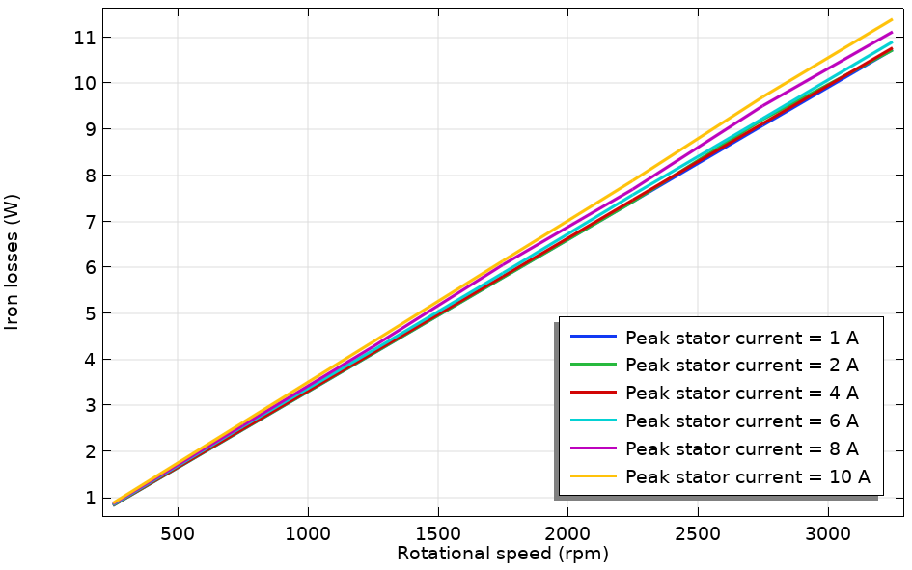
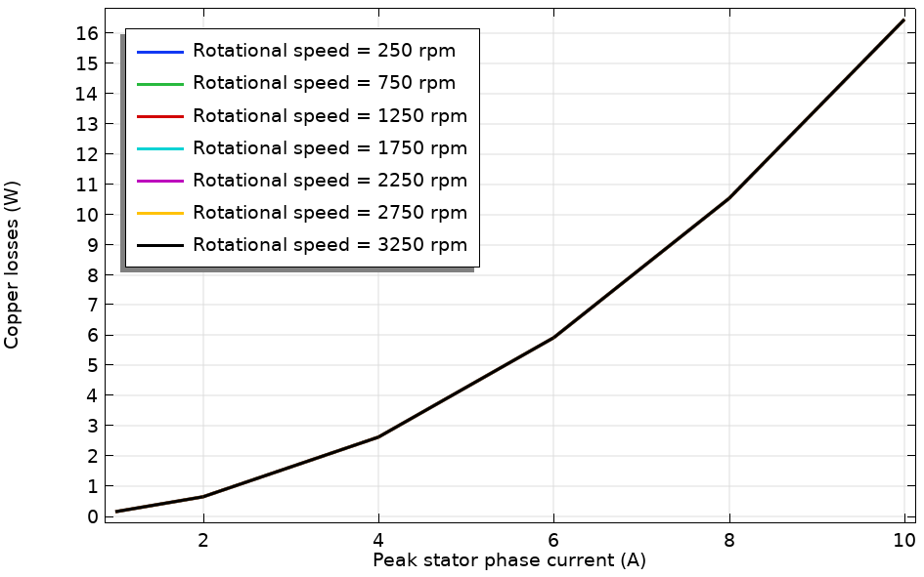



Variation of Torque, Iron Losses and Copper Losses
Average torque variation with stator current
Iron loss variation with speed @ different stator current values
Copper loss variation with current @ different rotor speed values
Average torque varies linearly with stator current:
Iron losses scale linearly with the rotor speed and exhibit a weak dependence on stator current:
The copper losses vary parabolically with stator current:
The above results are before considering temperature rise
Empirical coefficients from the plots: k₁ = 0.07 N.m/A, k₂ = 0.204 W/rps, k₃ = 0.164 W/A²
$Tr=k1$I
$Wi=k2$ω$r$
$Wc=k3$I²

Slide 9
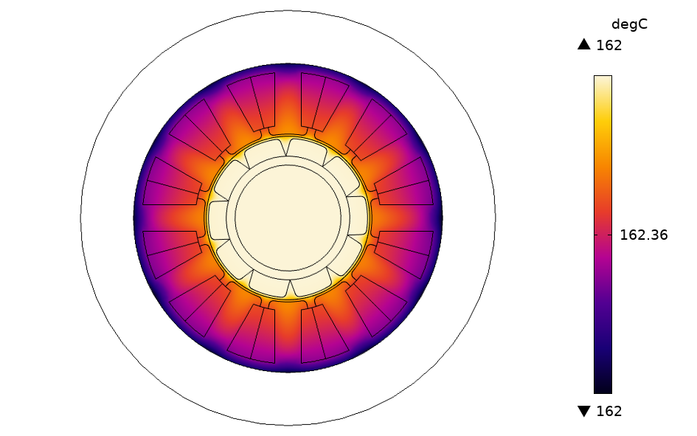
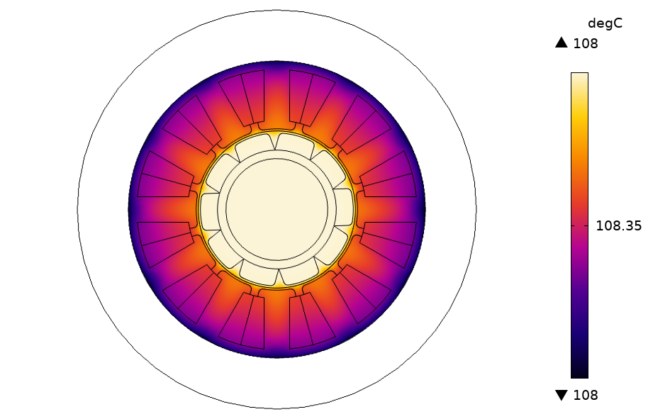
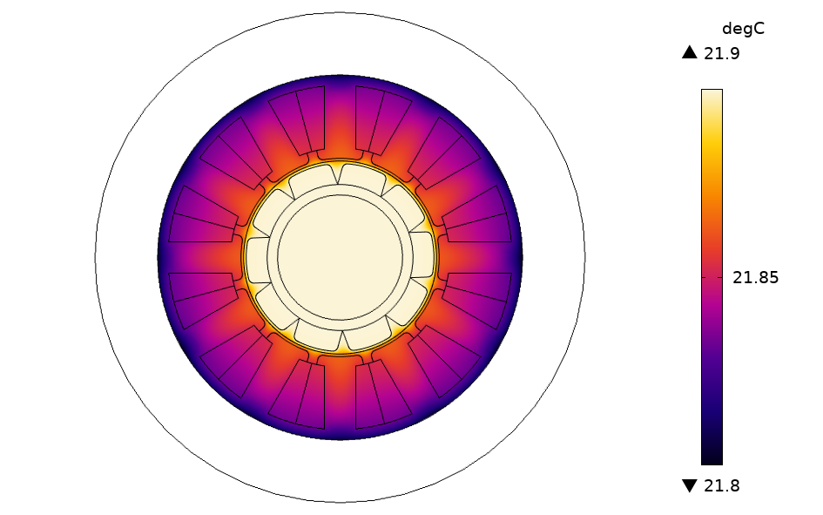
Effect of Cooling Conditions on Temperature Rise
Temperature rise with natural air convection
Temperature rise with forced air convection
(flow velocity = 1 m/s)
Temperature rise with forced water cooling
(flow velocity = 50 mm/s)
The temperature distribution can be compared for various cooling conditions such as natural and forced convection
The above results are for a rotor speed of 3000 rpm and stator current of 2 A
The insulation requirements can be determined based on the maximum temperature rise

Slide 10
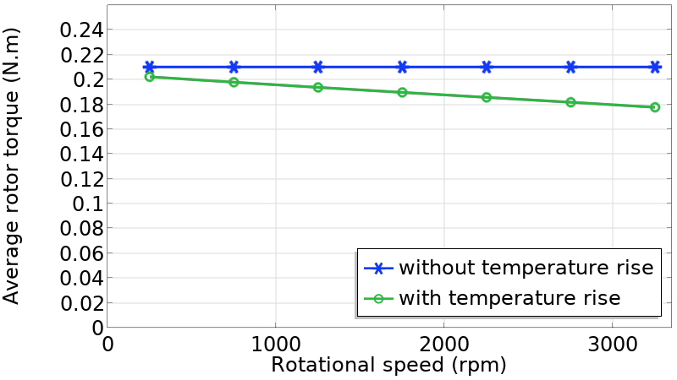
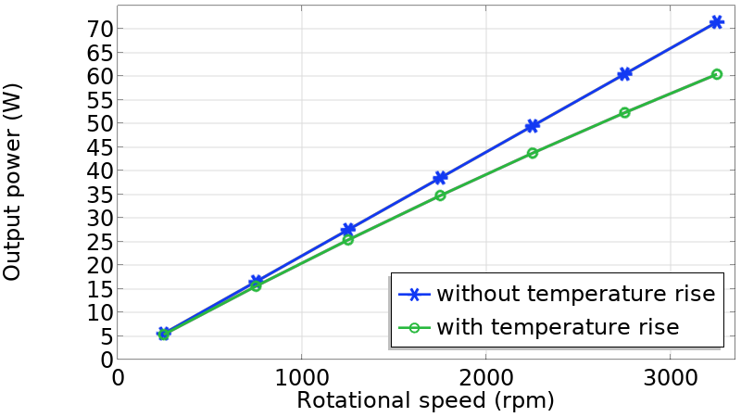
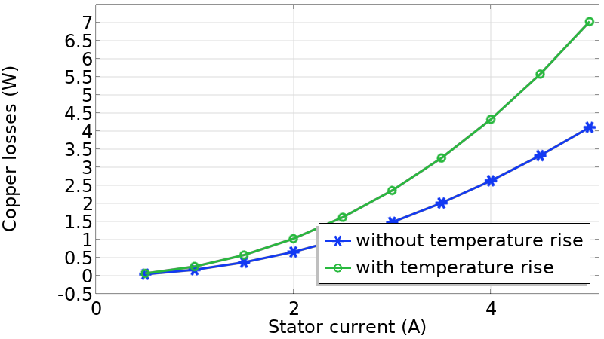
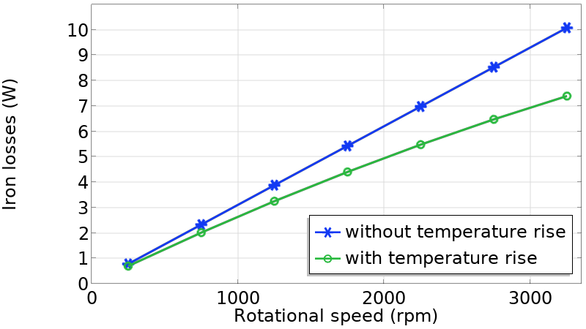
Effect of Temperature on Motor Performance
Temperature increase decreases torque
Temperature increase decreases power
Temperature increase decreases coil losses
Temperature increase decreases iron losses
Temperature increase, produce a decrease of output power and an increase copper losses
  Imply a significantly lower efficiency
Mitigated by reduction of iron losses

Slide 11
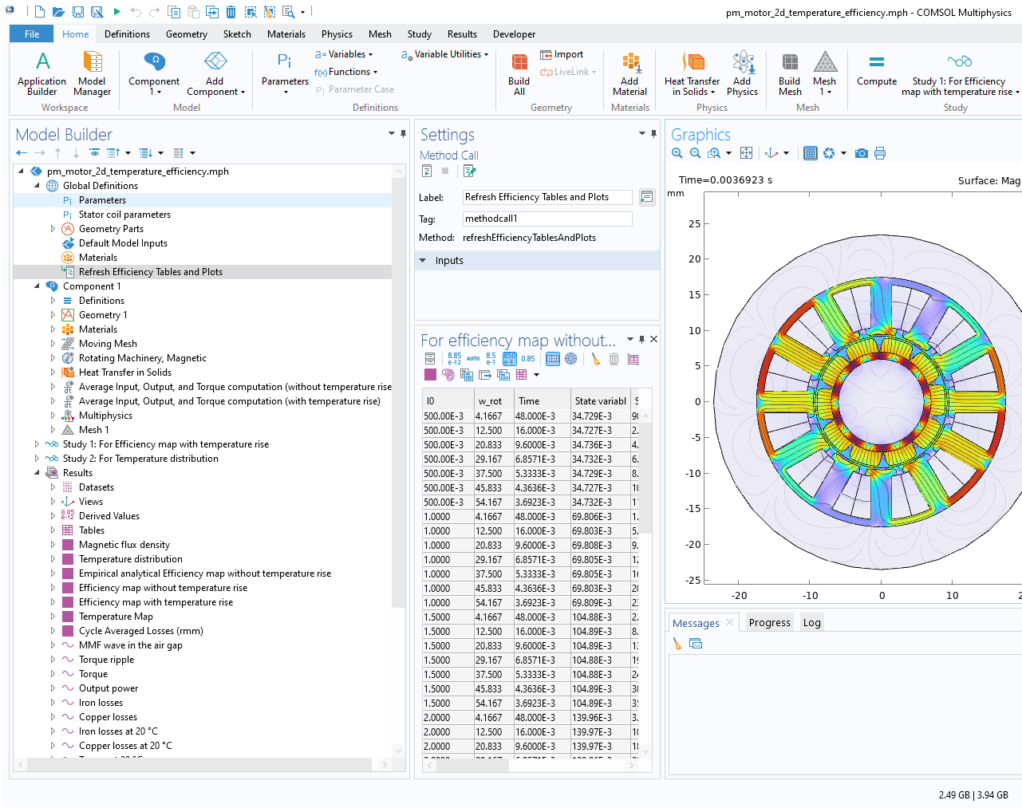
Generating Efficiency Maps
Use the Method Call for “Refresh Efficiency Tables and Plots” to generate the two efficiency maps

Slide 12
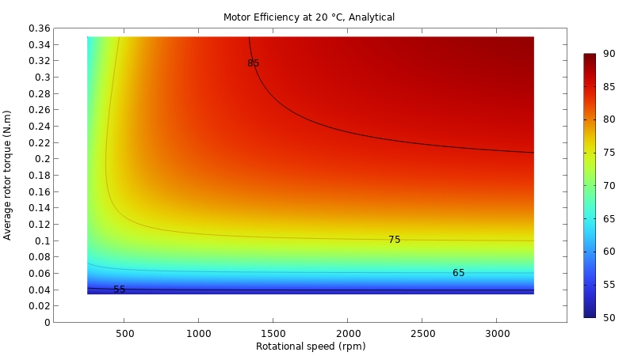
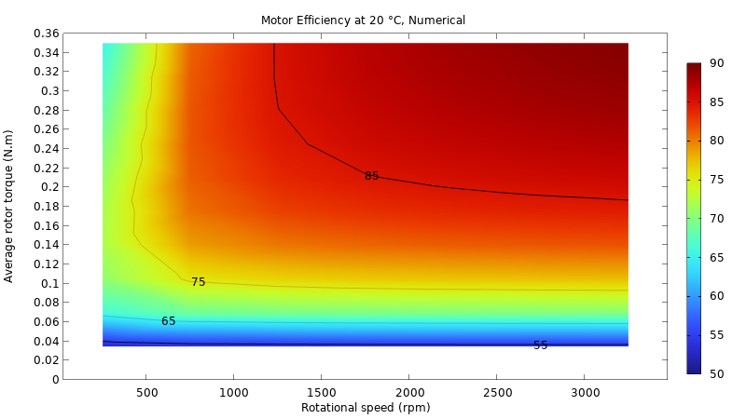
Efficiency Map at 20 °C
Analytically generated Efficiency map
(without temperature rise)
Efficiency map from parametric simulations
(without temperature rise)
Efficiency map has been generated using analytical expressions for torque, iron losses and copper losses with empirical coefficients (before considering temperature rise effects)
Efficiency map generated from parametric simulations shows agreement with the analytically generated efficiency map

Slide 13
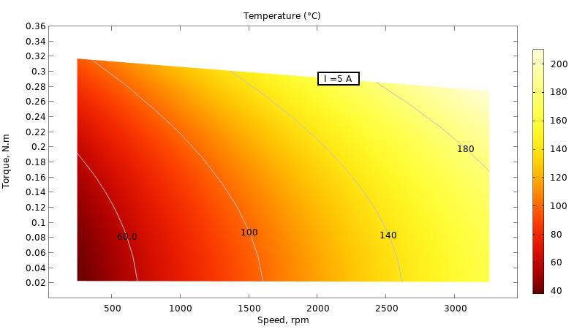
Effect of Temperature on Efficiency
Efficiency map including the effect of
temperature rise
Temperature map
The efficiency map with temperature rise effects shows reduction in torque with speed, and substantial change in efficiency distribution
The temperature map shows the average motor temperature as a function of the speed and torque

Slide 14
Conclusions
A tutorial on a electric motor for obtaining losses, temperature rise and efficiency map is presented
The power balance phenomenon is probed for rotating machines to check self-consistency in FEM simulations
The effect of temperature rise on the output and losses can be studied with variation in motor performance parameters – torque and speed
The temperature rise can be examined with different cooling conditions to determine the suitable insulation class
The efficiency map after including temperature rise effects can be observed to reflect a change in efficiency distribution and decrease in torque with temperature
More details and more stories from
Computing Loss, Temperature, and Efficiency in Electric Motors

