Slide 1
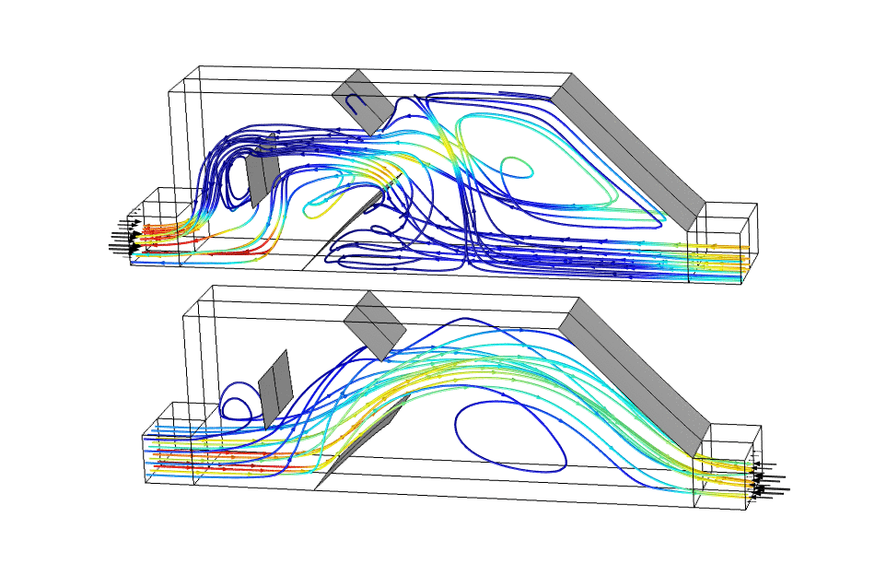
Shape Optimization of a
3D Tesla Microvalve

Slide 2
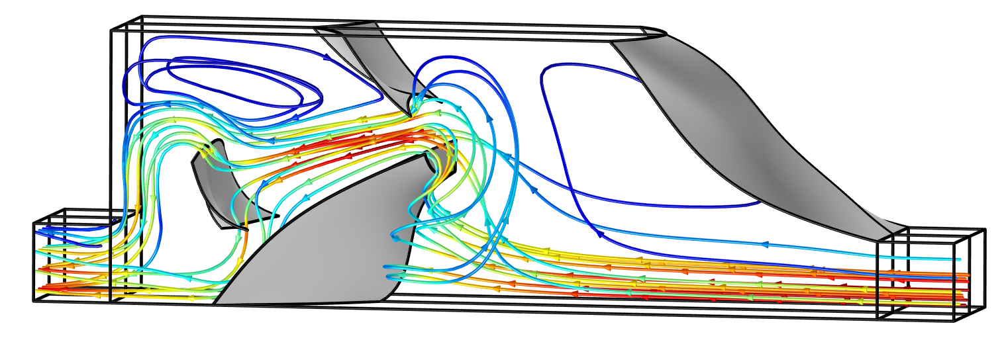
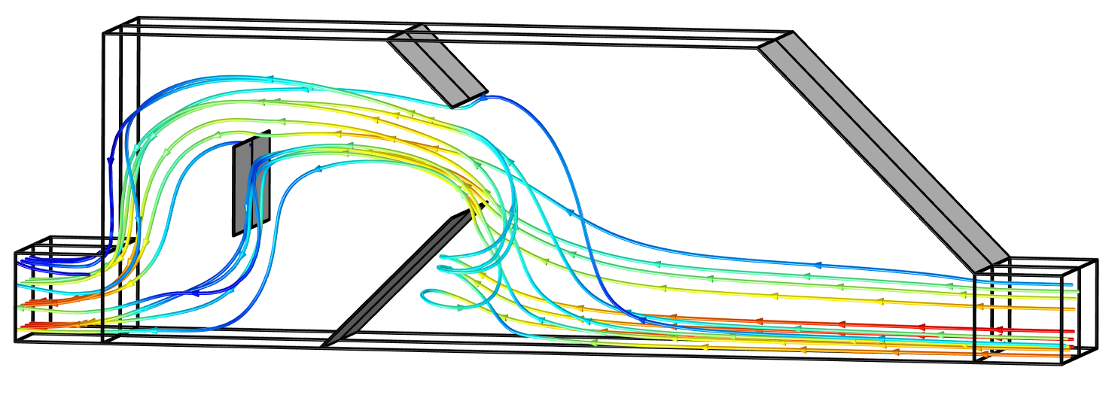
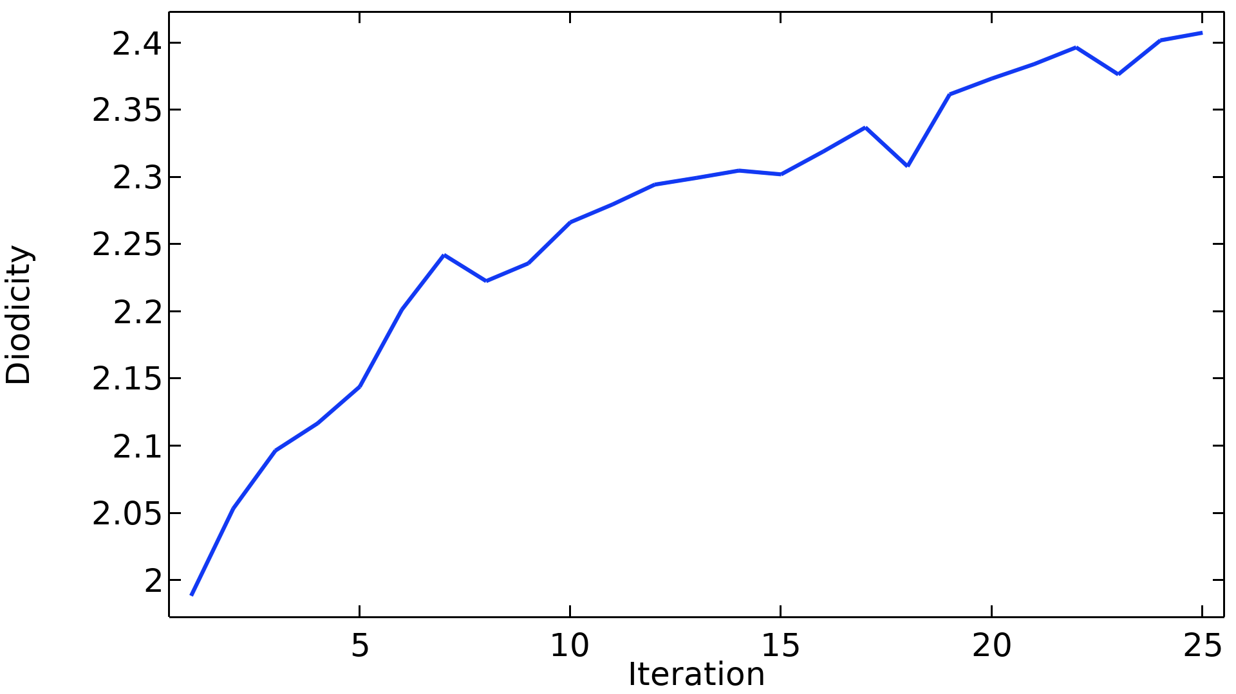
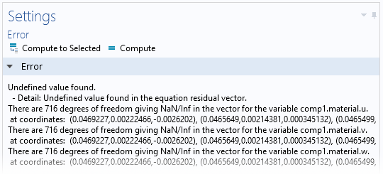
Shape Optimization of a 3D Tesla Microvalve
Introduction
Shape optimization can be used to improve the
performance of products.
In this model we will use it to optimize a
3D tesla microvalve.
This requires large deformations, which normally
results in NaN/Inf error messages due to
inverted elements.
The issue can be circumvented using a model method
that imports and exports the design between restarts
of the optimization solver.
Oscillations in the objective function due to remeshing
are to be expected
Shape Optimization of a 3D Tesla Microvalve

