Slide 1
Shape Optimization of an Acoustic Demultiplexer with 4 Ports

Slide 2
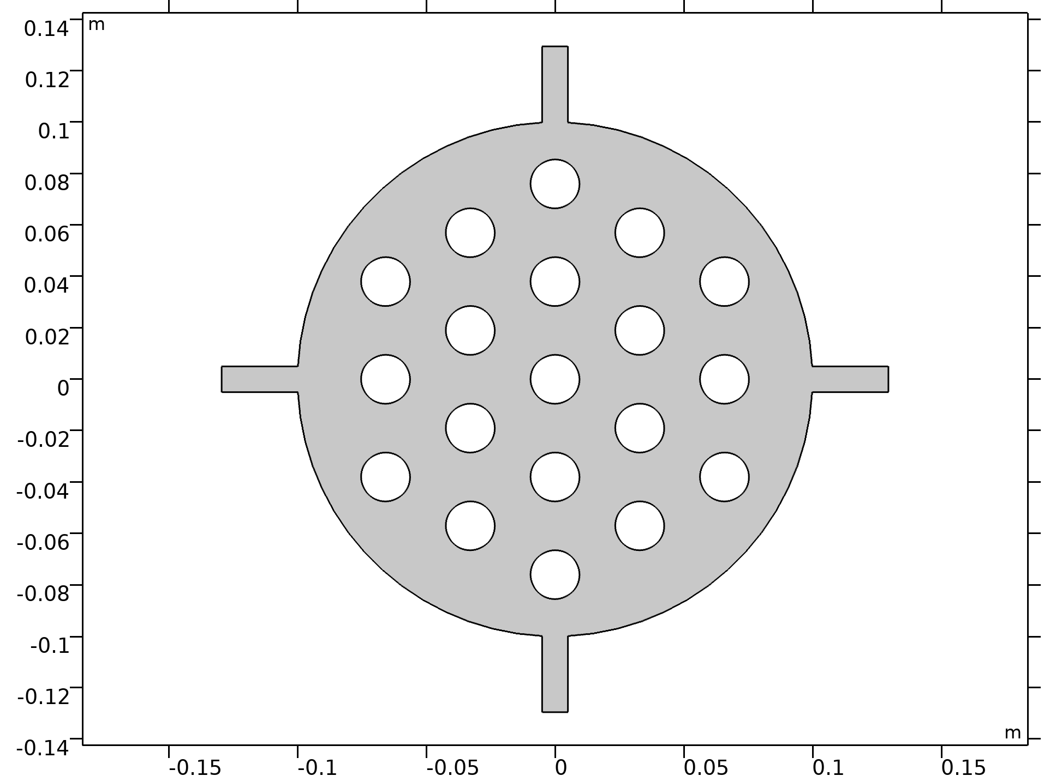
Introduction
A demultiplexer is a device that directs different
frequency bands to different outputs.
In this model we will design a demultiplexer by
performing shape optimization on all the circular
boundaries in a sonic crystal configuration (image to the right).
The model uses shape optimization with Helmholtz
regularization together with a MinMax formulation for
the power ratio of the three output ports.
Initial geometry of the sonic crystal configuration.
Shape Optimization of an Acoustic Demultiplexer with 4 Ports

Slide 3
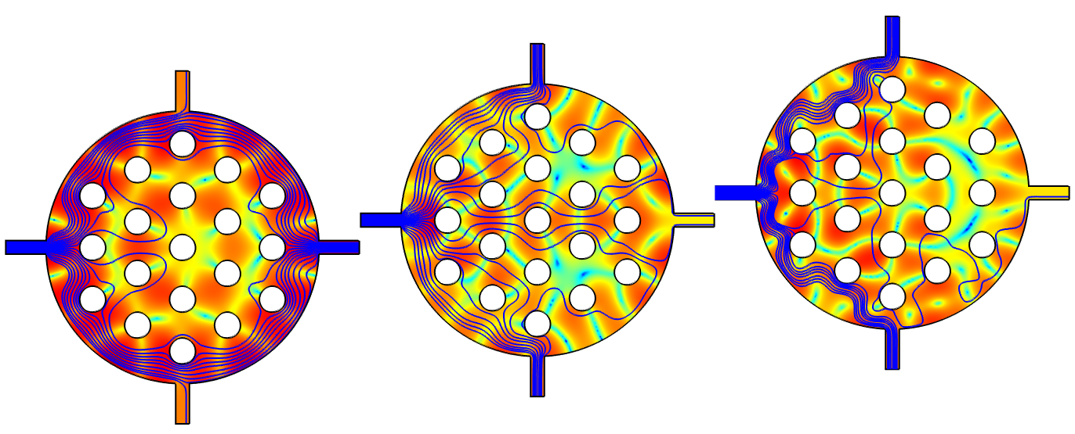
Results: Original Design
7.5 kHz
6.5 kHz
5.5 kHz
Sound pressure level distribution and intensity flow.
Shape Optimization of an Acoustic Demultiplexer with 4 Ports

Slide 4
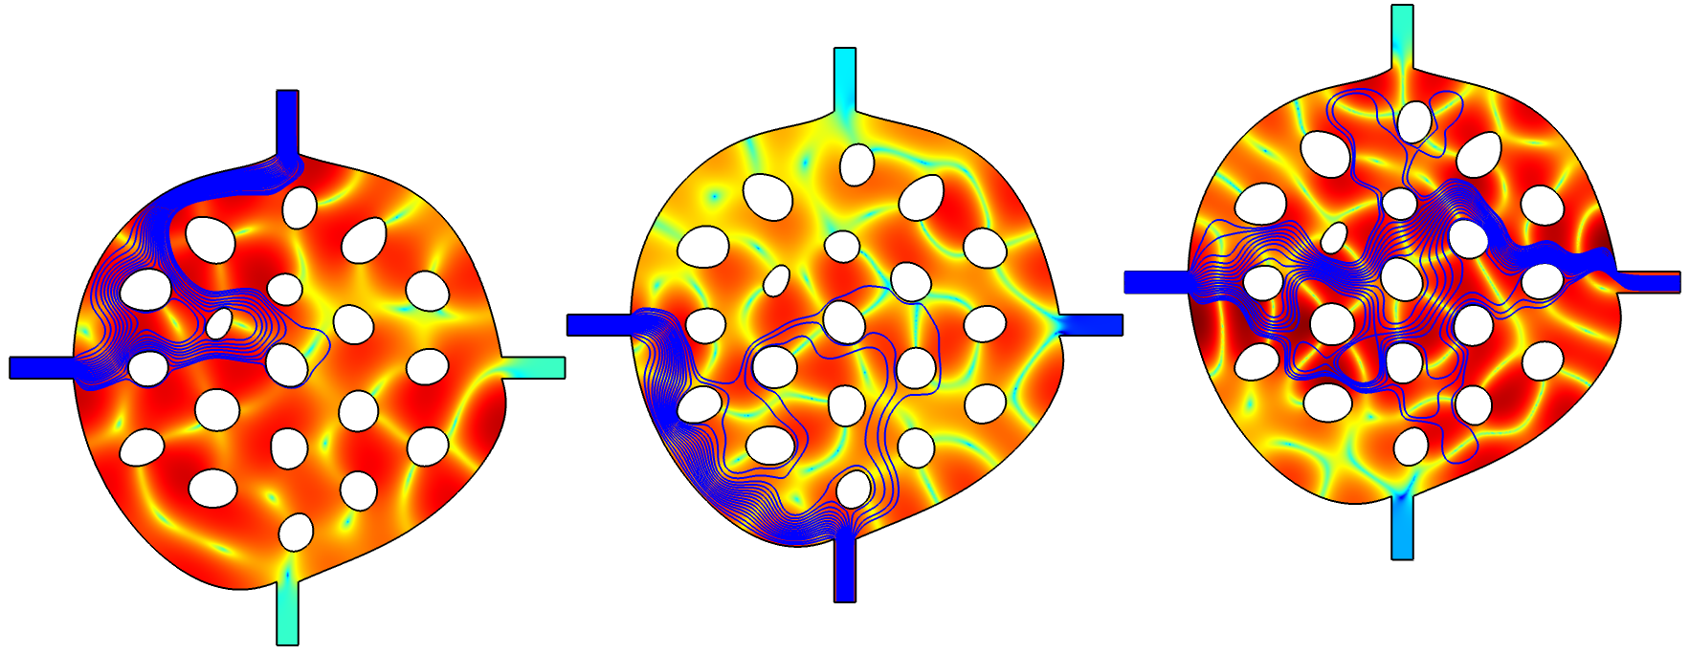
Results: Optimized Design
7.5 kHz
6.5 kHz
5.5 kHz
Sound pressure level distribution and intensity flow.
Shape Optimization of an Acoustic Demultiplexer with 4 Ports

Slide 5
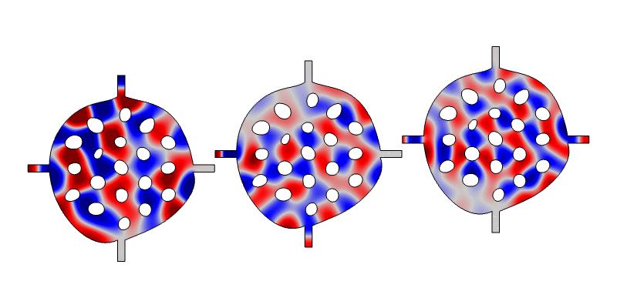
Results: Optimized Design
7.5 kHz
6.5 kHz
5.5 kHz
Pressure field animation.
Shape Optimization of an Acoustic Demultiplexer with 4 Ports

Slide 6
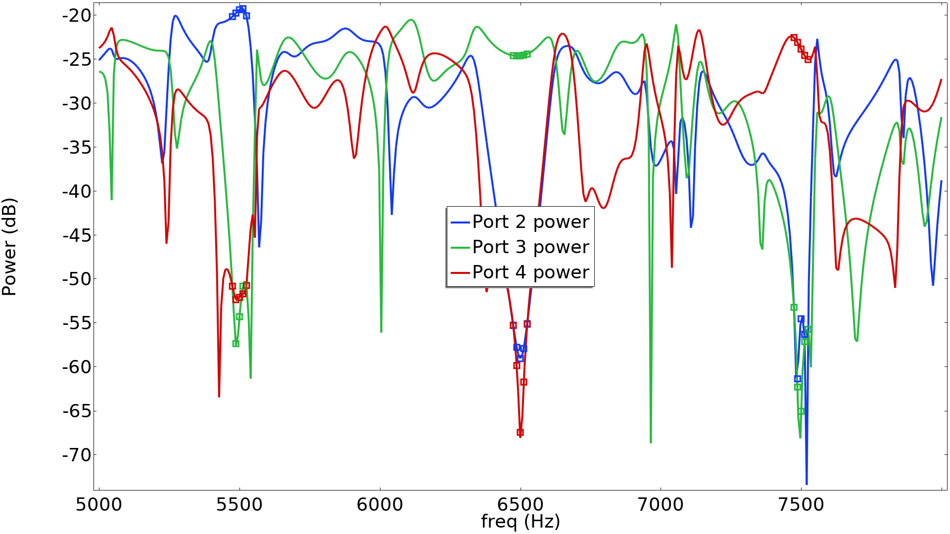
Results
30 dB
Shape Optimization of an Acoustic Demultiplexer with 4 Ports

