Slide 1
Optimal Control for
Heating of a Rod

Slide 2
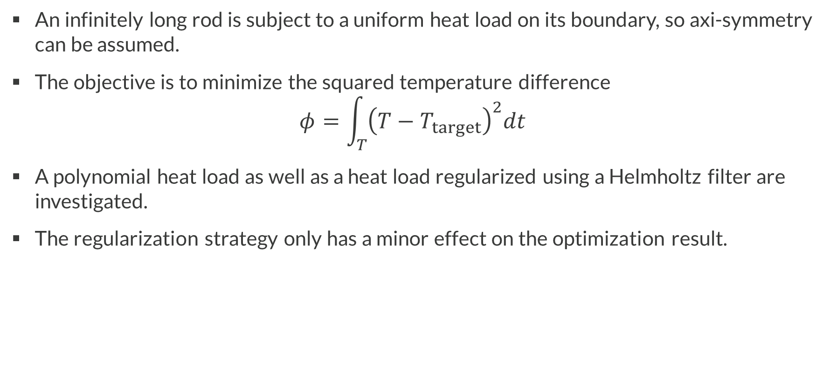
Introduction
An infinitely long rod is subject to a uniform heat load on its boundary, so axi-symmetry can be assumed.
The objective is to minimize the squared temperature difference
$φ=\int_{T}{{\left(T−T_{target}\right)}^{2}dt}$
A polynomial heat load as well as a heat load regularized using a Helmholtz filter are investigated.
The regularization strategy only has a minor effect on the optimization result.
Optimal Control for Heating of a Rod

Slide 3
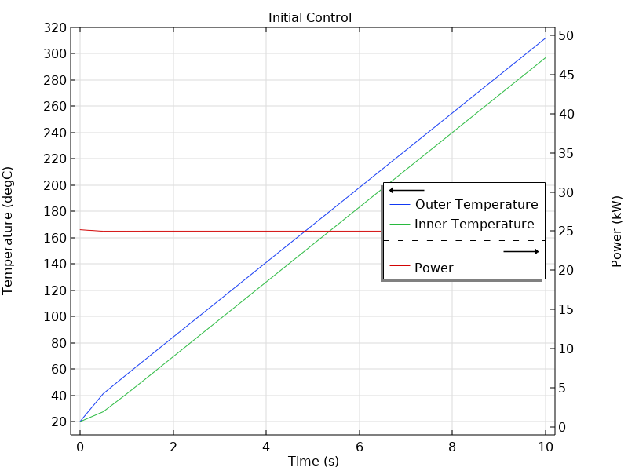
Results: Initial Control, Constant Power

Slide 4
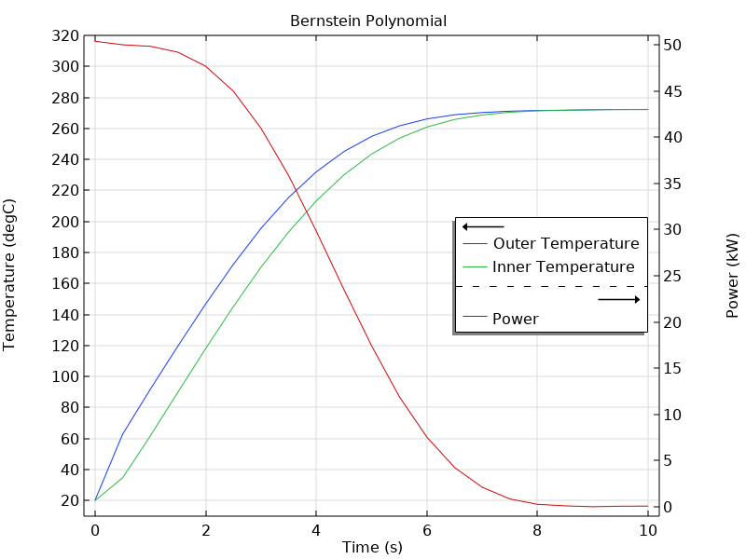
Results: Bernstein Polynomial Control Function

Slide 5
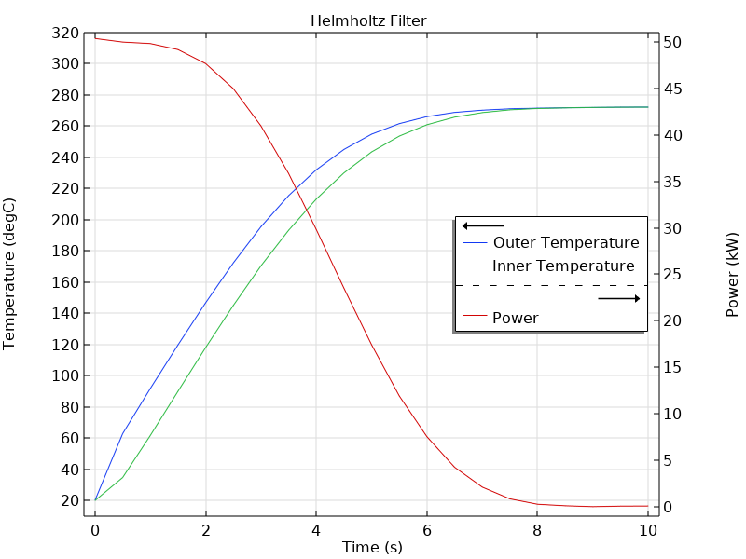
Results: Helmhotz Filter Control Function

