Slide 1
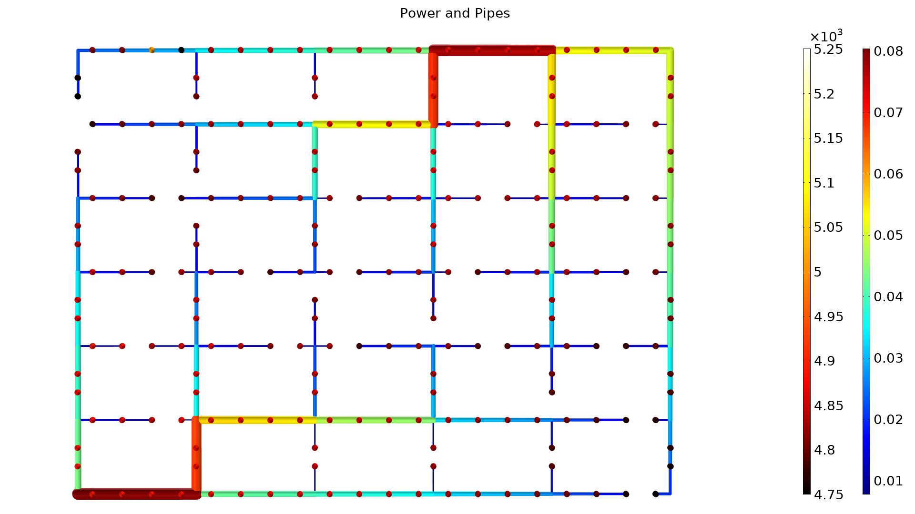
Topology Optimization of a District Heating Network

Slide 2
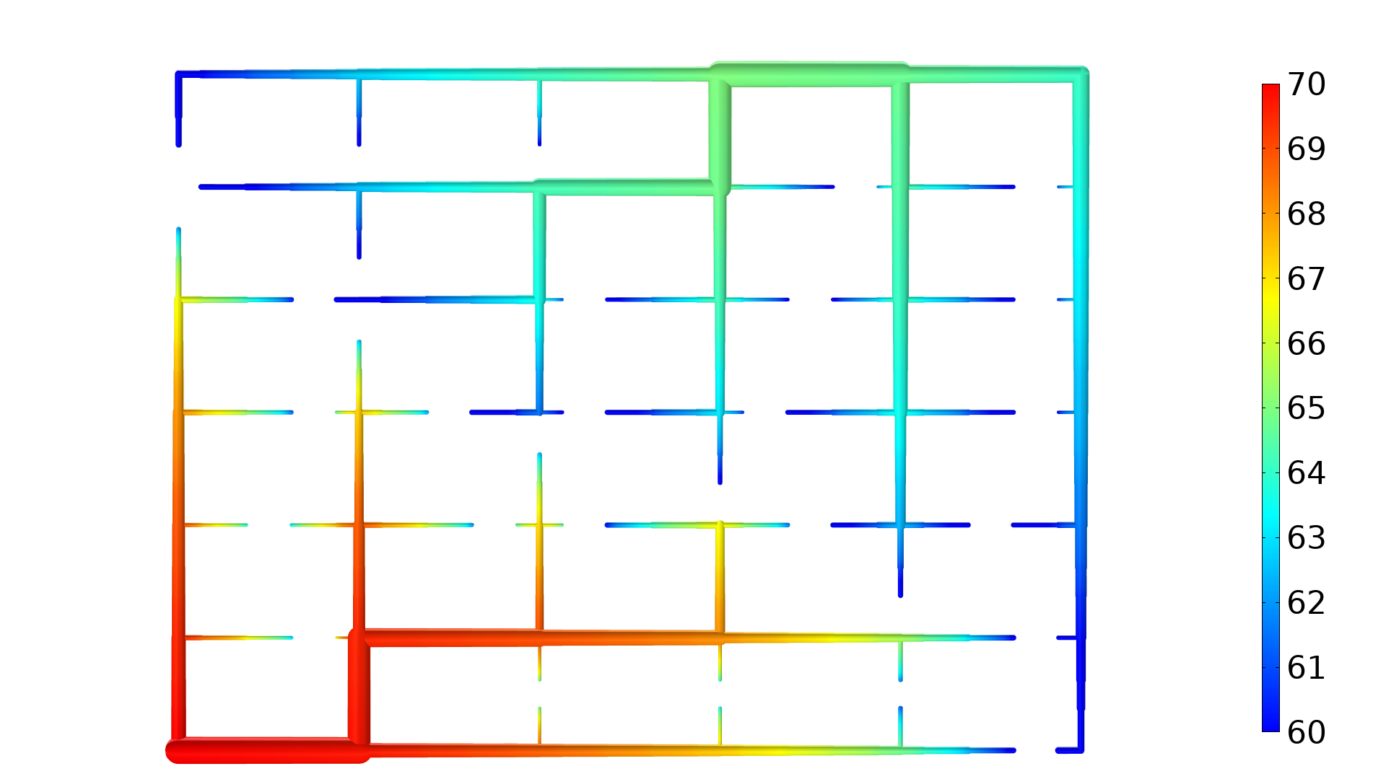
Topology Optimization of a District Heating Network
Introduction
This model uses the Pipe Flow Module to design a district heating network.
The flow is pressure driven with two heat producers.
Heat is lost to the consumers, but also to the surrounding environment.
65 ºC
70 ºC
Topology Optimization of a District Heating Network

Slide 3
Topology Optimization of a District Heating Network
Optimization
The controls are the pipe diameters and the pump pressure as well as the bypass and radiator valve settings for each consumer.
A constraint aggregation function is used to ensure that none of the consumers freeze.
The objective function is to minimize the cost of establishing the network as well as the running costs.
Power (W)
Diameter (m)
Topology Optimization of a District Heating Network

Slide 4
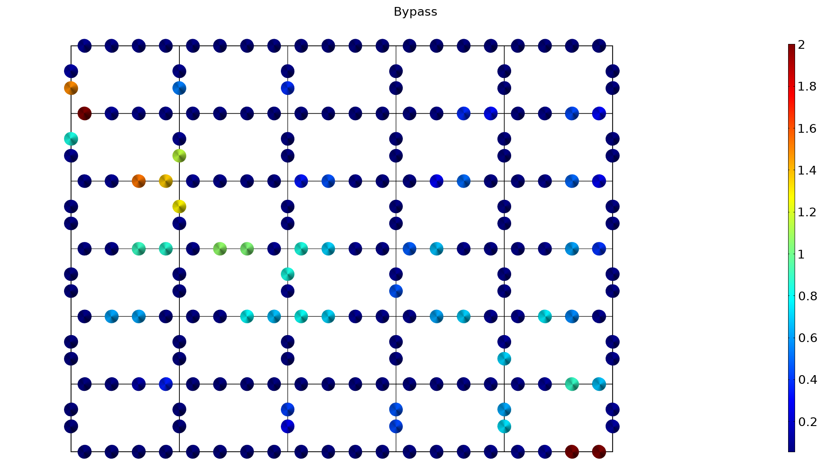
Topology Optimization of a District Heating Network
Notes:
The bypass valves are mostly open in the end of the network.

Slide 5
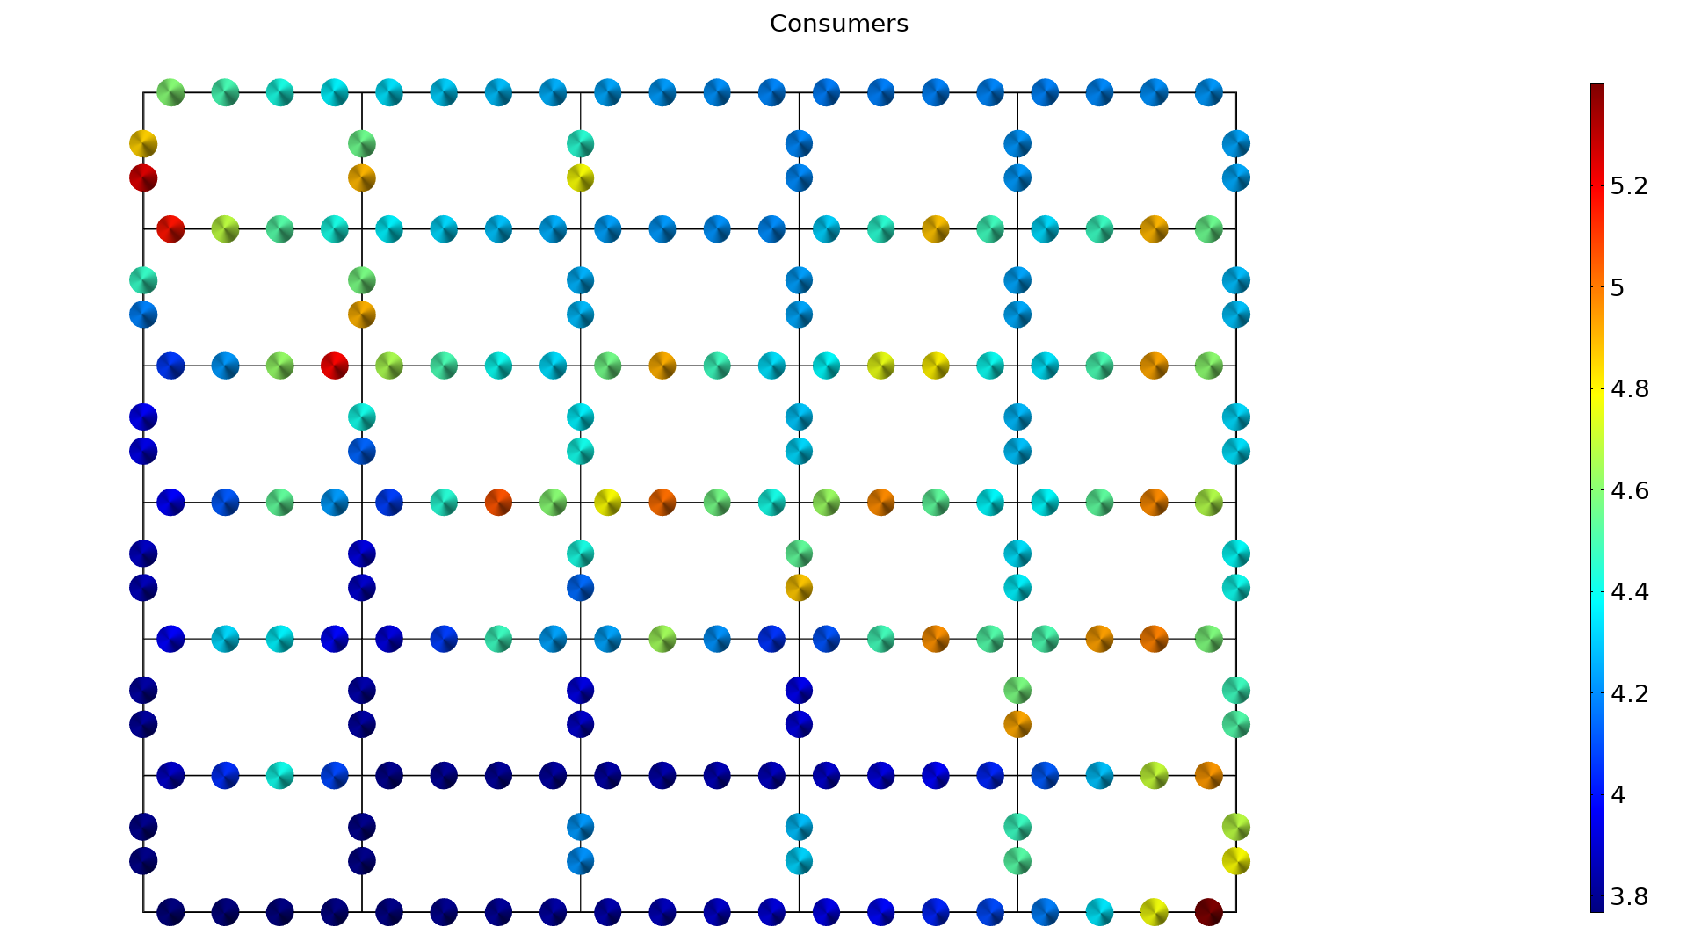
Topology Optimization of a District Heating Network
Notes:
The consumers in the network associated with the top producer have to turn up their radiator a bit more, because the inflow temperature is only 65 as opposed to 70 [degC].

Slide 6
Reference
Blommaert, Maarten, Yannick Wack, and Martine Baelmans, An adjoint optimization approach for the topological design of large-scale district heating networks based on nonlinear models, Applied Energy 280, 116025, 2020.

