Slide 1
Effective thermal conductivity calculation
Parnika Gupta

Slide 2
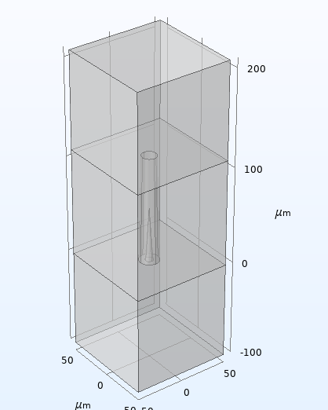
8W/m² flux in
Glass(k)= 1.2W/m.K
Buffer blocks, thermal conductivity (k)= 500W/m.K
Via (k)=Copper
Cavity (k)= air
-8W/m² flux out, 20degC Temperature fixed

Slide 3
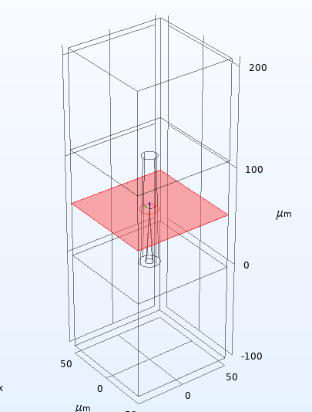
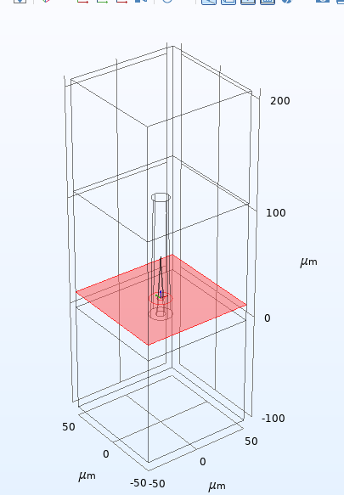
Average surface temp of cutplane 1
Average surface temp of cutplane 2

Slide 4
Calculation
K= Q x deltaT/deltax
deltaT= surface average temp of cutplane 1- surface average temperature of cutplane 2
Q= 8W/m²
Deltax= cutplane 1 height position- cutplane 2 height position

